Slide 1
Keep Trying
by Kauri 2

Slide 2
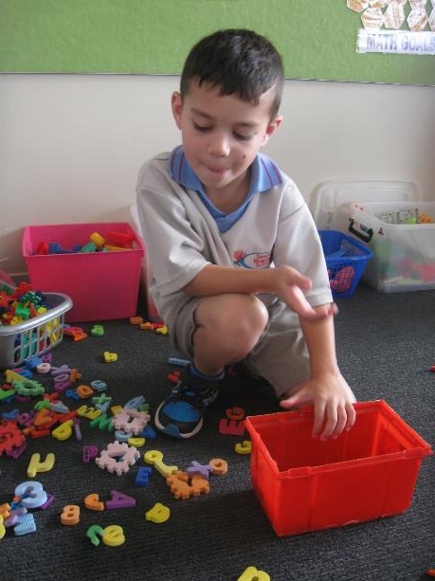
“I can’t tidy up,” said Roman.
But Miss Jolliffe said, “Keep trying. You can do it.”
And he could.

Slide 3
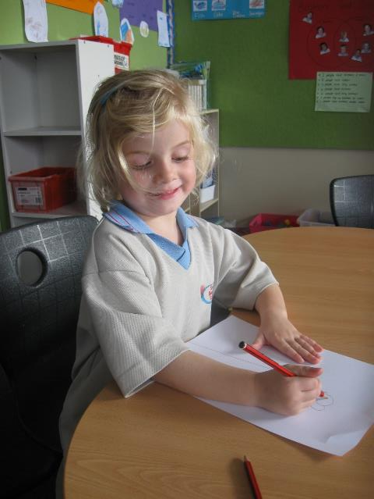
“I can’t draw a picture,” said Zara.
But Miss Jolliffe said, “Keep trying. You can do it.”
And she could.

Slide 4
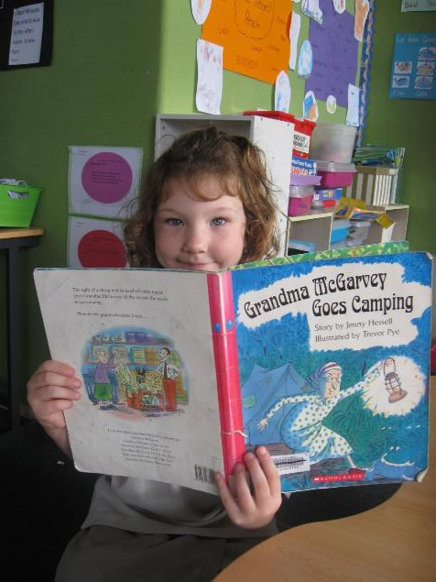
“I can’t read a book,” said Charlotte.
But Miss Jolliffe said, “Keep trying. You can do it.”
And she could.

Slide 5
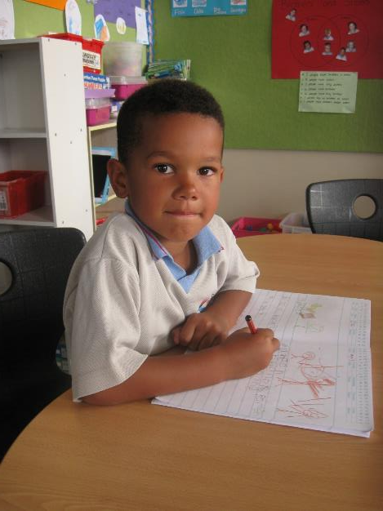
“I can’t write a story,” said Makeen.
But Miss Jolliffe said, “Keep trying. You can do it.”
And he could.

Slide 6
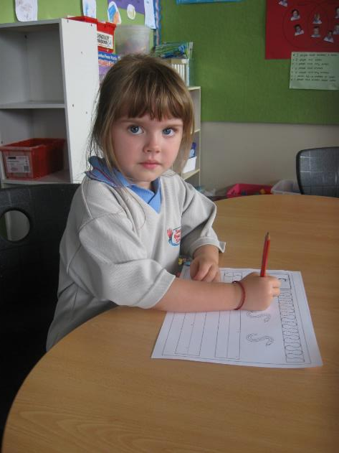
“I can’t write letters,” said Dove.
But Miss Jolliffe said, “Keep trying. You can do it.”
And she could.

Slide 7
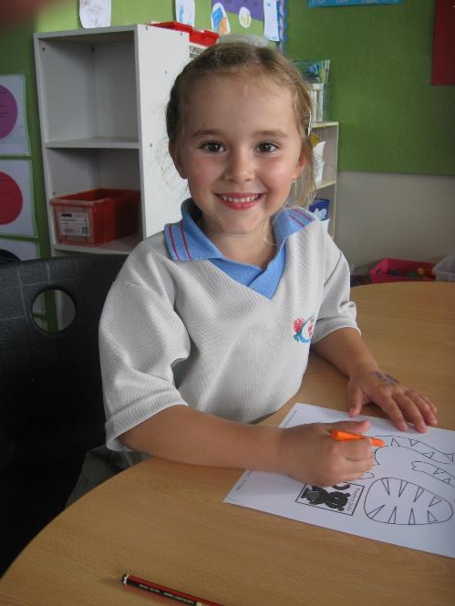
“I can’t colour my picture,” said Kaylee.
But Miss Jolliffe said, “Keep trying. You can do it.”
And she could.

Slide 8
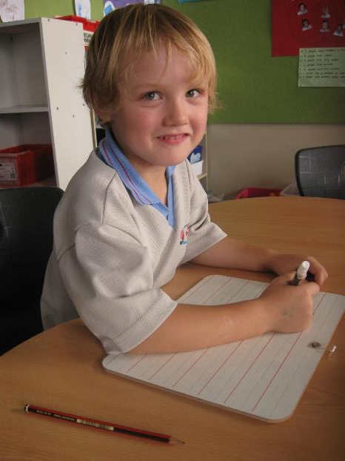
“I can’t write on a whiteboard,” said Jamie.
But Miss Jolliffe said, “Keep trying. You can do it.”
And he could.

Slide 9
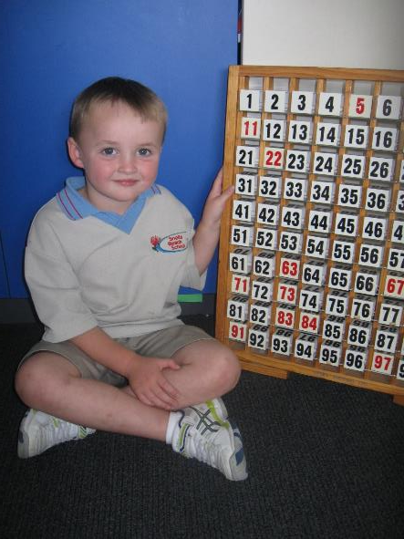
“I can’t count,” said Macsen.
But Miss Jolliffe said, “Keep trying. You can do it.”
And he could.

Slide 10
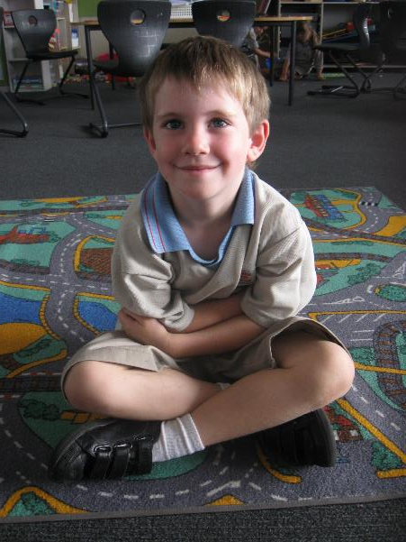
“I can’t sit on the mat,” said Mitchell.
But Miss Jolliffe said, “Keep trying. You can do it.”
And he could.

Slide 11
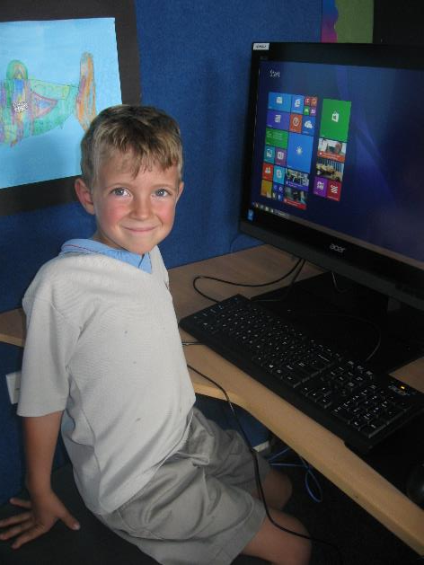
“I can’t use the computer,” said Loki.
But Miss Jolliffe said, “Keep trying. You can do it.”
And he could.

Slide 12
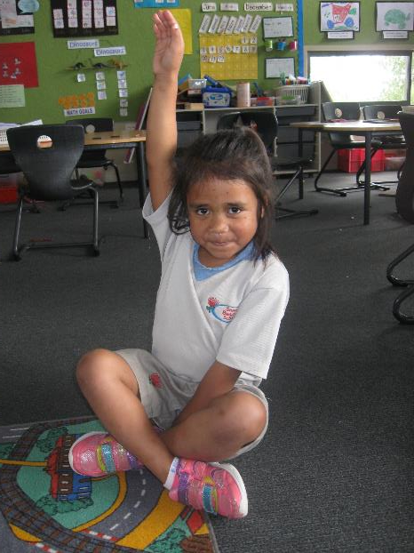
“I can’t put my hand up,” said Marieata.
But Miss Jolliffe said, “Keep trying. You can do it.”
And she could.

Slide 13
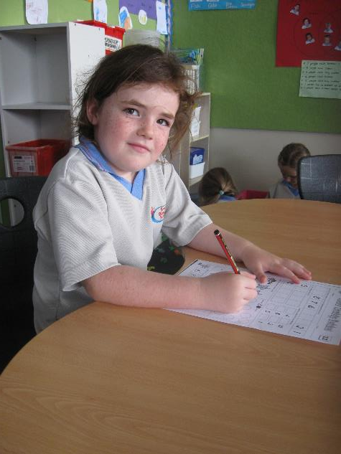
“I can’t do adding up numbers,” said Isabelle.
But Miss Jolliffe said, “Keep trying. You can do it.”
And she could.

Slide 14
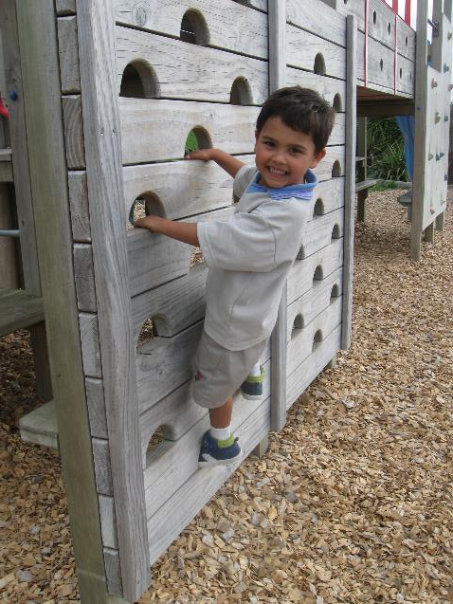
“I can’t climb up the wall,” said Reid.
But Miss Jolliffe said, “Keep trying. You can do it.”
And he could.

Slide 15
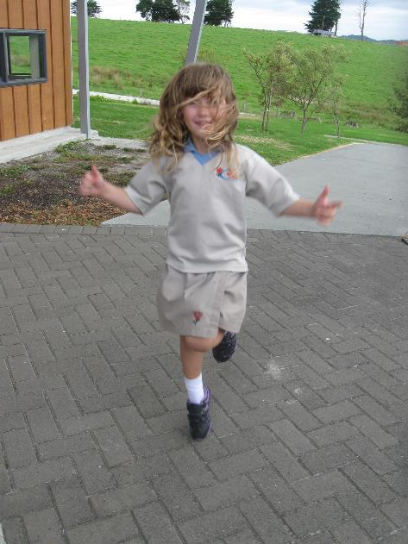
“I can’t skip,” said Ayla.
But Miss Jolliffe said, “Keep trying. You can do it.”
And she could.

Slide 16
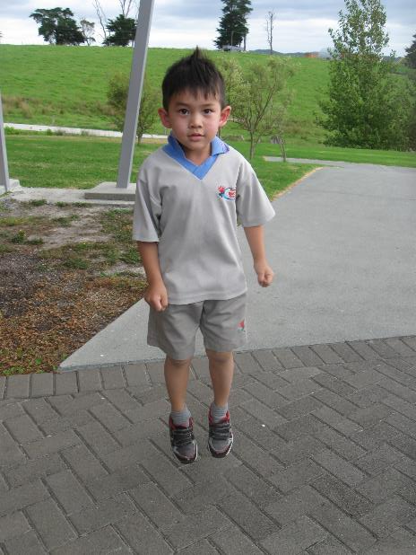
“I can’t jump,” said Logan.
But Miss Jolliffe said, “Keep trying. You can do it.”
And he could.

Slide 17
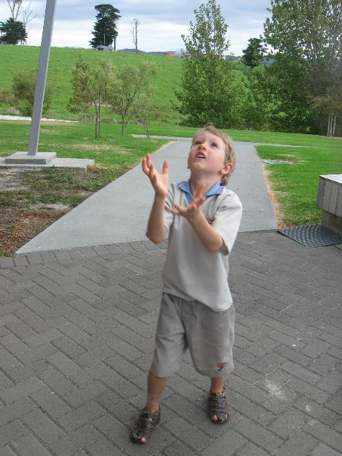
“I can’t catch,” said Cade.
But Miss Jolliffe said, “Keep trying. You can do it.”
And he could.

Slide 18
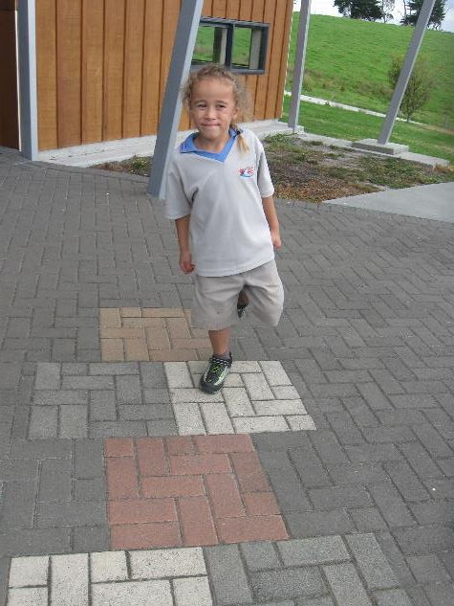
“I can’t play hopscotch,” said Charlie.
But Miss Jolliffe said, “Keep trying. You can do it.”
And he could.

