Slide 1
I CAN WRITE
by Kauri 2

Slide 2
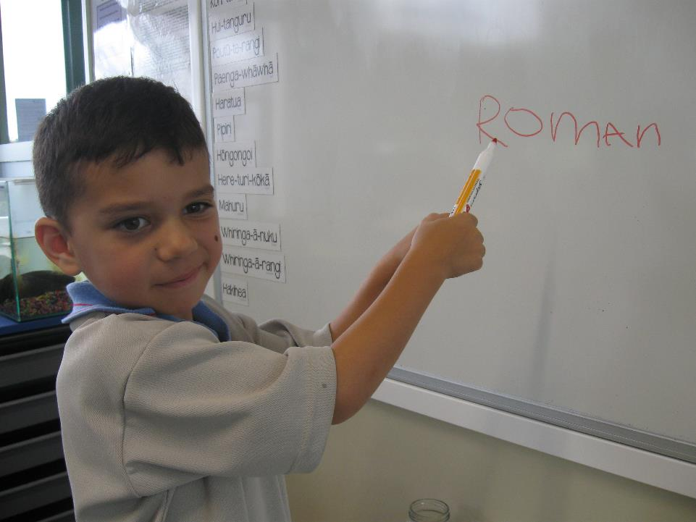
I can write on the whiteboard with a marker.

Slide 3
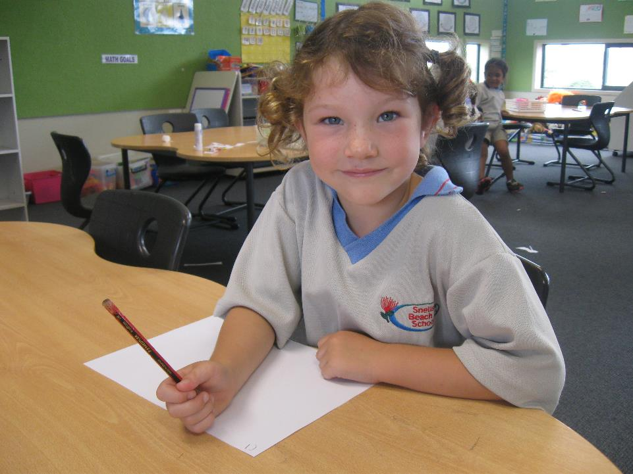
I can write on paper with a pencil.e

Slide 4
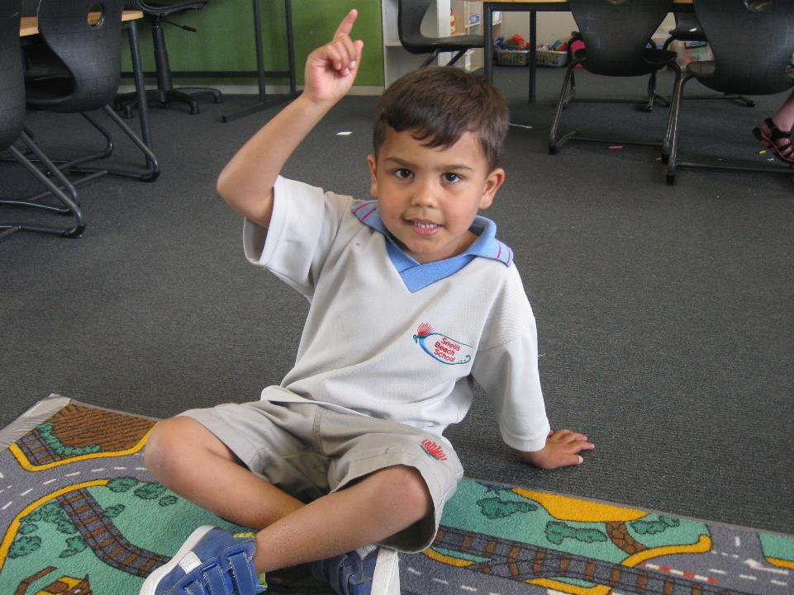
I can write in the air with my finger.

Slide 5
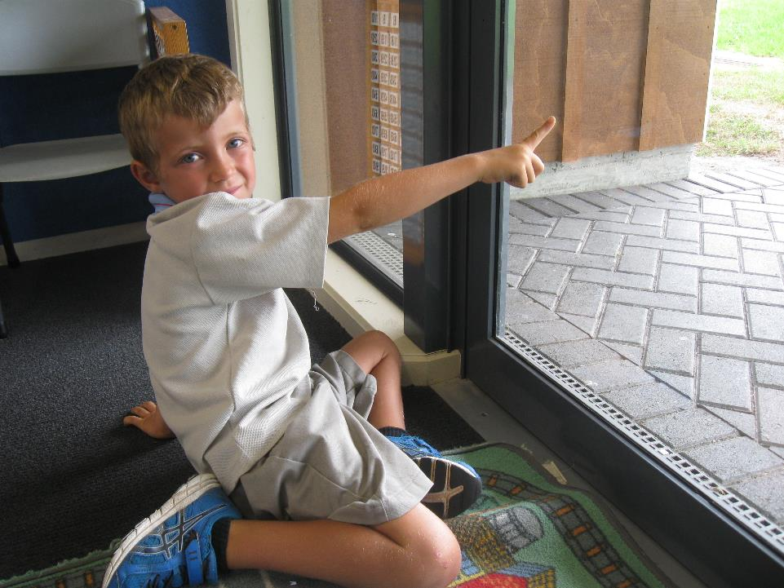
I can write on the window with my finger.

Slide 6
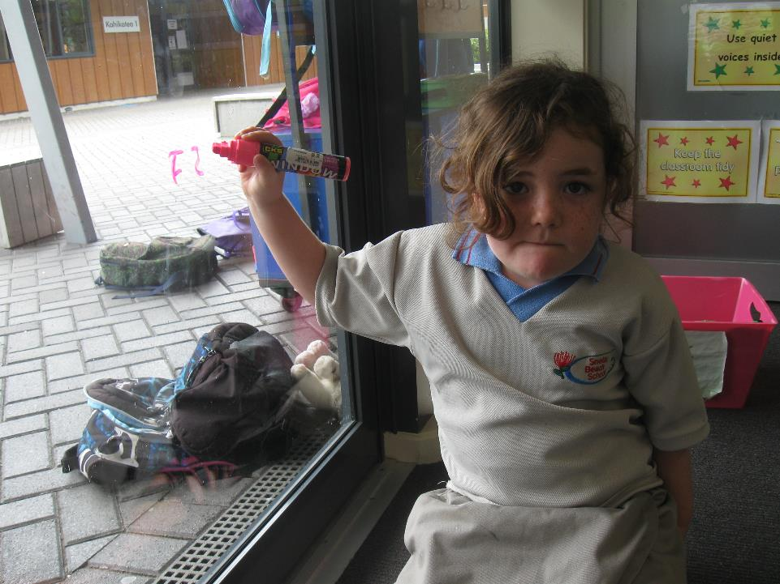
I can write on the window with a marker.

Slide 7
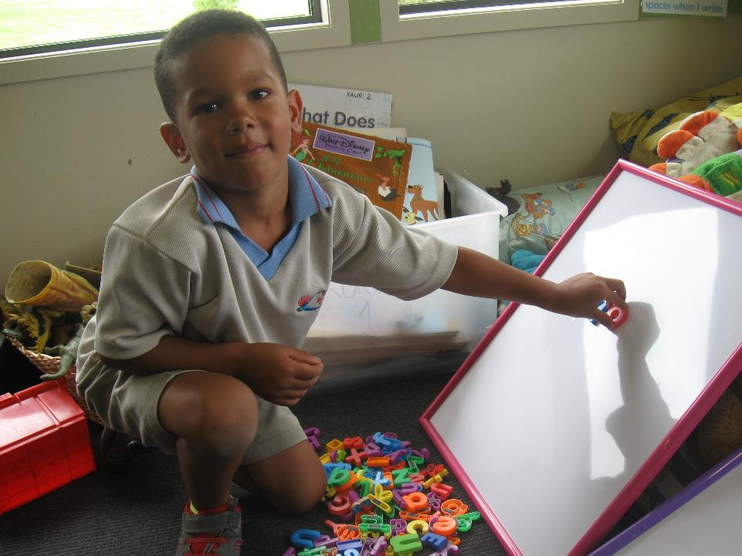
I can write on the magneticboard with magnets.

Slide 8
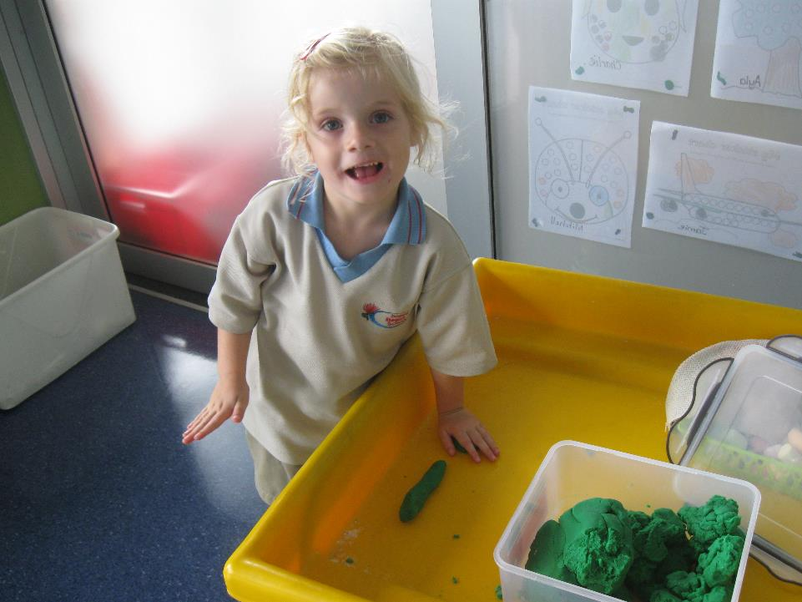
I can write in the tray with playdough.

Slide 9
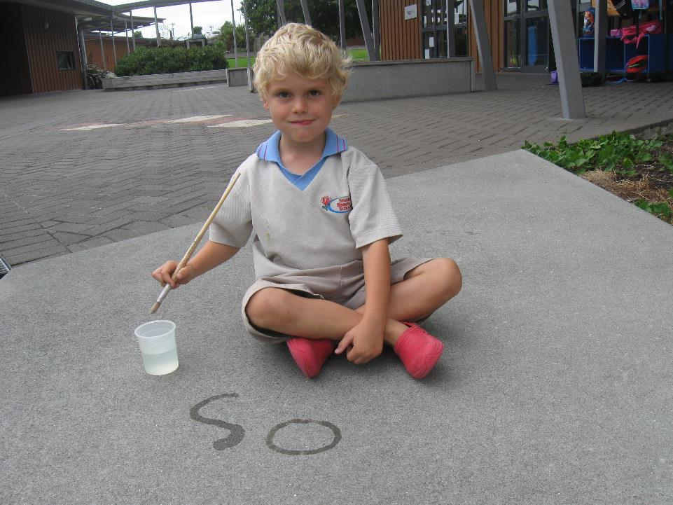
I can write on the path with water.

Slide 10
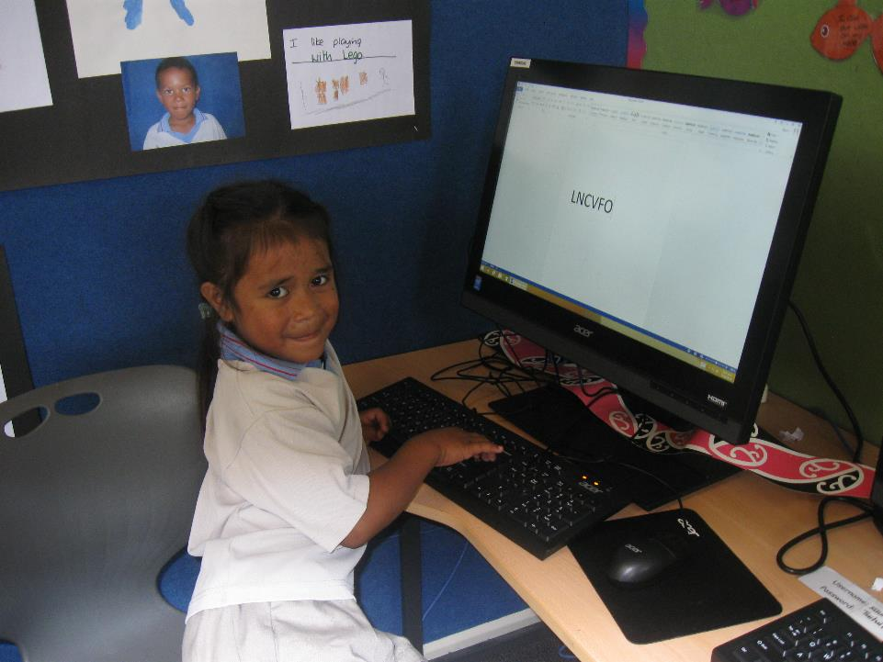
I can write on the computer.

