Slide 1
Paper Making.
With Kauri 1.

Slide 2
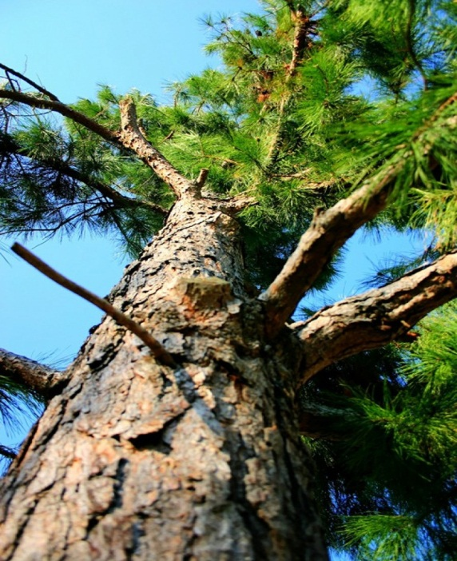
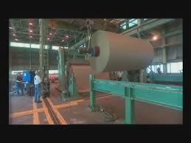
Getting the idea.
We found pine trees when we explored Goodall Reserve.
We discovered that pine trees are used to make paper.

Slide 3
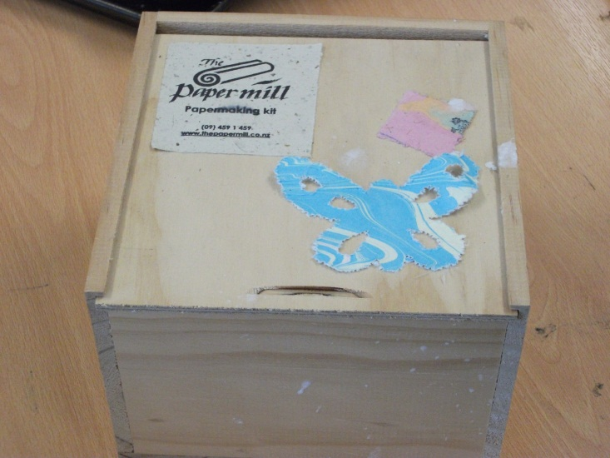
We wanted to know: Could we make paper?
We sent away for a paper making kit from a place in Whangarei called the Paper Mill.
We watched videos of kids making paper on you tube.

Slide 4
We found books on paper making.

Slide 5
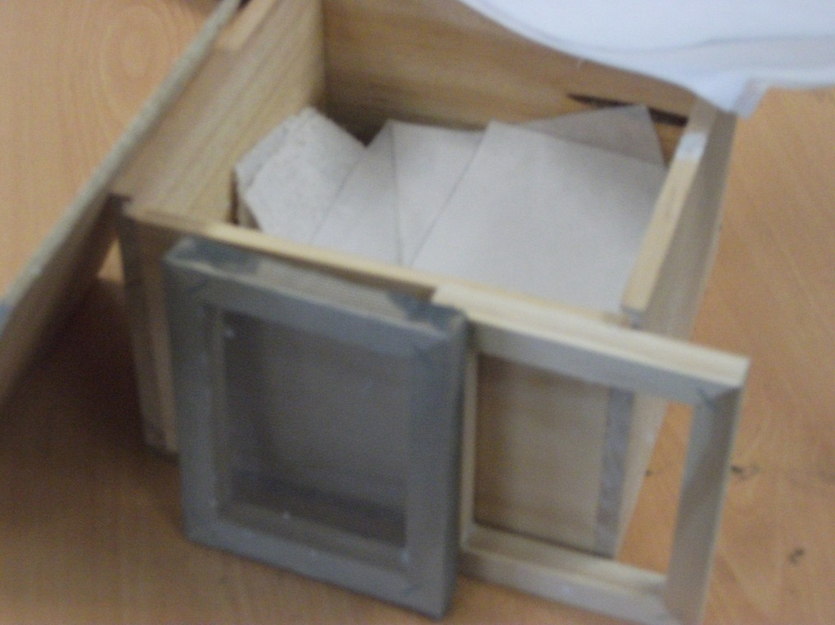
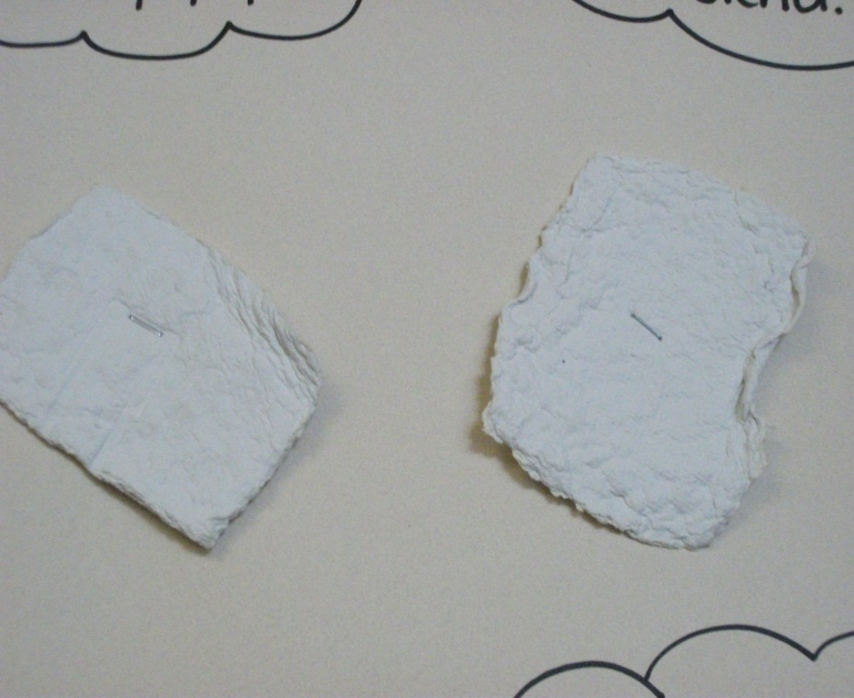
Our kit arrived and was full of equipment and instructions.
Everything was very small.
Good for small hands.
Good for small pieces of paper.

Slide 6
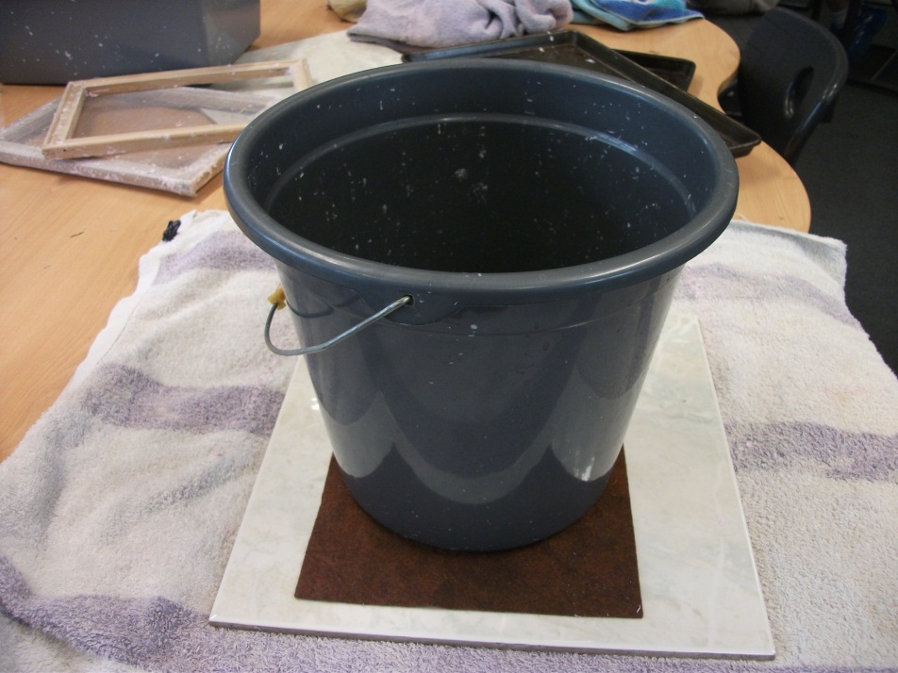
We had a go at making paper.
We used the equipment from our kit and a container from our class.
It was messy and very wet. (Our bucket had a hole in it.)

Slide 7
We wanted to make bigger paper.

Slide 8
Mrs Watkin got some picture frames and wire mesh to make a bigger deckle and mould.

Slide 9
Amelia’s Mum lent us a blender.

Slide 10
We got shredded paper from Miss Henry and the doctors’.

Slide 11
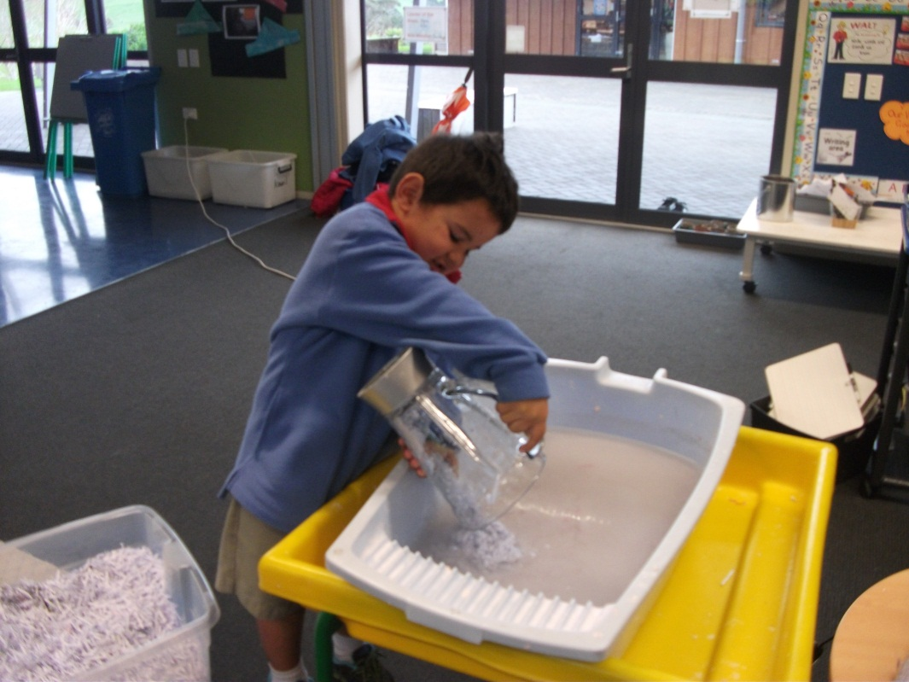
We made a lot of paper pulp by blending shredded paper and water.

Slide 12
We used our new frame to make bigger pieces of paper.

Slide 13
We filled the deckle and frame with paper pulp.

Slide 14
We turned the flat wet paper out onto a piece of felt.

Slide 15
We made sure the felt is wet first.

Slide 16
When we had a stack of wet paper sheets we squashed them to get out some of the water.

Slide 17
We laid the paper out to dry but it took a very long time.

Slide 18
We saw paper being dried on windows on youtube so we tried it.

Slide 19
The paper dries much more quickly.

Slide 20
We have experimented with adding coloured dye to the paper pulp.

Slide 21
We have made a lot of paper.

Slide 22
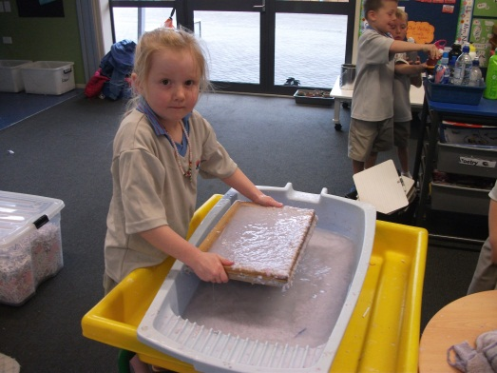
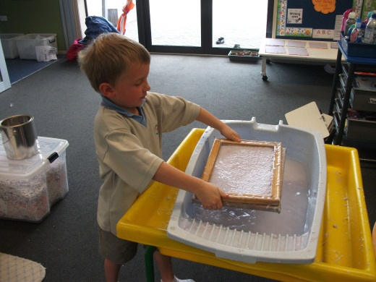
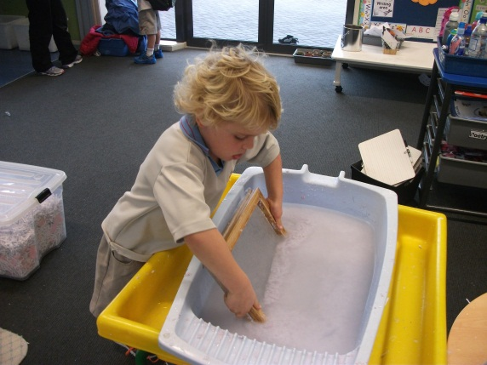
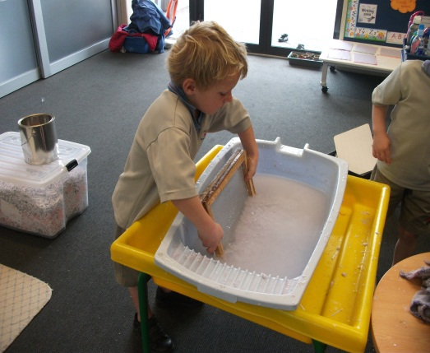
It’s fun you should try it!!!!

