Slide 1
Smarty Hats.
by Kauri 1

Slide 2
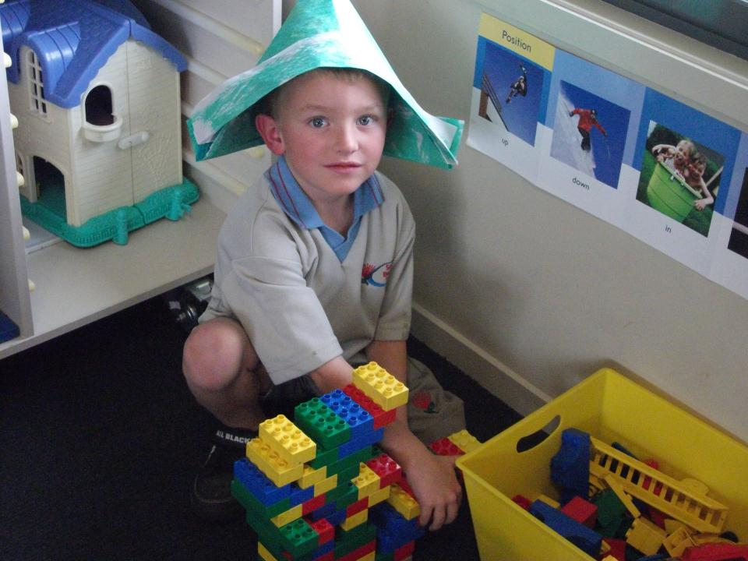
I am a Smarty Hat.
Rum-tum-tuplo.
See me play
With some duplo.

Slide 3
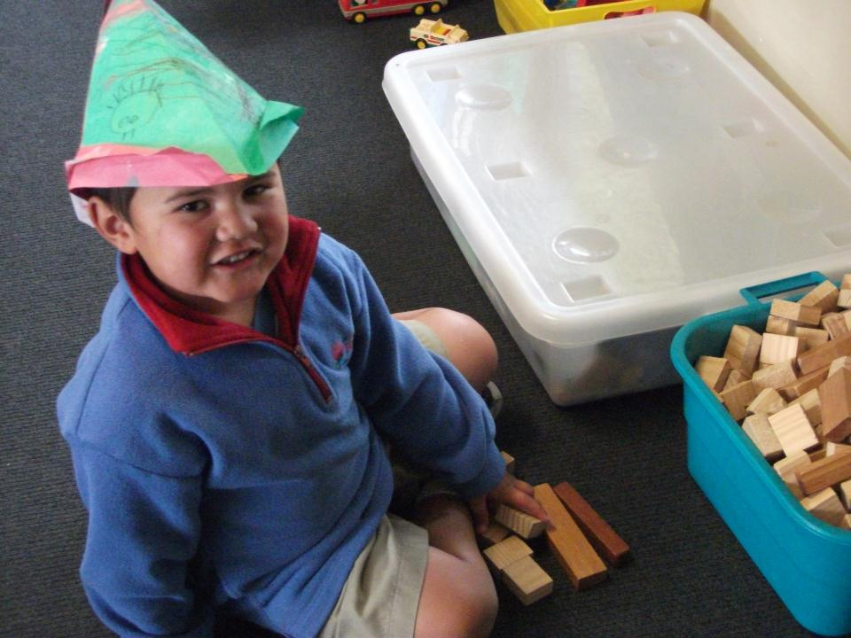
I am a Smarty Hat.
Rum-tum-rock.
See me play with some blocks.

Slide 4
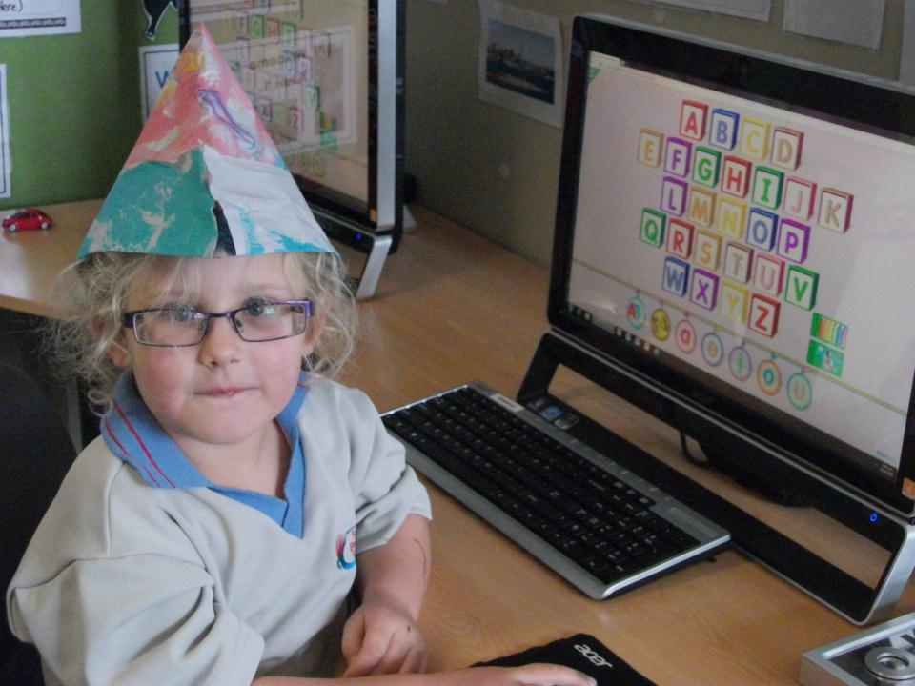
I am a Smarty Hat.
Rum- tum-tooter
See me play
On the computer.

Slide 5
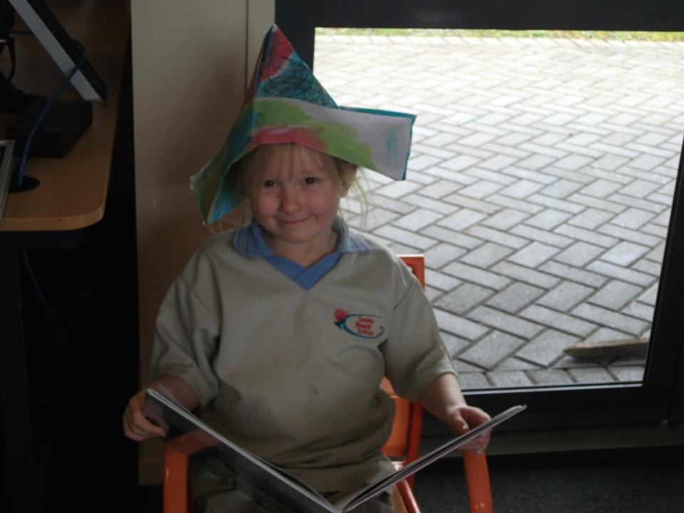
I am a Smarty Hat.
Rum-tum-took
See me sitting
Reading a book.

Slide 6
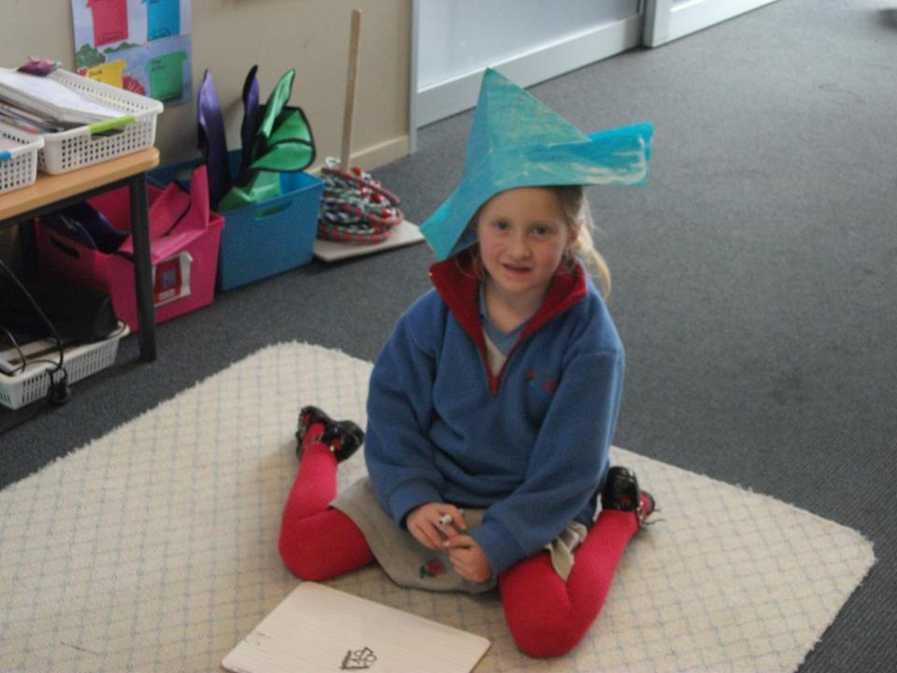
I am a Smarty Hat
Rum-tum-tight
See the white board
I can write.

Slide 7
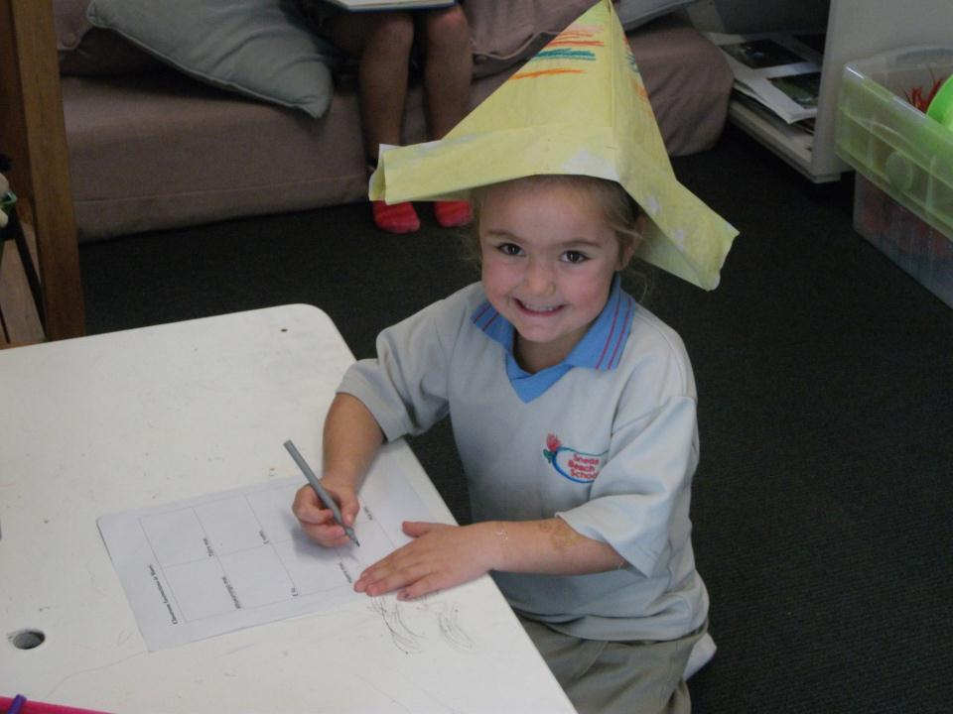
I am a Smarty Hat.
Rum-tum-straw
See the felt pens
I can draw.

Slide 8
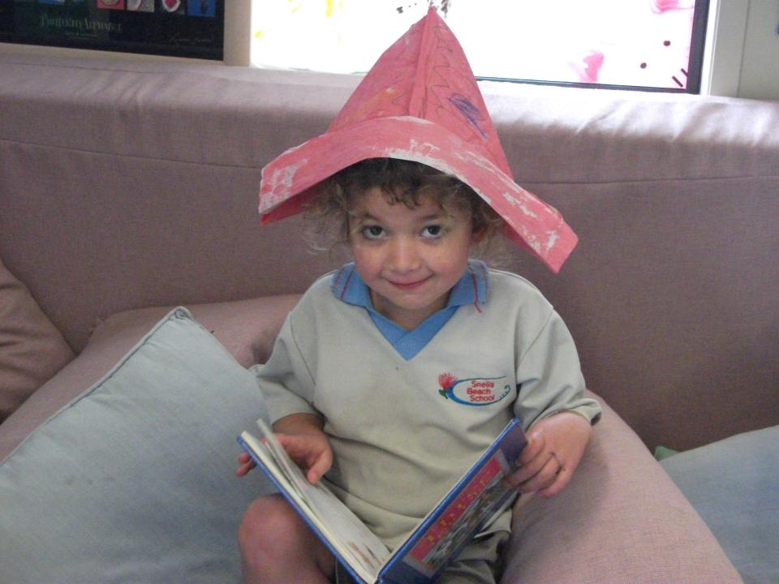
I am a Smarty Hat.
Rum-tum- teed
See my book
I can read.

