Slide 1
I can read.
by Kauri 1

Slide 2
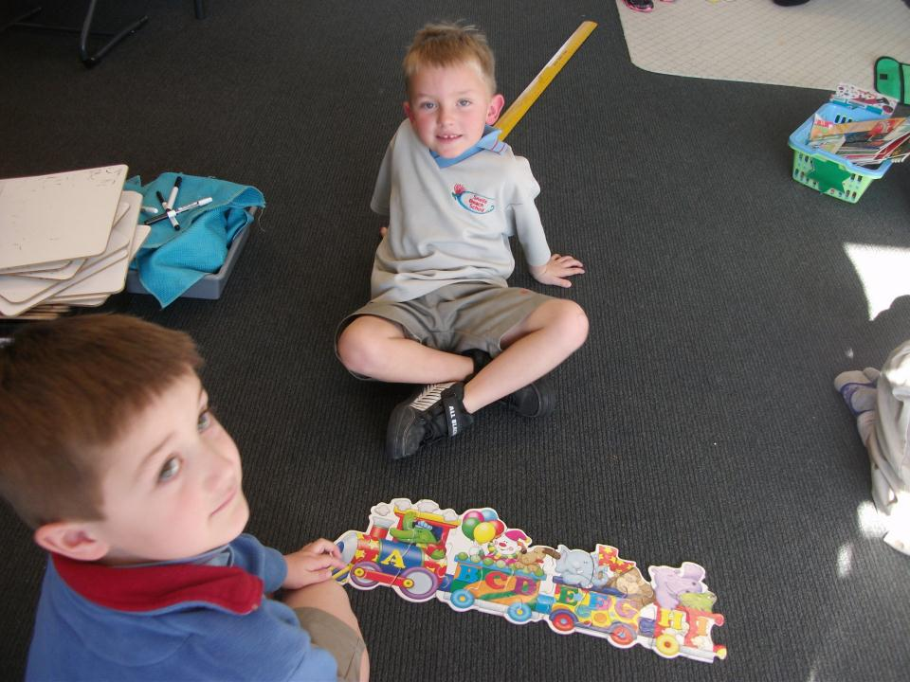
I can read the alphabet.

Slide 3
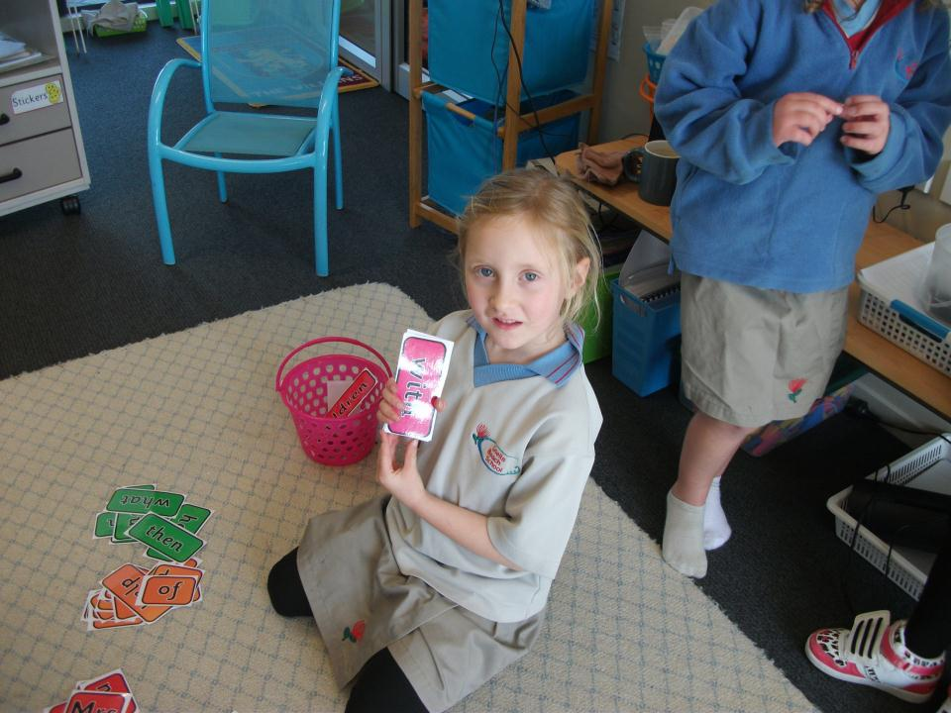
I can read a word card.

Slide 4
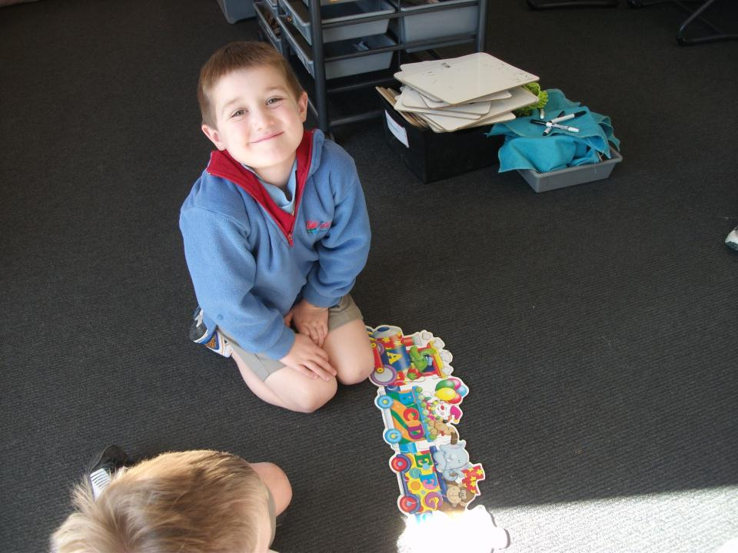
I can read the alphabet.

Slide 5
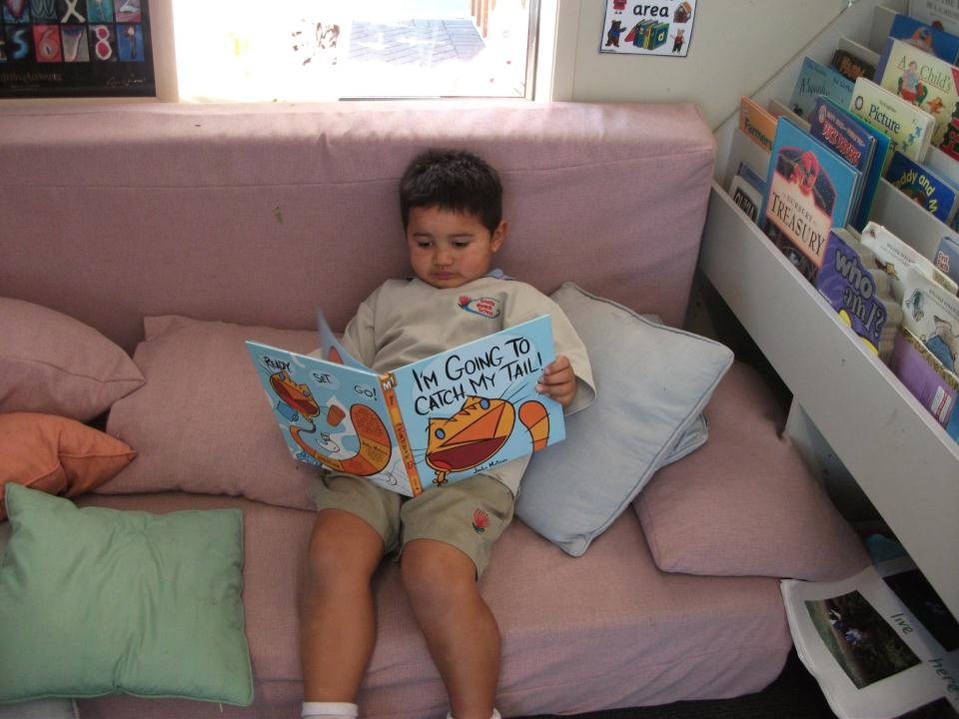
I can read a library book.

Slide 6
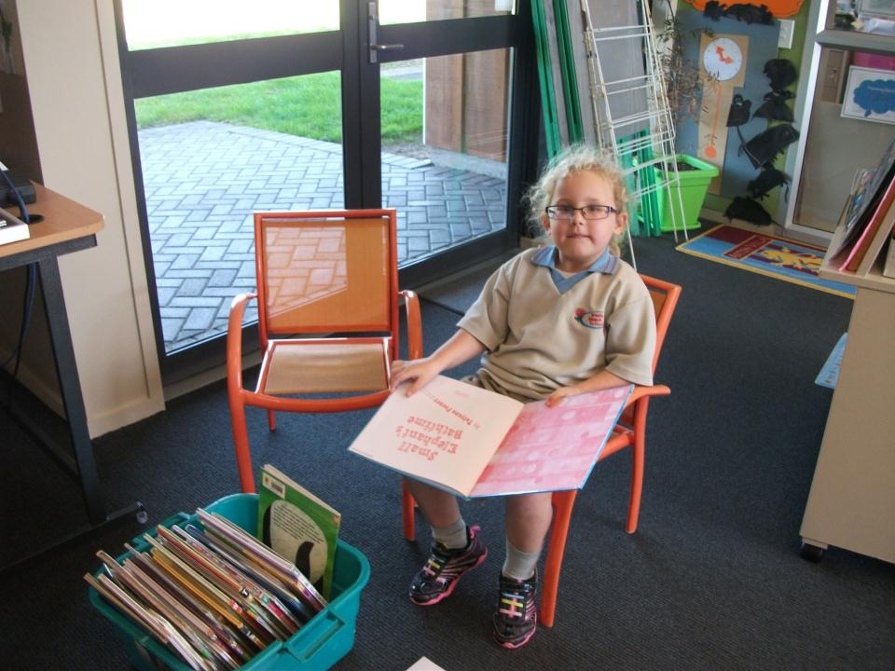
I can read a book from the tub.

Slide 7
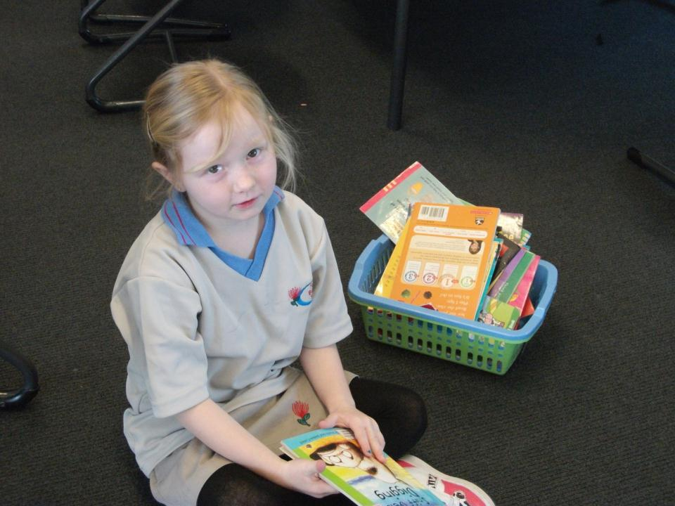
I can read from the basket.

Slide 8
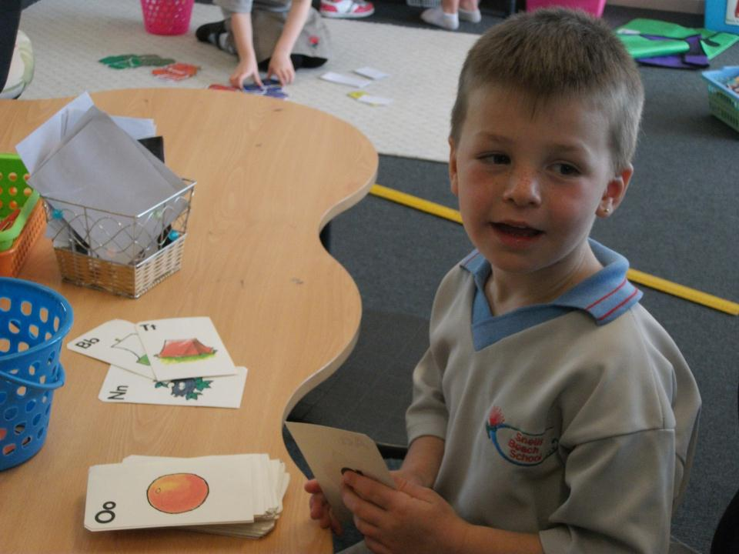
I can read an alphabet card.

Slide 9
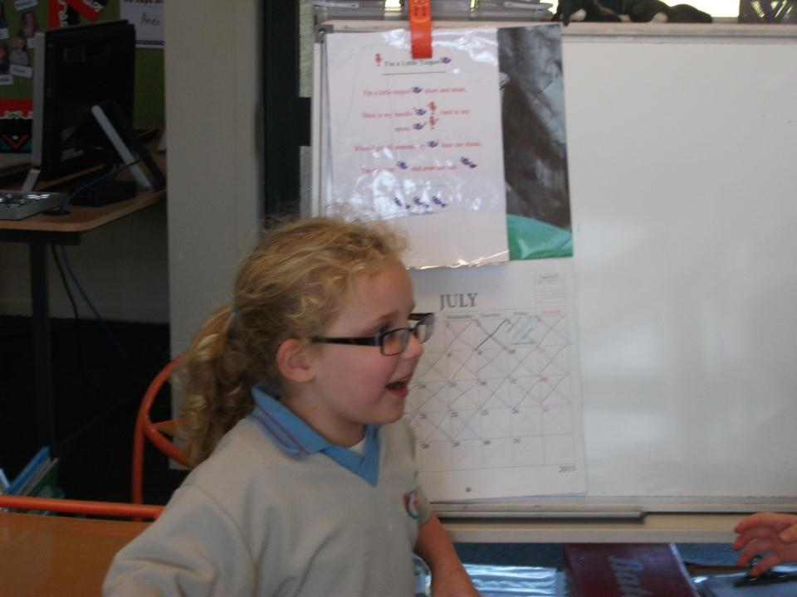
I can read a poem.

Slide 10
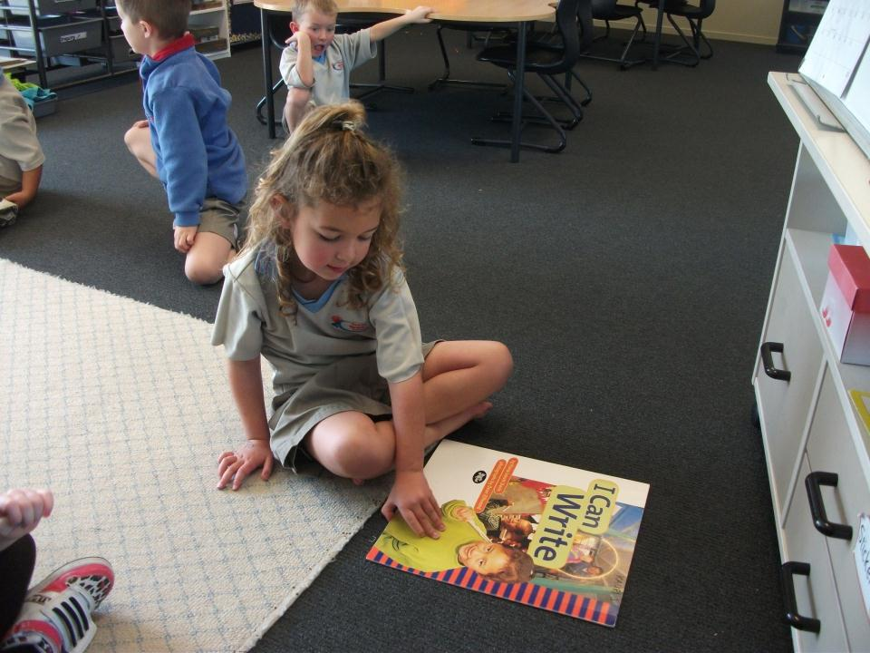
I can read a big book.

Slide 11
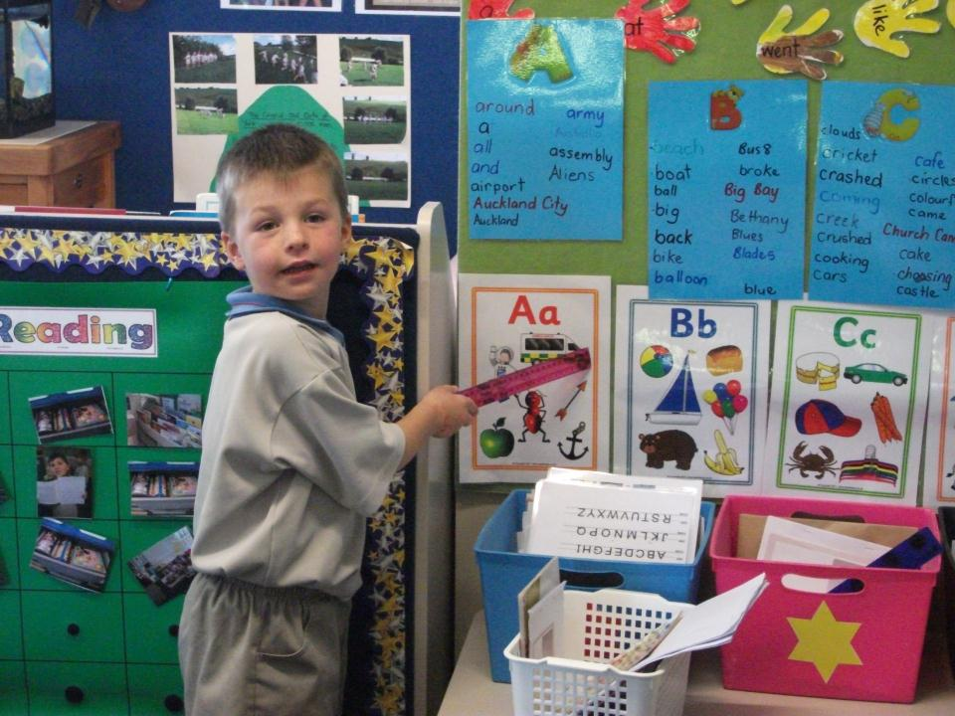
I can read our walls.

