Slide 1
Sounds of Belonging to Snells Beach School

Slide 2
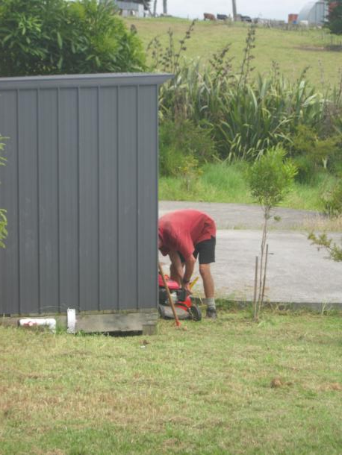
Mr Outwin filling up the lawn mower.

Slide 3
The Flag flapping in the wind.

Slide 4
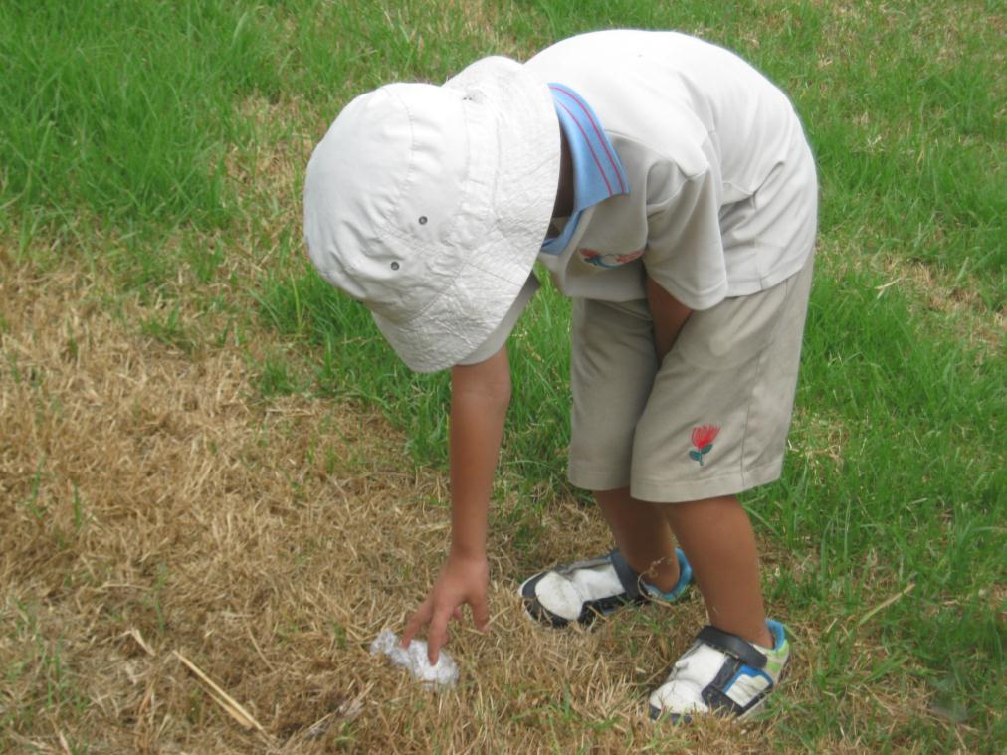
Joseph picking up rubbish.

Slide 5
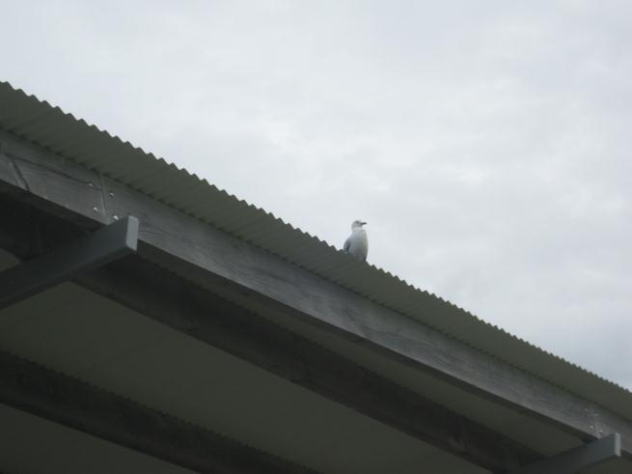
The sea gull squawking at the children.

Slide 6
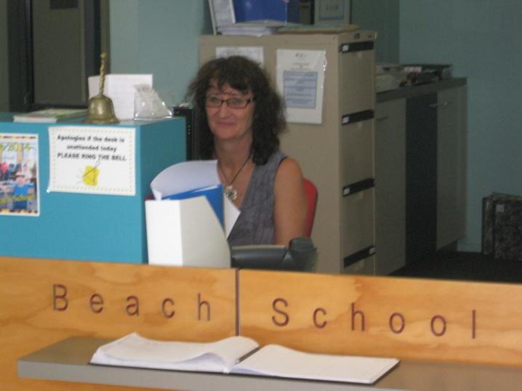
Miss Henry working on her computer.

Slide 7
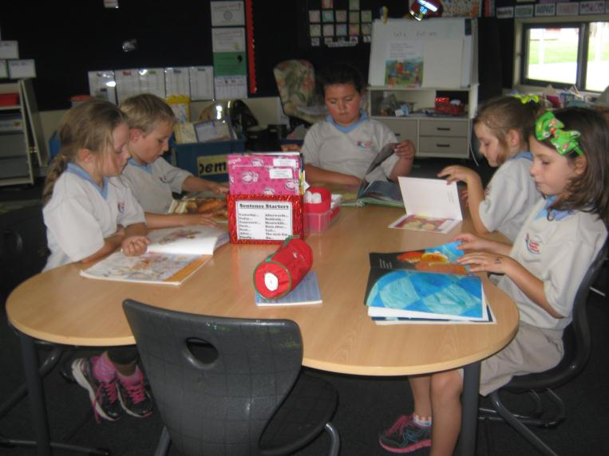
The children reading quietly at their table.

Slide 8
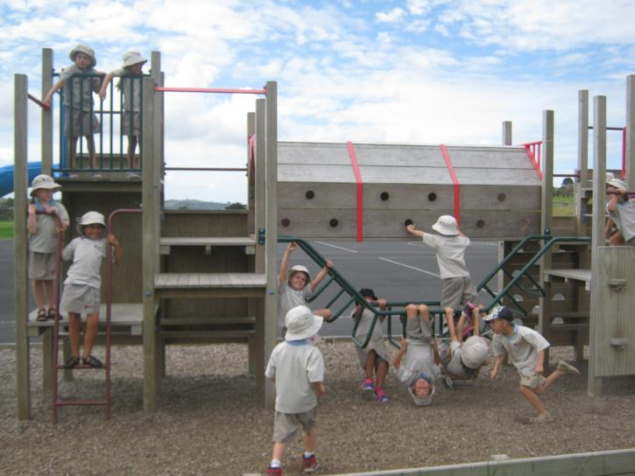
The little monkeys playing on the playground.

Slide 9
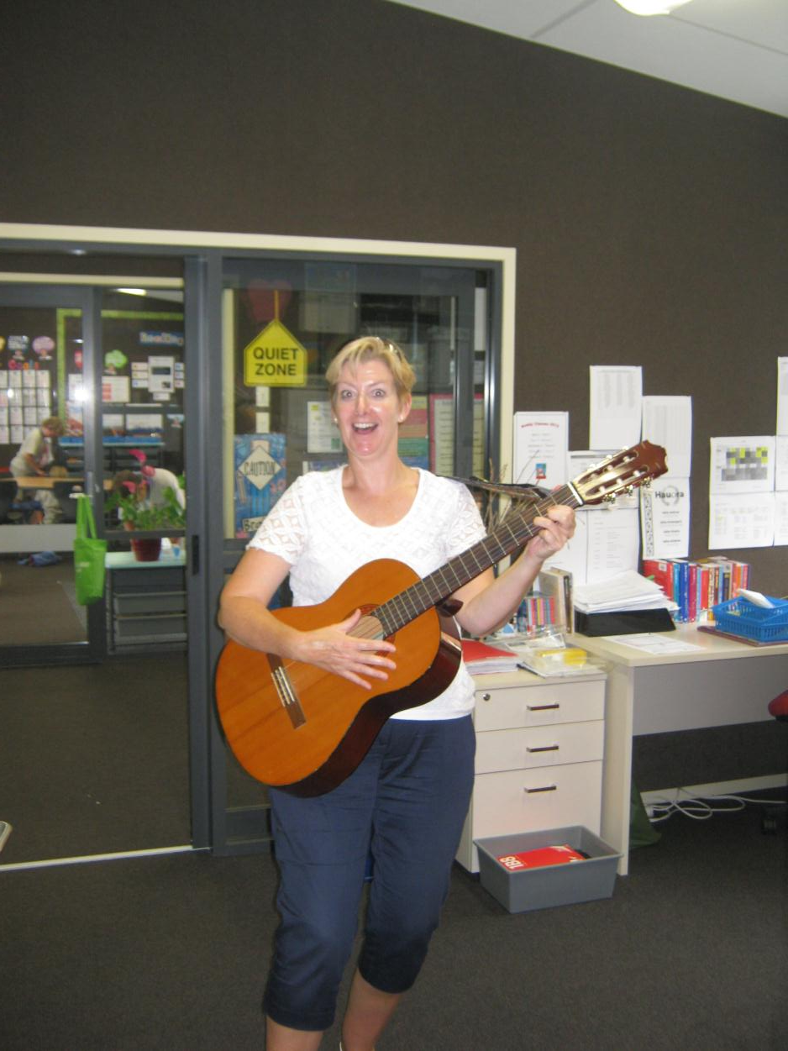
Mrs Gore playing the guitar.

Slide 10
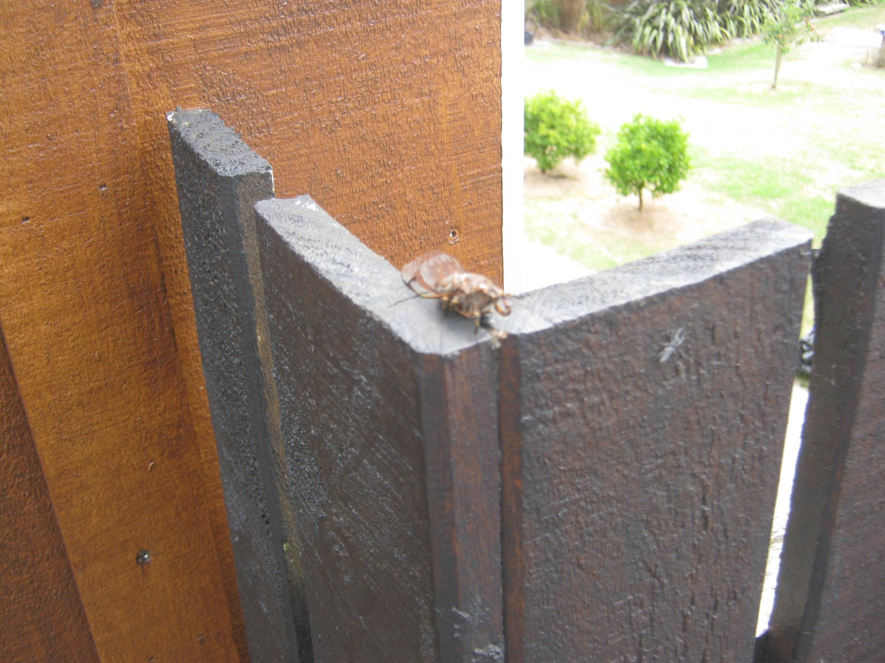
A cicada singing its song.

Slide 11
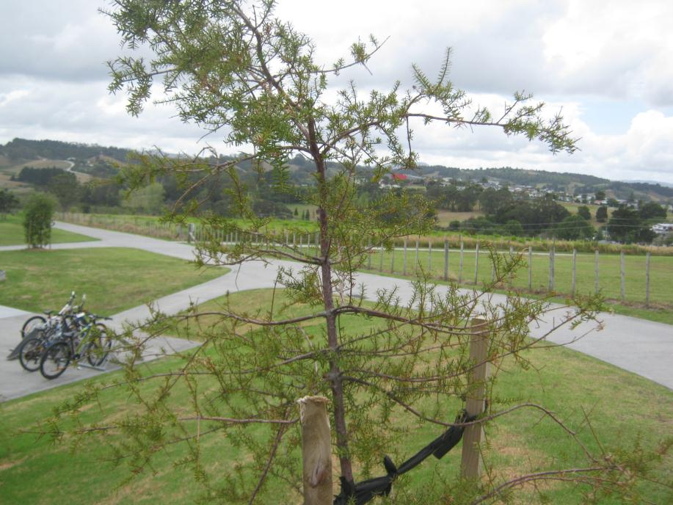
Trees blowing in the wind.

