Slide 1
Mrs Watkin’s Tub.
by Kauri 1

Slide 2
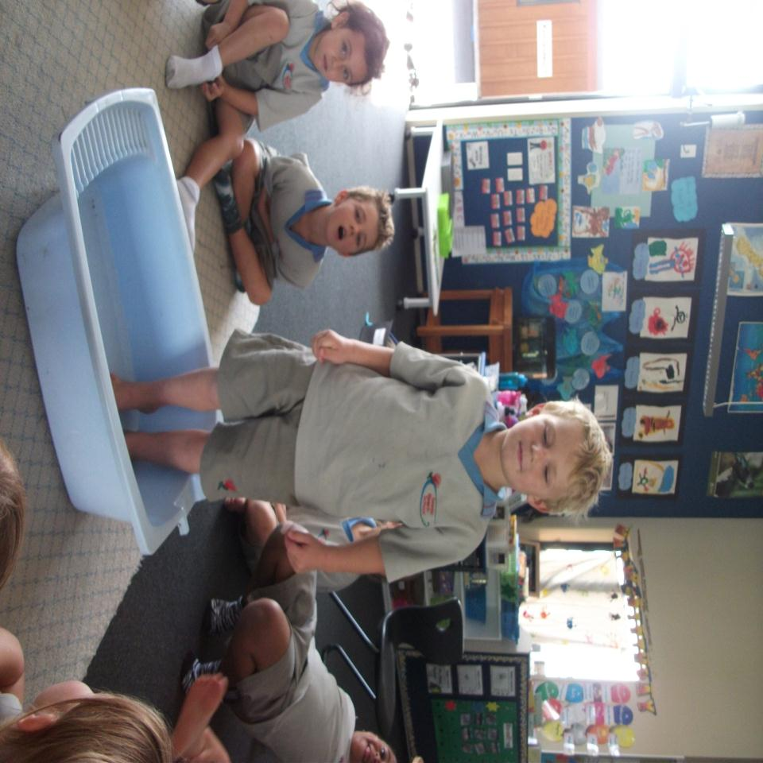
Jacob is in the tub.

Slide 3
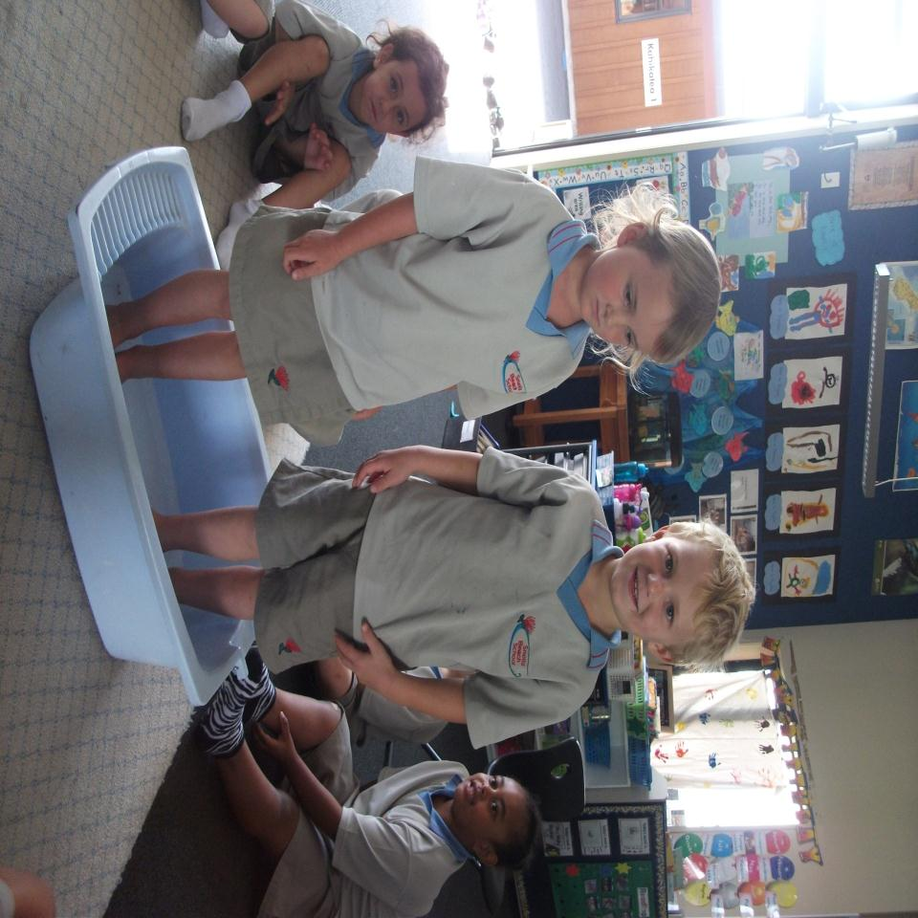
Bethany is in the tub.

Slide 4
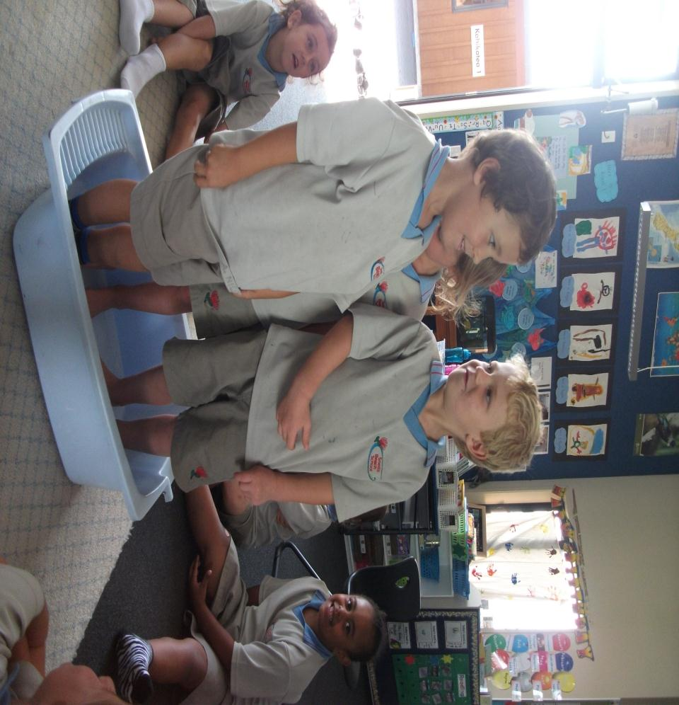
Angus is in the tub.

Slide 5
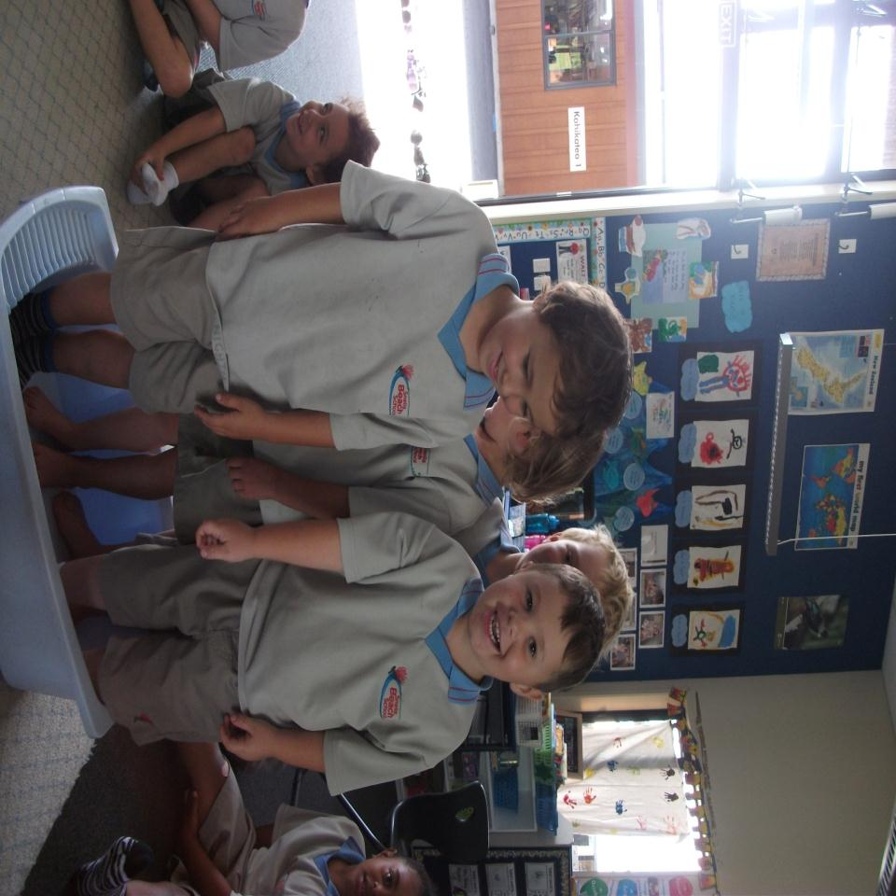
Felix is in the tub.

Slide 6
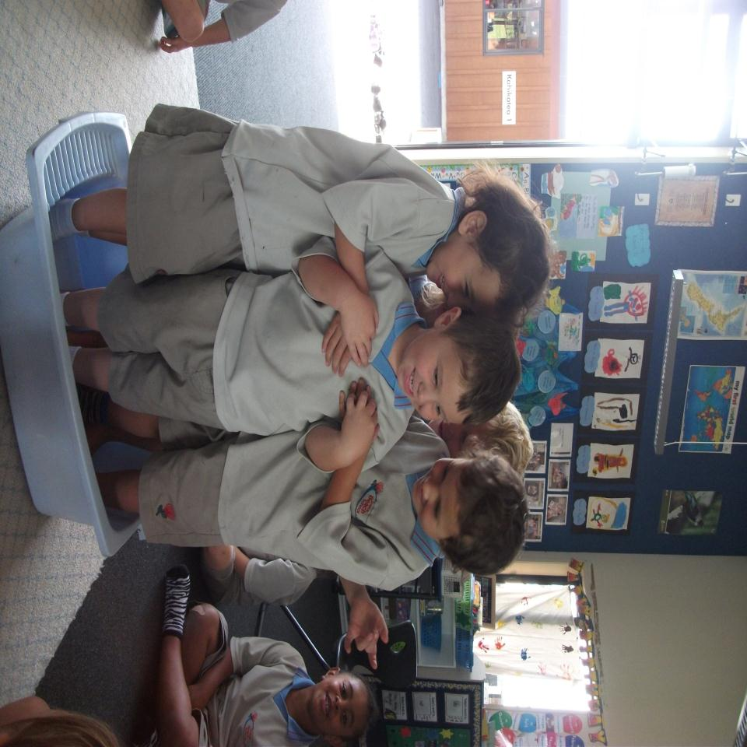
Ashlee is in the tub.

Slide 7
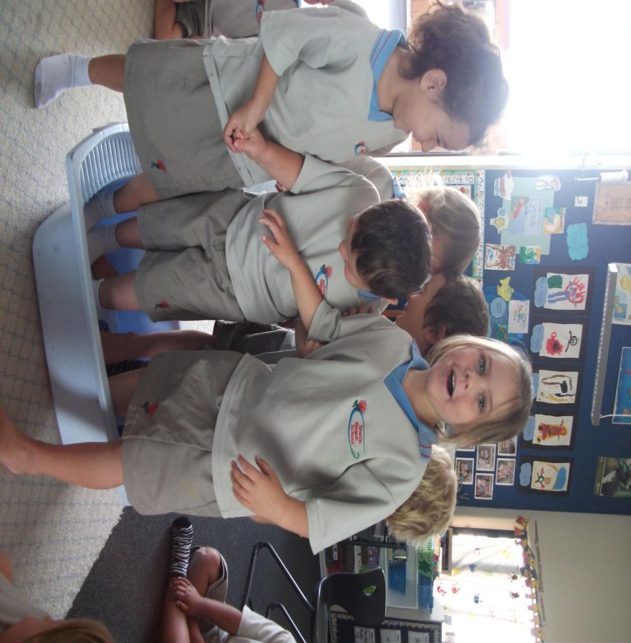
Vienna is in the tub.

Slide 8
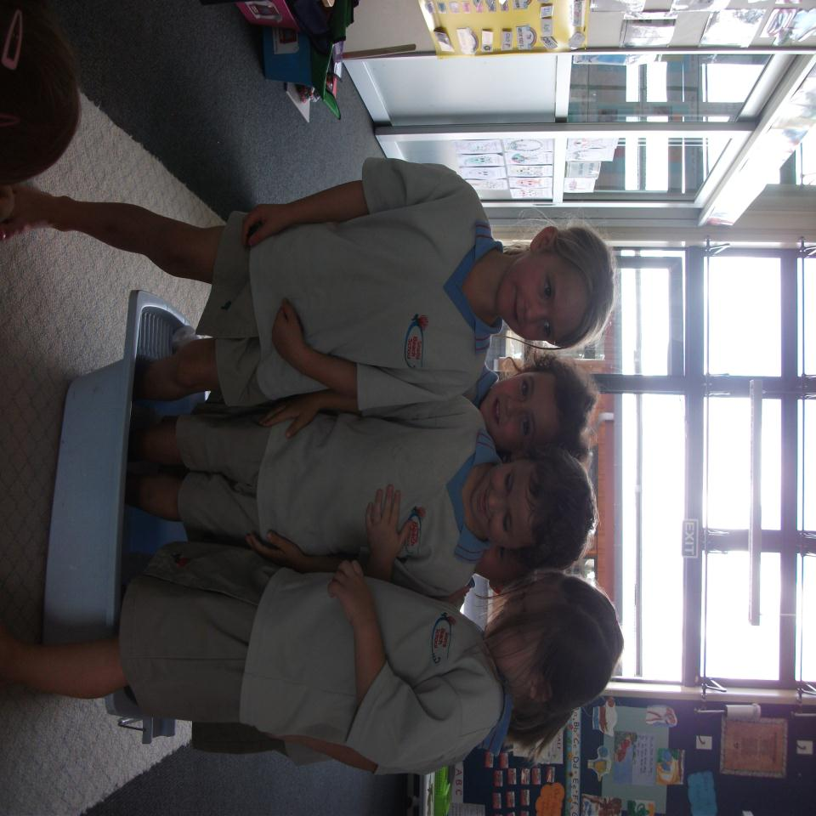
Tilly is in the tub.

Slide 9
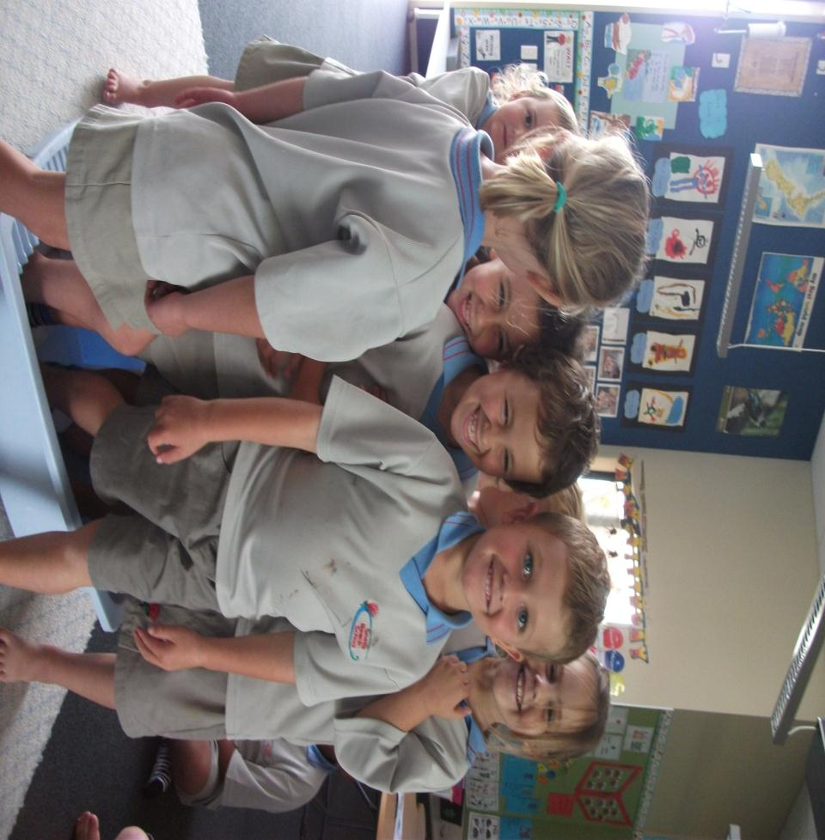
Blake is in the tub.

Slide 10
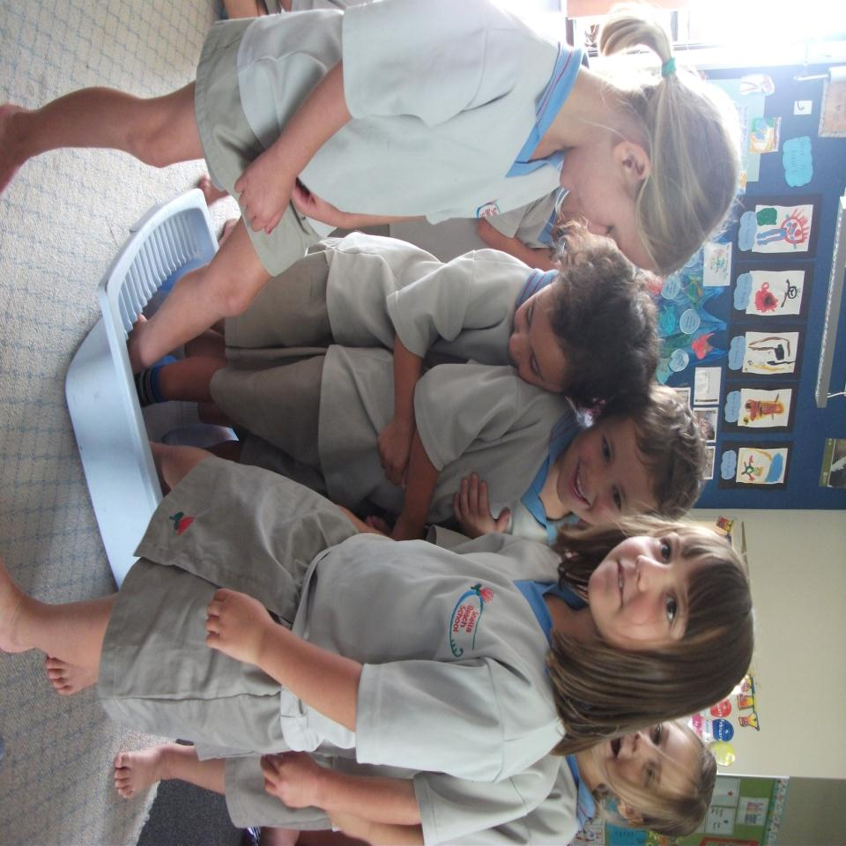
Ashlee is in the tub.

Slide 11
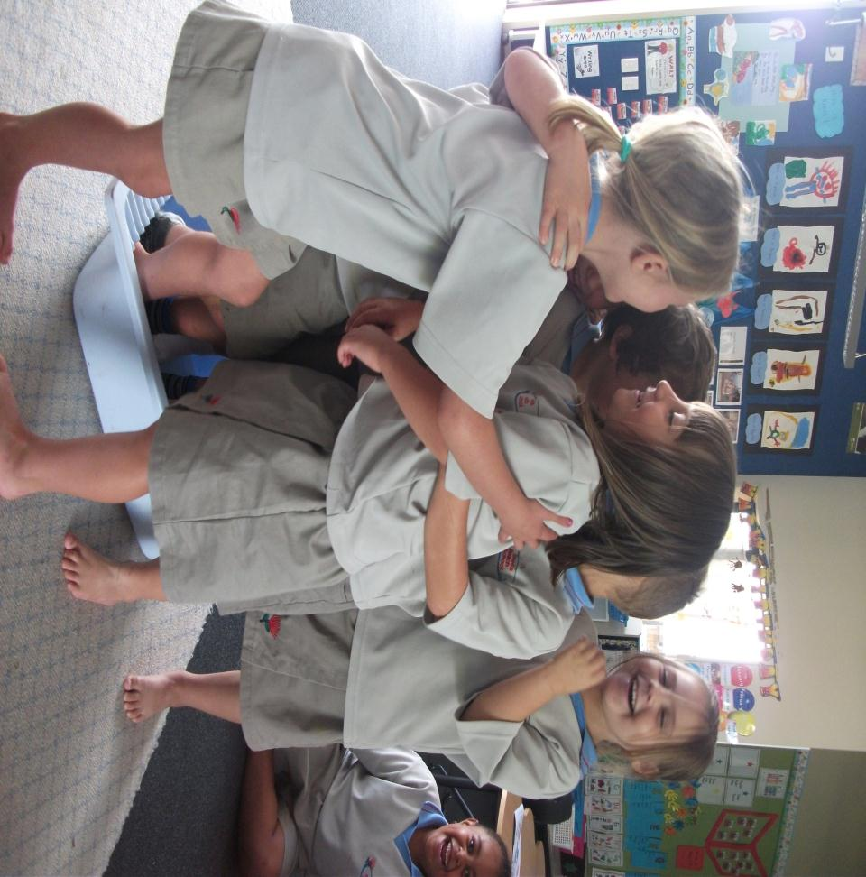
Tayler is in the tub.

Slide 12
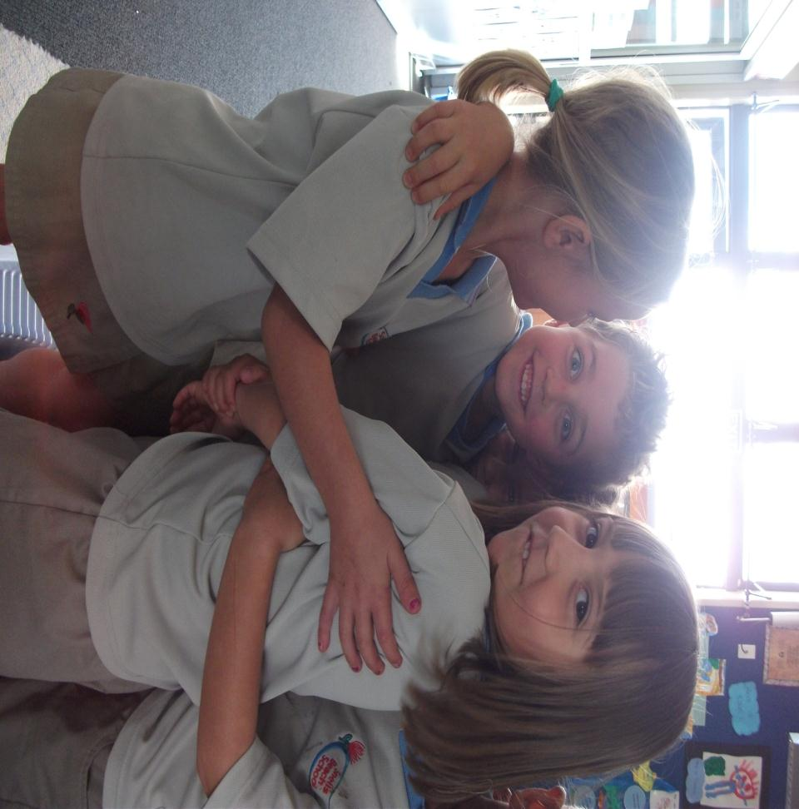
Royston is in the tub.

Slide 13
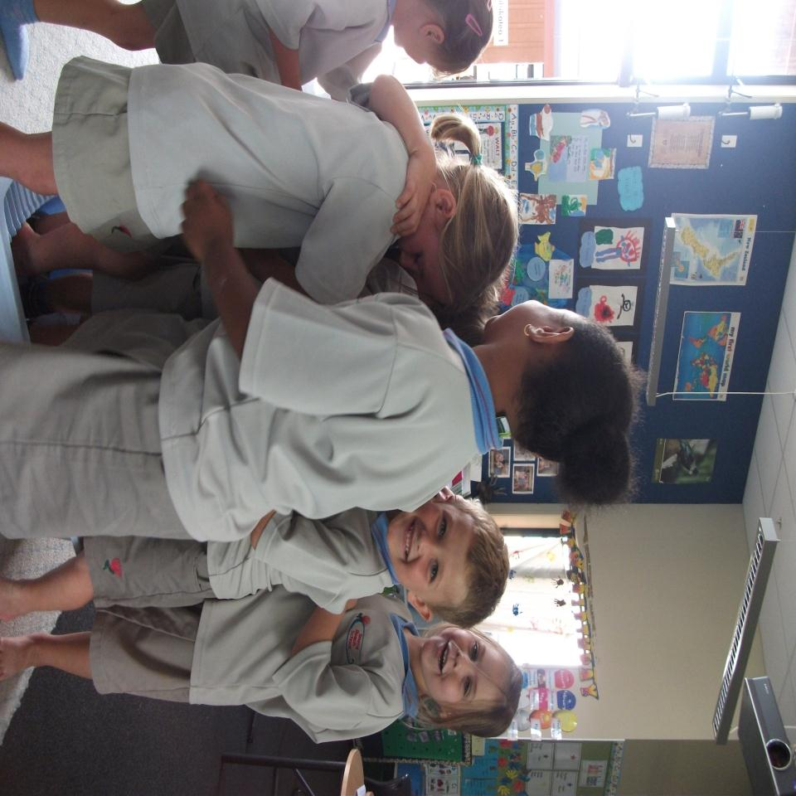
Taraivini is in the tub.

Slide 14
Abigail is in the tub.

Slide 15
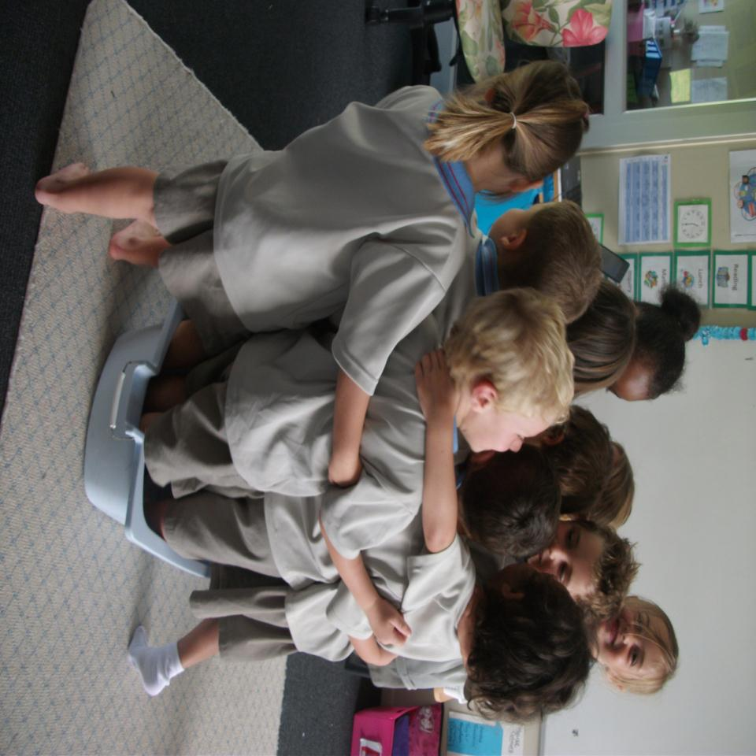
Kauri 1 is in the tub.
Squishy, squashy.
Squishy, squashy.

