Slide 1
I Can Read To My Buddy.
By Kauri 1.

Slide 2
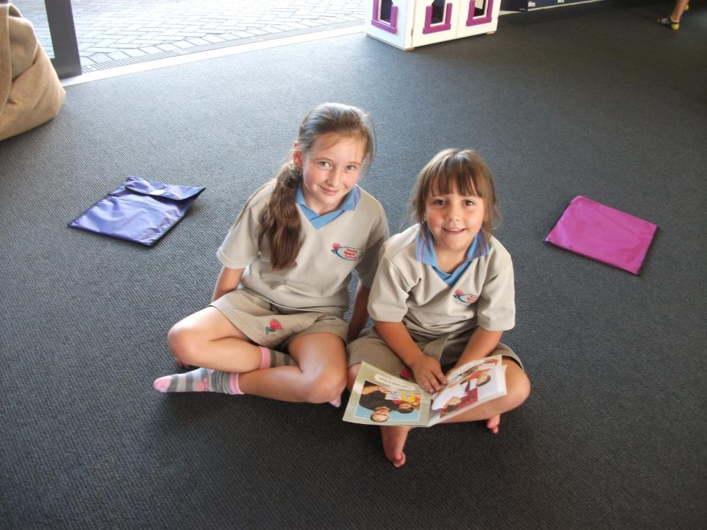
“I can read to Isabella”, said Tayler.

Slide 3
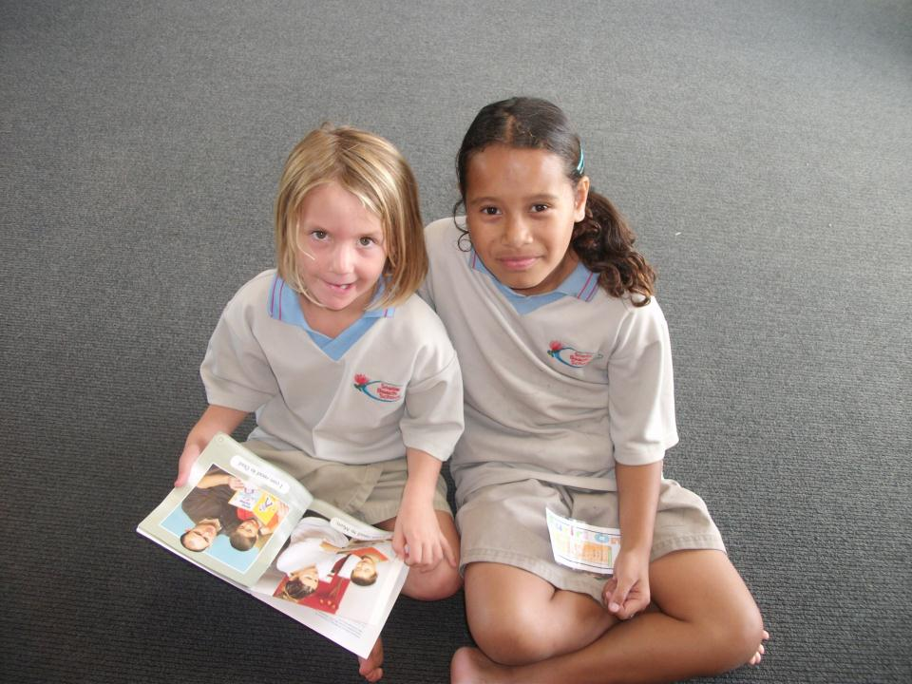
“I can read to Tycee”, said Tilly.

Slide 4
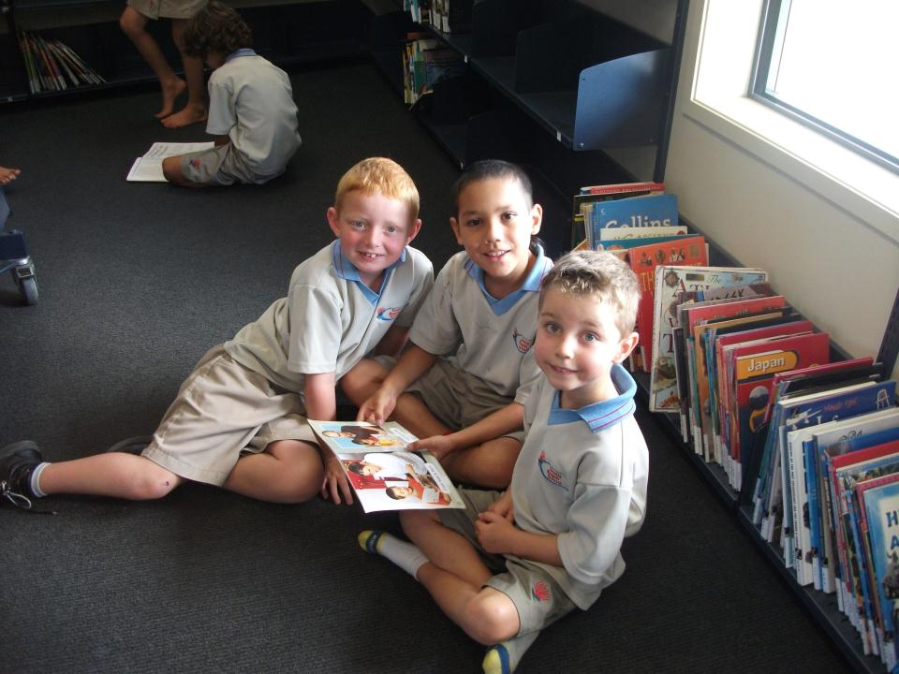
“I can read to Gene and Dante”, said Royston.

Slide 5
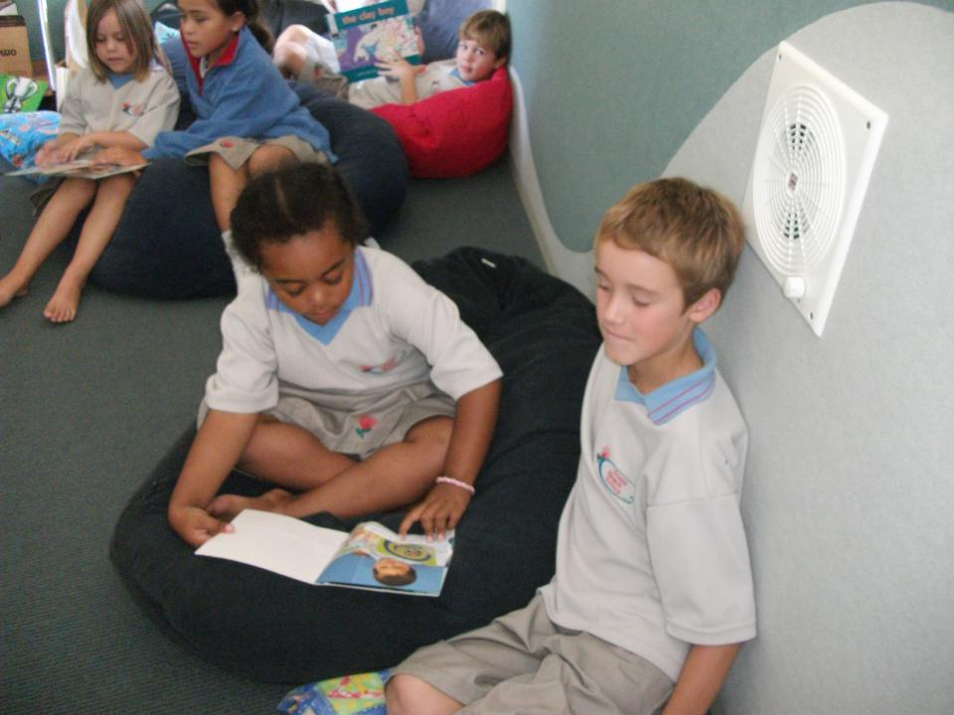
“I can read to Franz”, said Taraivini.

Slide 6
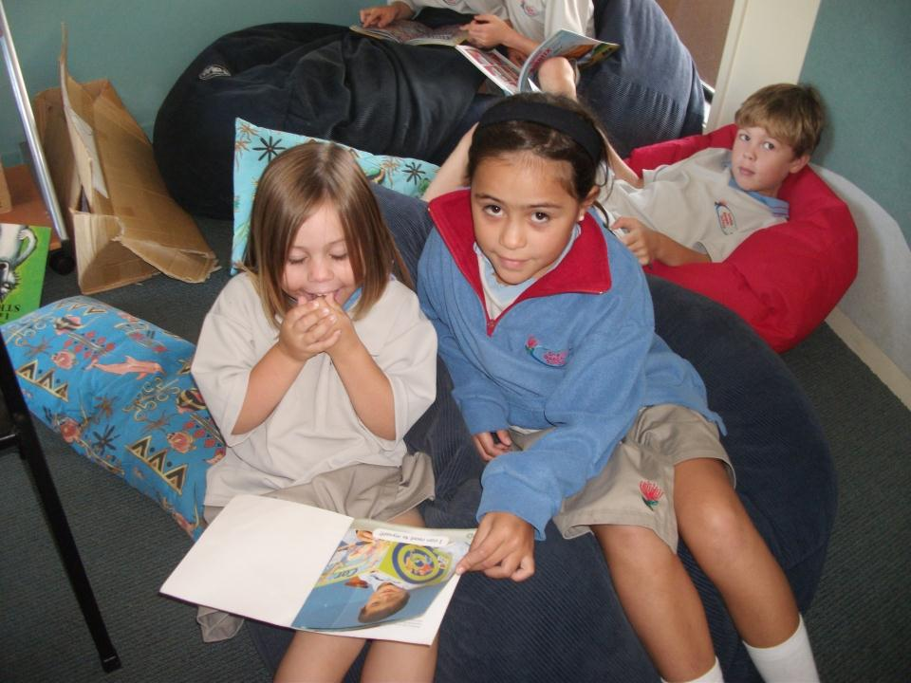
“I can read to Joy”, said Vienna.

Slide 7
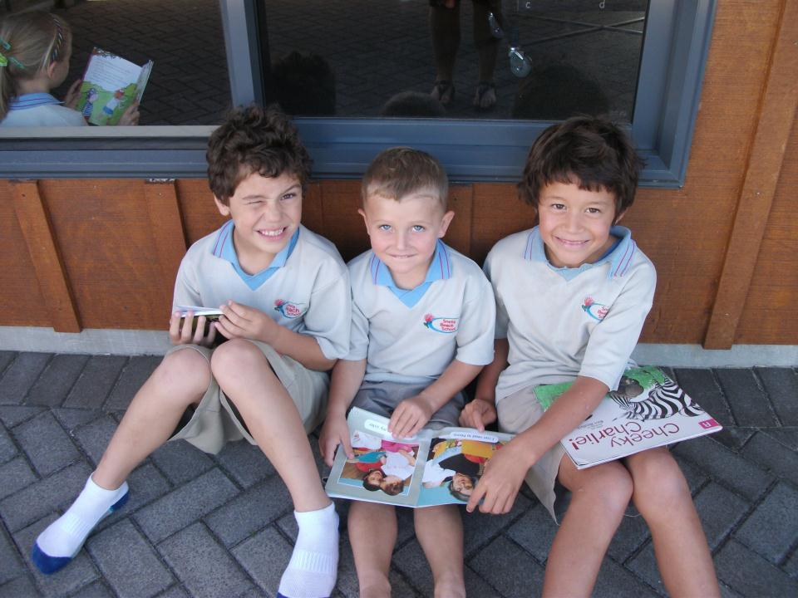
“I can read to Kauri and Devyn,” said Blake.

Slide 8
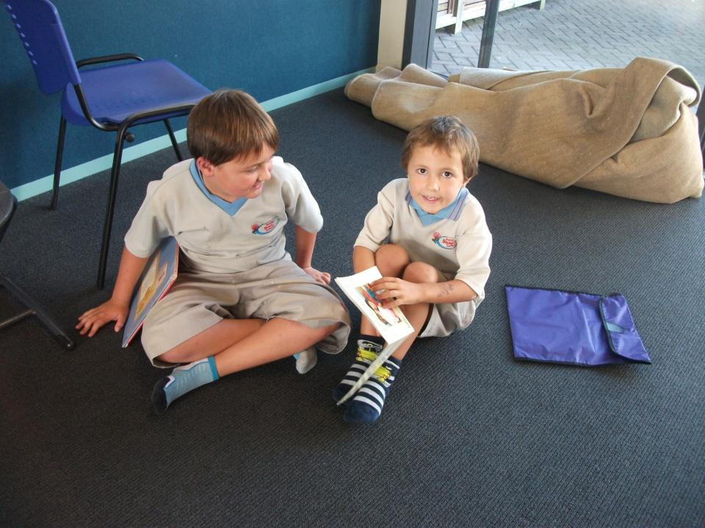
“I can read to Samuel,” said Angus.

