Slide 1
Lunch for Kauri 2
by Kauri 2

Slide 2
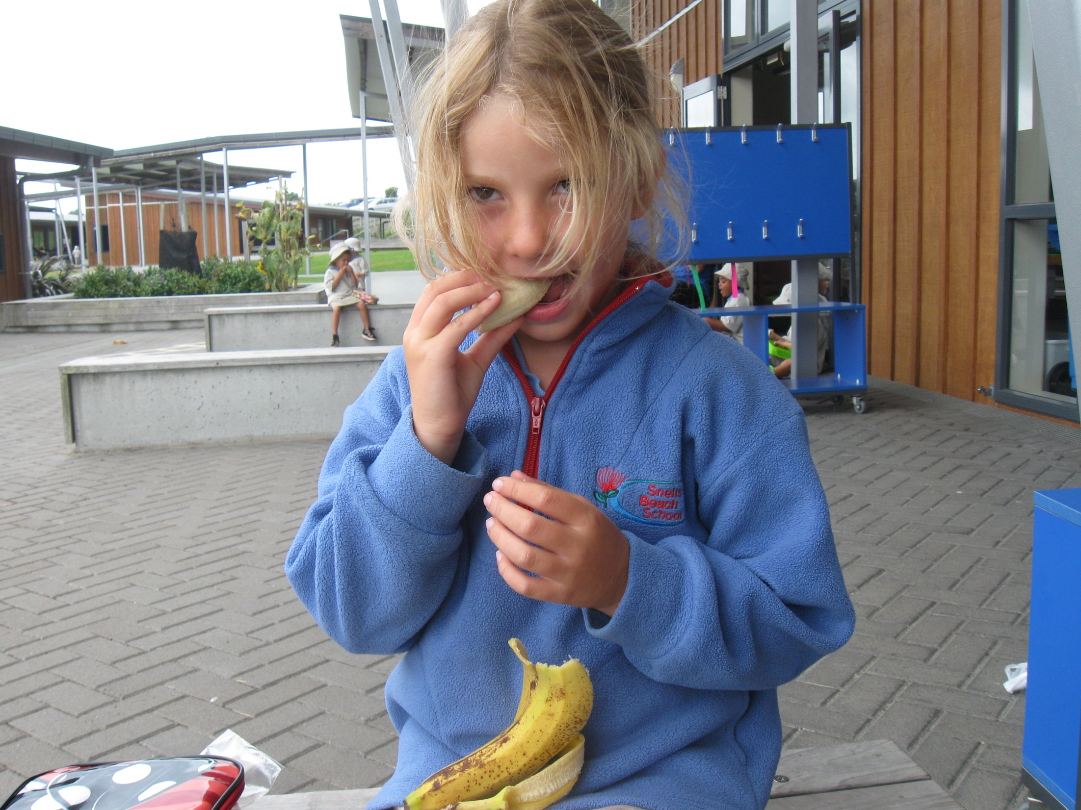
“Here is a banana,” said Jessica.
“This is for me!”

Slide 3
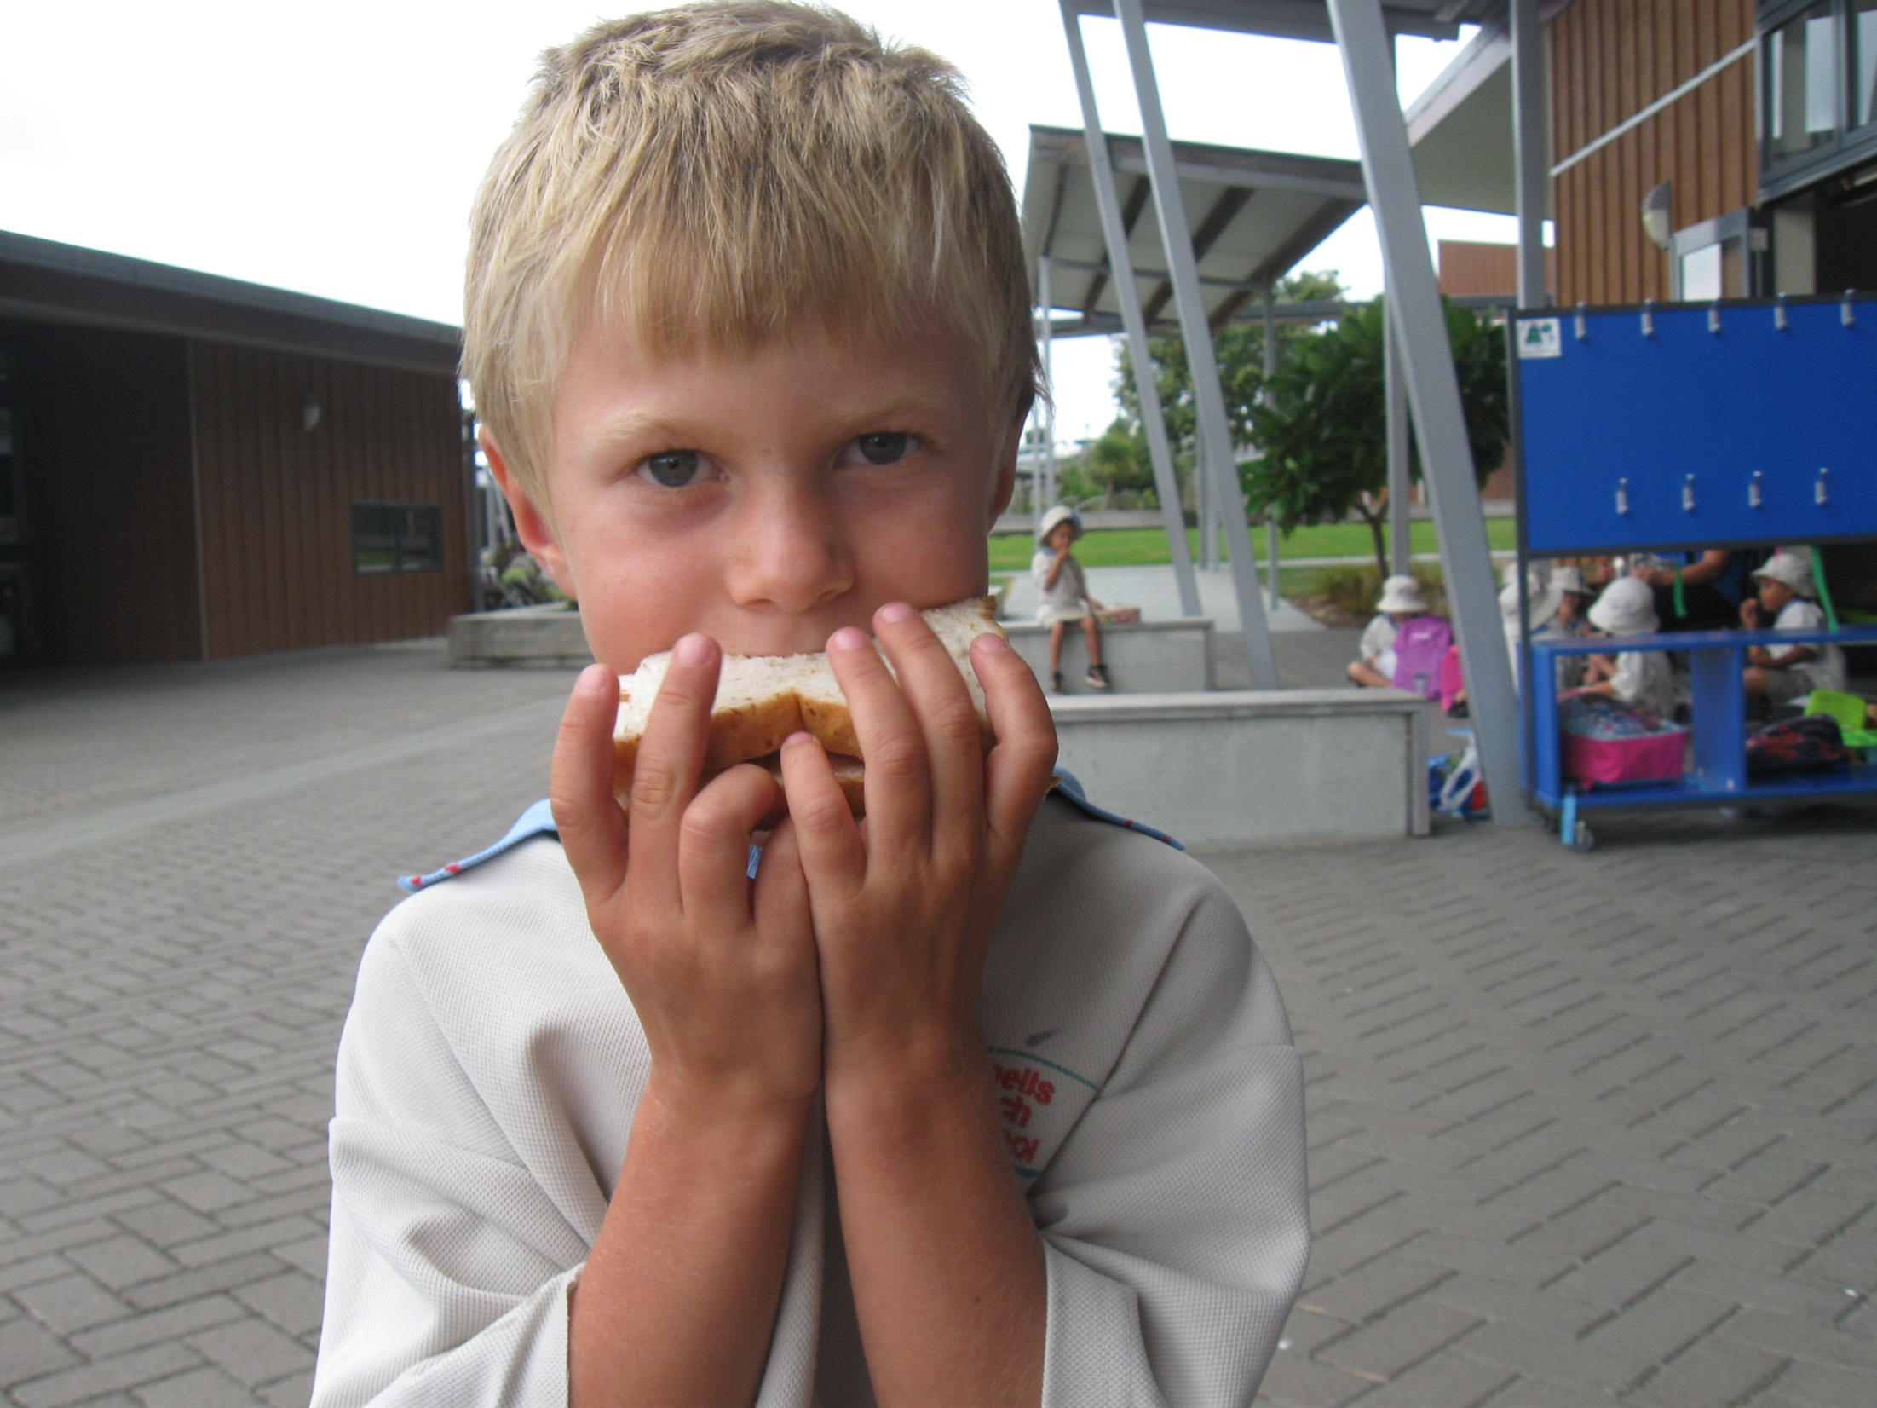
“Here is a sandwich,” said Micah.
“This is for me!”

Slide 4
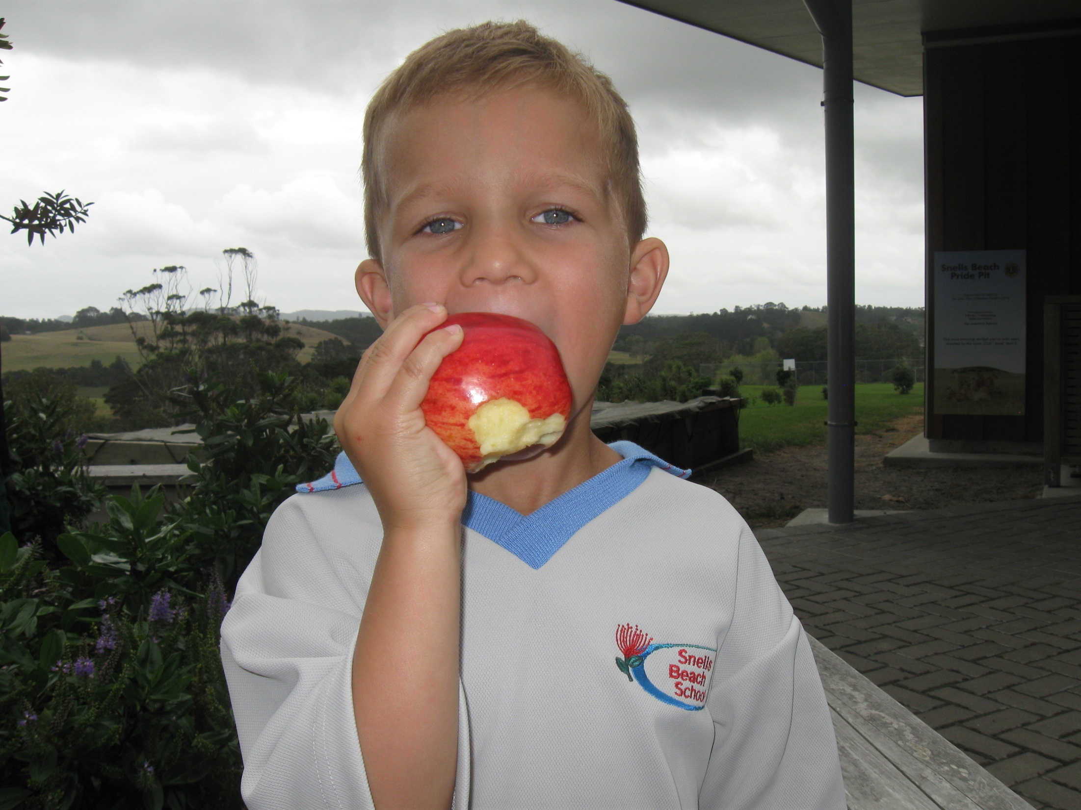
“Here is an apple,” said Lucas.
“This is for me!”

Slide 5
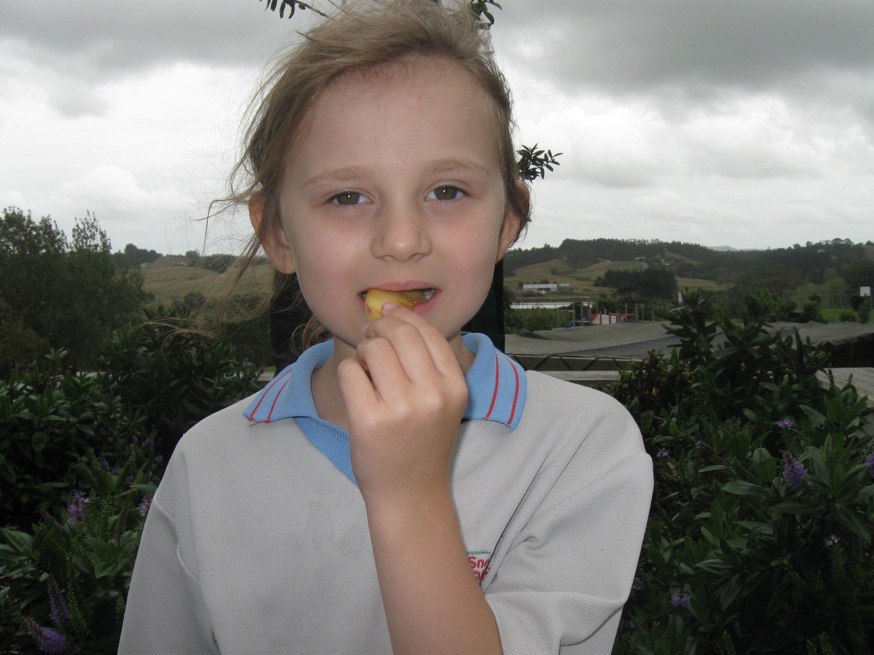
“Here is a peach,” said Mikayla.
“This is for me!”

Slide 6
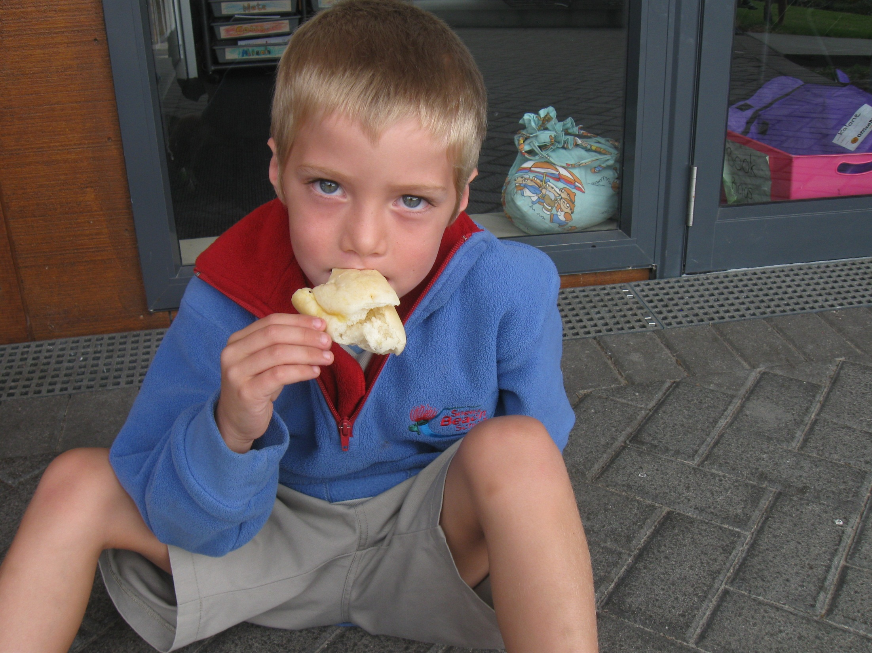
“Here is a cake,” said Jake.
“This is for me!”

Slide 7
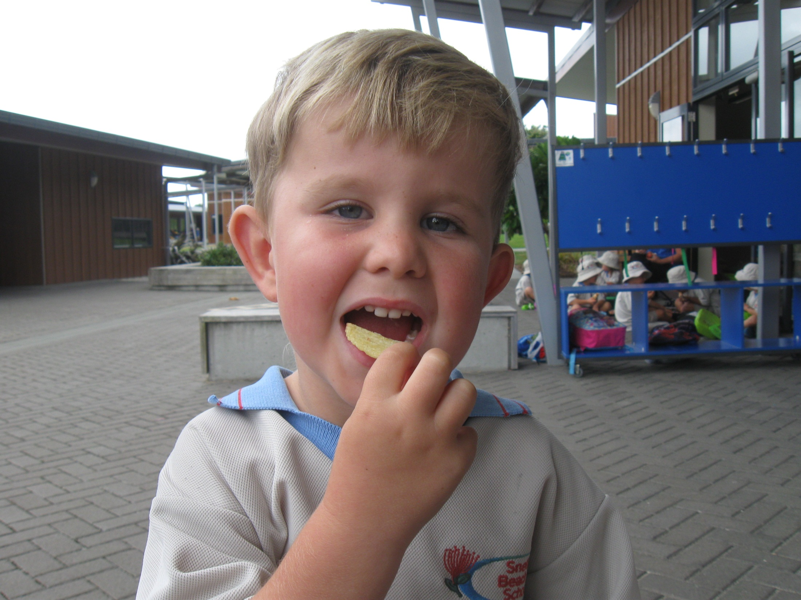
“Here is a chip,” said Casey.
“This is for me!”

Slide 8
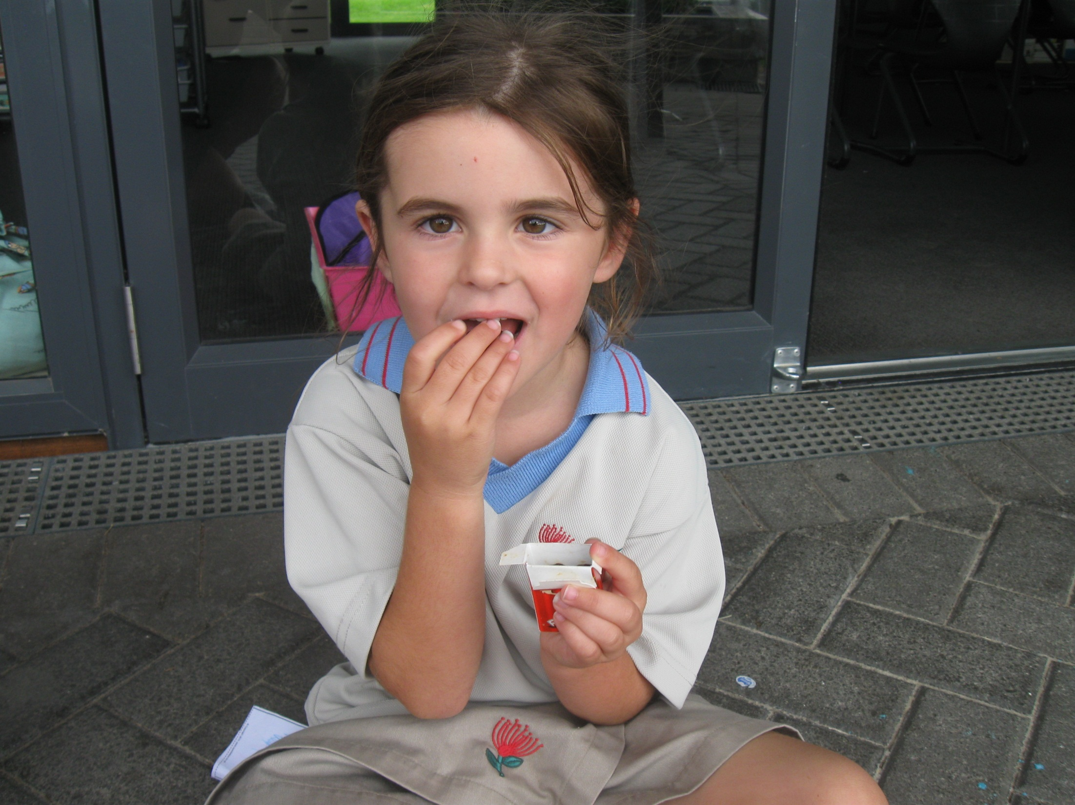
“Here is a raisin,” said Paige.
“This is for me!”

Slide 9
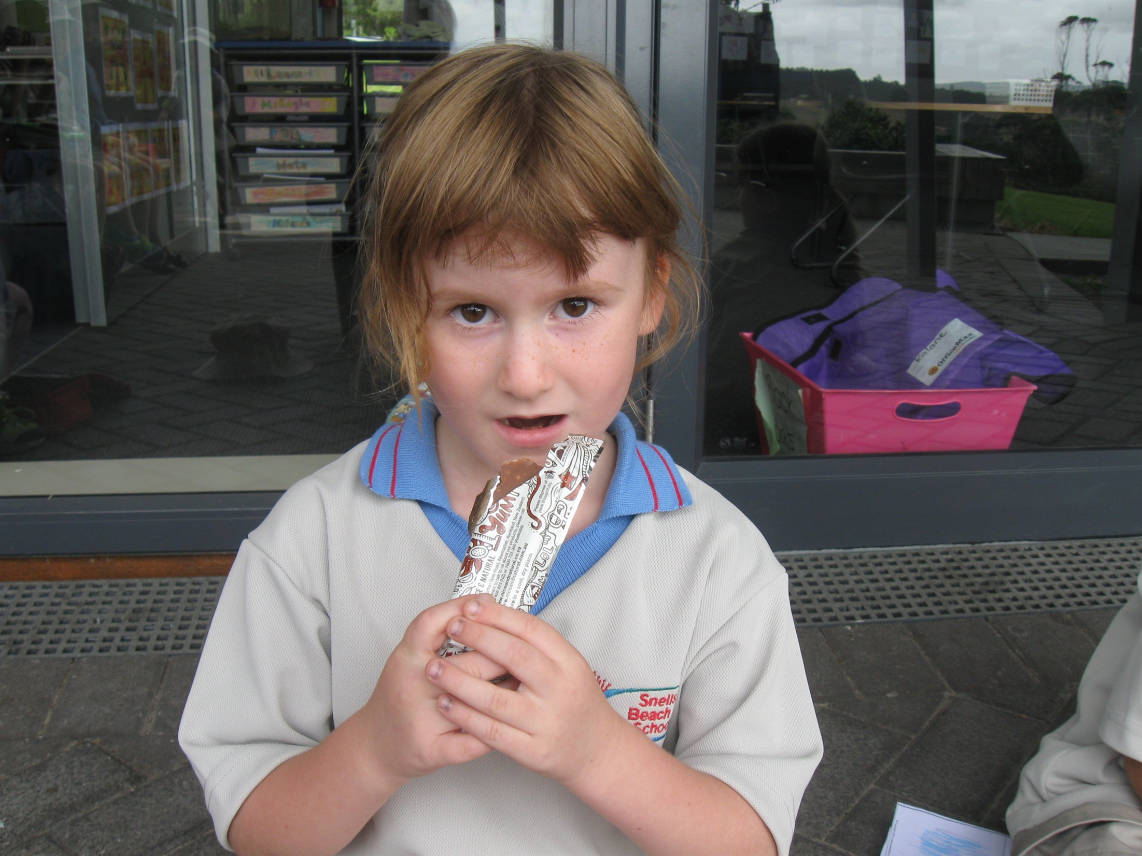
“Here is a museli bar,” said Marie.
“This is for me!”

