Slide 1
Look at our school.
by Kauri 1.

Slide 2
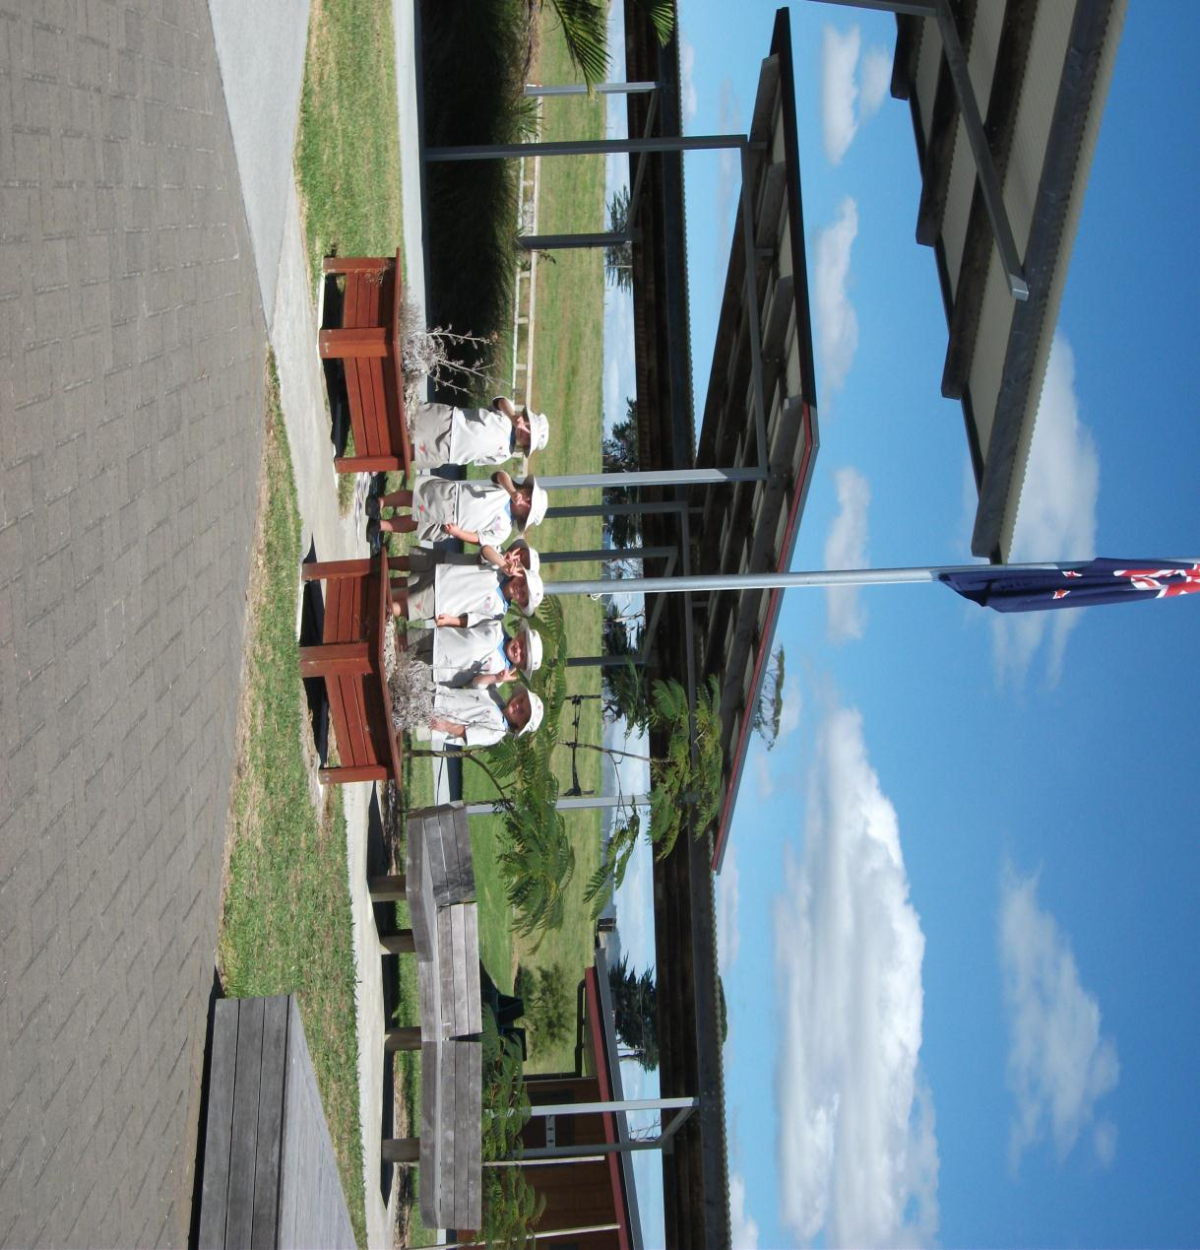
Look at our flagpole.

Slide 3
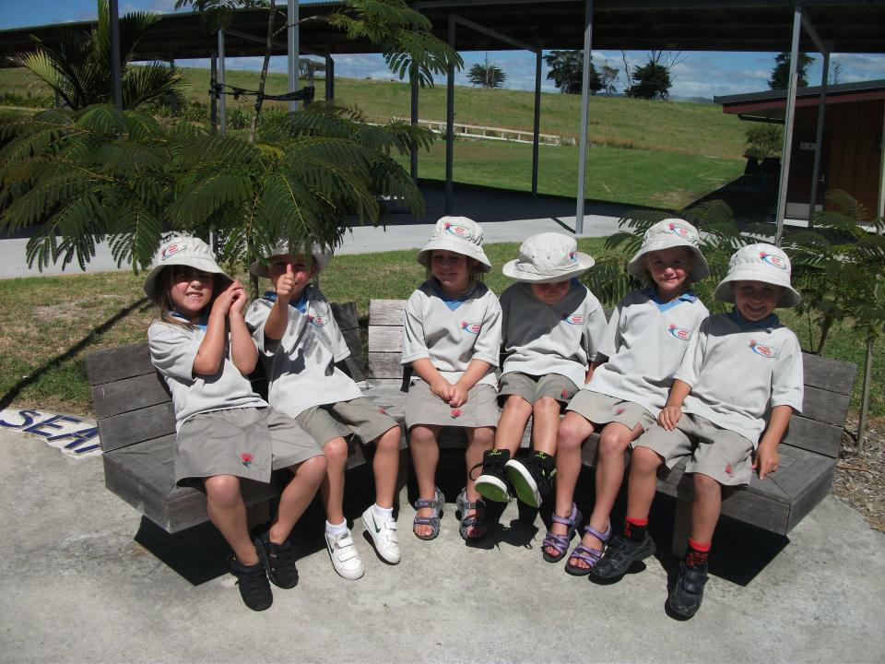
Look at our friendship seat.

Slide 4
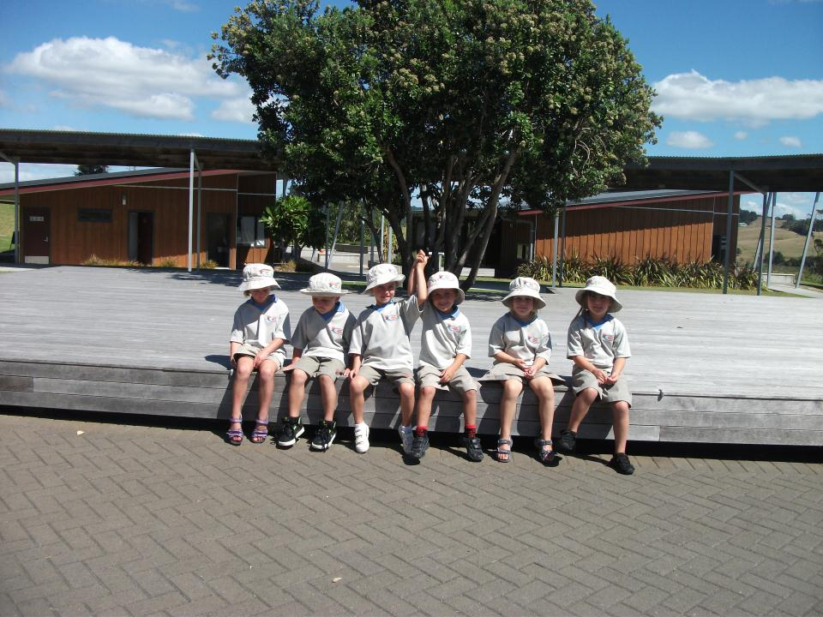
Look at our stage.

Slide 5
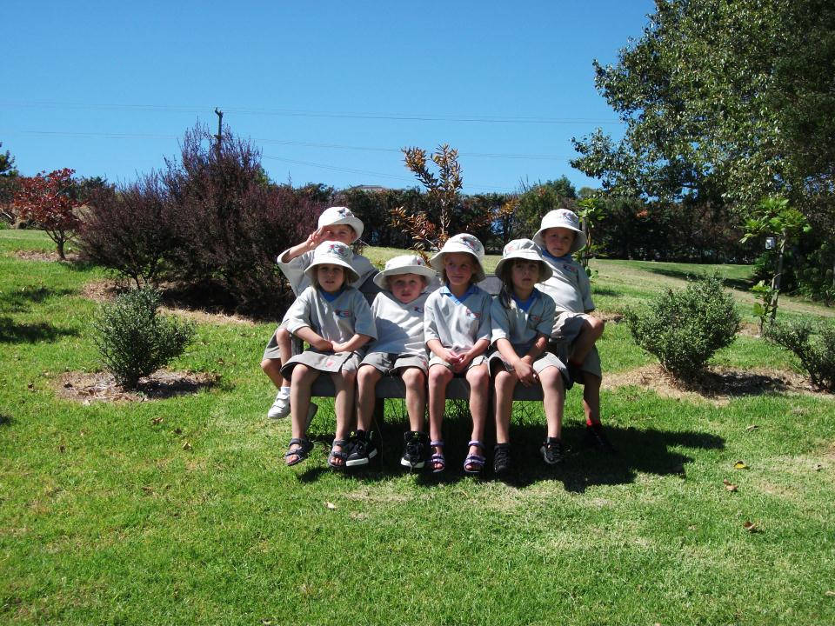
Look at our peaceful seat.

Slide 6
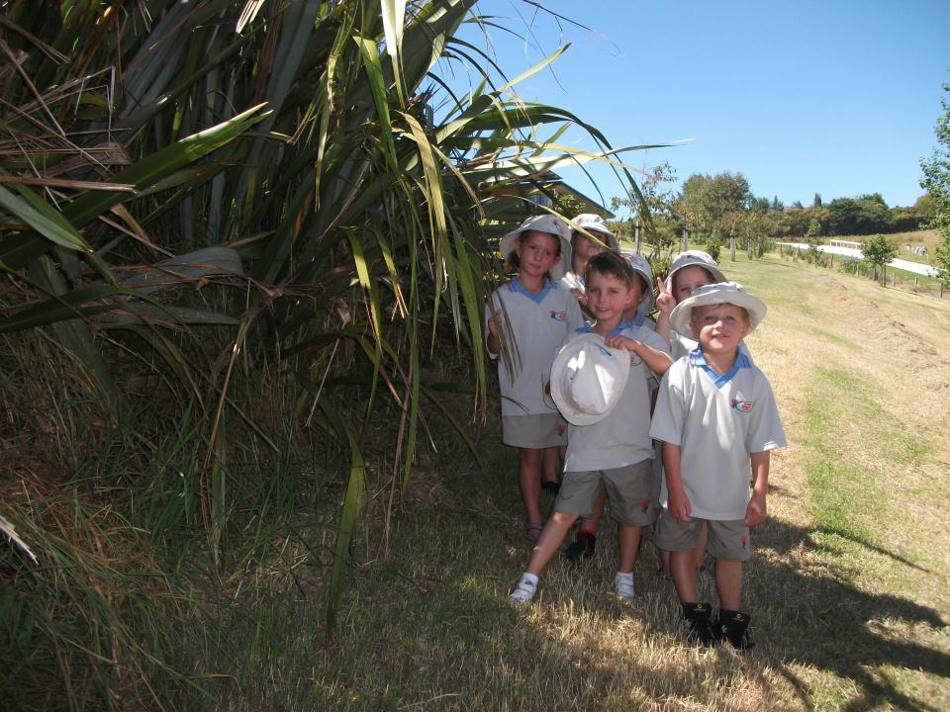
Look at our flax.

Slide 7
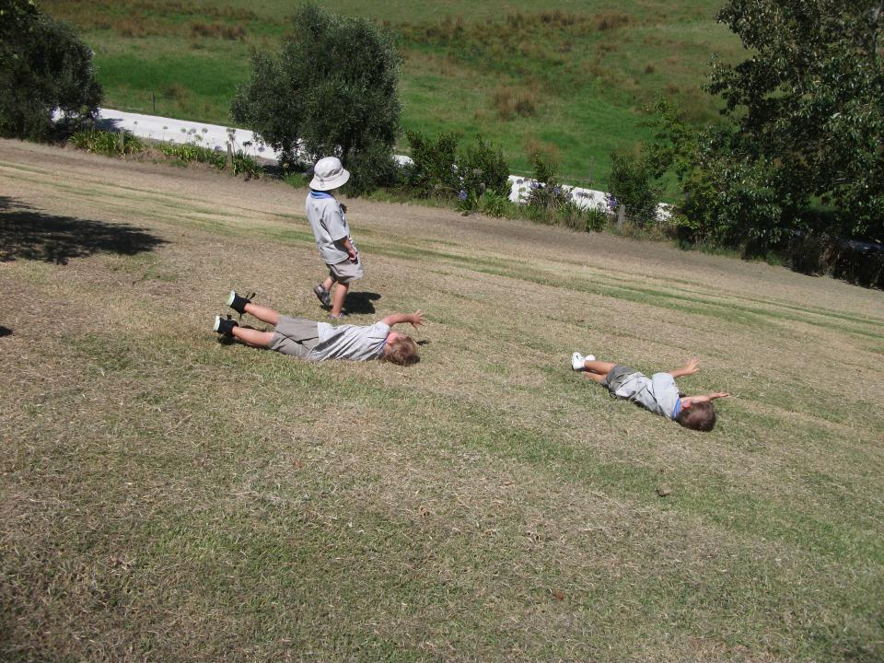
Look at our hill.

Slide 8
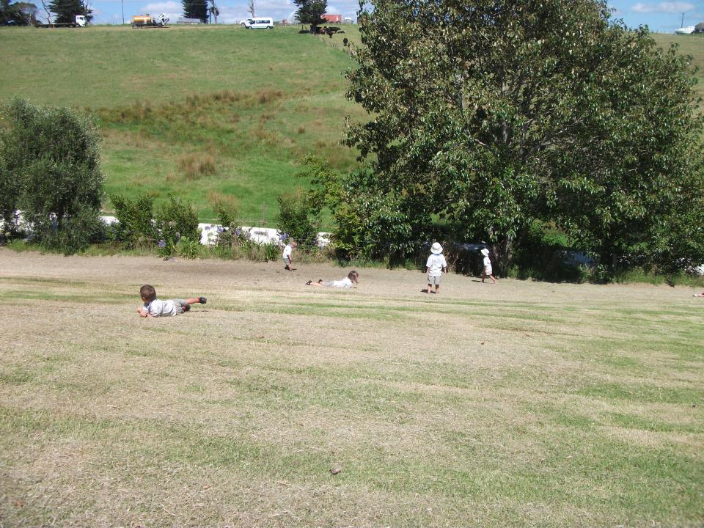
Look at our roly polys.

Slide 9
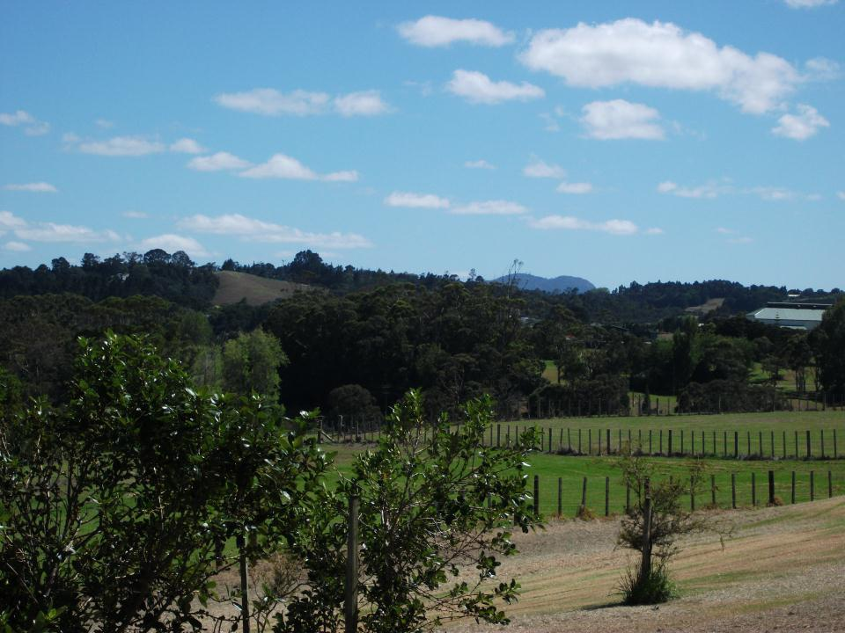
Look at our school mountain.

Slide 10
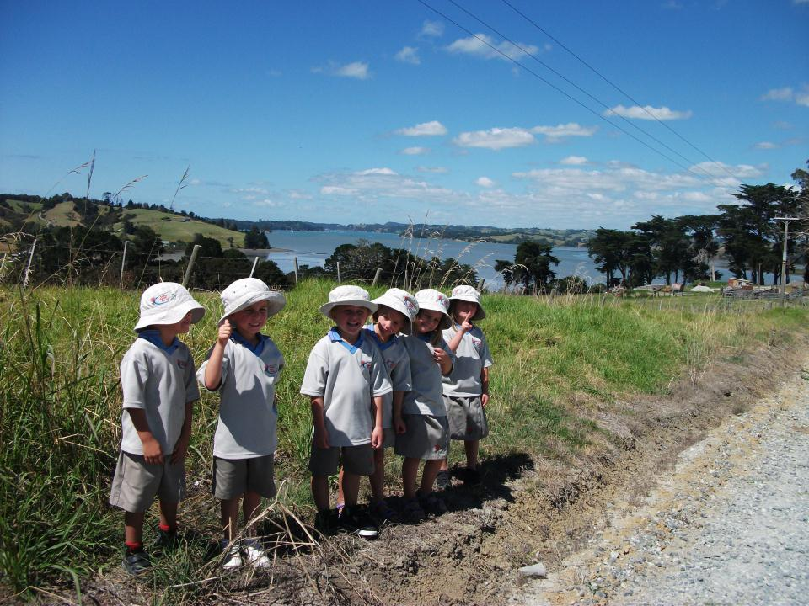
Look at our school river.

