Slide 1
Look At Me
by Kauri 2

Slide 2
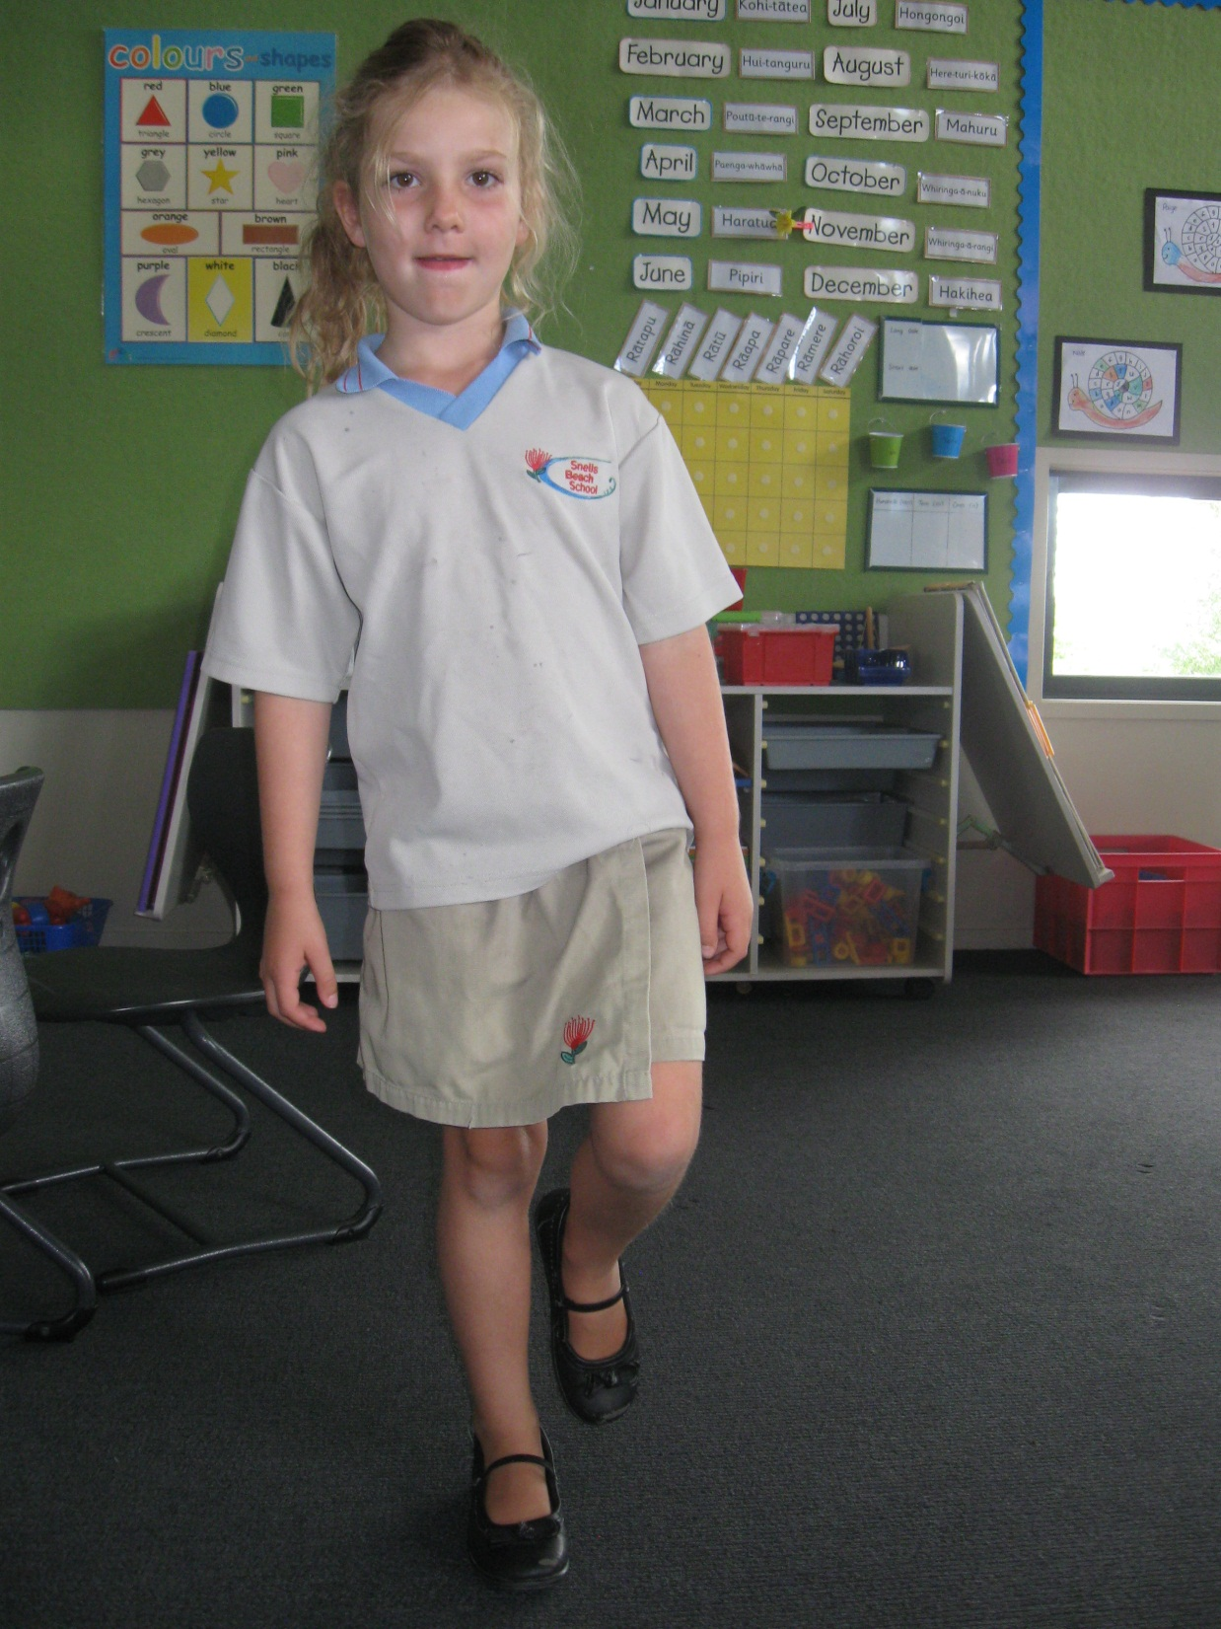
Look at me.
I am hopping.

Slide 3
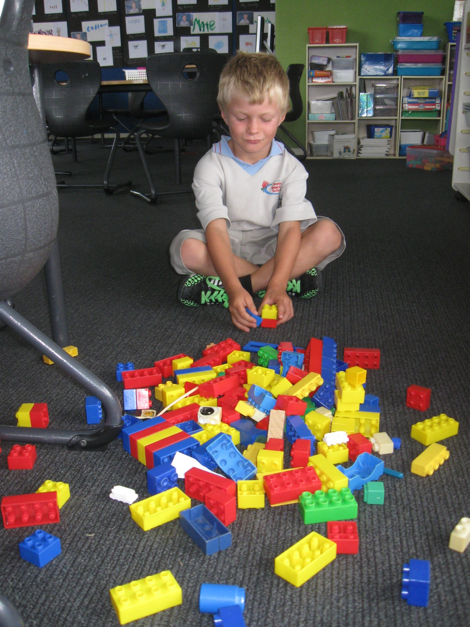
Look at me.
I am building with Lego.

Slide 4
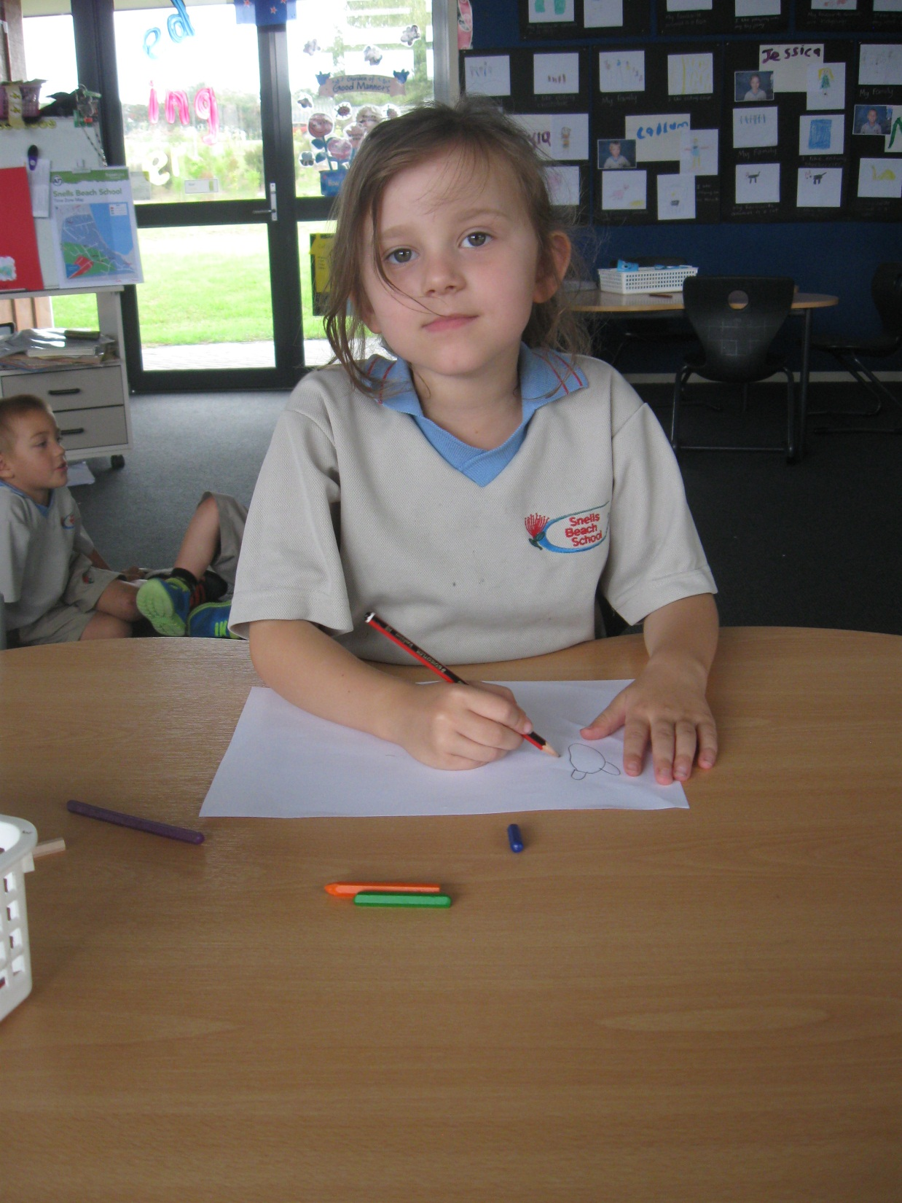
Look at me.
I am drawing.

Slide 5
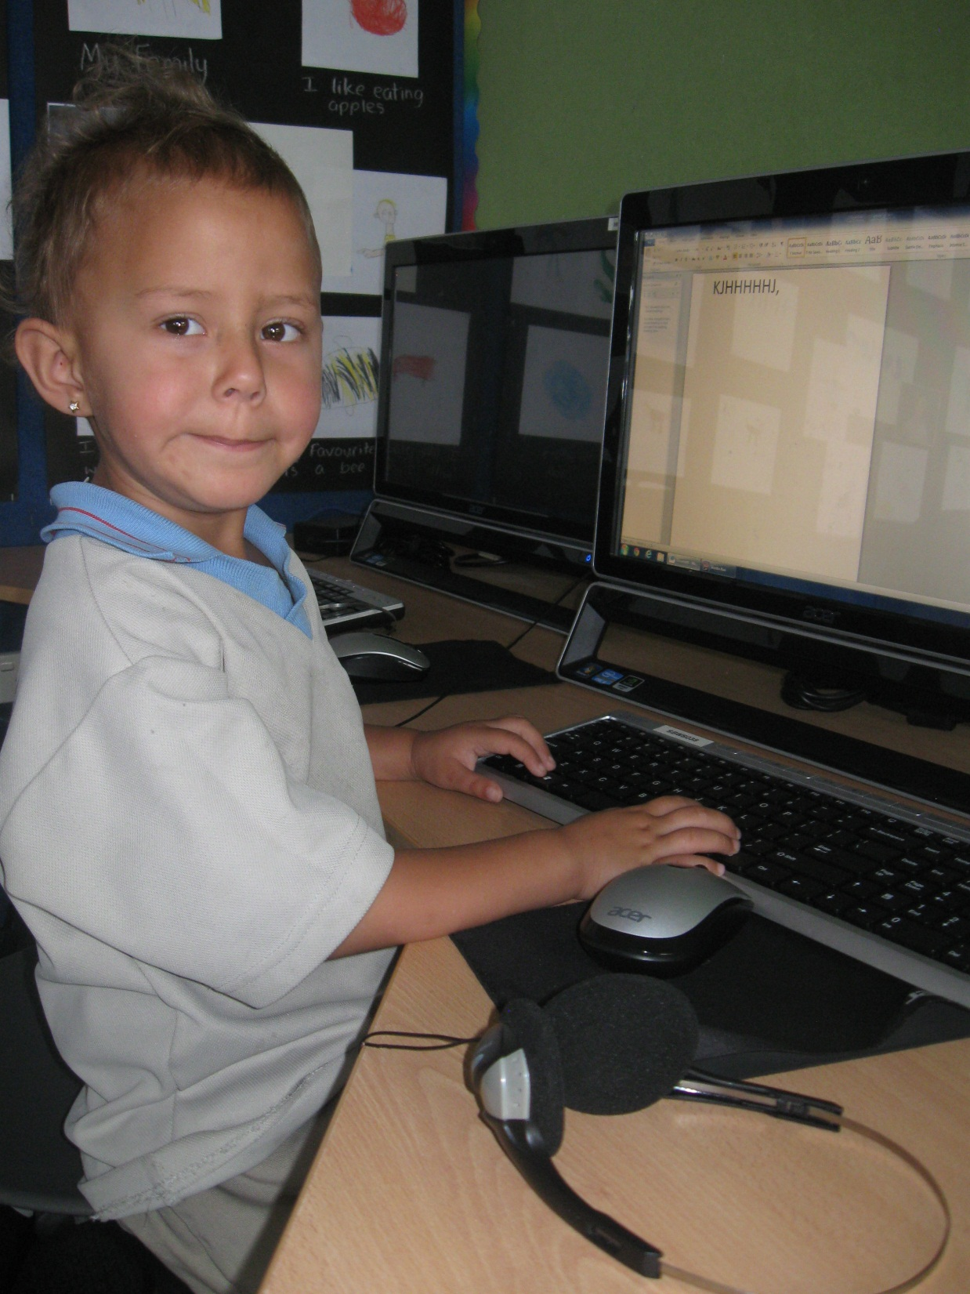
Look at me.
I am typing.

Slide 6
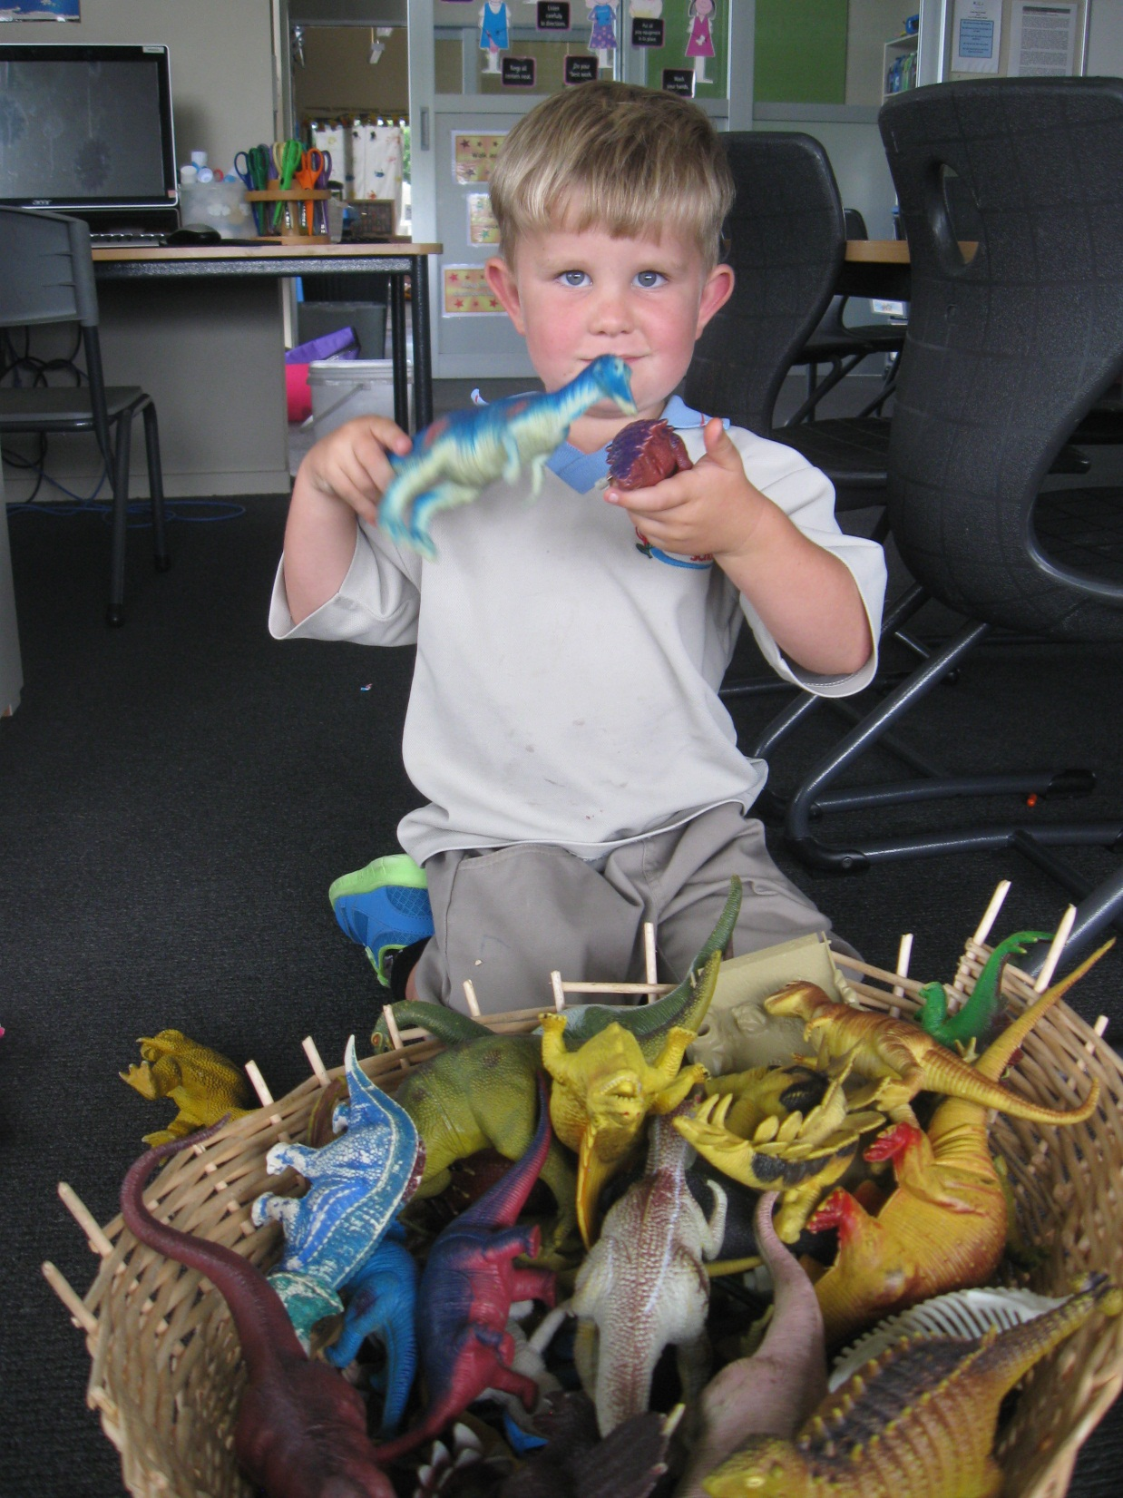
Look at me.
I am playing with dinosaurs.

Slide 7
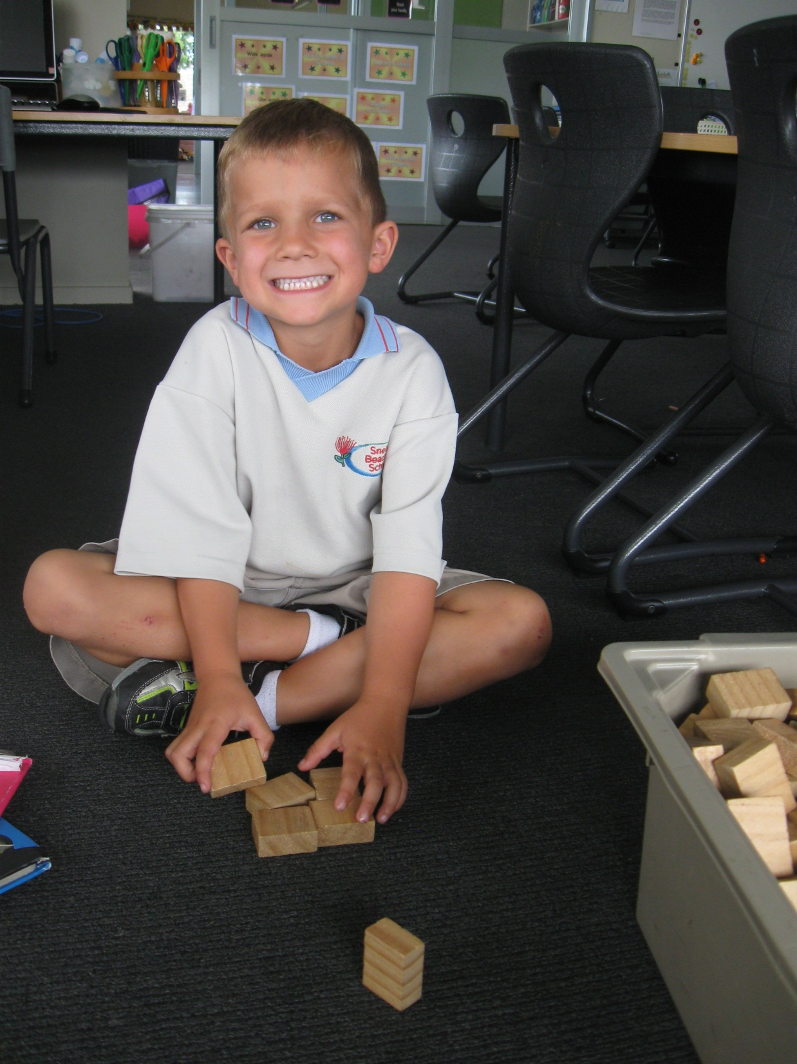
Look at me.
I am playing with blocks.

Slide 8
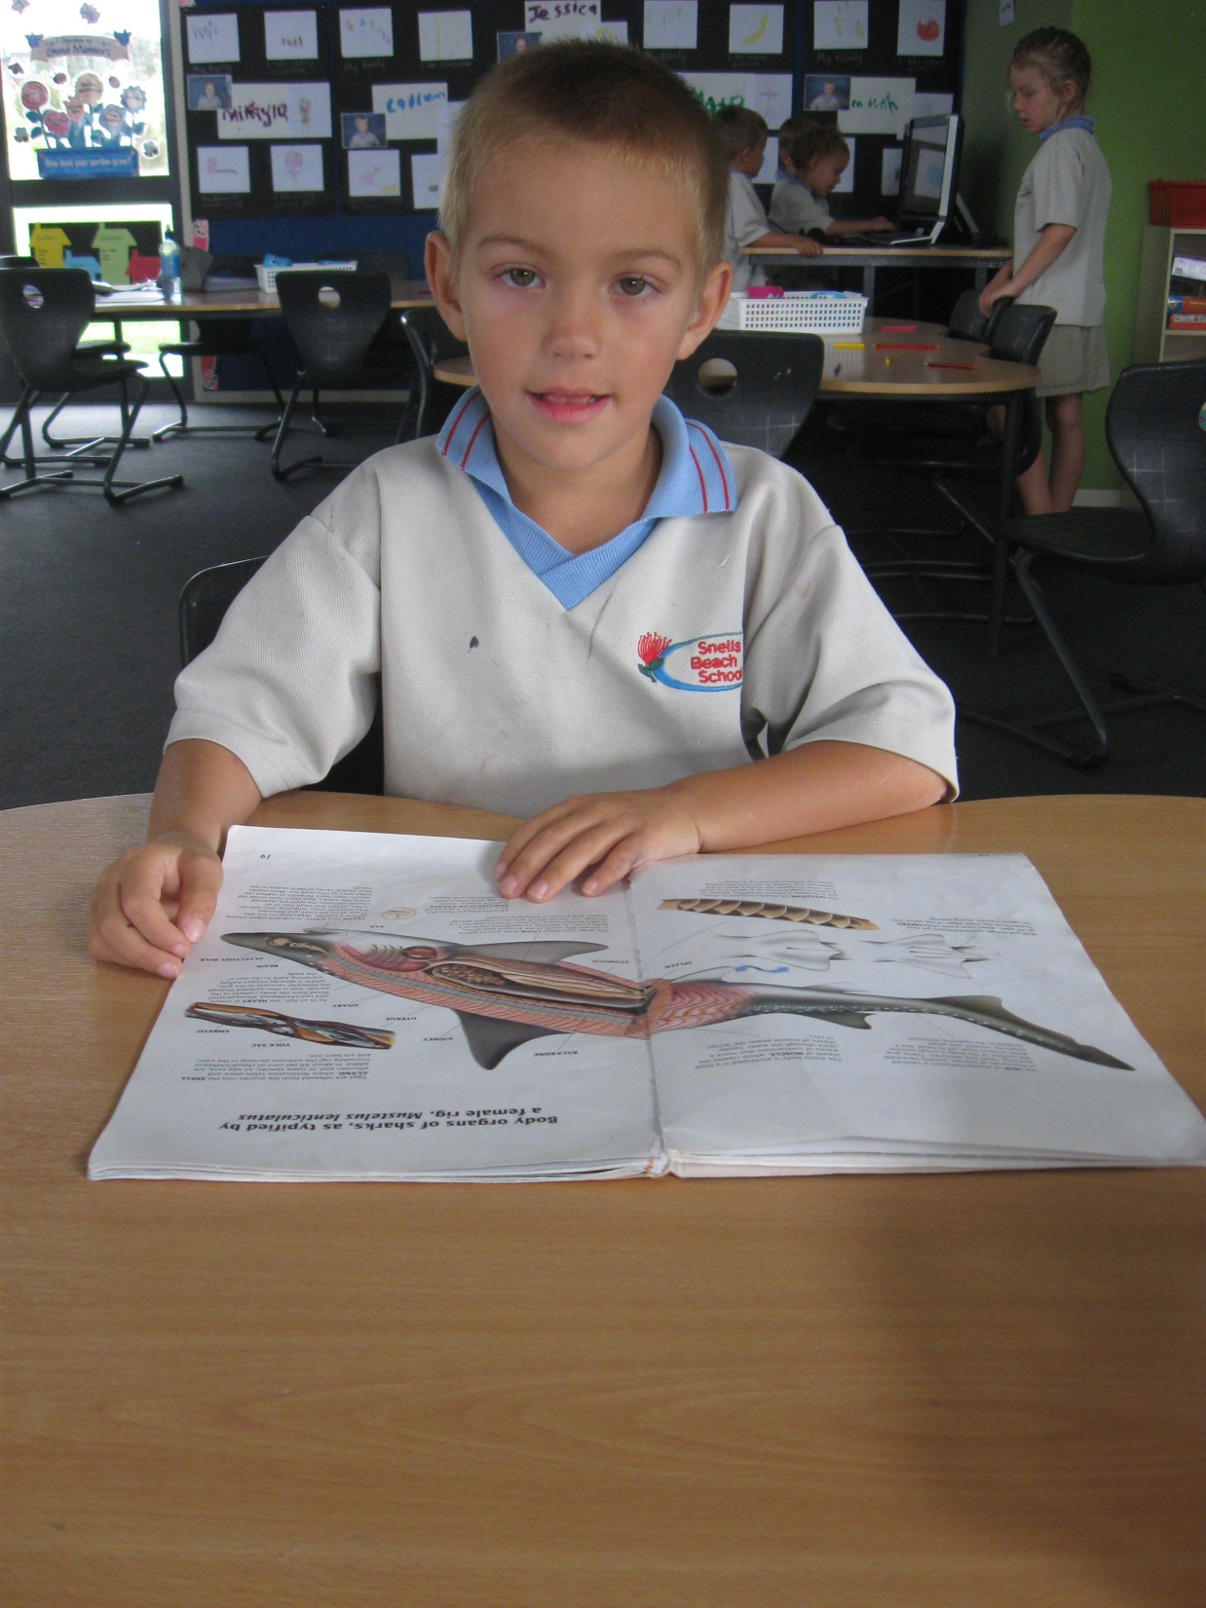
Look at me.
I am reading.

Slide 9
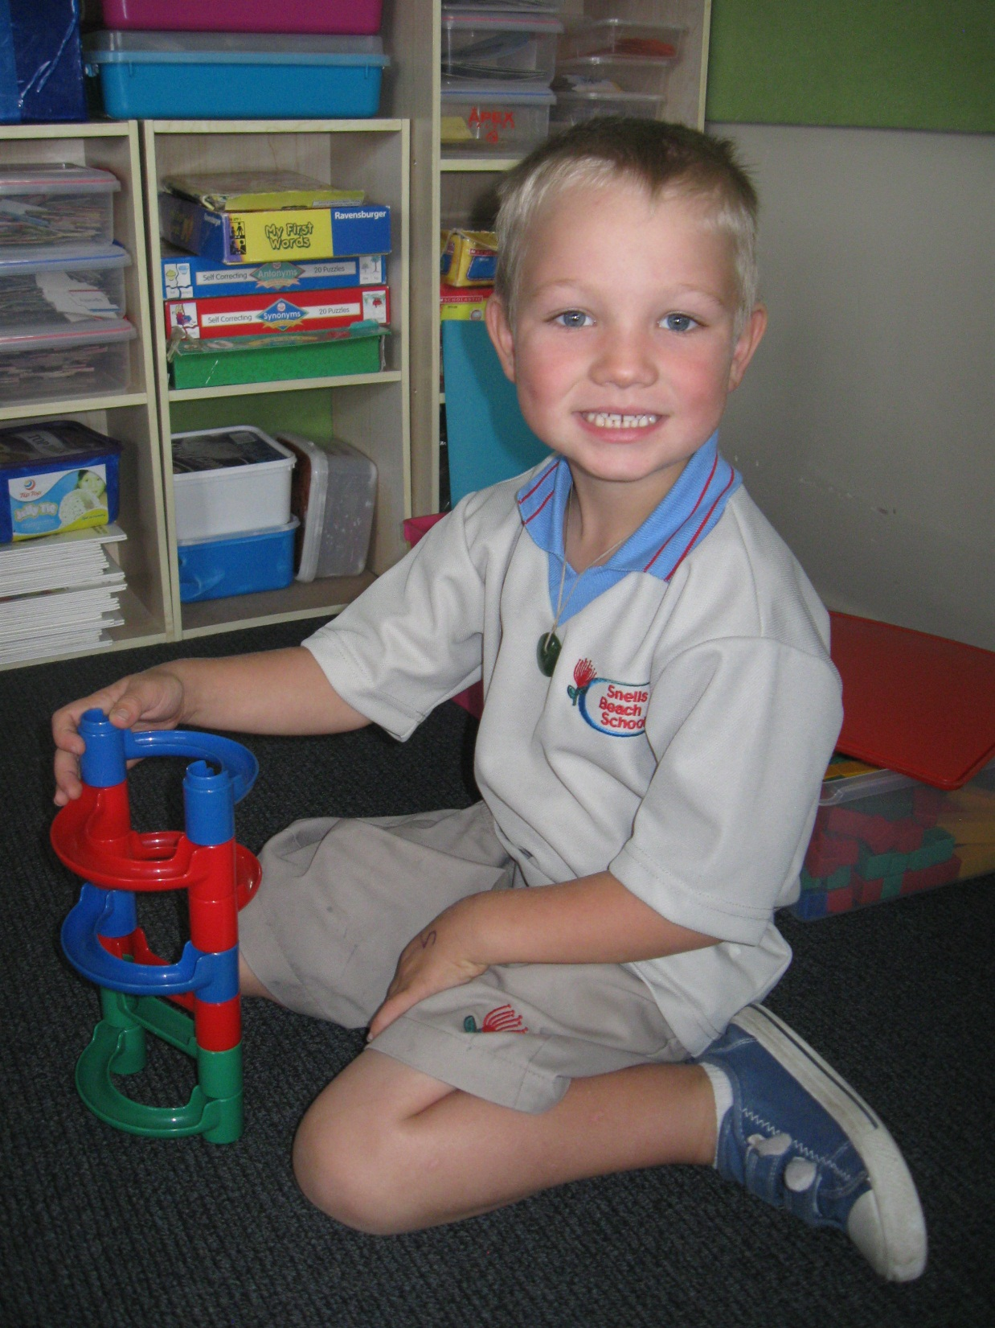
Look at me.
I am building.

Slide 10
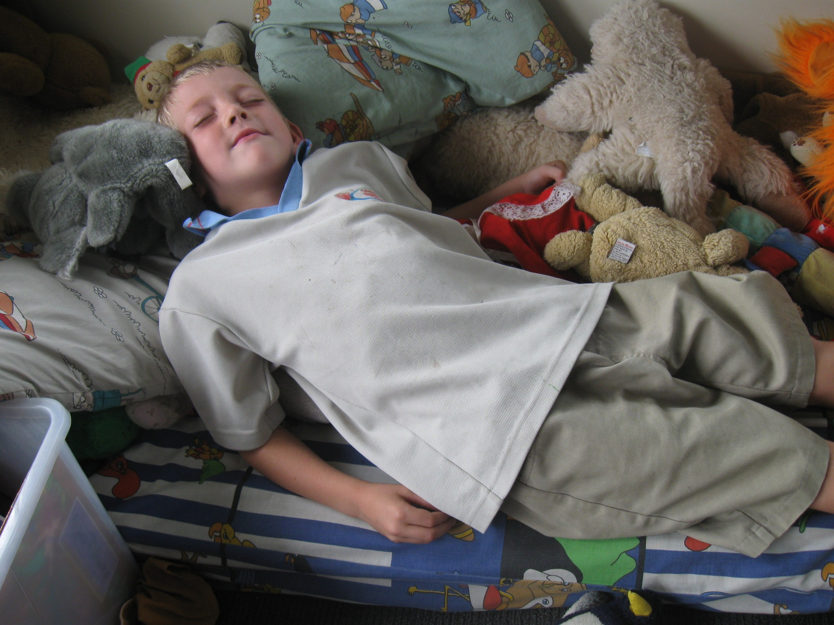
Look at me.
I am sleeping.

