Slide 1
I Can Write
by Kauri 1

Slide 2
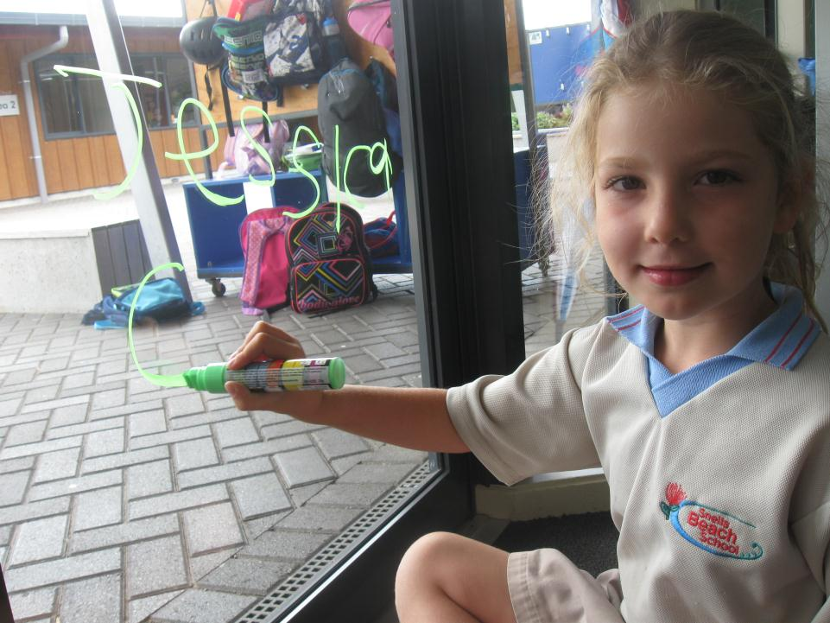
I can write on the window with a glass pen.

Slide 3
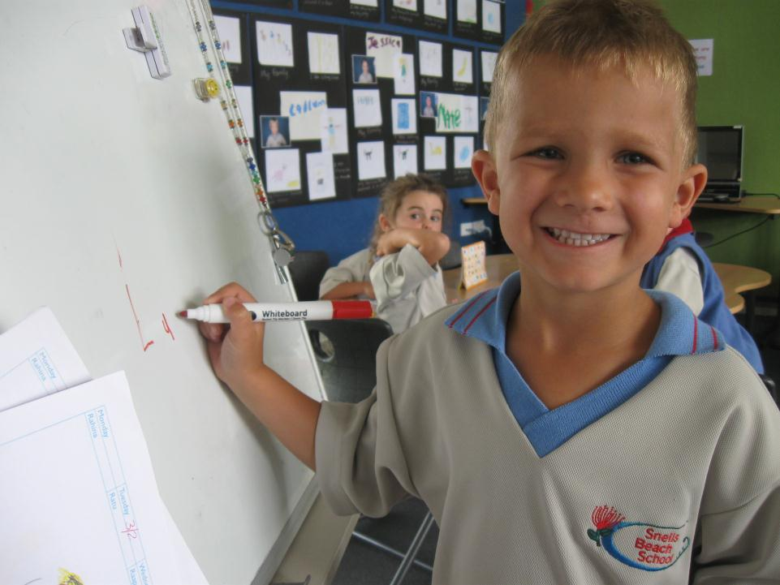
I can write on the whiteboard with a marker.

Slide 4
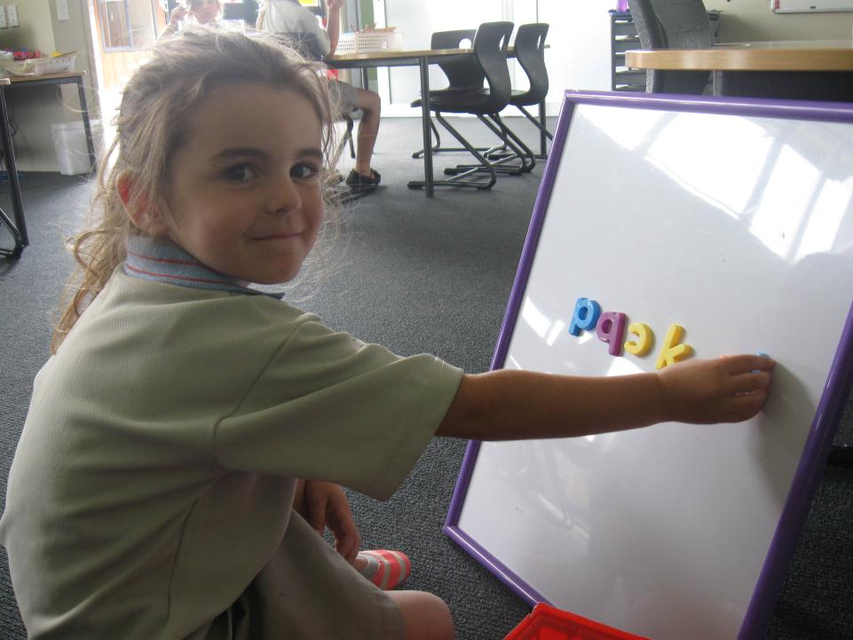
I can write on the magnetic board with magnets.

Slide 5
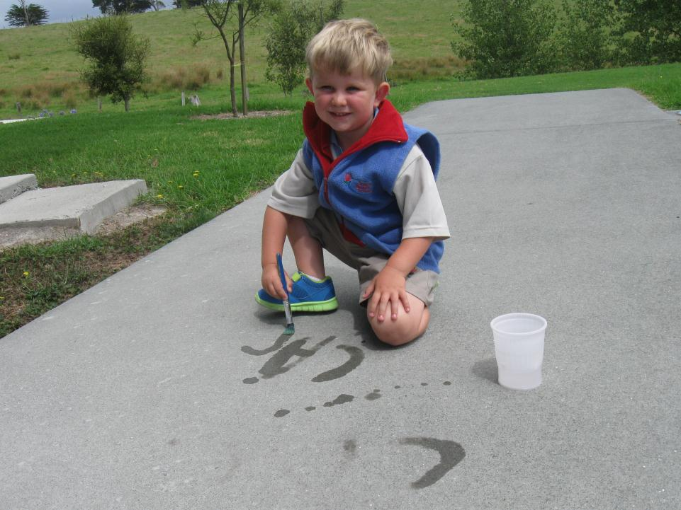
I can write on the path with water.

Slide 6
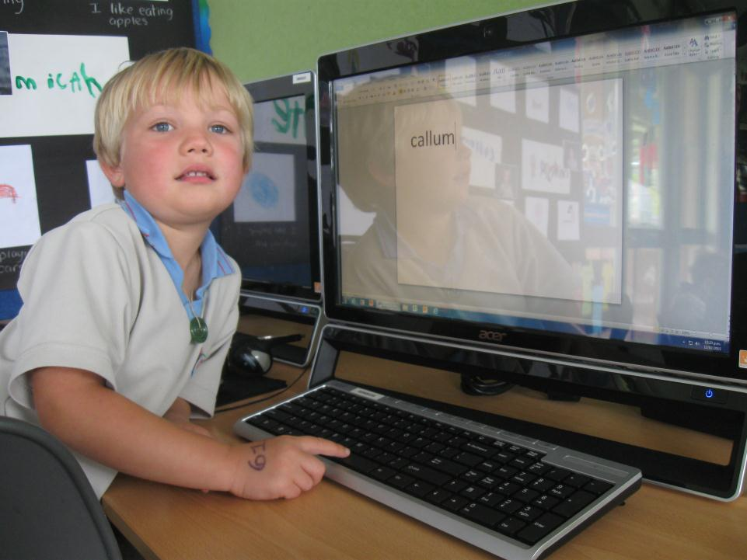
I can write on the computer.

Slide 7
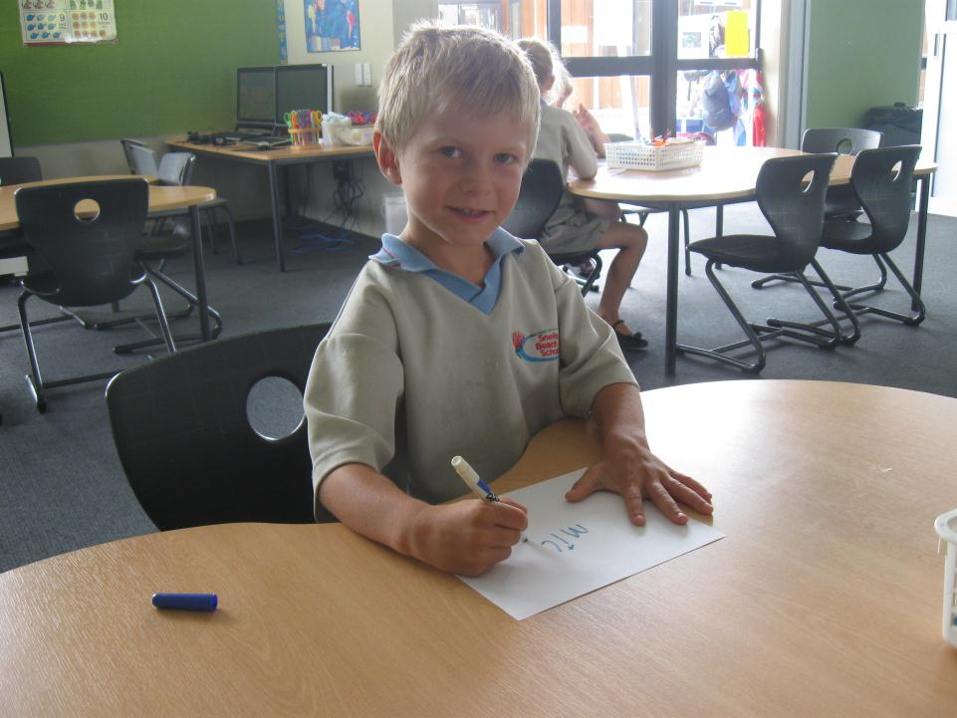
I can write on paper with a pen.

Slide 8
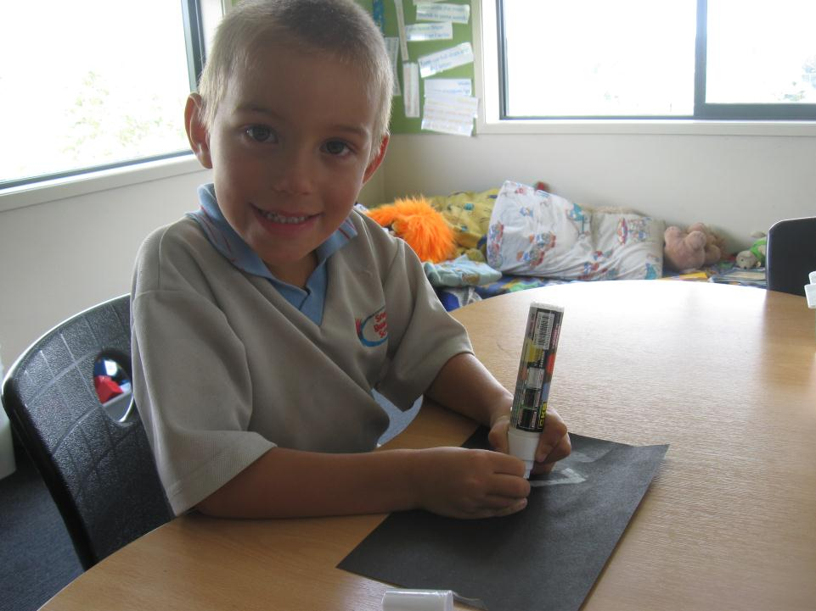
I can write on cardboard with a pen.

Slide 9
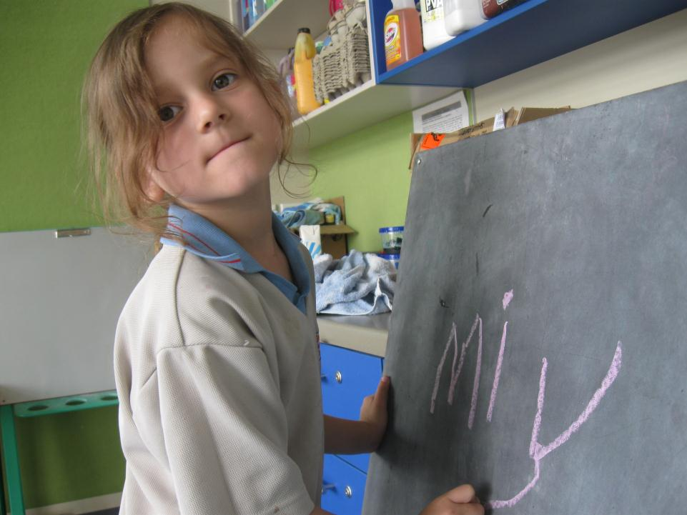
I can write on the blackboard with chalk.

Slide 10
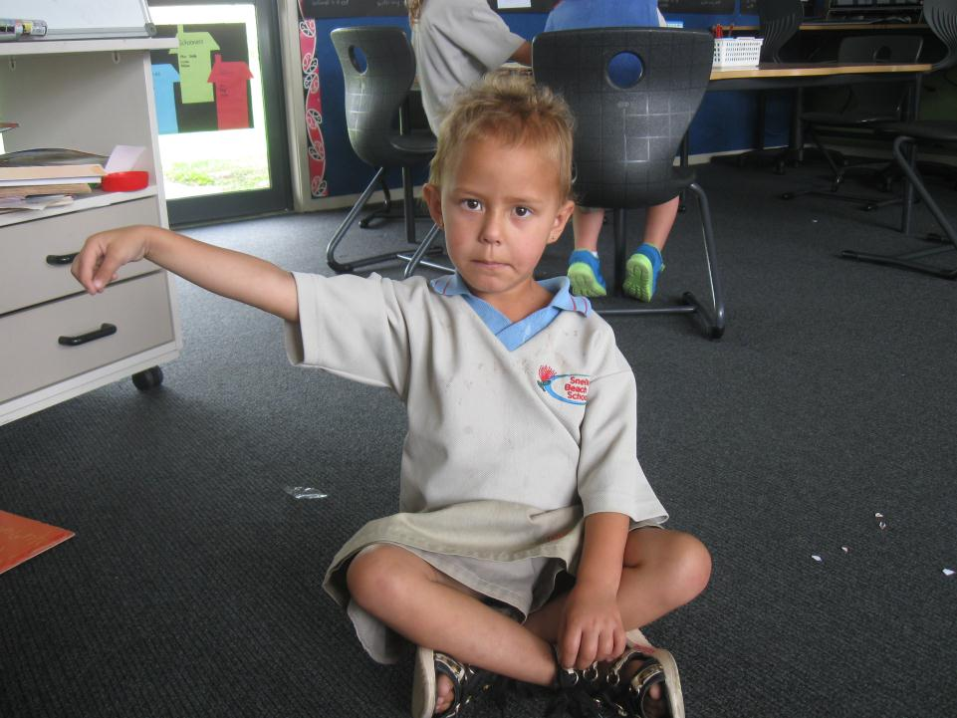
I can write in the air with my finger.

Slide 11
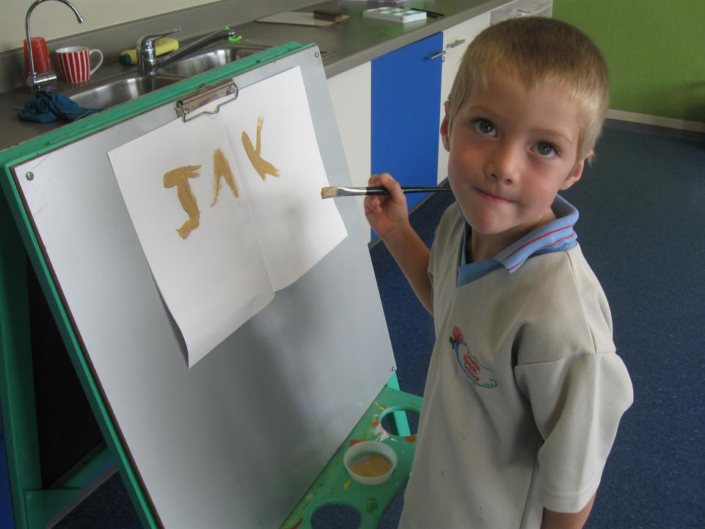
I can write on the easel with paint.

