Slide 1
Kauri 1 is Counting on Christmas.
A Read and Count Story by Kauri 1.

Slide 2
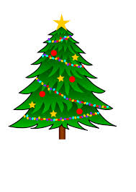
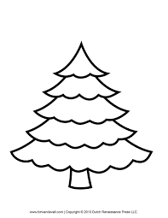
1
Christmas tree

Slide 3
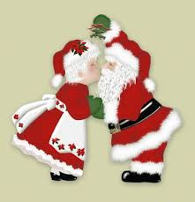
2
Santa Claus

Slide 4
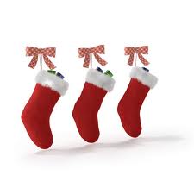
3
Christmas Stockings

Slide 5
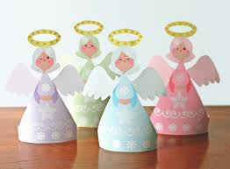
4
Angels

Slide 6
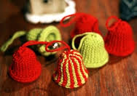
5
Bells

Slide 7
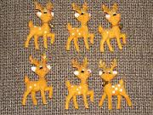
6
Reindeer.

Slide 8
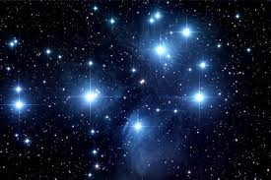
7
Stars

Slide 9
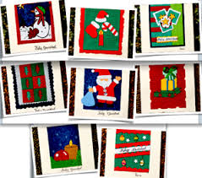
8
Cards

Slide 10
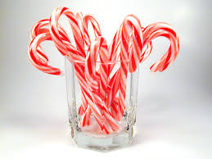
9
Candy canes

Slide 11
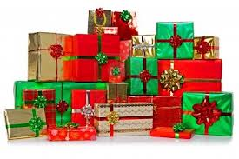
10
Presents

