Slide 1
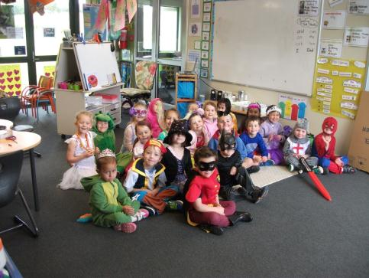
“Smile!” said Mrs Watkin.
by Kauri 1.

Slide 2
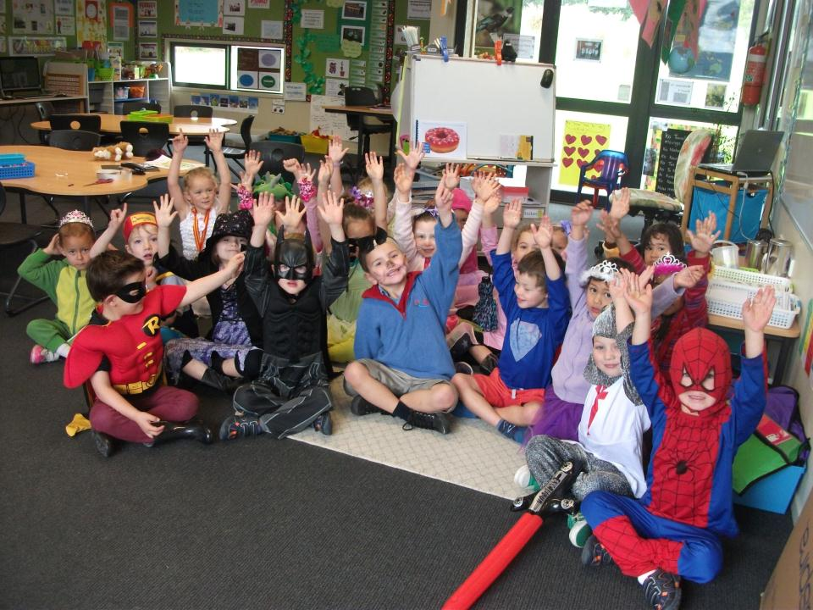
“Smile!” said Mrs Watkin. ‘ Click’

Slide 3
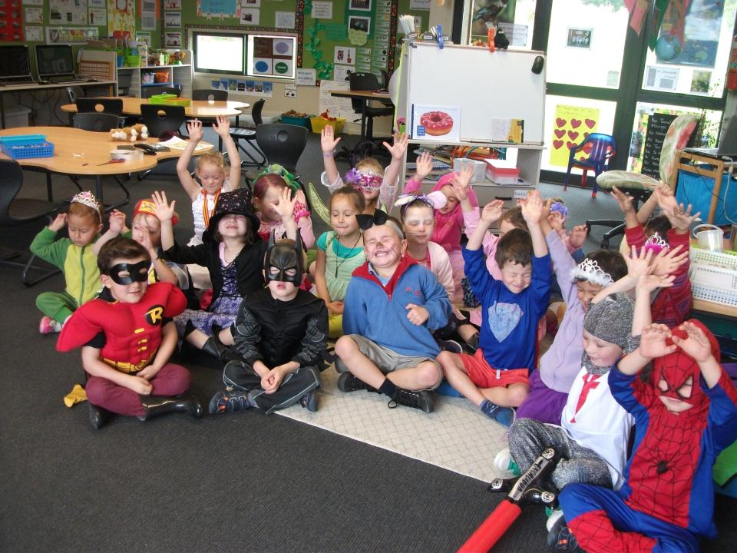
But we had our hands up.

Slide 4
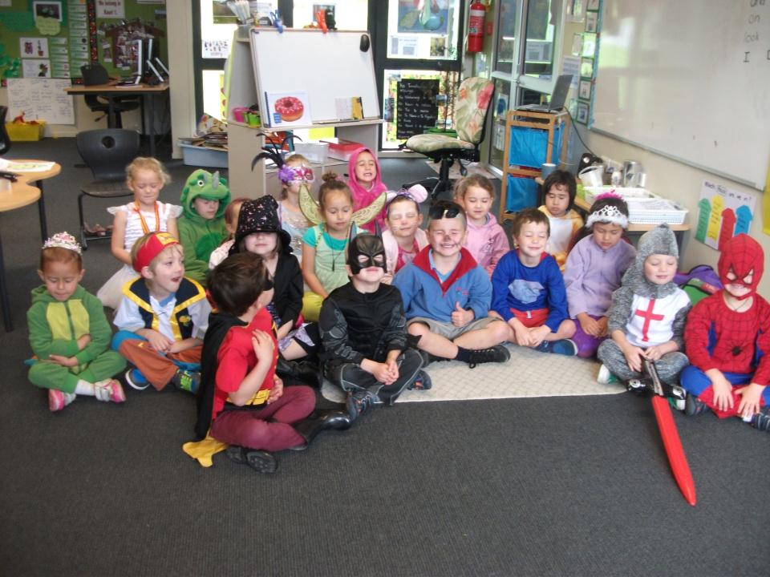
“Smile!” said Mrs Watkin. Click
But we had our eyes shut.

Slide 5
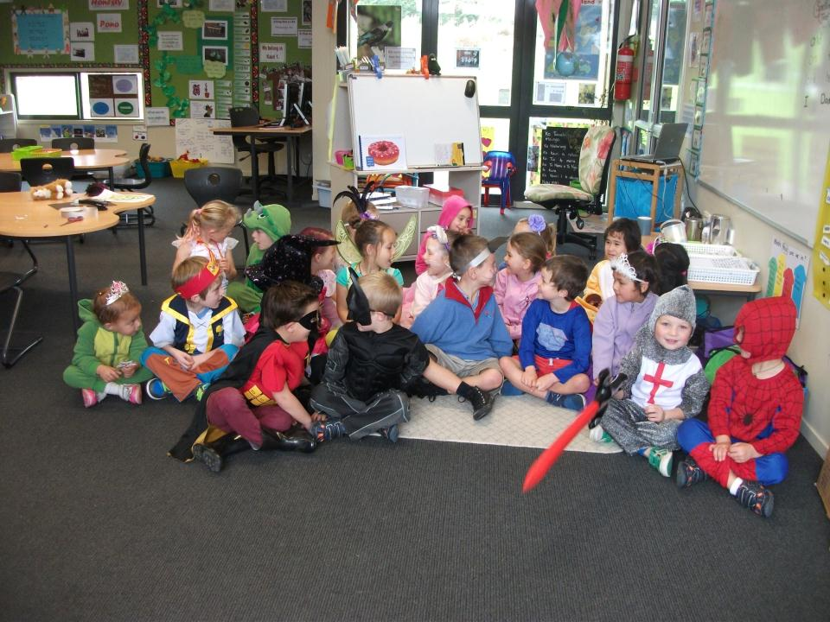
“Smile!” Said Mrs Watkin. Click.

Slide 6
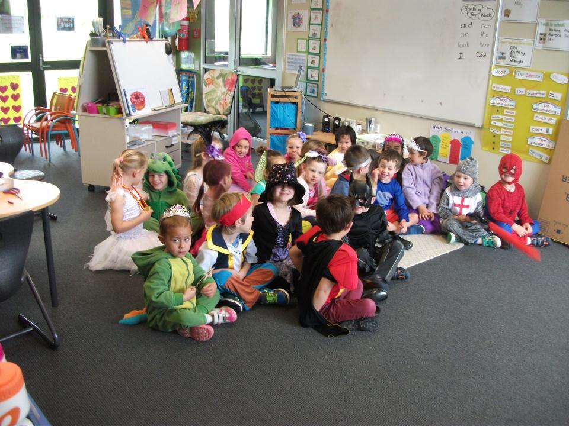
But we were talking to our friends.

Slide 7
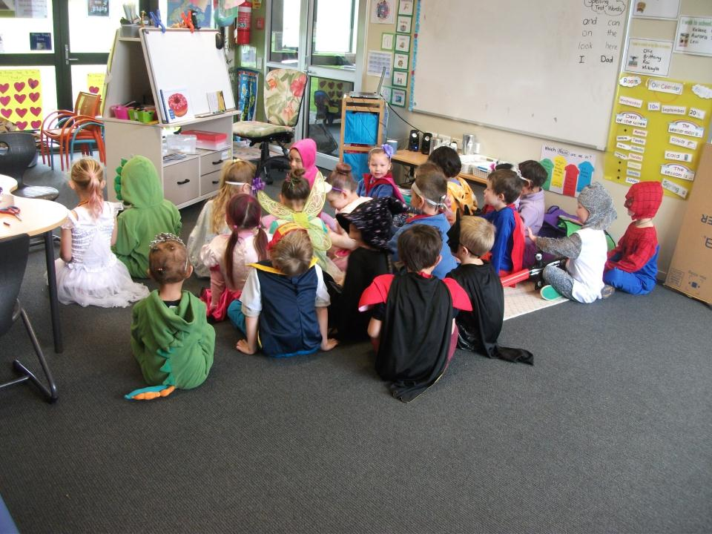
“Smile!” said Mrs Watkin. Click.
But we had our backs turned.

Slide 8
“Smile!” said Mrs Watkin.
What a beautiful photo .

Slide 9
