Slide 1
The Tiger who came to Morning Tea.
By
Kauri1

Slide 2
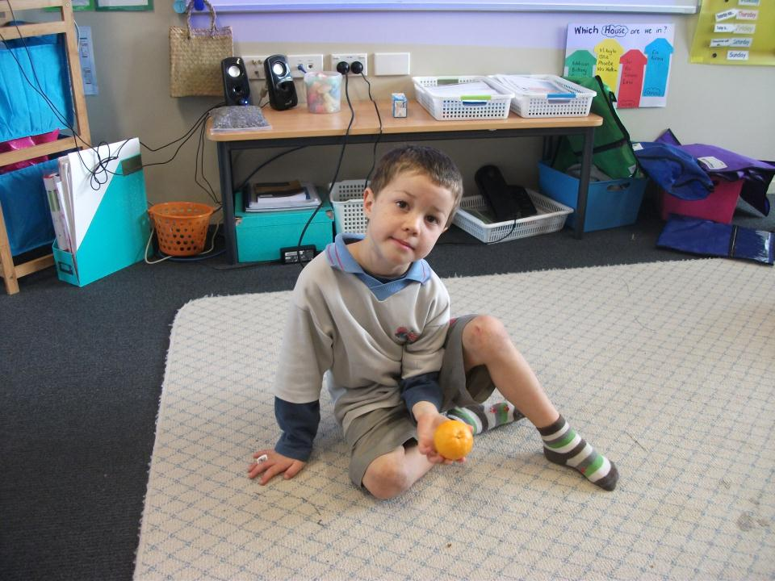
The orange.
Gobble , gobble.

Slide 3
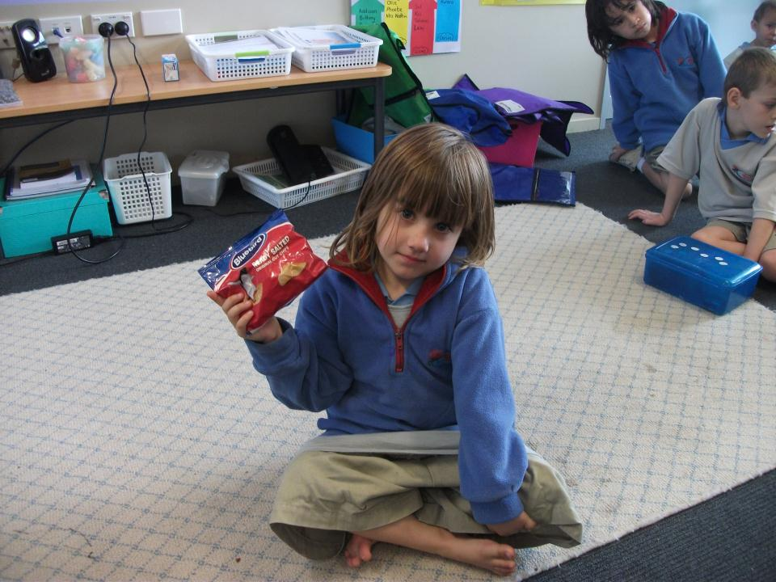
The chips.
Gobble , gobble.

Slide 4
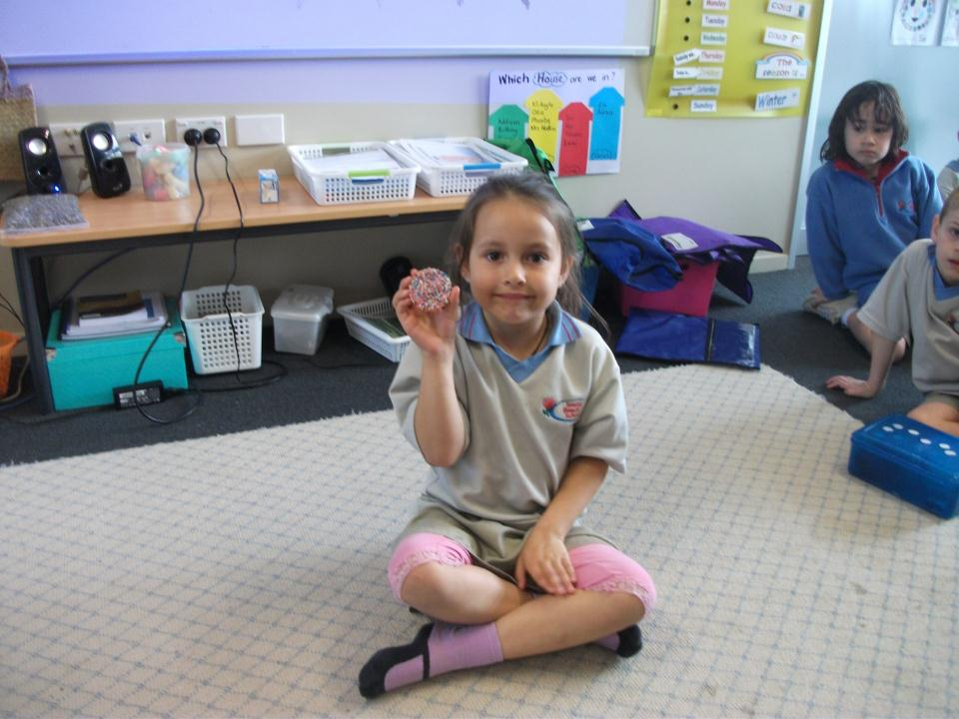
The sprinkles.
Gobble, gobble.

Slide 5
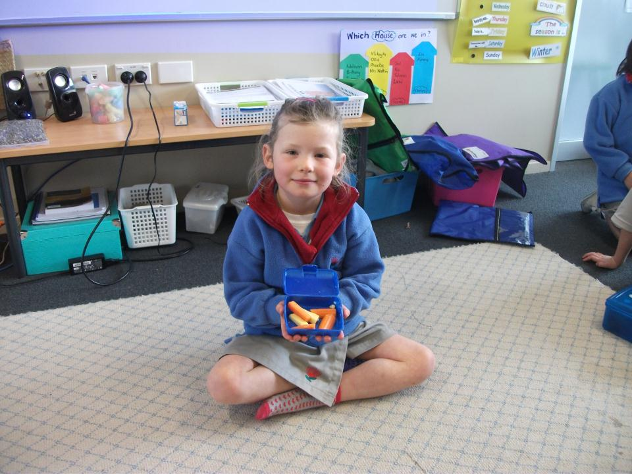
The cheese and carrots.
Gobble, gobble.

Slide 6
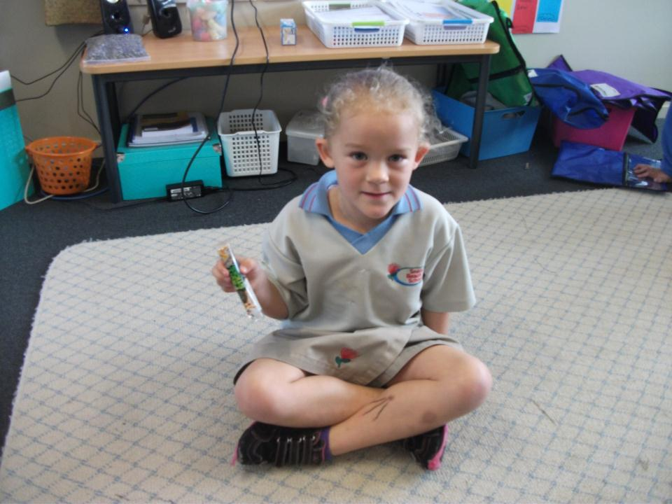
The bar.
Gobble, gobble.

Slide 7
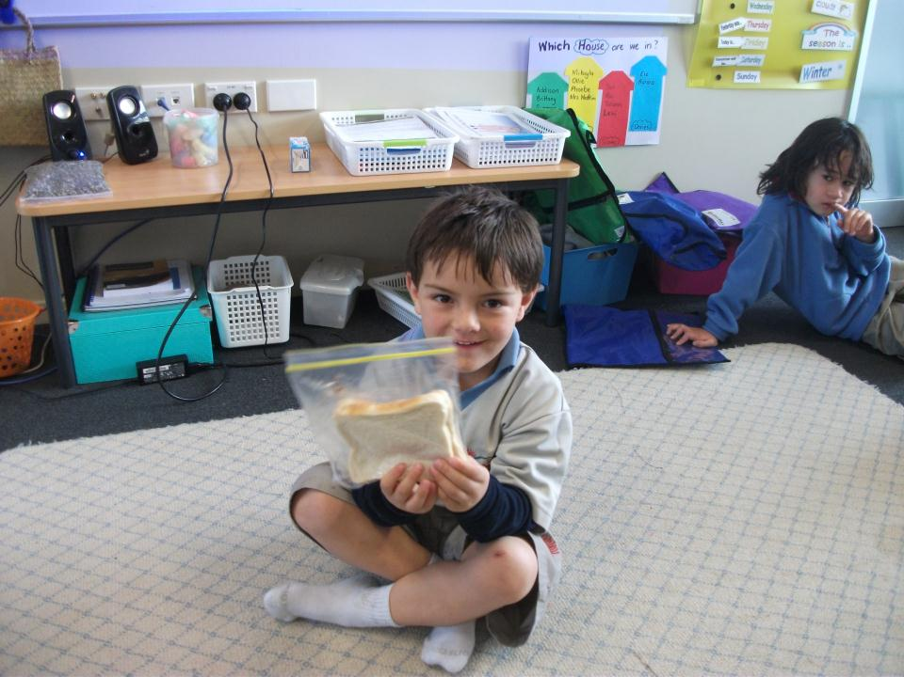
The sandwiches.
Gobble, gobble.

Slide 8
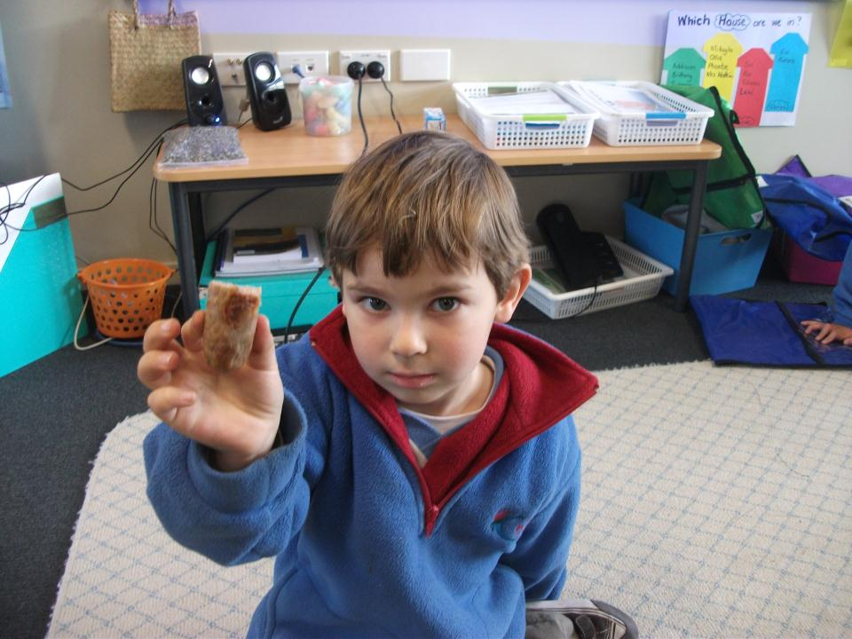
The sausage.
Gobble, gobble.

Slide 9
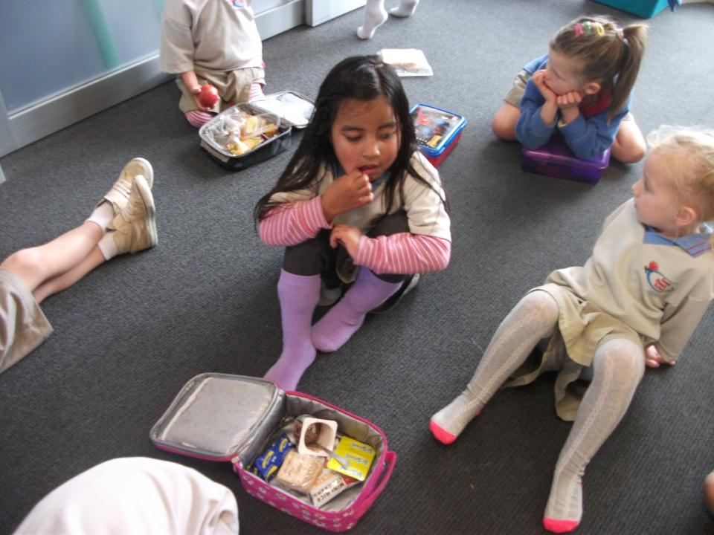
The yogurt.
Gobble, gobble.

Slide 10
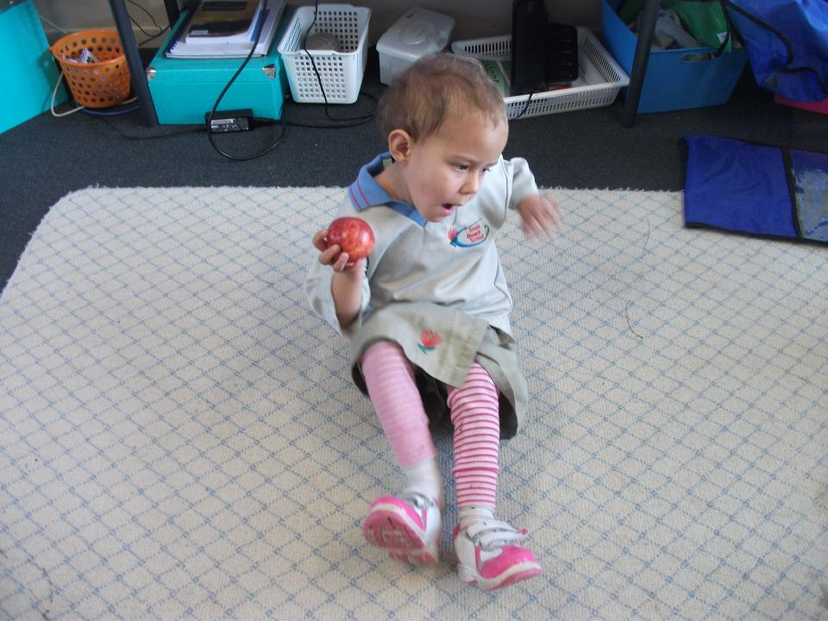
The apple.
Gobble, gobble.

Slide 11
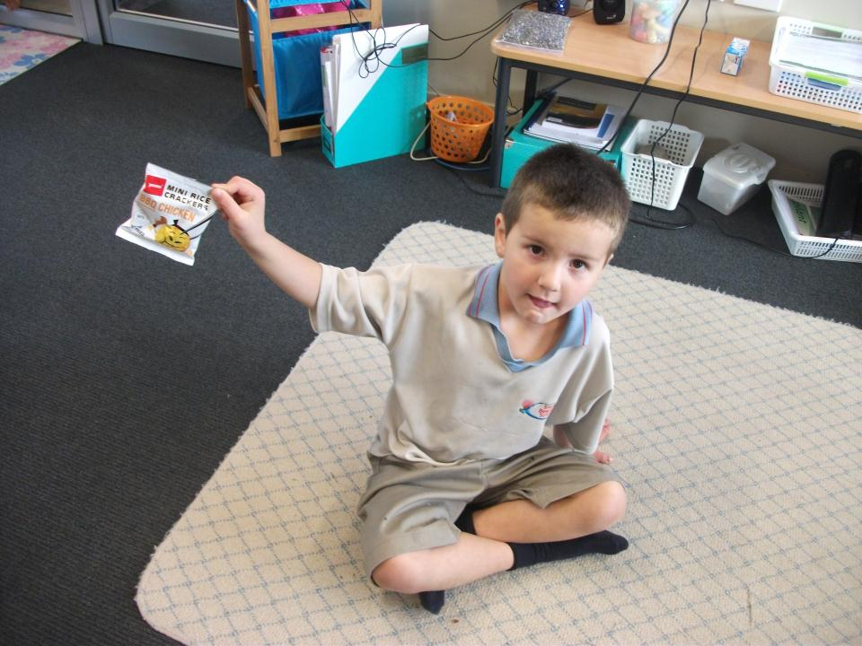
The crackers. Gobble, gobble.

Slide 12
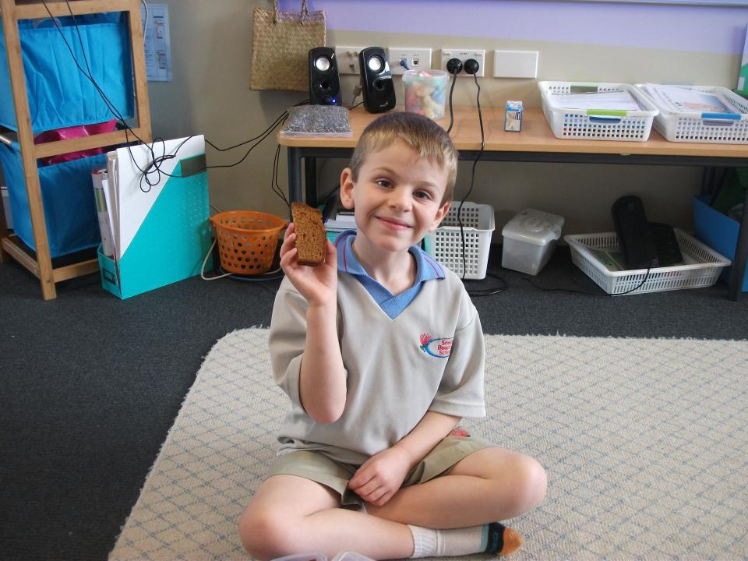
The cake.
Gobble, gobble.

Slide 13
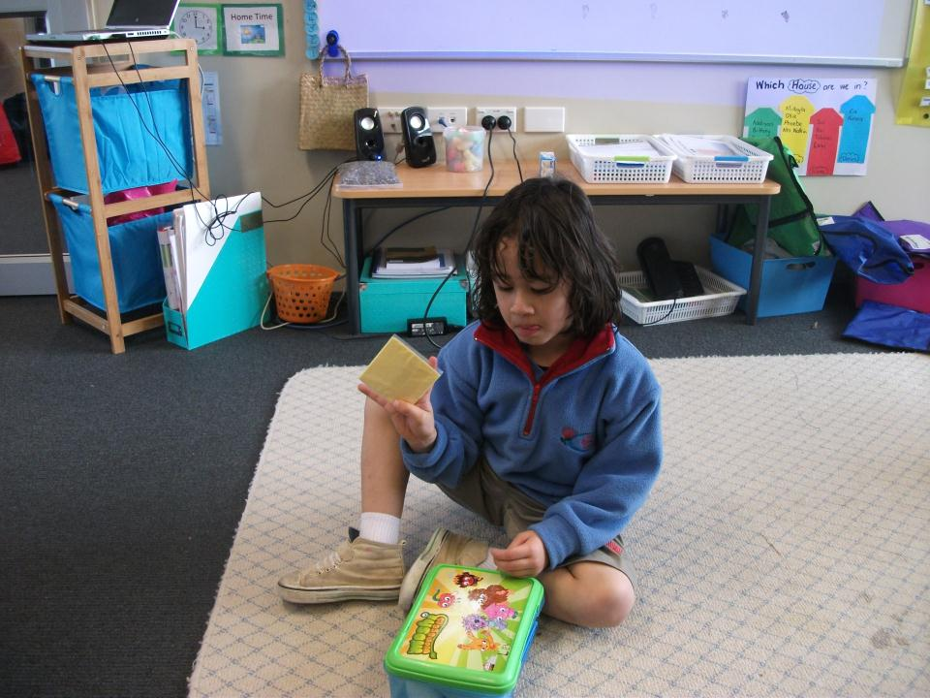
The cheese slice.
Gobble, gobble.

Slide 14
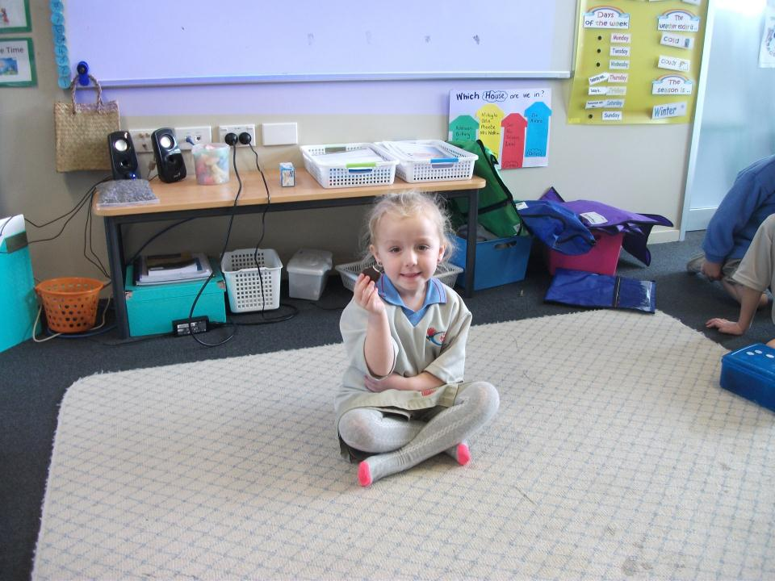
The biscuit.
Gobble, gobble.

Slide 15
Oh, you greedy tiger!

