Slide 1
Kauri 1 baked cupcakes together.
Here are some photos to show what awesome cooks we are.

Slide 2
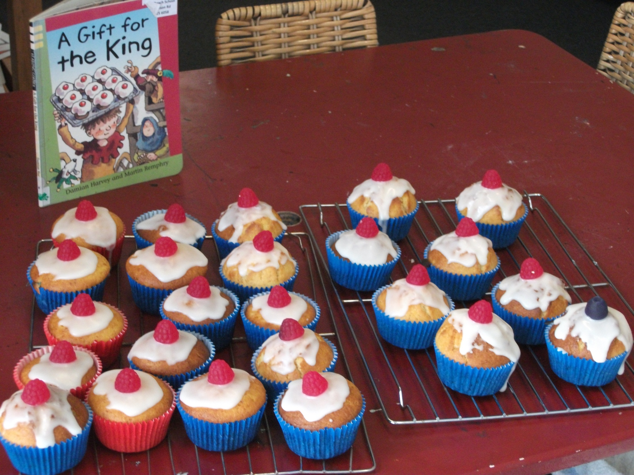

Slide 3
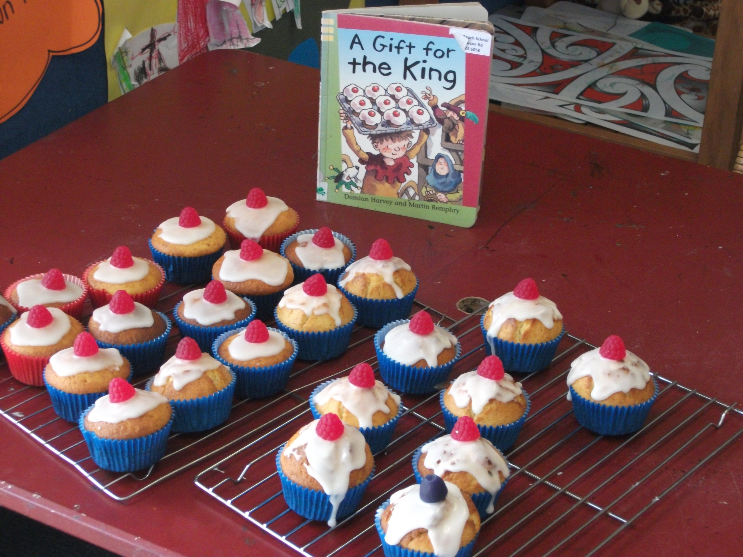

Slide 4
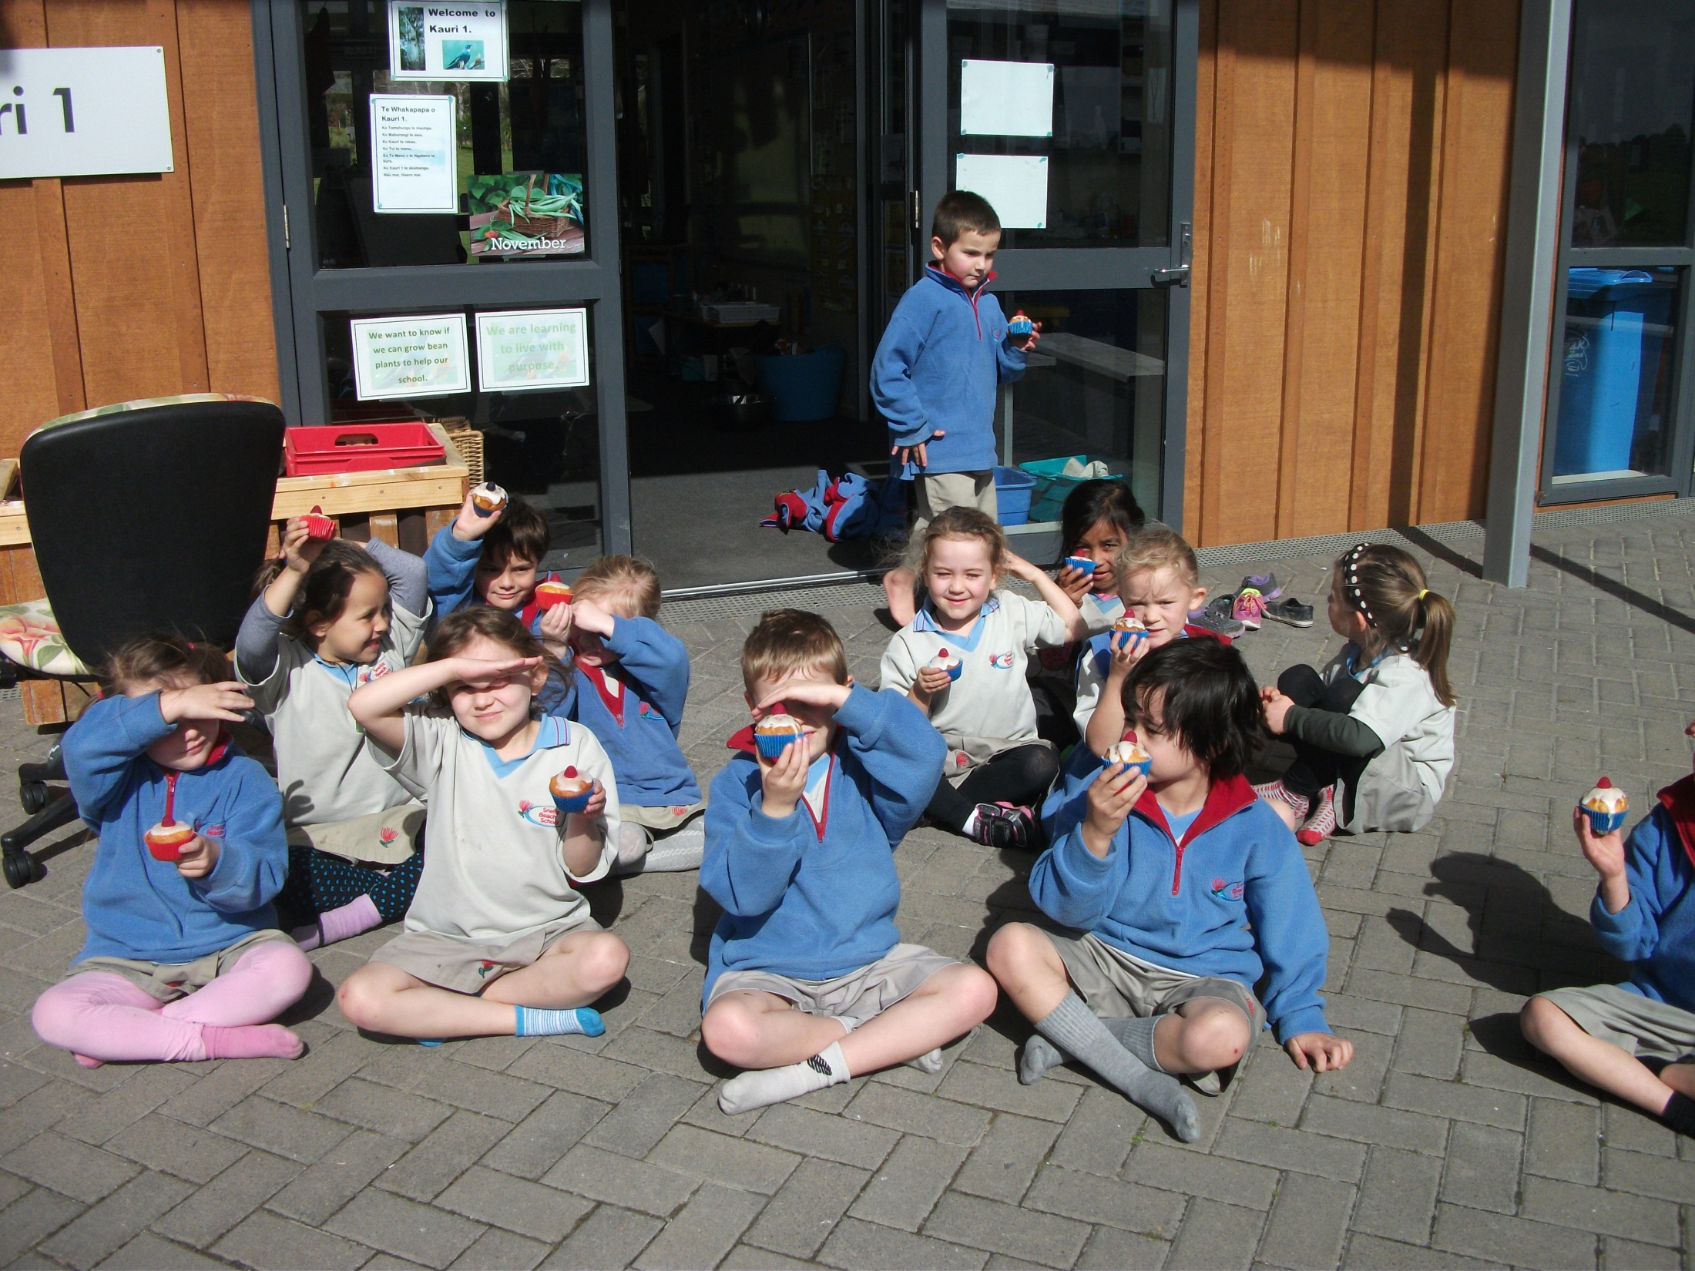

Slide 5
