Slide 1
I Can Read.
by Kauri 1.

Slide 2
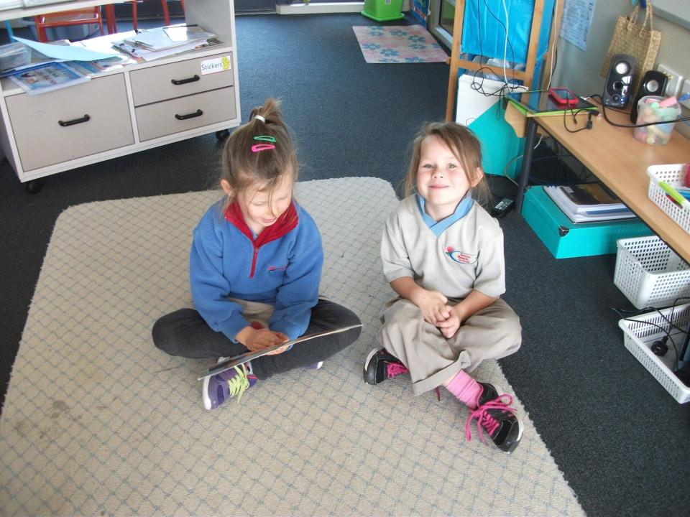
I can read to Addison.

Slide 3
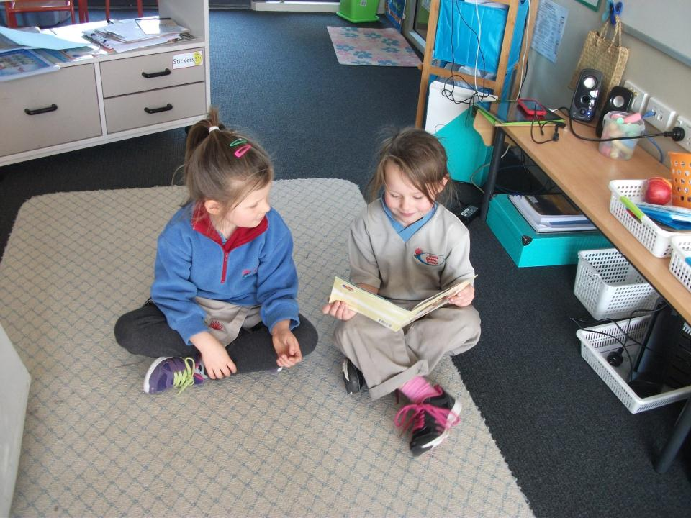
I can read to Phoebe.

Slide 4
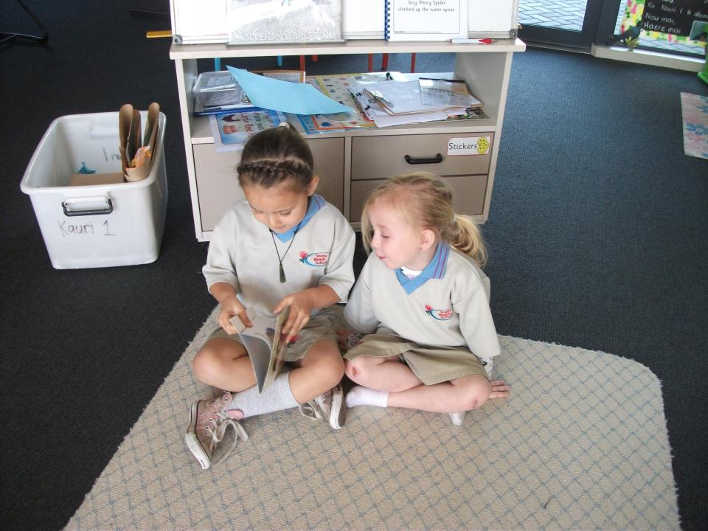
I can read to Summer.

Slide 5
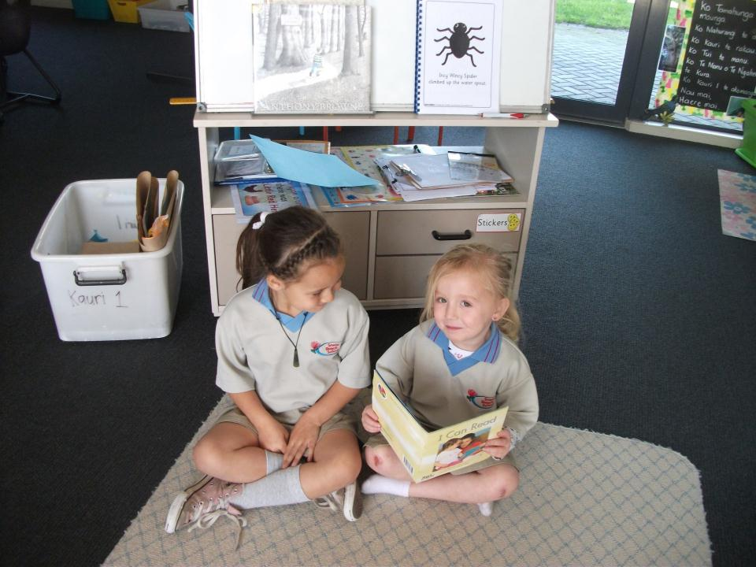
I can read to Aurora.

Slide 6
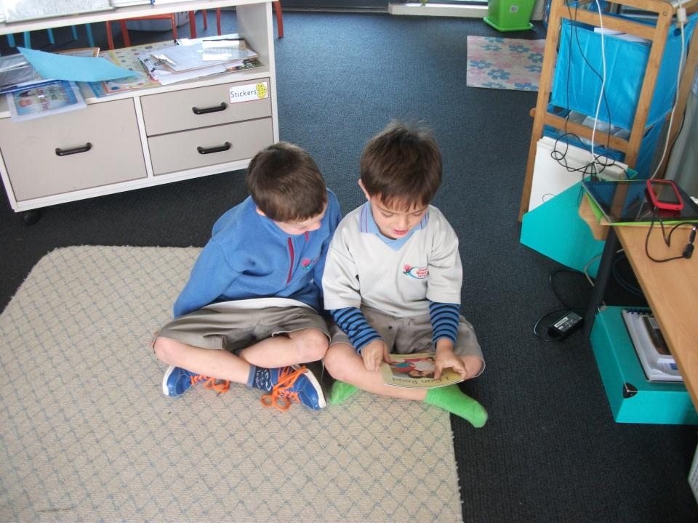
I can read to Rai.

Slide 7
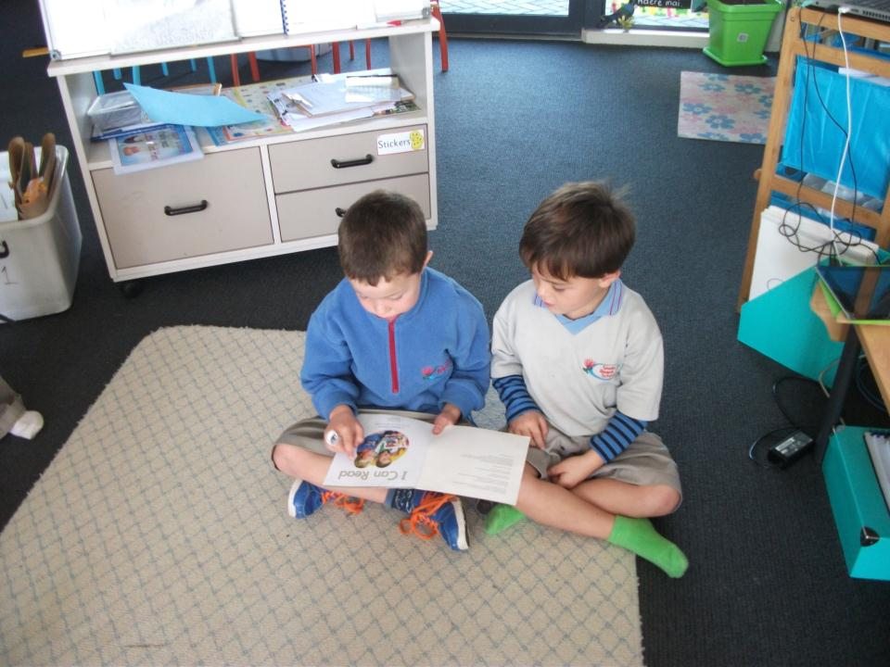
I can read to Ollie.

Slide 8
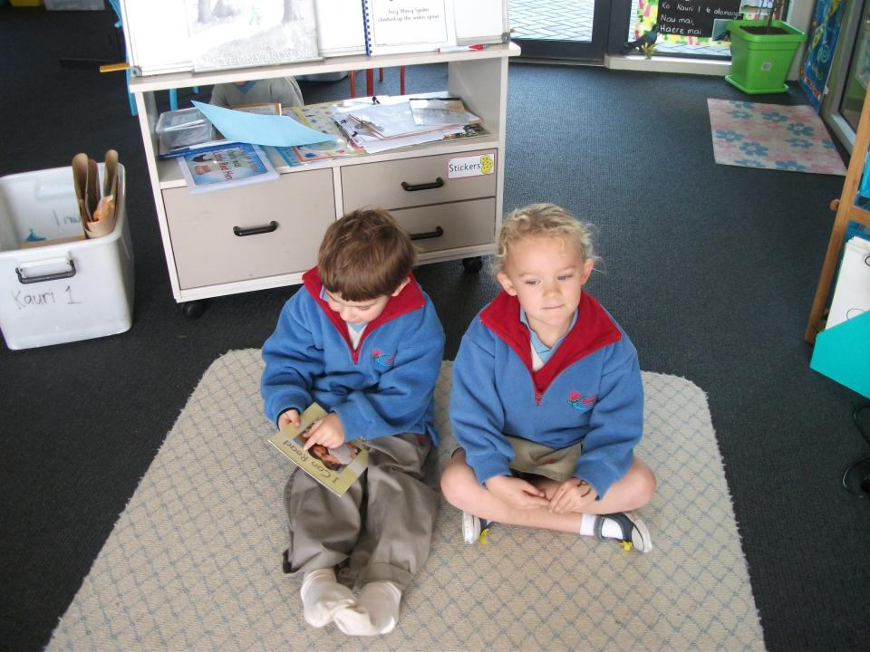
I can read to Brittany.

Slide 9
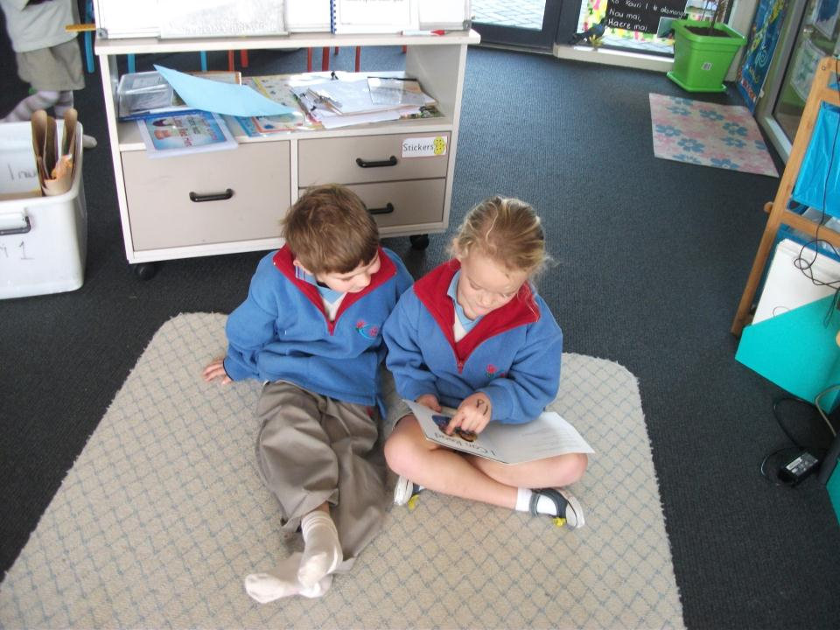
I can read to Talann.

Slide 10
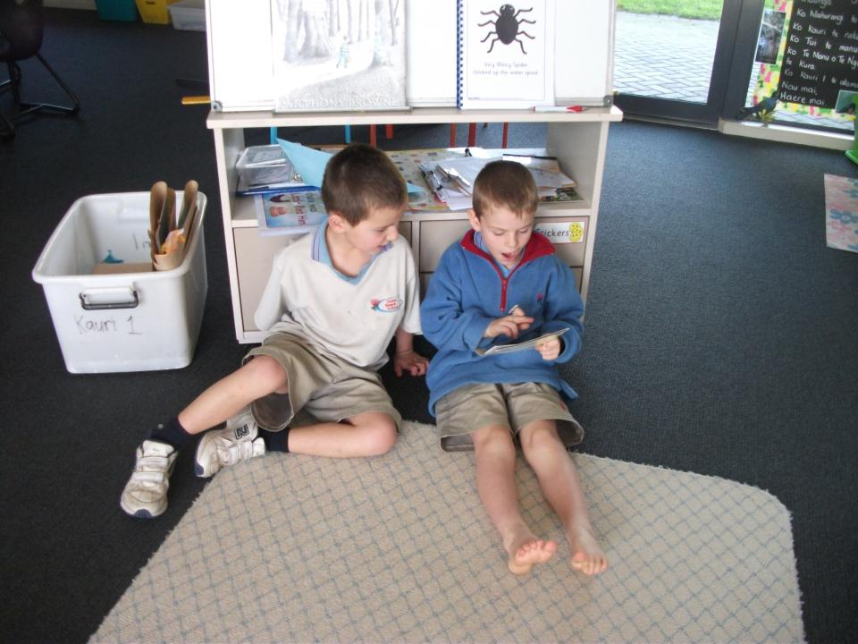
I can read to Rhyley.

Slide 11
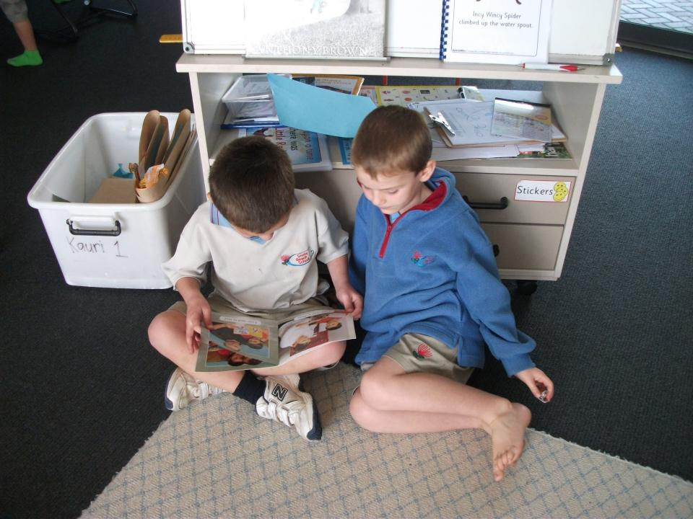
I can read to Sol.

Slide 12
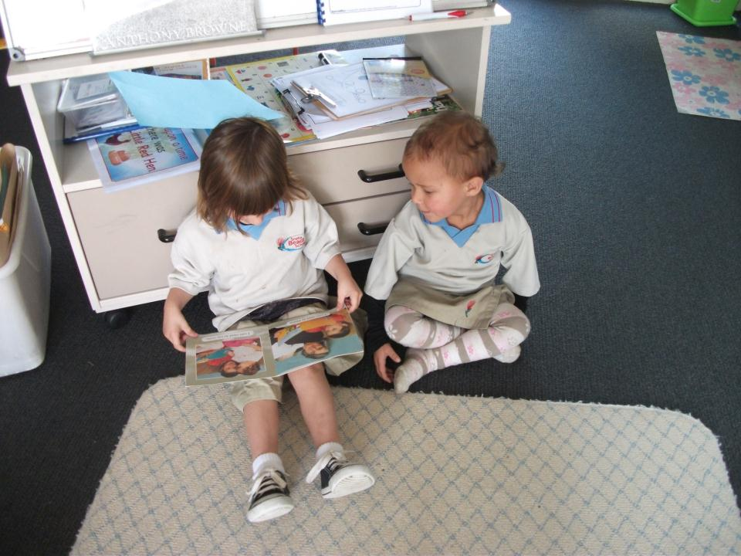
I can read to Kalane.

Slide 13
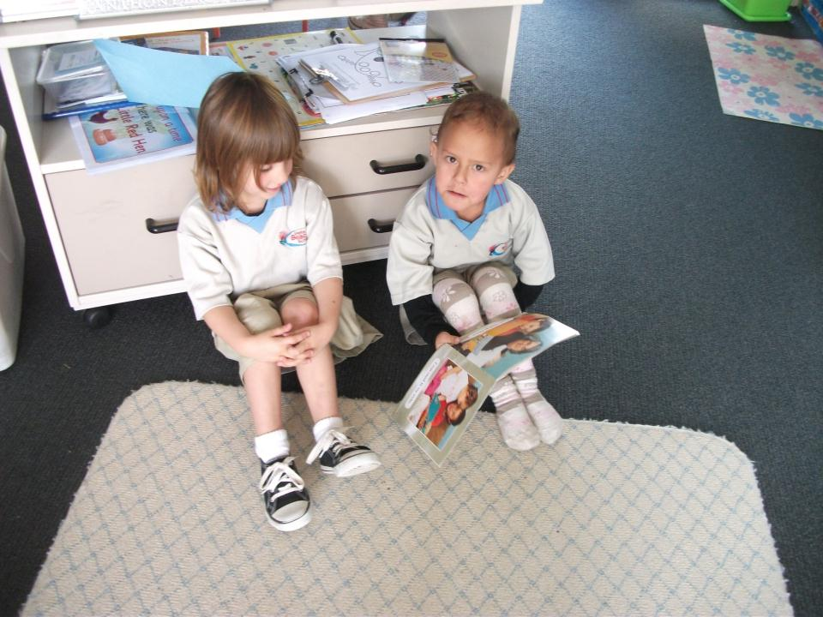
I can read to Ele.

Slide 14
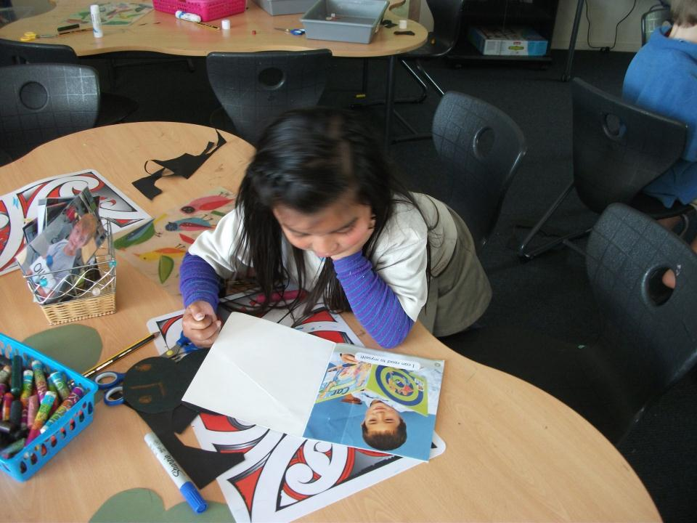
“I can read to myself”, said Brianna.

