Slide 1
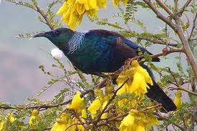
We’re Going on a Tui Hunt.
by Kauri 1.

Slide 2
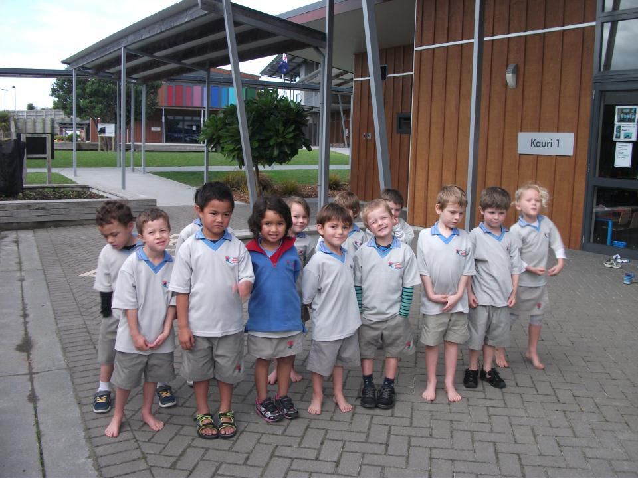
We’re going on a tui hunt. We're going to catch a tricky one. What an awesome day.
We’re not scared.

Slide 3
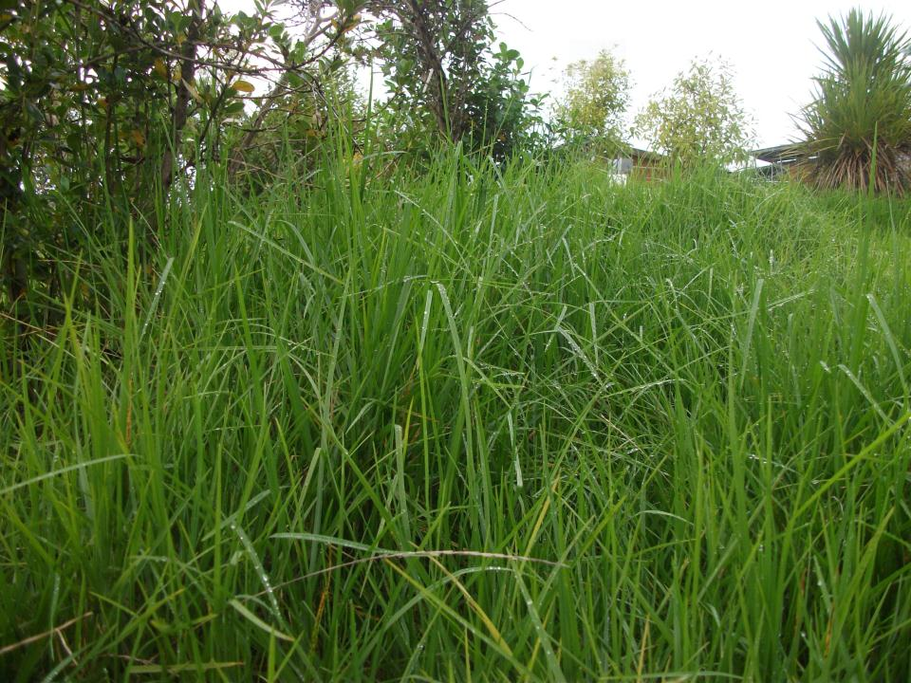
Uh-uh! Long grass! Long wet grass. We can’t go over it. We can’t go under it. Oh no! We’ve got to go through it!

Slide 4
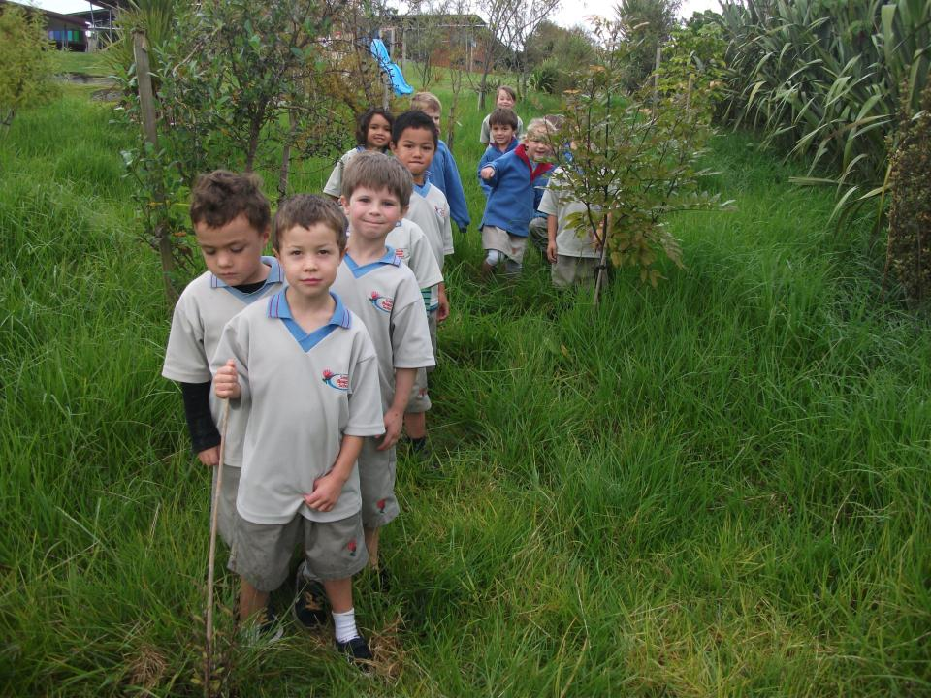
Swishy swashy!
Swishy swashy!
Swishy swashy!

Slide 5
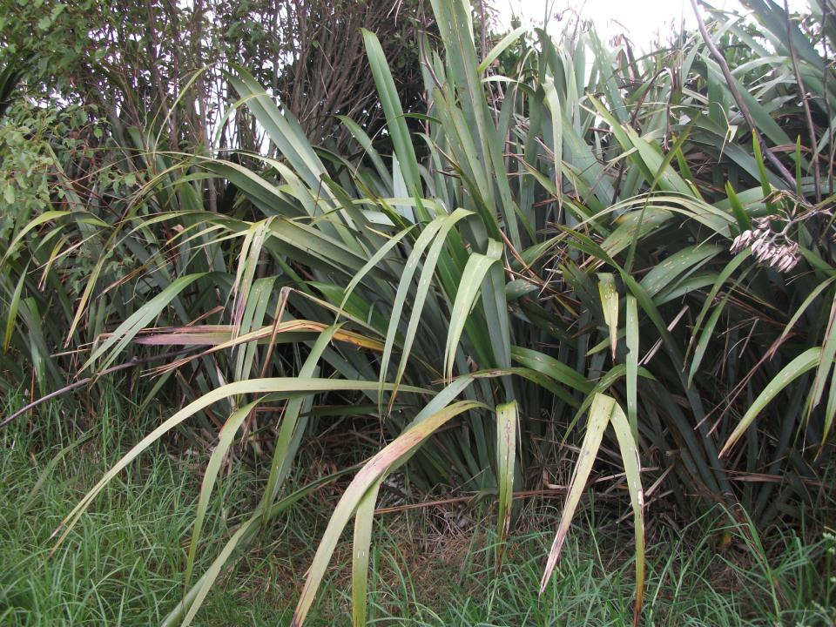
We’re going on a tui hunt. We're going to catch a tricky one. What an awesome day.
We’re not scared.

Slide 6
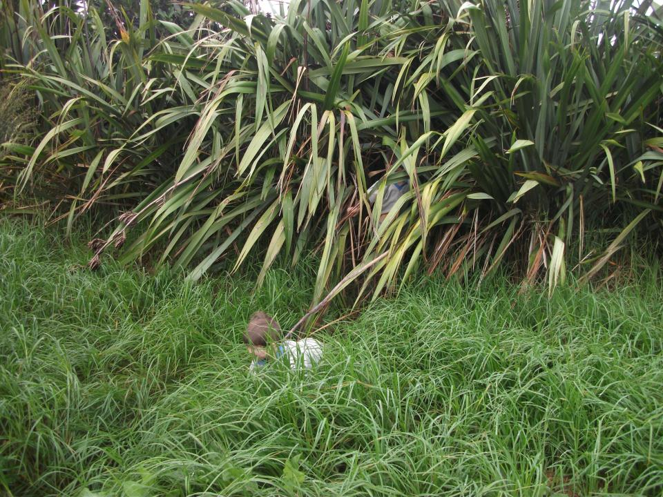
Uh-uh! Thick flax! Thick scary flax. We can’t go over it. We can’t go under it. Oh no! We’ve got to go through it!

Slide 7
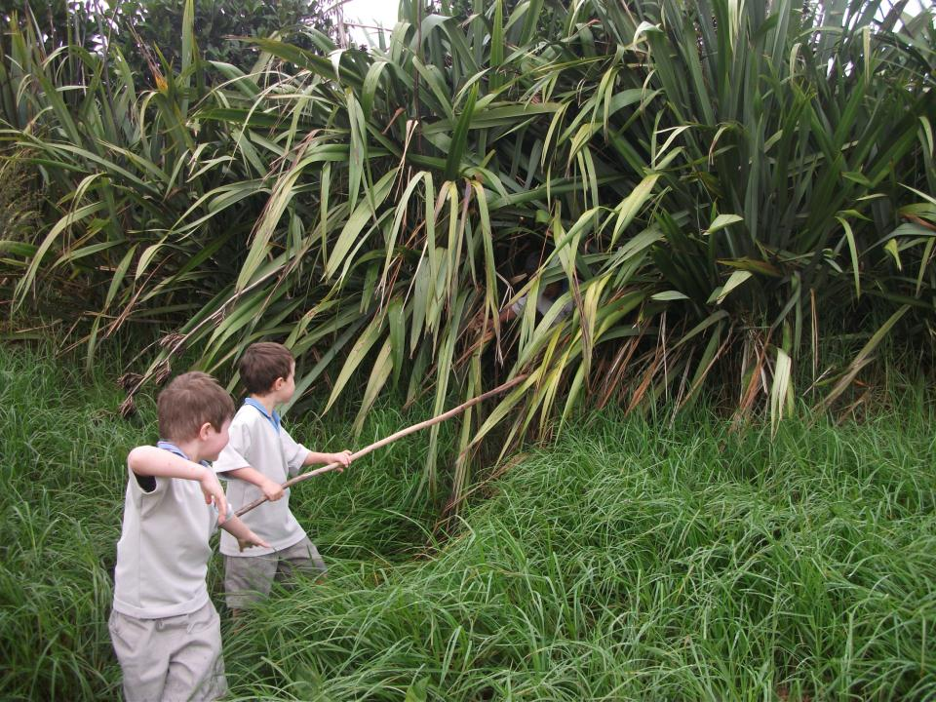
Crawl creep!

Slide 8
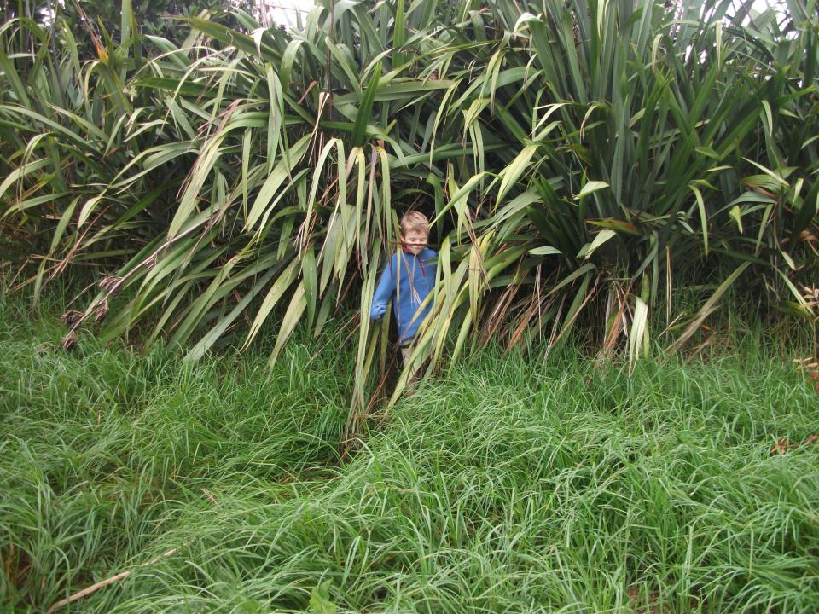
Crawl creep!

Slide 9
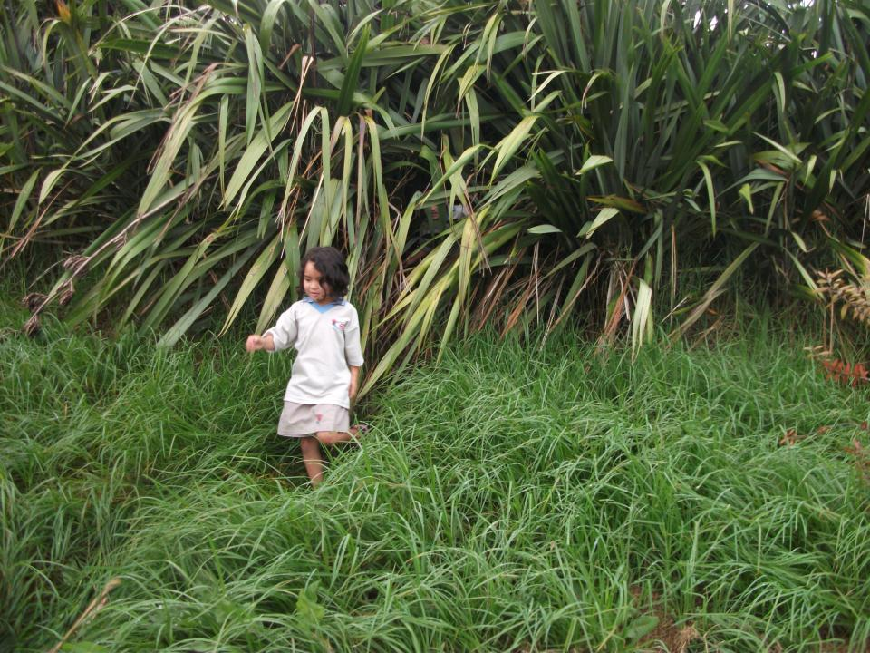
Crawl creep!

Slide 10
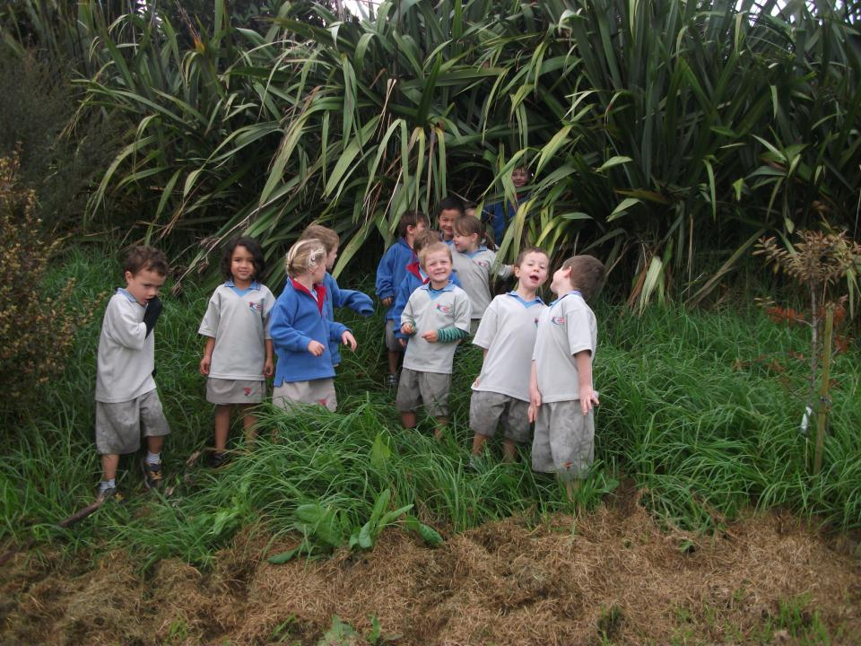

Slide 11
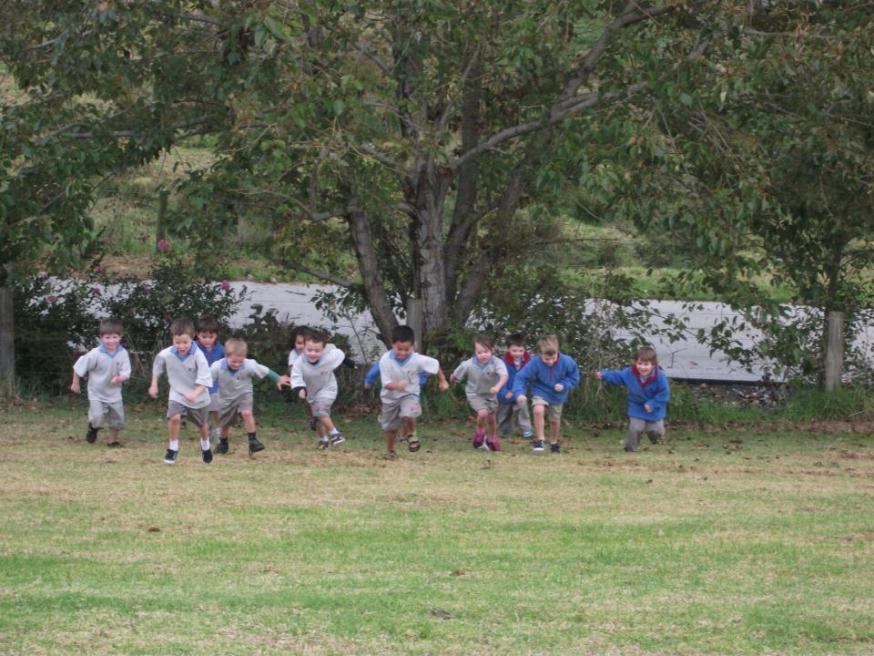
We’re going on a tui hunt. We're going to catch a tricky one. What an awesome day.
We’re not scared.

Slide 12
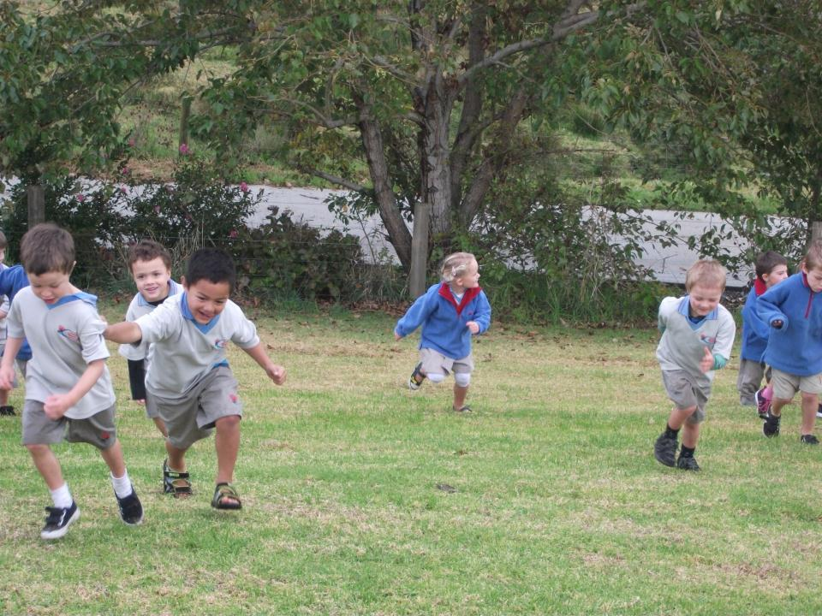
Uh-uh! Big Hill! Big steep hill. We can’t go over it. We can’t go under it. Oh no! We’ve got to go through it!

Slide 13
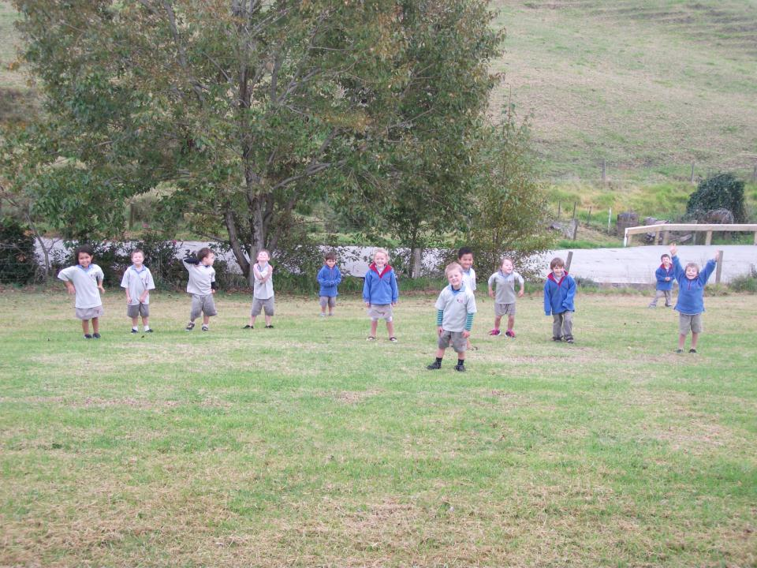
Stumble trip!
Stumble trip!
Stumble trip!

Slide 14
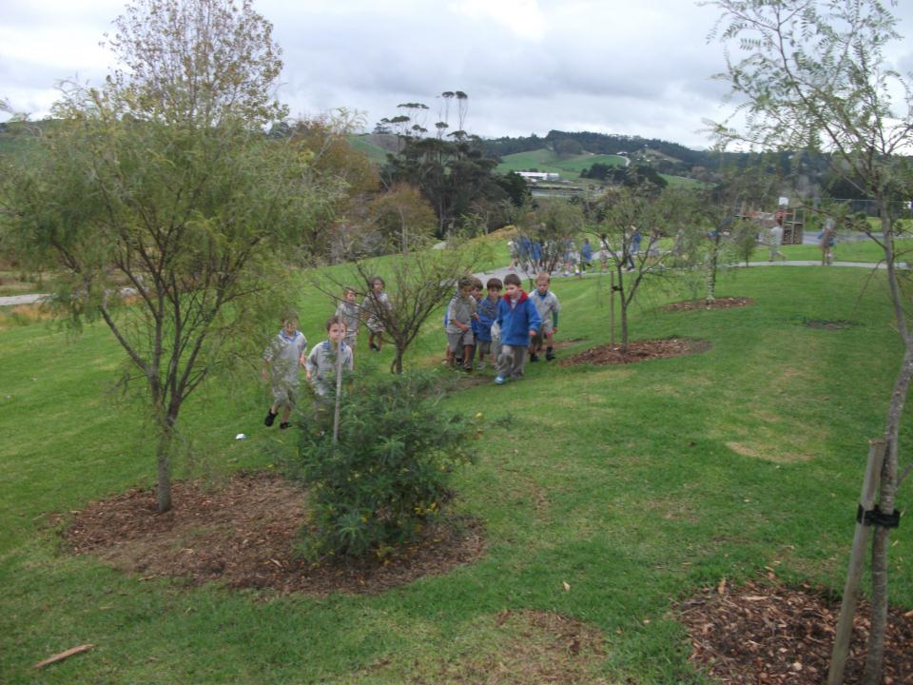
We’re going on a tui hunt. We're going to catch a tricky one. What an awesome day.
We’re not scared.

Slide 15
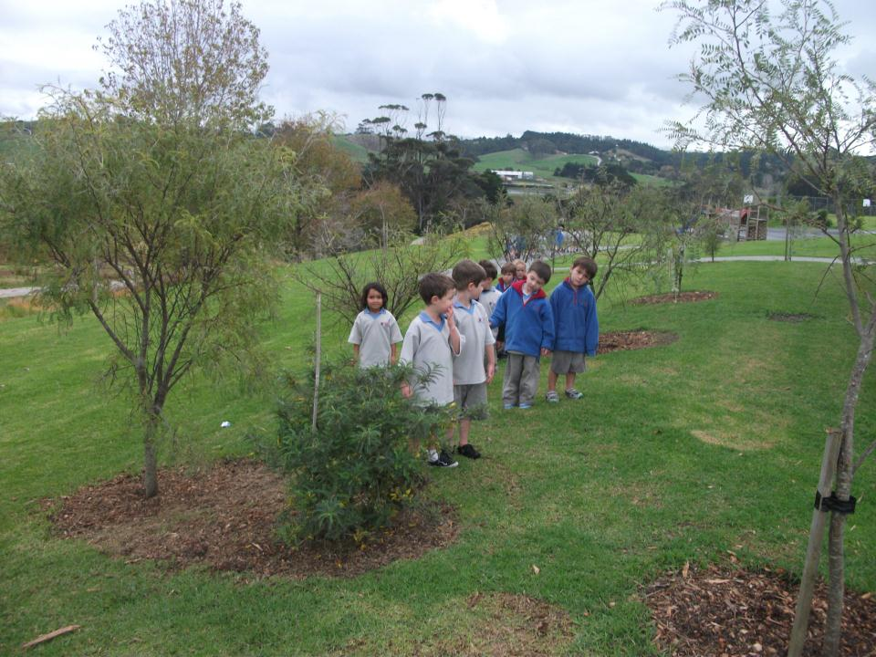
Uh-uh! Kowhai bushes! Scritchy scratchy Kowhai bushes. We can’t go over it. We can’t go under it. Oh no! We’ve got to go through it!

Slide 16
Scritchy scratchy!
Scritchy scratchy!
Scritchy scratchy!

Slide 17
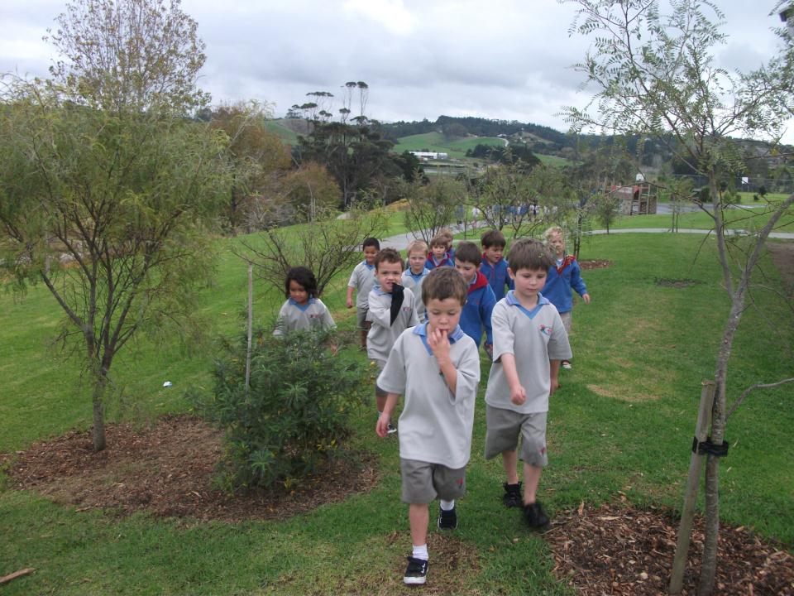
We’re going on a tui hunt. We're going to catch a tricky one. What an awesome day.
We’re not scared.

Slide 18
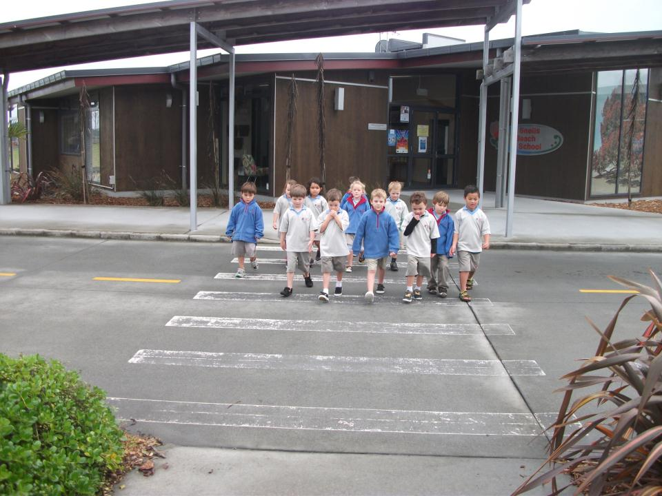
Uh-uh! Driveway! Busy bustling school driveway. We can’t go over it. We can’t go under it. Oh no! We’ve got to go through it!

Slide 19
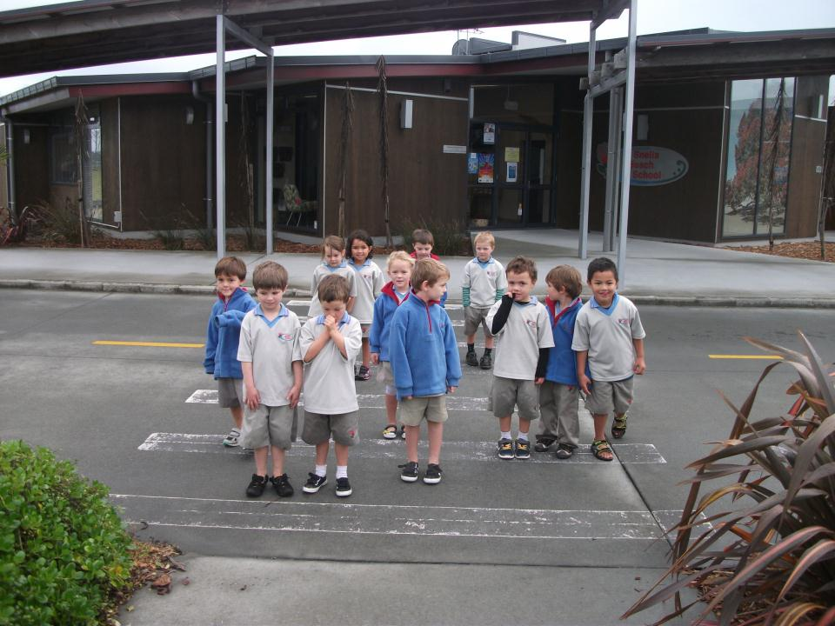
Criss cross!
Criss cross!
Criss cross!

Slide 20
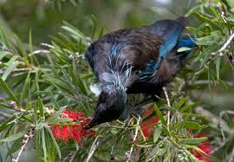
Here’s the tui.
That very tricky tui.
Eating nectar in the bush.

Slide 21
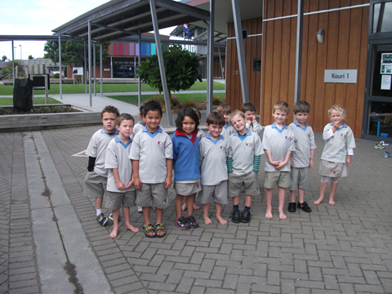
We love a tui hunt!

