Slide 1
Too Big.
By The Red Stars in Kauri 1.

Slide 2
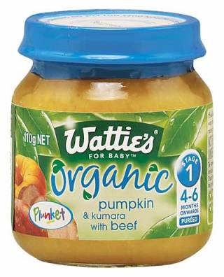
I am too big for baby food.

Slide 3
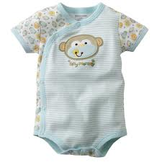
I am too big for baby clothes.

Slide 4
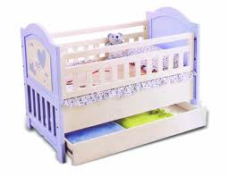
I am too big for a baby bed.

Slide 5
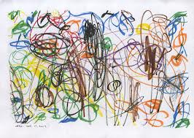
I am too big for scribbling.

Slide 6
I am too big for kindy.

Slide 7
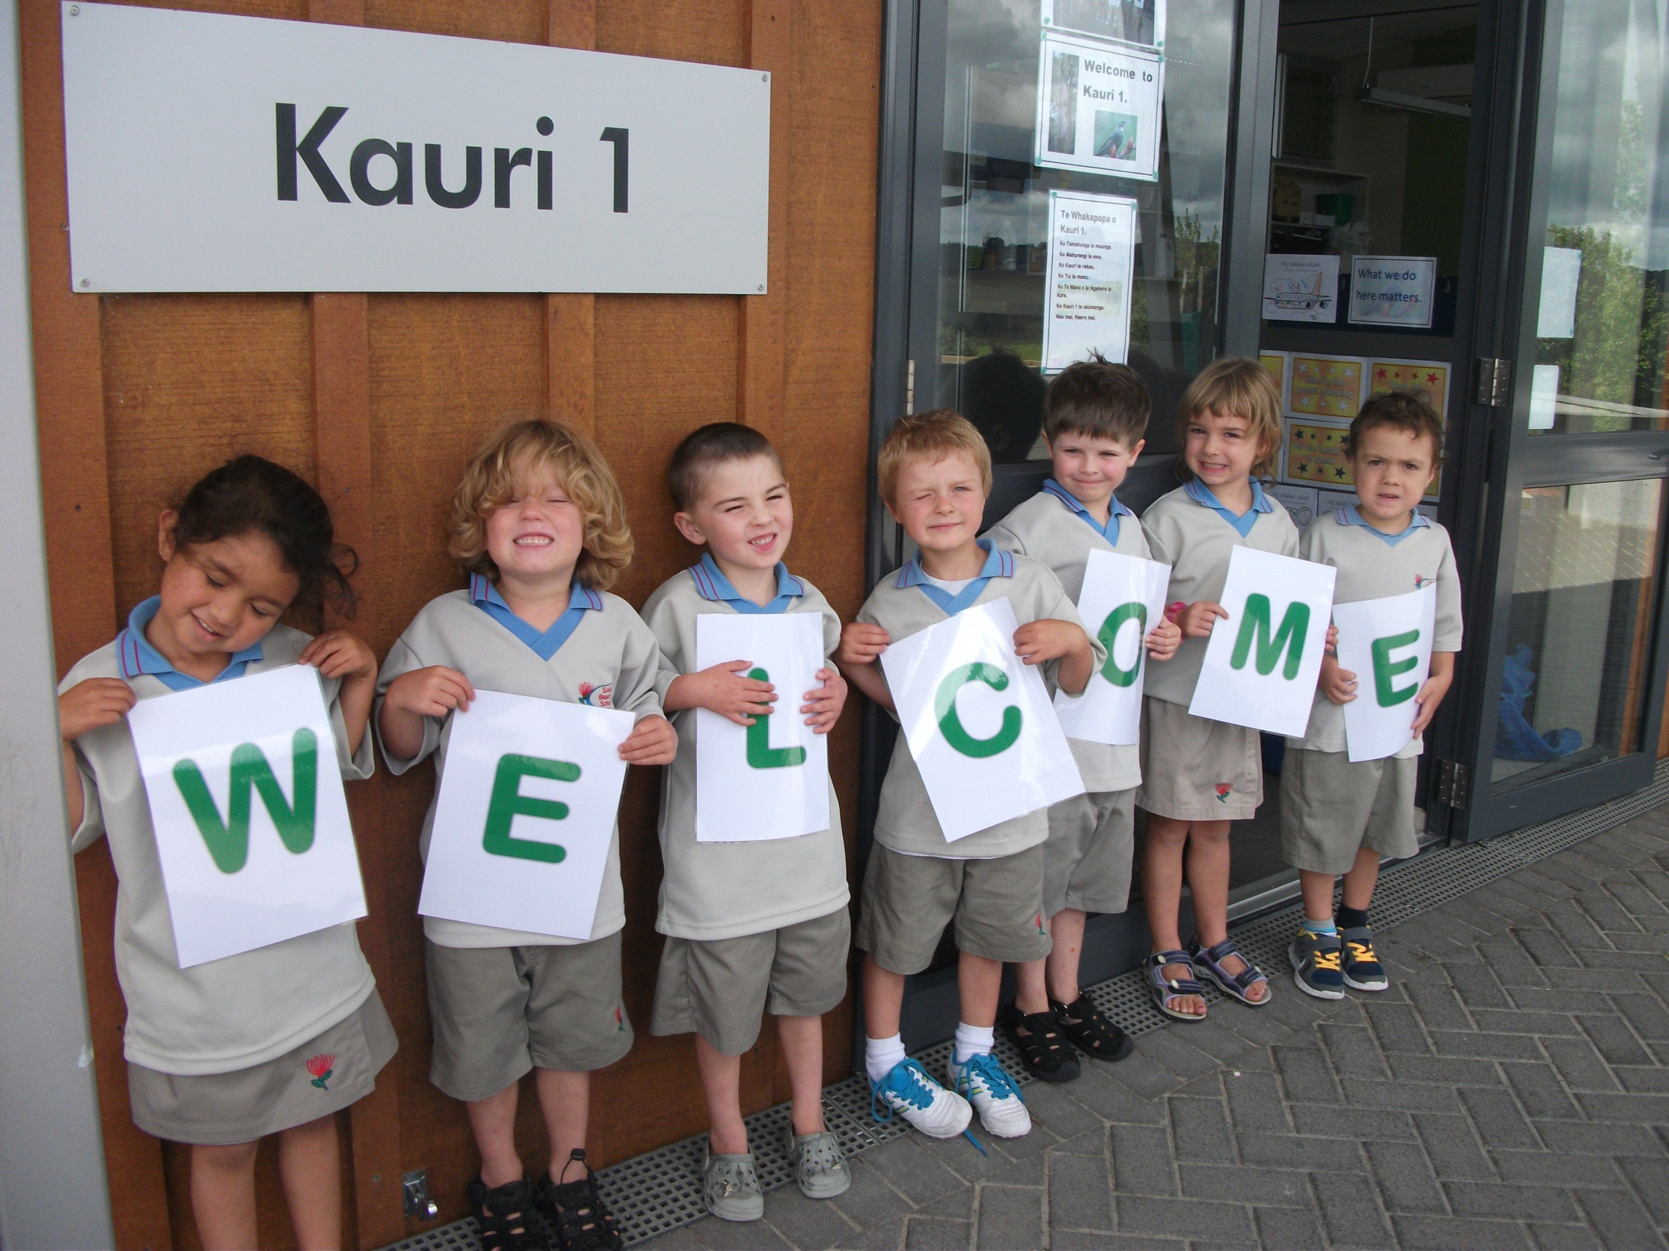
But I am not too big for school.

