Slide 1
Sounds of Belonging to Snells Beach School
by Kahikatea 1

Slide 2
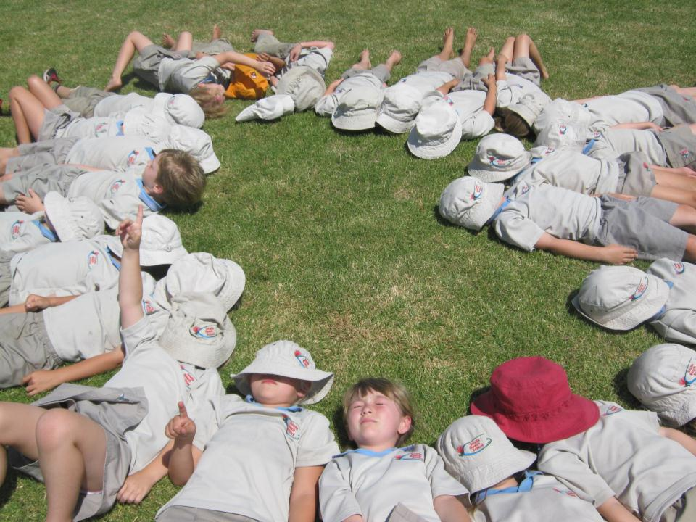

Shhhh, Kahikatea 1. What can you hear?

Slide 3
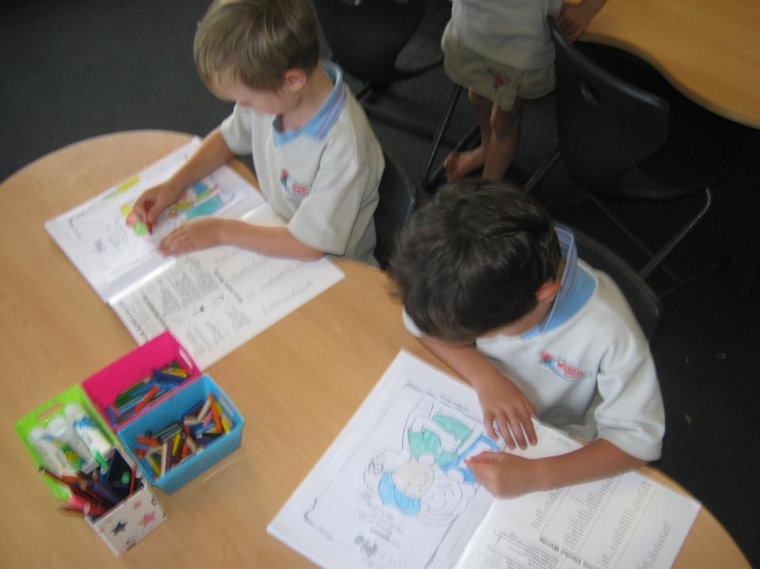
Children working quietly.

Slide 4
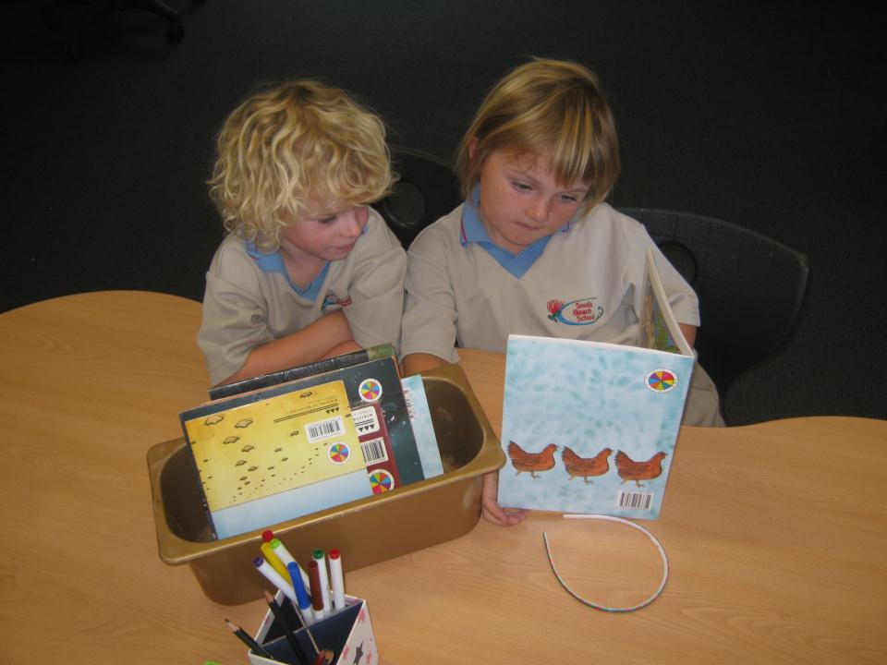
Reading books to our buddies.

Slide 5
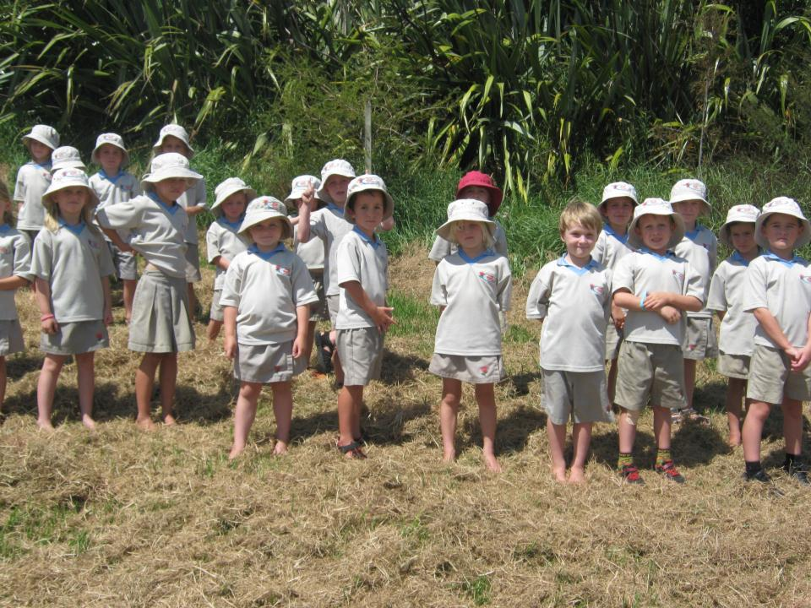
Dry grass crunching under our feet.

Slide 6
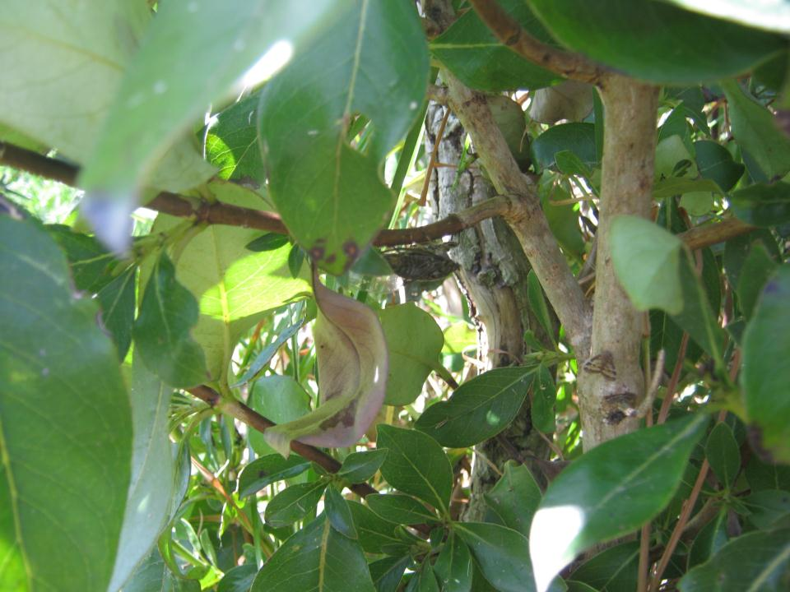
Cicadas singing in the sun.

Slide 7
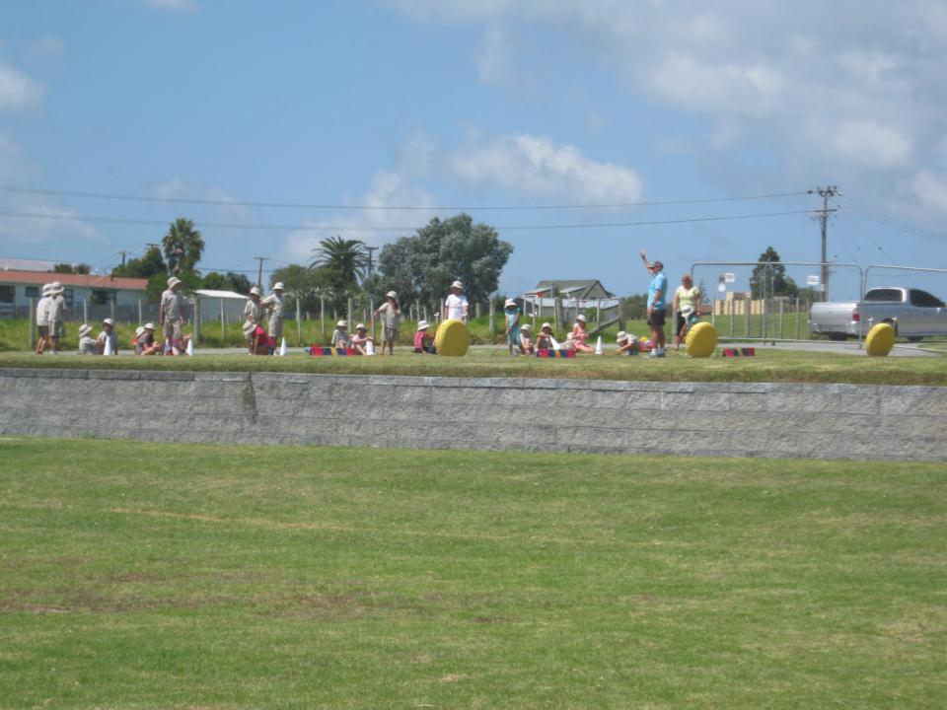
Children doing sport with Tony.

Slide 8
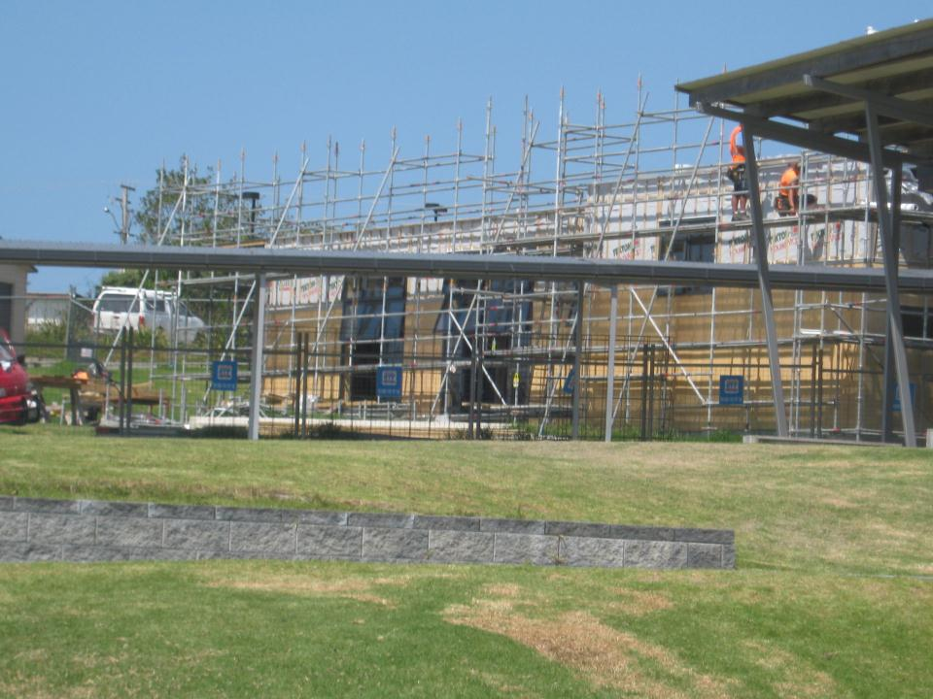
Hammer, hammer, bang, bang, clang, clang!

Slide 9
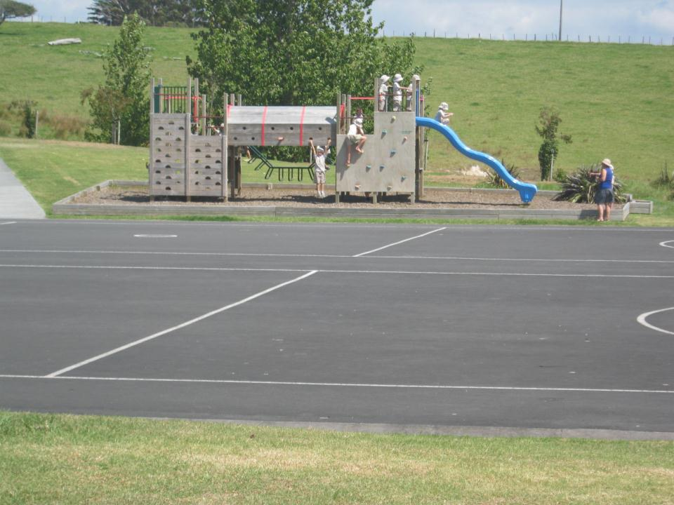
Children playing on the playground.

Slide 10
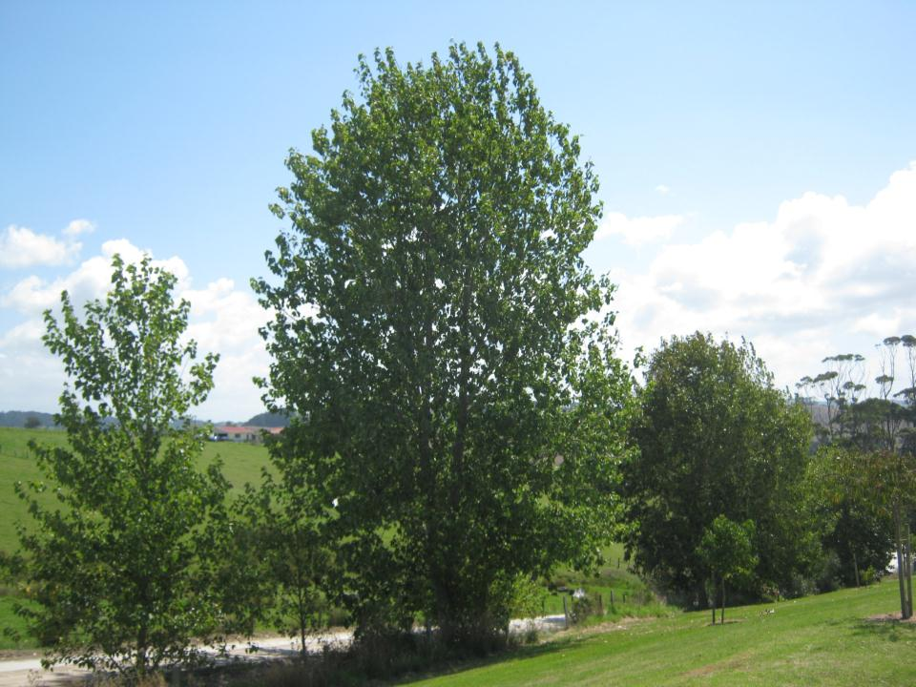
The wind blowing in the trees.

Slide 11
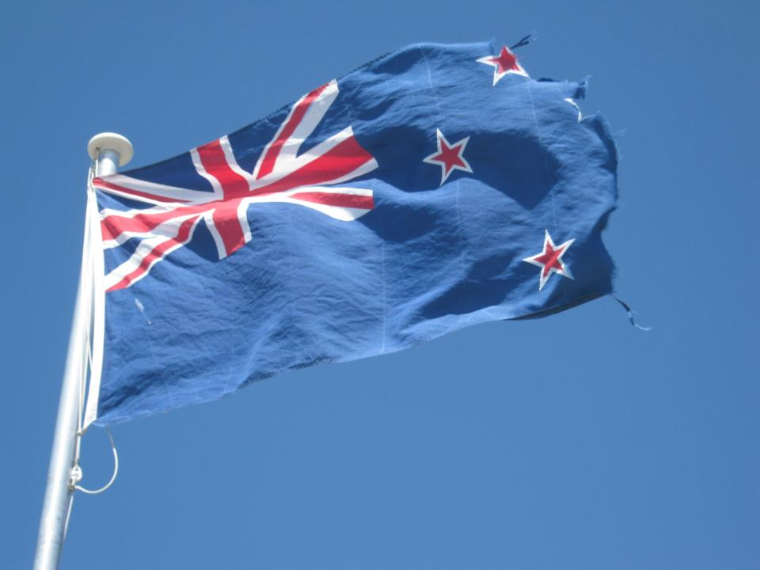
The flag flapping in the wind.

Slide 12
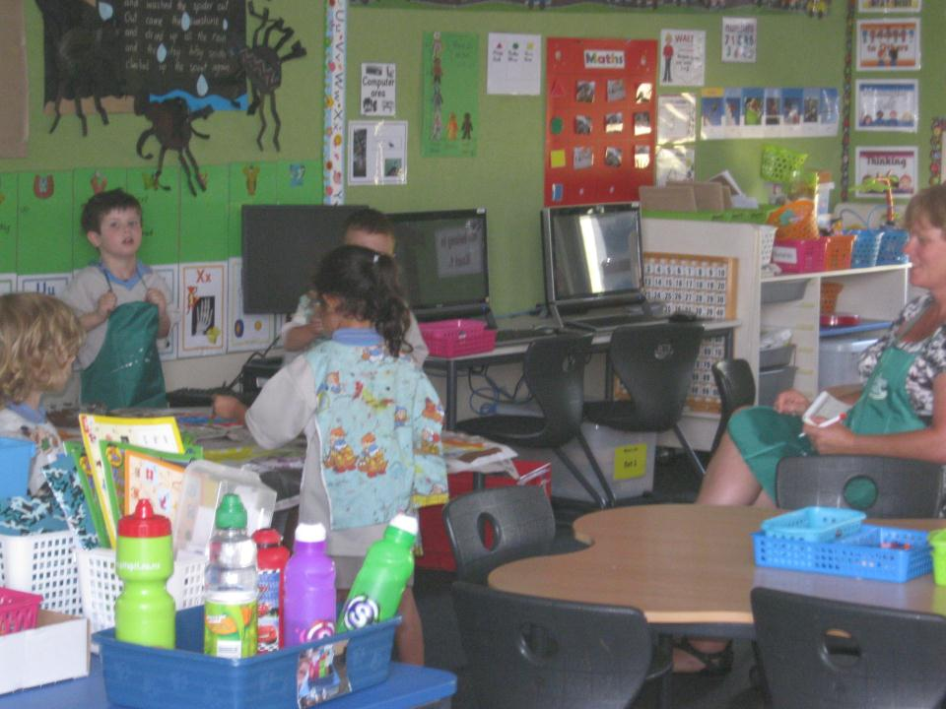
Kauri 1 Painting.

Slide 13
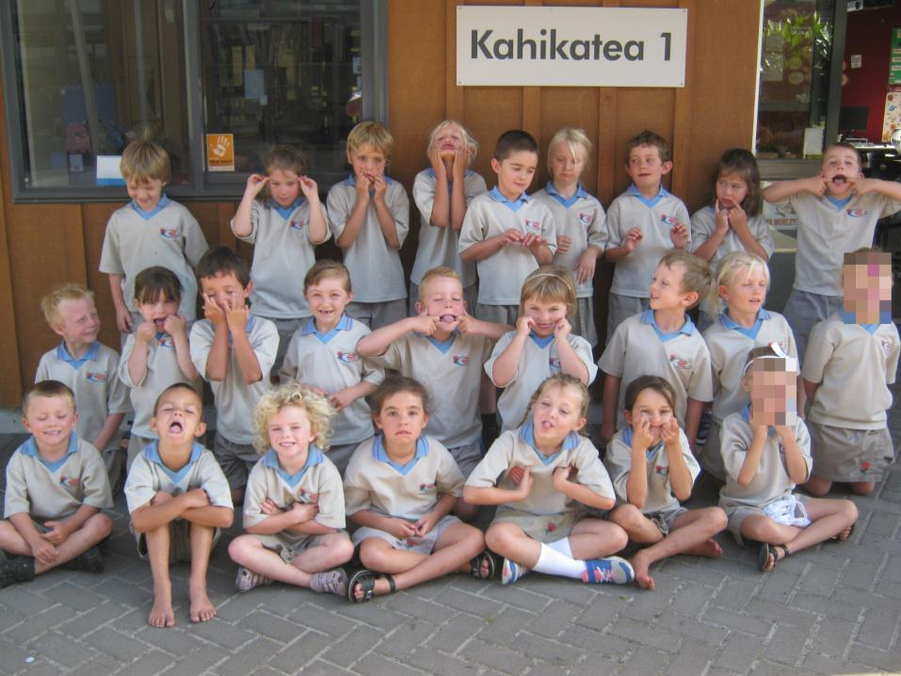
We are Kahikatea 1.

