Slide 1
Our Best Bears.
by Kauri 1.

Slide 2
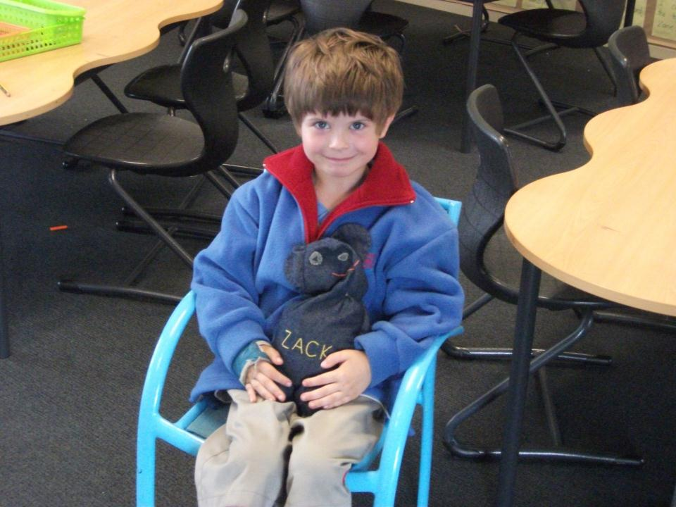
This is Zack’s bean bag bear.

Slide 3
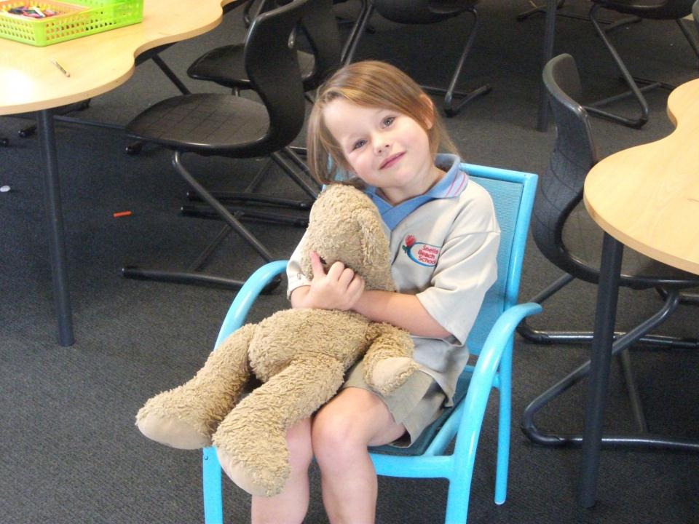
This is Addison’s dirty brown bear.

Slide 4
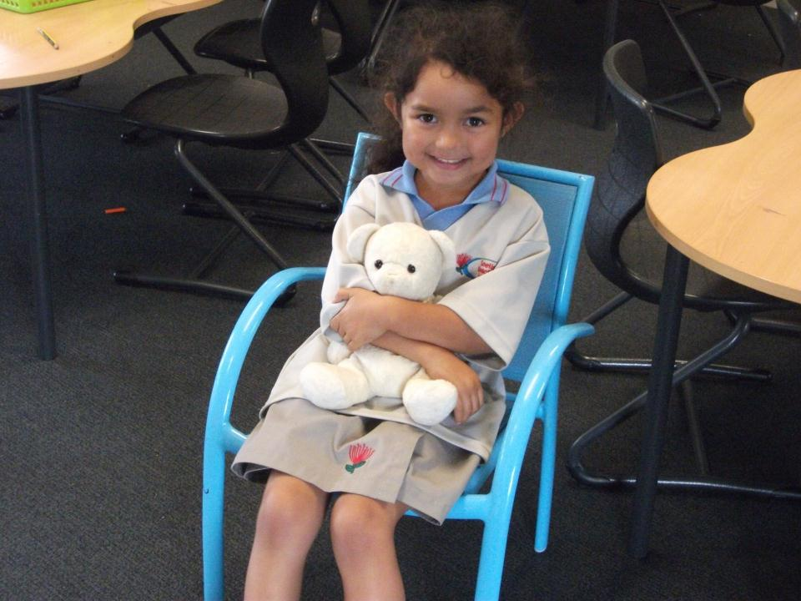
This is Alizae’s cuddly cream bear.

Slide 5
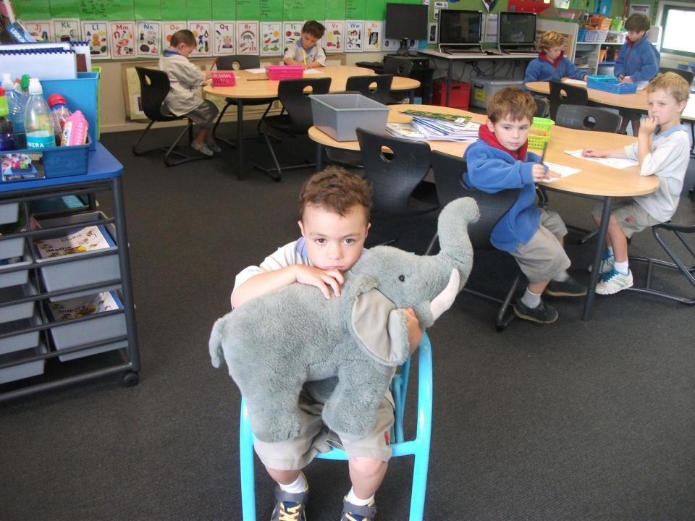
This is Tai’s enormous grey elephant.

Slide 6
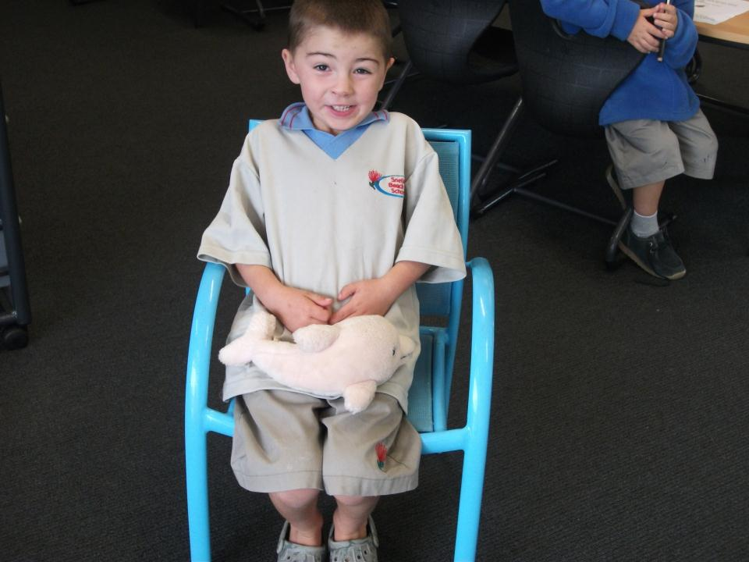
This is Roman’s delicious huggy dolphin.

Slide 7
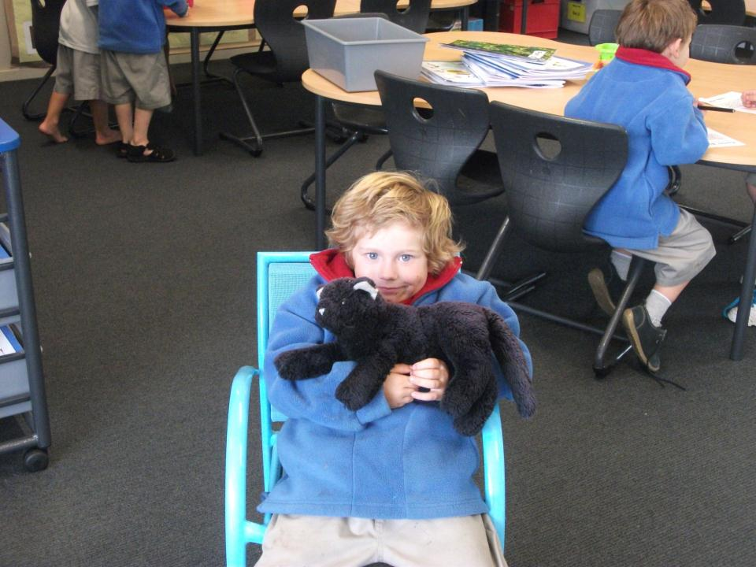
This is Zane’s precious purple pussycat.

Slide 8
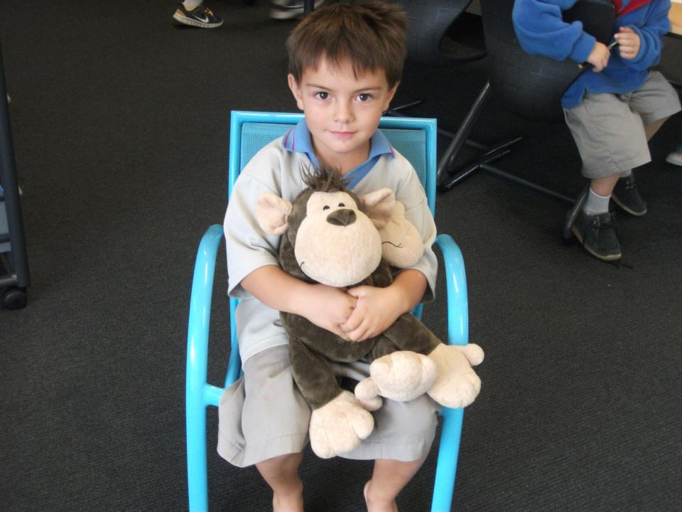
This is Ollie’s marvellous golden monkey.

Slide 9
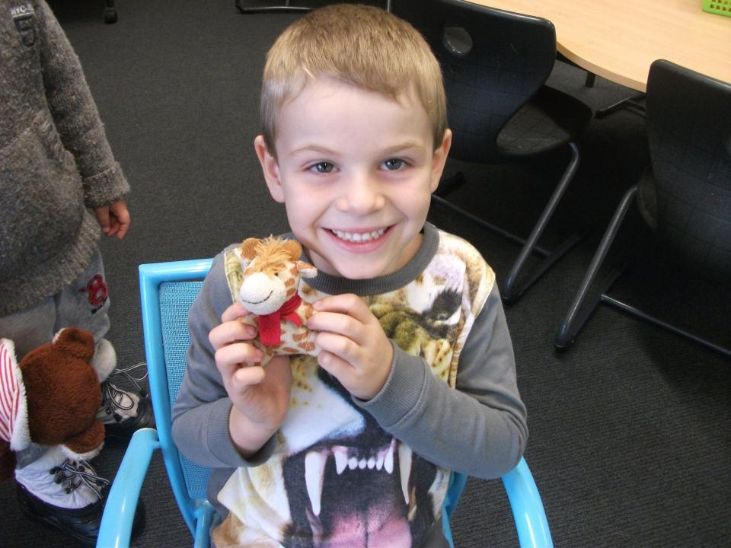
This is Sol’s cute and gorgeous giraffe.

Slide 10
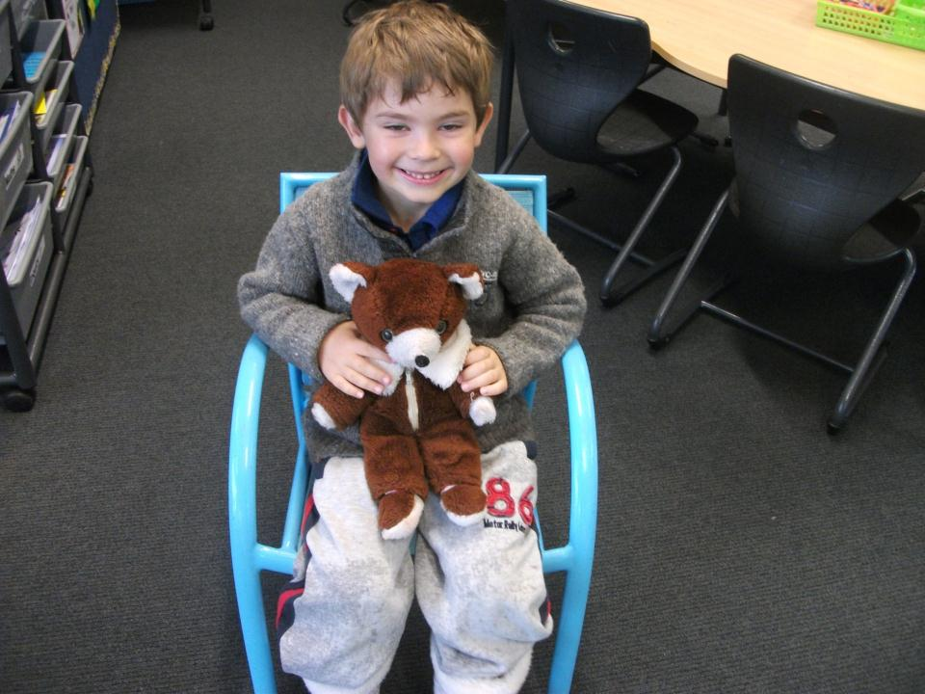
This is Talann’s best brown bear.

