Slide 1
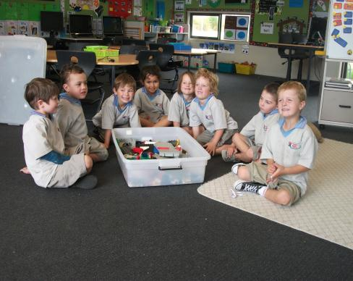
It’s My Lego.
by Kauri 1.

Slide 2
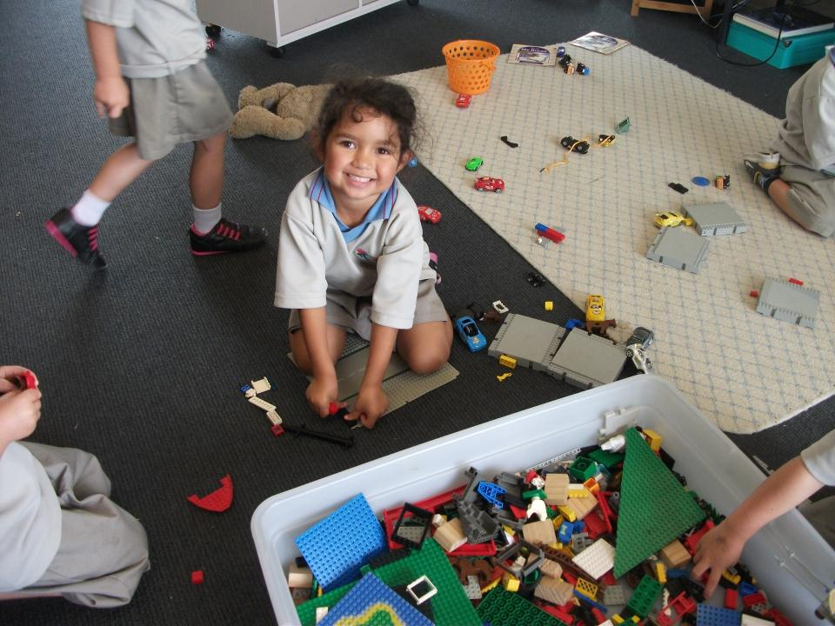
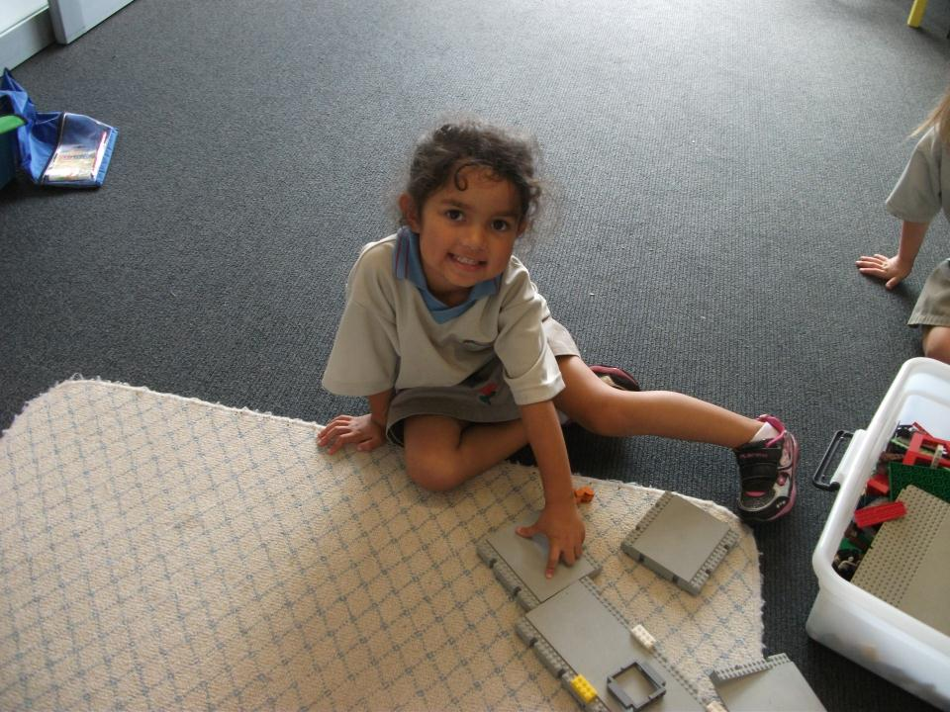
“It’s my lego,” said Alizae.

Slide 3
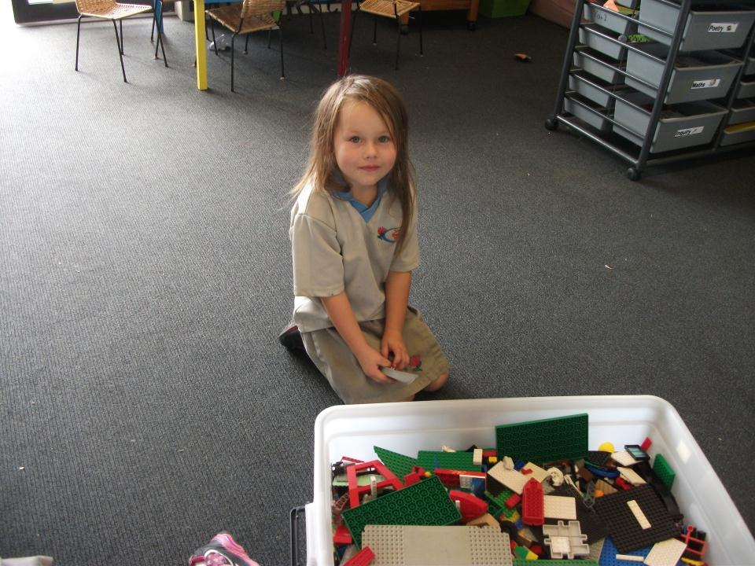
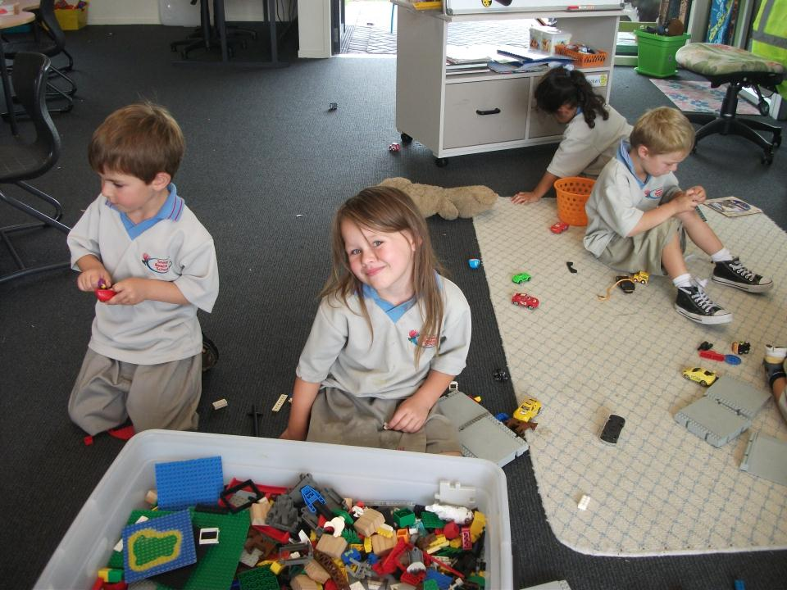
“It’s my lego ,” said Addison.

Slide 4
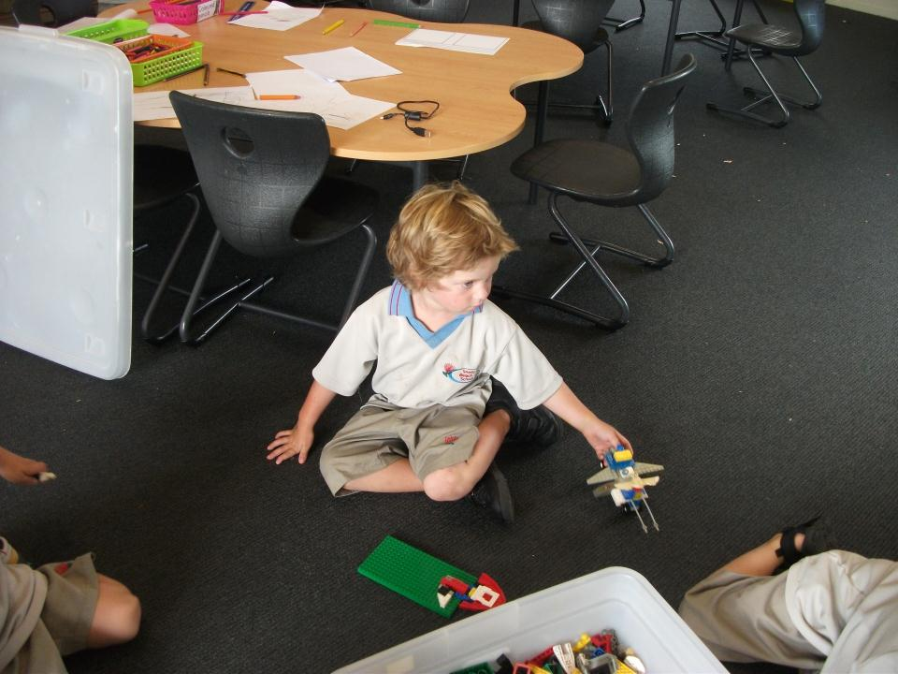
“It’s my lego”, said Zane.

Slide 5
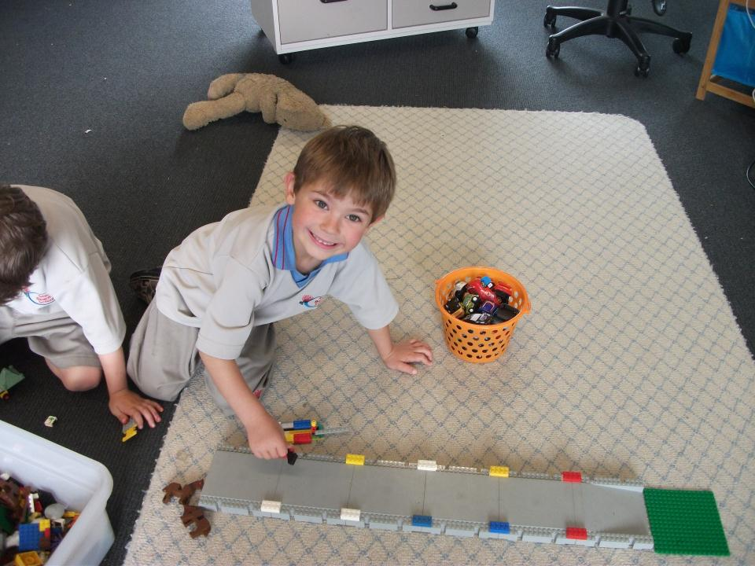
“It’s my lego”, said Talann.

Slide 6
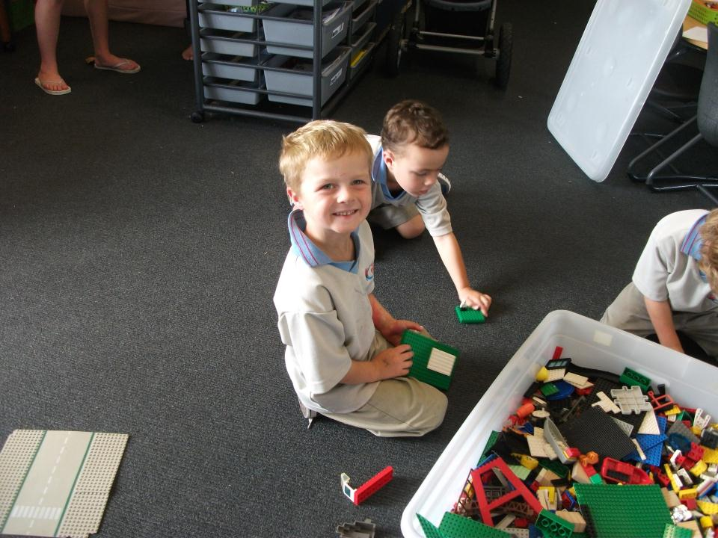
“It’s my lego”, said Jahmo.

Slide 7
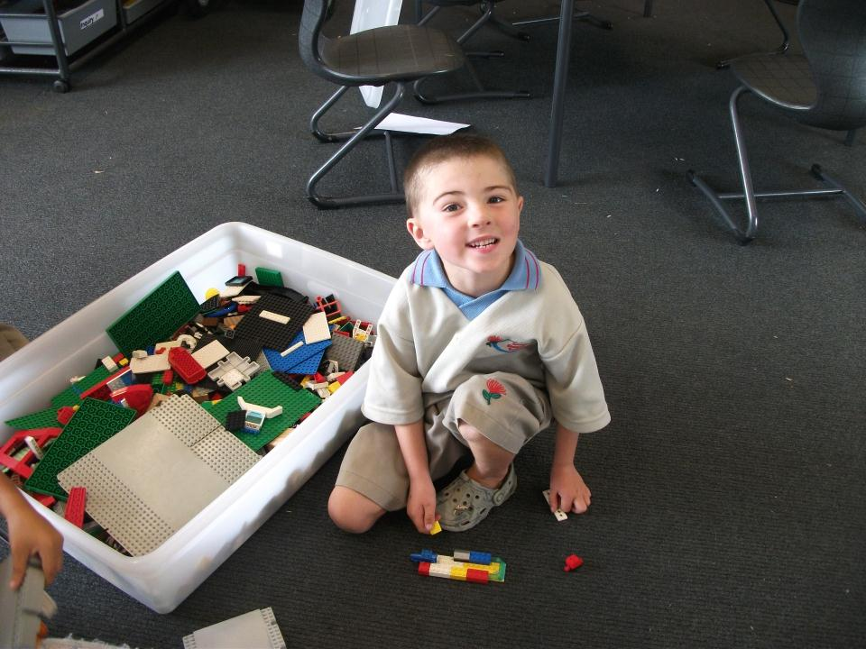
“It’s my lego,” said Roman.

Slide 8
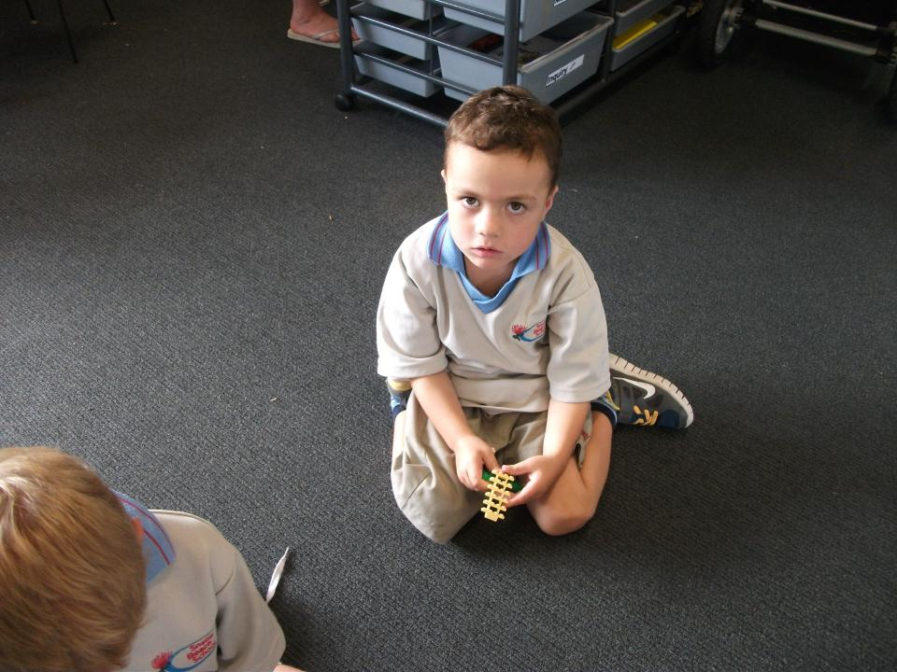
“It’s my lego”, said Taiatta.

Slide 9
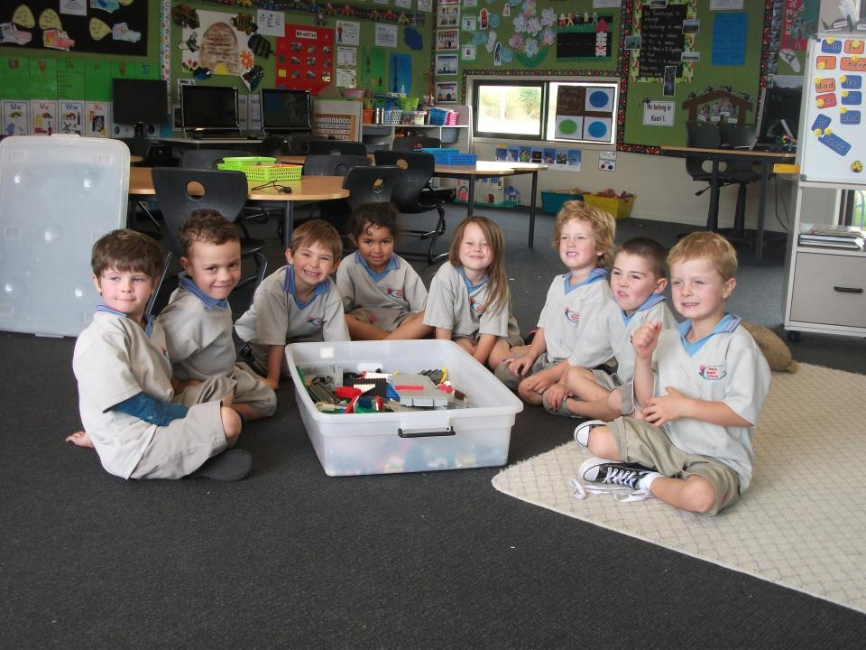
“It’s our lego,” said Kauri 1.

