Slide 1
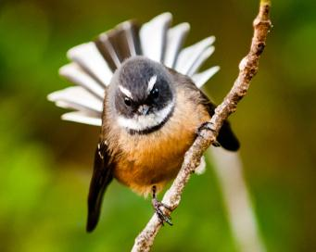
Fantail, Fantail.
by The Red Stars in
Kauri 1.

Slide 2
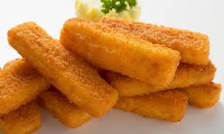
“Fantail, fantail, have some fishfingers”.

Slide 3
“No, no, no, I don’t like fishfingers”.

Slide 4
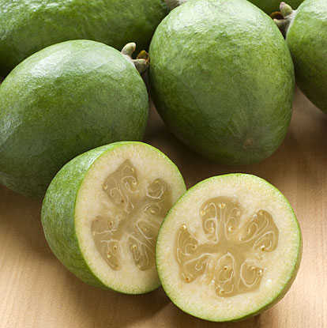
“Fantail, fantail, have some fejoas”.

Slide 5
“No, no, no, I don’t like fejoas”.

Slide 6
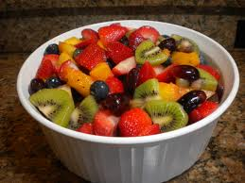
“Fantail, fantail, have some fruit salad”.

Slide 7
“No, no, no, I don’t like fruit salad.”

Slide 8
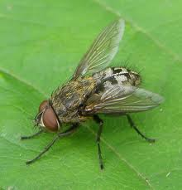
“Fantail, fantail have this fly.”

Slide 9
“Yes, yes, yes I do like flies. ”

Slide 10
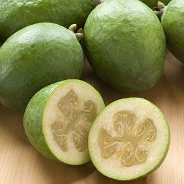
I don’t want fishfingers, I don’t want fruit salad and I don’t want fejoas,

Slide 11
But I want that fly!” “Goodbye fly”.

