Slide 1
The Picnic.
by Kauri 1

Slide 2
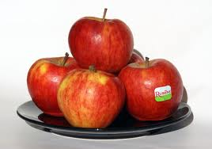
Addison put the apples in.

Slide 3
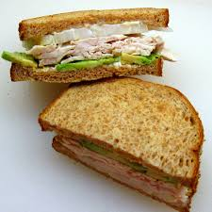
Olliver put the chicken sandwiches in.

Slide 4
Taiatta put the chips in.

Slide 5
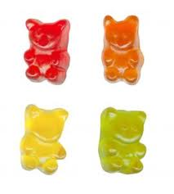
Zane put the lollies in.

Slide 6
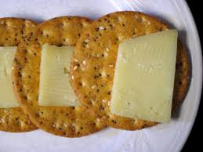
Mrs Watkin put the crackers and cheese in.

Slide 7
Alizae put the juice in.

Slide 8
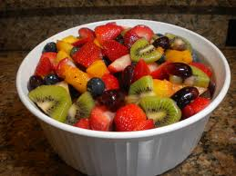
Jahmo put the fruit salad in.

Slide 9
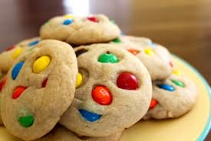
Roman put the cookies in.

