Slide 1
Smile
by Kauri 2

Slide 2
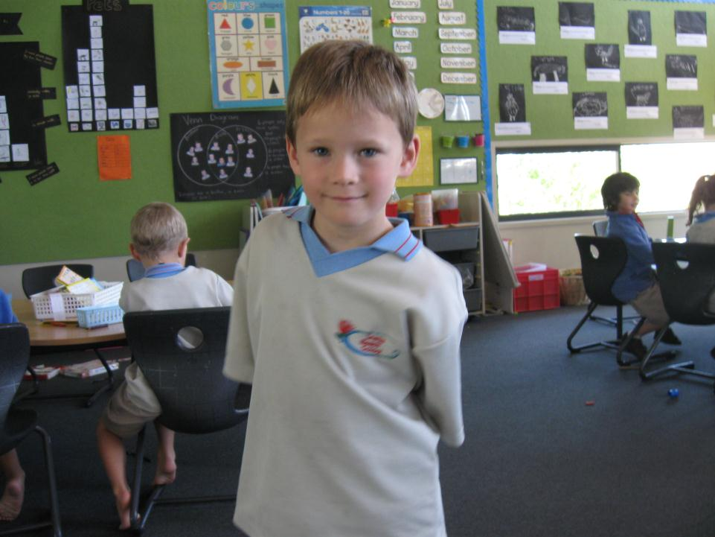
CLICK!
“Smile,” said Conor

Slide 3
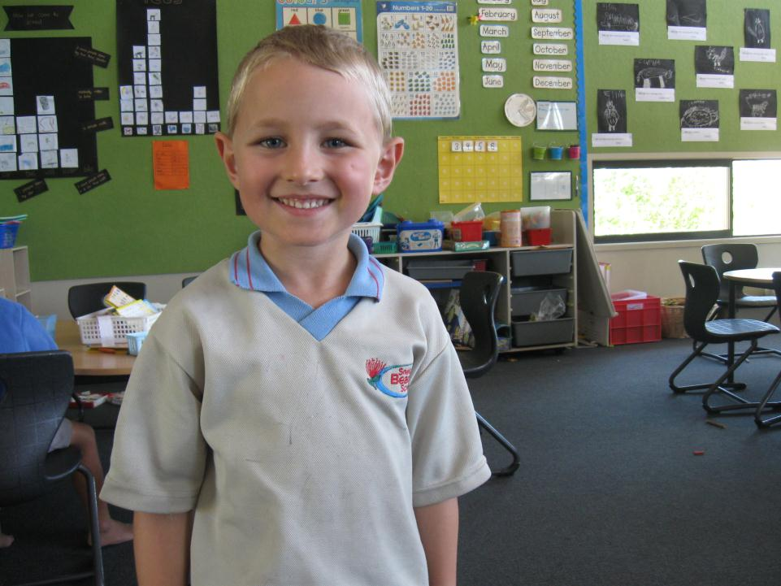
CLICK!
“Smile,” said Ephriam

Slide 4
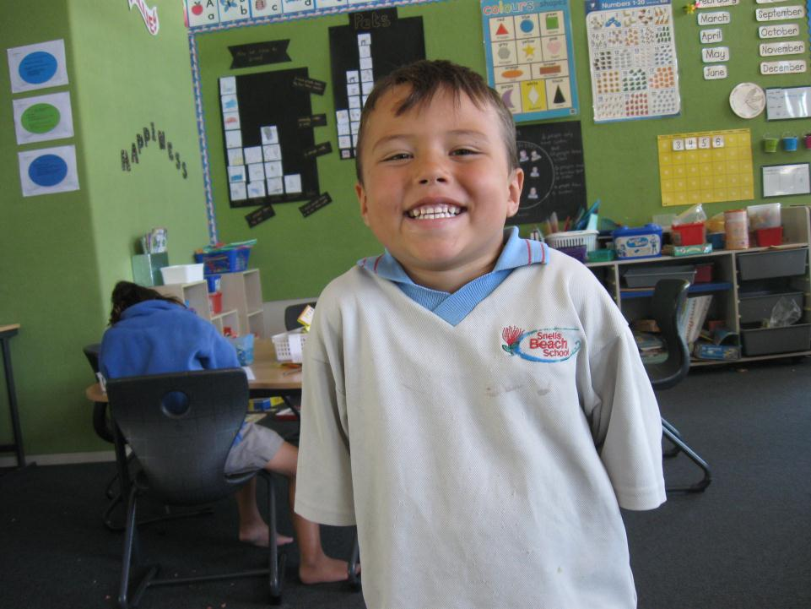
CLICK!
“Smile,” said Conor

Slide 5
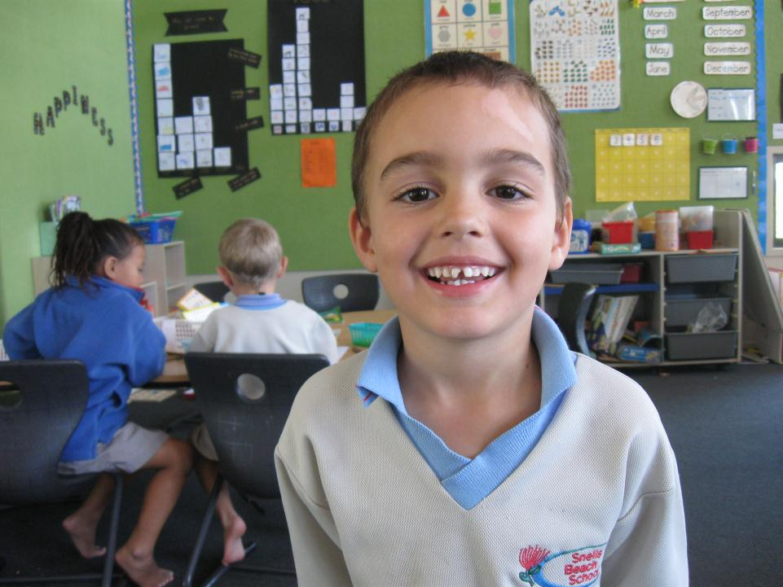
CLICK!
“Smile,” said Elliot

Slide 6
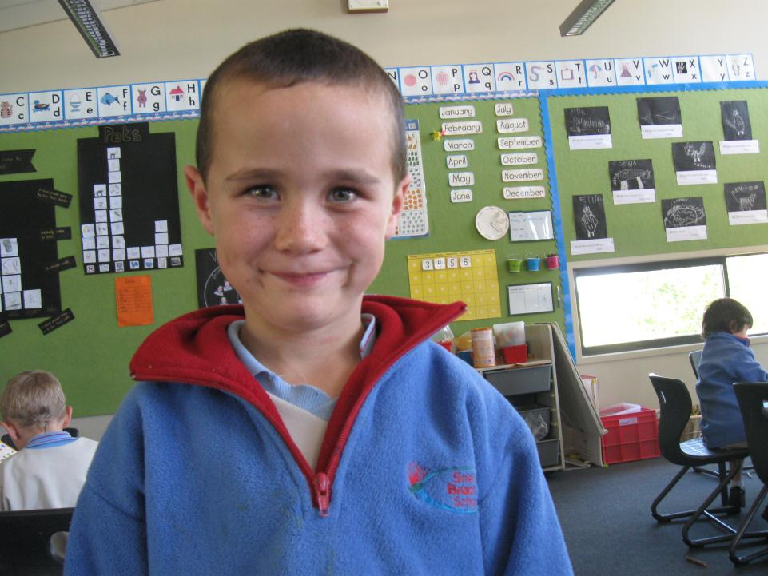
CLICK!
“Smile,” said Cody

Slide 7
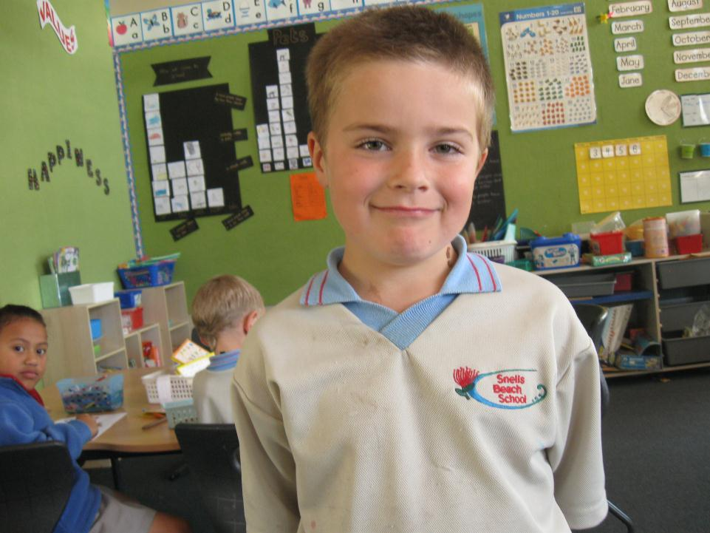
CLICK!
“Smile,” said Niko

Slide 8
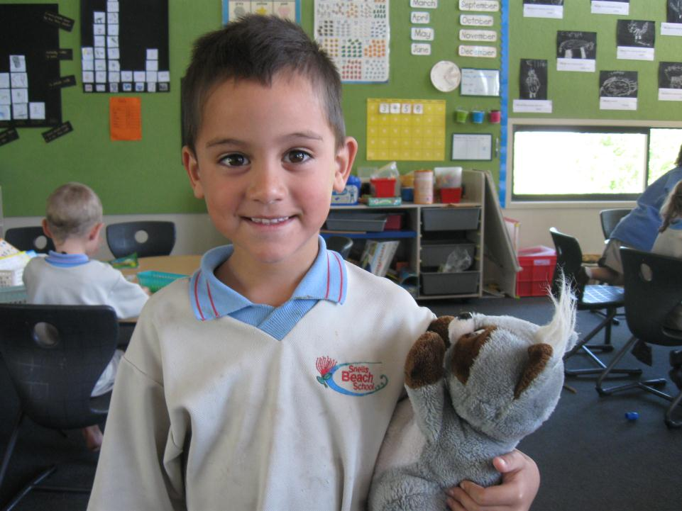
CLICK!
“Smile,” said Connor

Slide 9
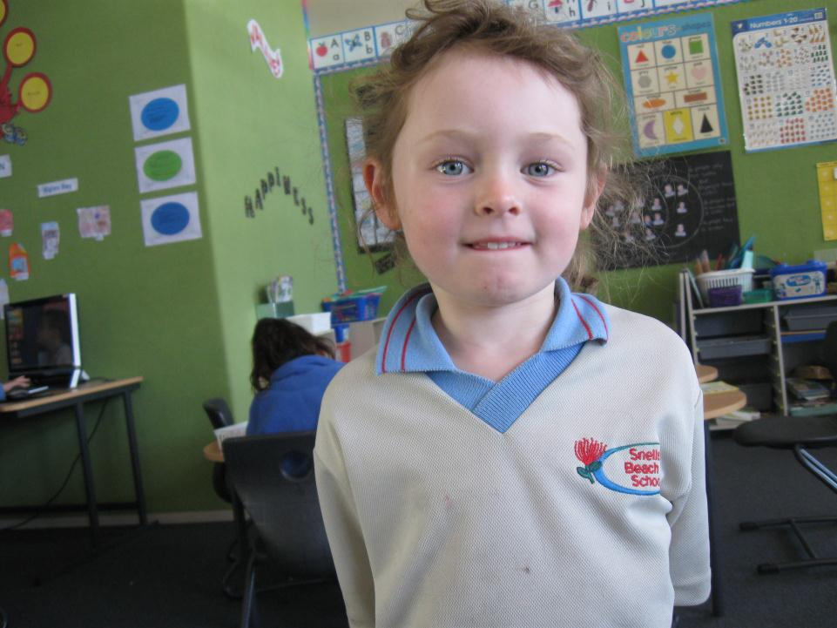
CLICK!
“Smile,” said Joseph

Slide 10
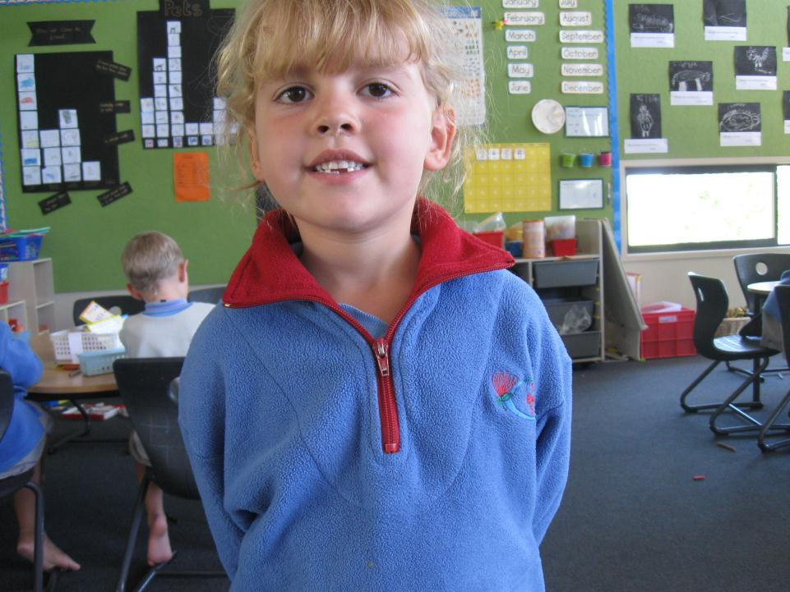
CLICK!
“Smile,” said Bella

Slide 11
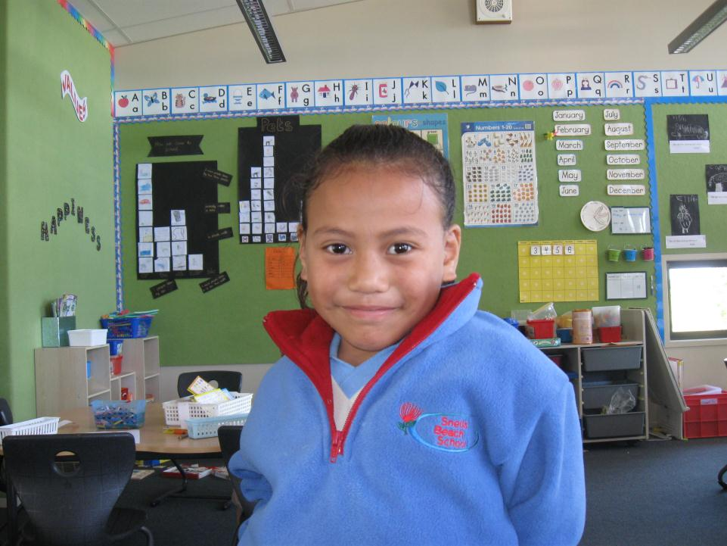
CLICK!
“Smile,” said Olivia

Slide 12
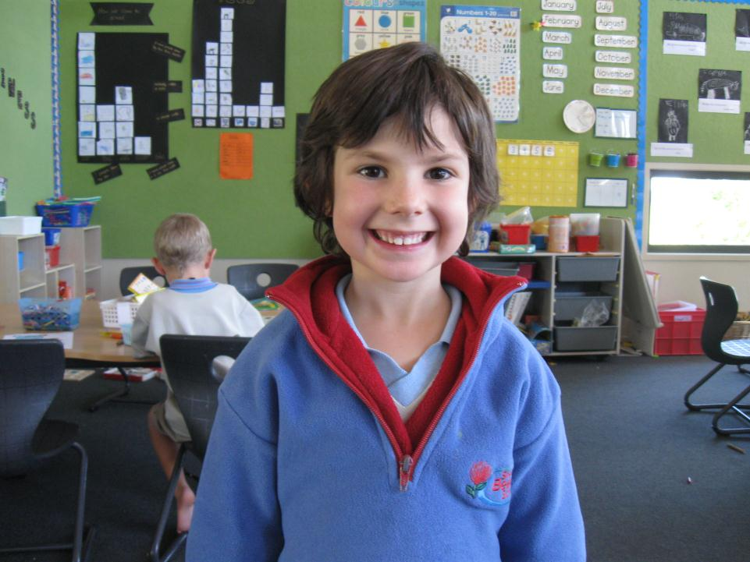
CLICK!
“Smile,” said Seila

Slide 13
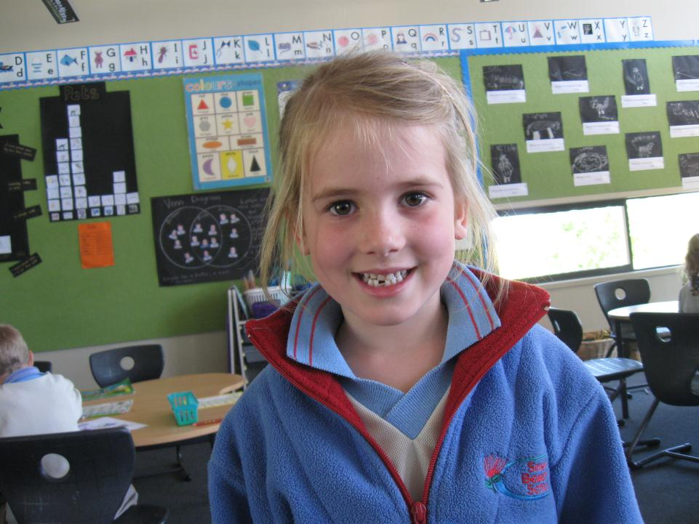
CLICK!
“Smile,” said Caelyn

Slide 14
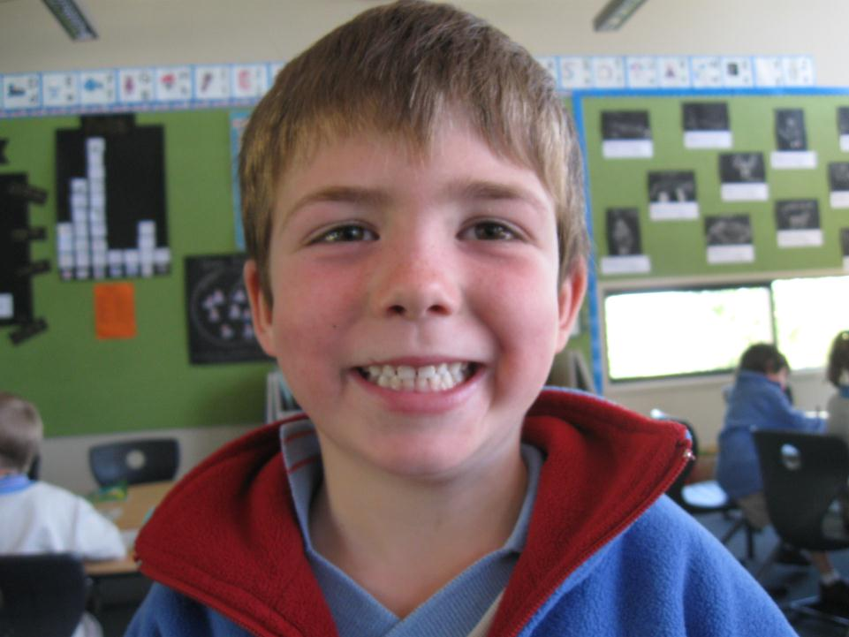
CLICK!
“Smile,” said Ella

