Slide 1
Reading Lesson
Using our Fitzroy.

Slide 2
Why Fitzroy?
Phonetics based
Complements a whole language programme
Ensures reading success due to learning being built slowly.
Ensures children learn their alphabet and letter sounds thoroughly.

Slide 3
From the Beginning:
Children need to know at least 13 alphabet names and sounds before they begin the first book.
Reading is based on alphabet activities when the children first begin.
Our first book is “The Fat Cat”
There are 60 books in the programme and each builds on to skills learnt and introduces another.

Slide 4
A Typical Lesson
Reading Warm-up
Big Book
Group Tumble

Slide 5
Fitzroy Lesson
New letters (for early readers) or new sounds (diagraphs or single letter sounds)
Special words and any
New words whose meaning may need to be explained
Reading the book together
Follow-up sheets

Slide 6
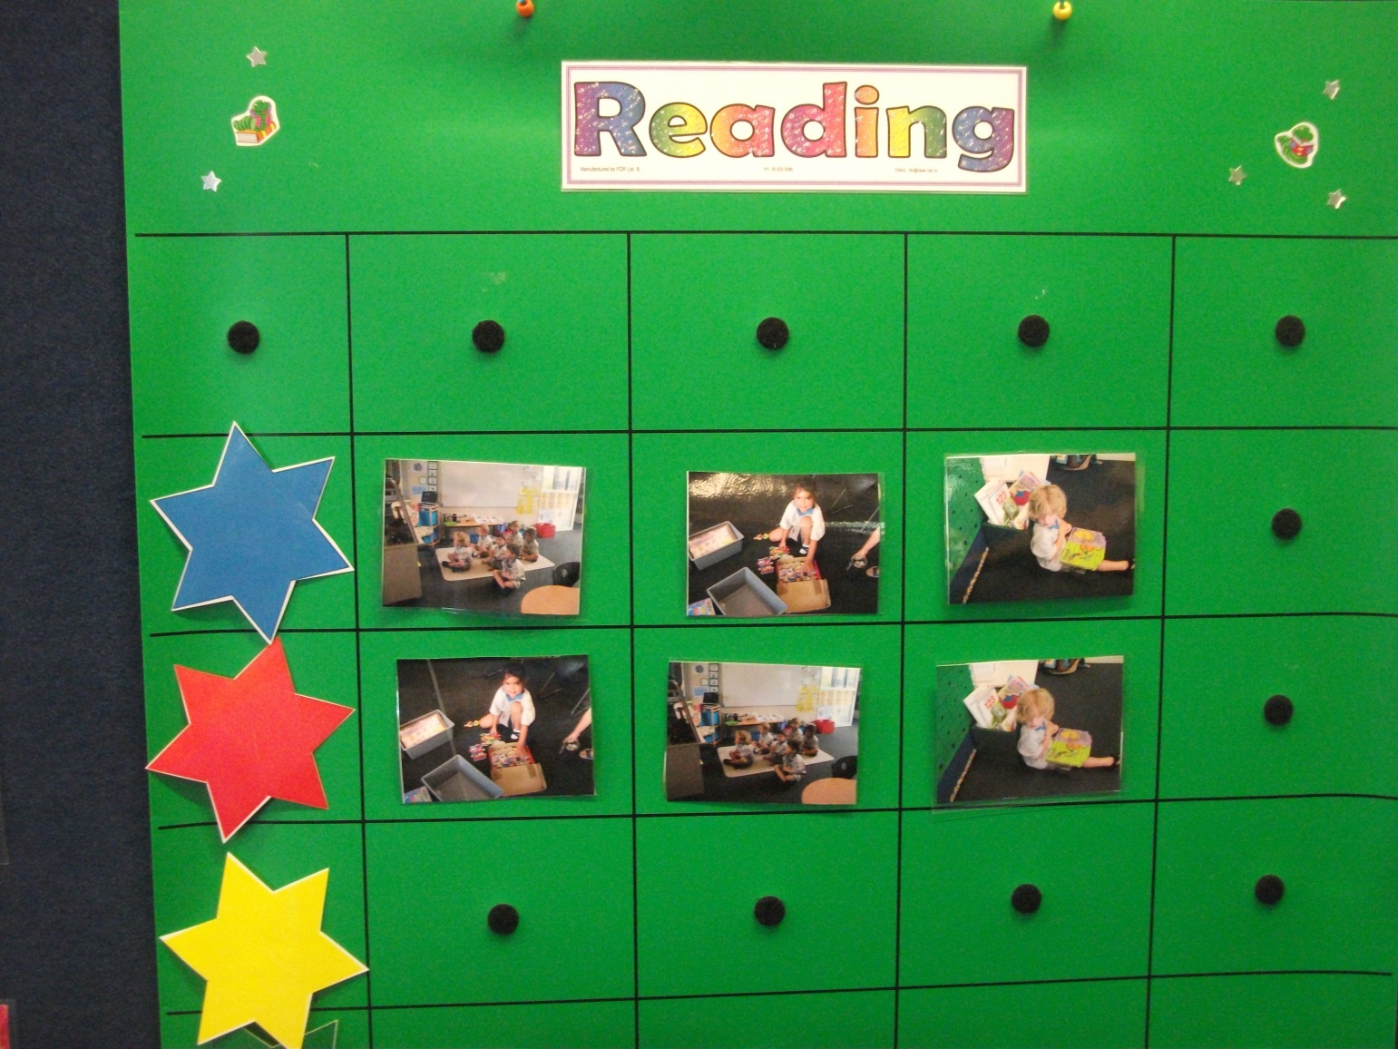
Typical Tumble

Slide 7
FITZROY TUMBLE: P.WATKIN
FITZROY TUMBLE: P.WATKIN
FITZROY TUMBLE: P.WATKIN
GROUPS | DAY 1 | DAY 2 | DAY 3 | DAY 4
Blue Stars Magenta | Pre-test spelling from reader Student follow-up cover for worksheets booklet | Recover known words-flashcards Student follow-up Sheet A | Introduce new sounds & diagraphs Teacher reads text Scan text play dough mats Brainstorm charts Mark Worksheet A Student follow-up Sheet B | Special words Scan reader Syllabification Flash cards Listen/say/write Students read book as a group Mark Worksheet B Student follow-up Sheet C
Green Stars Magenta
Red Stars
Yellow Stars
GROUPS | DAY 5 | DAY 6 | DAY 7 | DAY 8
Blue Stars Magenta | Flashcards of words we know Students read book Mark Worksheet C Student follow-up Sheet D | Introduce & work on new words Students read book Mark Worksheet D Student follow-up Sheet E | Comprehension discussion top of Sheet F Students to read book Mark Worksheet E Student follow-up Thinkers Keys activities based on book | Phrasing & fluency focus Students read book Student follow-up Sheet G
Green Stars Magenta
Red Stars
Yellow Stars
GROUPS | DAY 9 | DAY 10 | DAY 11 | DAY 12
Blue Stars Magenta | Teacher to work with the group on Comprehension activities Sheet F | Other reading resource- Ready to Read series Student follow-up related activity to book | Other reading resource- Ready to Read series Student follow-up related activity to book | Post-test on book: spelling & dictated sentence Student follow-up read text to a peer NB: When at end of a decade of books special assessment sheet is used.
Green Stars Magenta
Red Stars
Yellow Stars

Slide 8
KAURI 1 WEEKLY READING GROUP PLAN Term 1 WEEK 4
 | MONDAY | TUESDAY | WEDNESDAY | THURSDAY | FRIDAY
Red Stars | WALT: Relate pictures to print. Front & back of book |  |  |  | POETRY RESPONSE Here is the beehive. Here is the classroom, here are the kids.
 | Fitzroy Book N/A Ready to Read - Emergent
 | Homereading Here is the beehive. | Homereading Let’s Go | Homereading Hickory Dickory Dock. | Homereading Power Point Book.
 | Fitzroy-alphabet sheet C.Wheel- Let’s Go | Fitzroy-alphabet sheet C Wheel- Let’s Go | Fitzroy- alphabet sheet C Wheel- Let’s Go | Fitzroy-alphabet sheet C Wheel- Let’s Go
Blue Stars | WALT: Sounding out the individual sounds in a word to identify the word. |  |  |  | BIG BOOK RESPONSE Greedy Cat is Hungry. Acting out the story as a play.
 | Fitzroy Book: Book 1 Ready to Read – Emergent
 | Homereading The Boat | Homereading Old Tuatara | Homereading What do I see? | Homereading LunchBoxes
 | Fitzroy Day 9 C Wheel- The Boat | Fitzroy- Day 10 C Wheel- Old Tuatara | Fitzroy Day 11 C Wheel- What do I see? | Fitzroy- Day 12 C Wheel- LunchBoxes
Yellow Stars | WALT: Make links between illustrations & print |  |  |  | Running Records Alphabet Magenta 1.
 | Fitzroy Book: N/A Ready to Read -
Big Book Greedy Cat is Hungry. | Critical Thinking How do you think the family felt when they found out that Katie had fed the cat? | Print Conventions Fullstops | Vocabulary Finding here. |  | Web Site Book Power point story based on style of the Let’s Go. -for school - for swimming.
Poem Here is the Beehive. | Anthology | Talking & Listening When are there capital letters? | Rhyming

