Slide 1
Lunch Boxes.
by Kauri 1

Slide 2
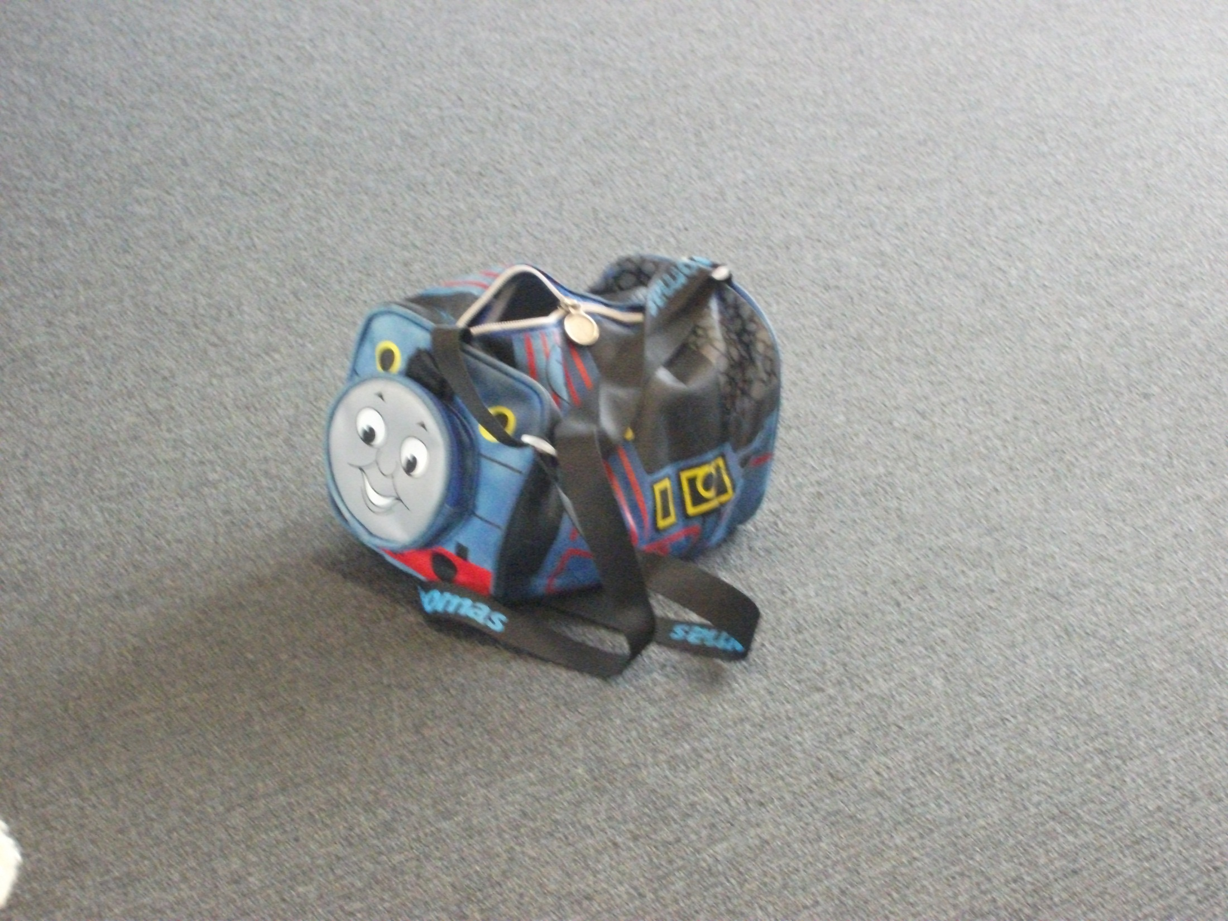
Lunch Boxes.
By Kauri 1

Slide 3
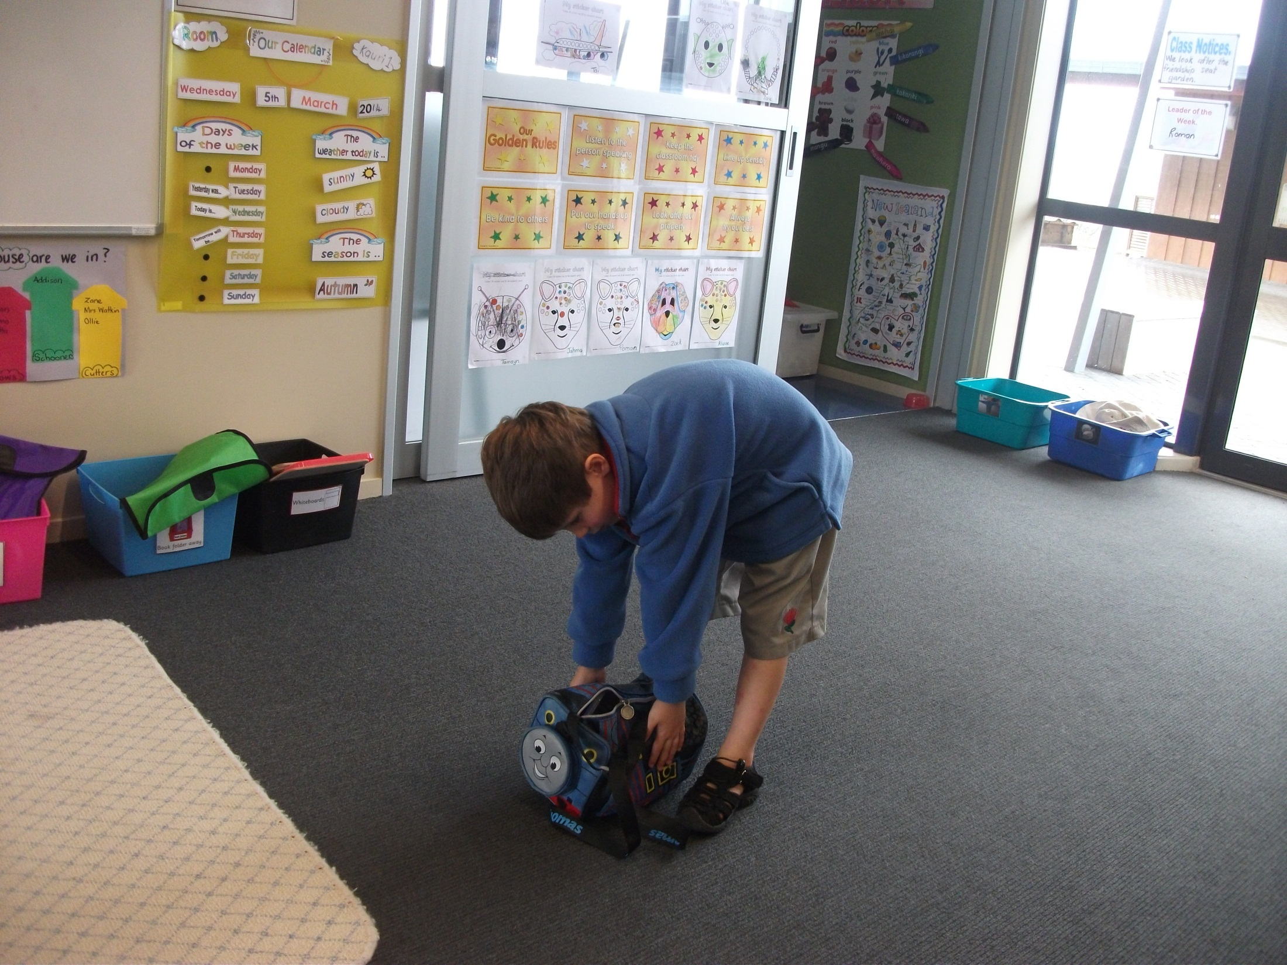
Zack’s train lunch box.

Slide 4
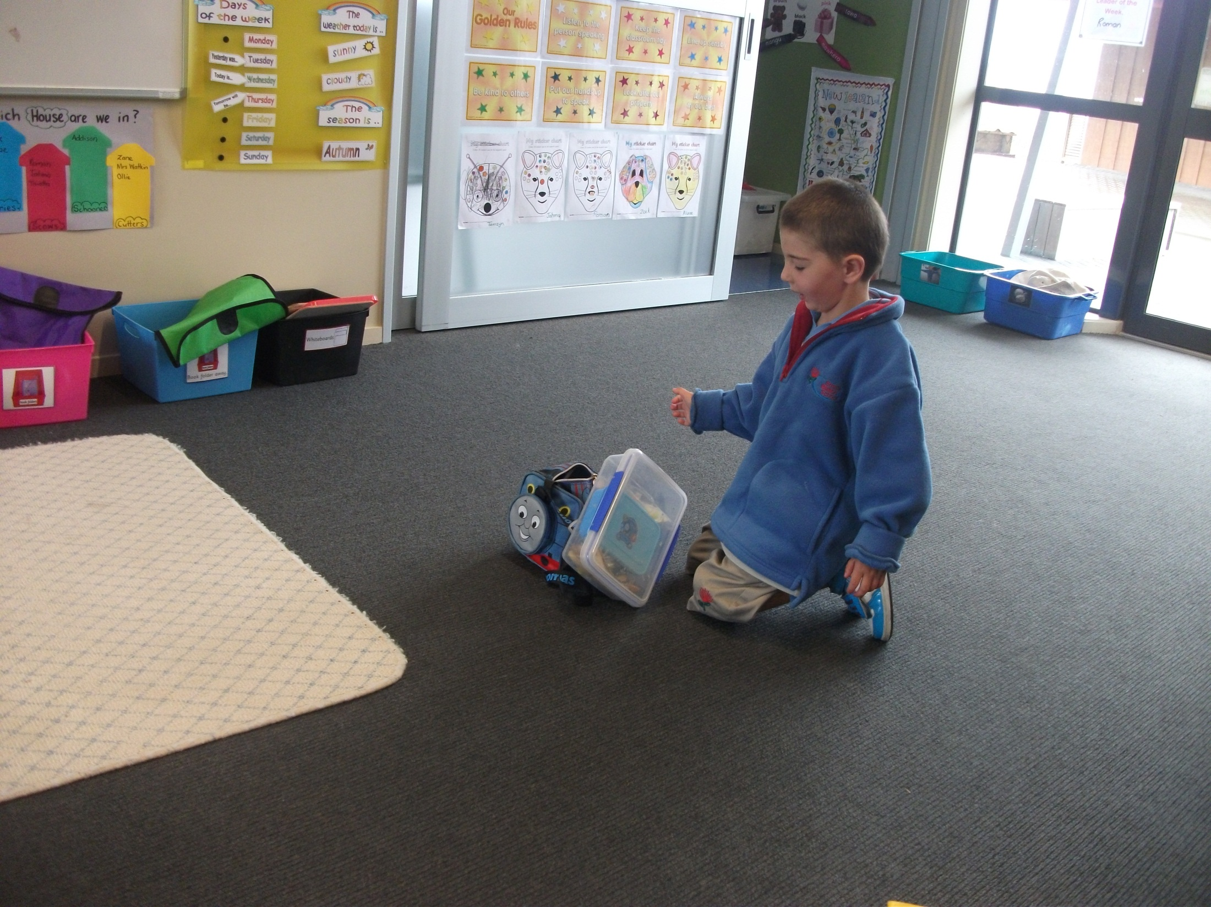
And Roman’s see-through lunch box.
Look out!

Slide 5
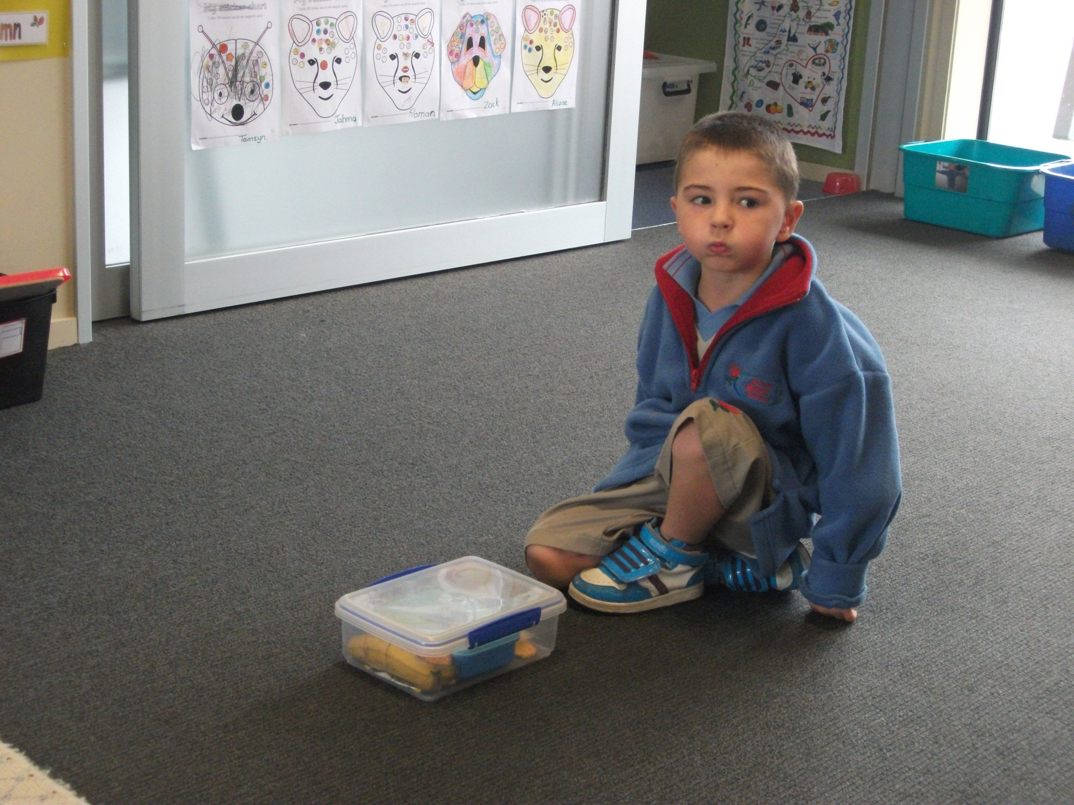
Roman’s see-through lunch box.

Slide 6
And Alizae’s Dora lunch box.

Slide 7
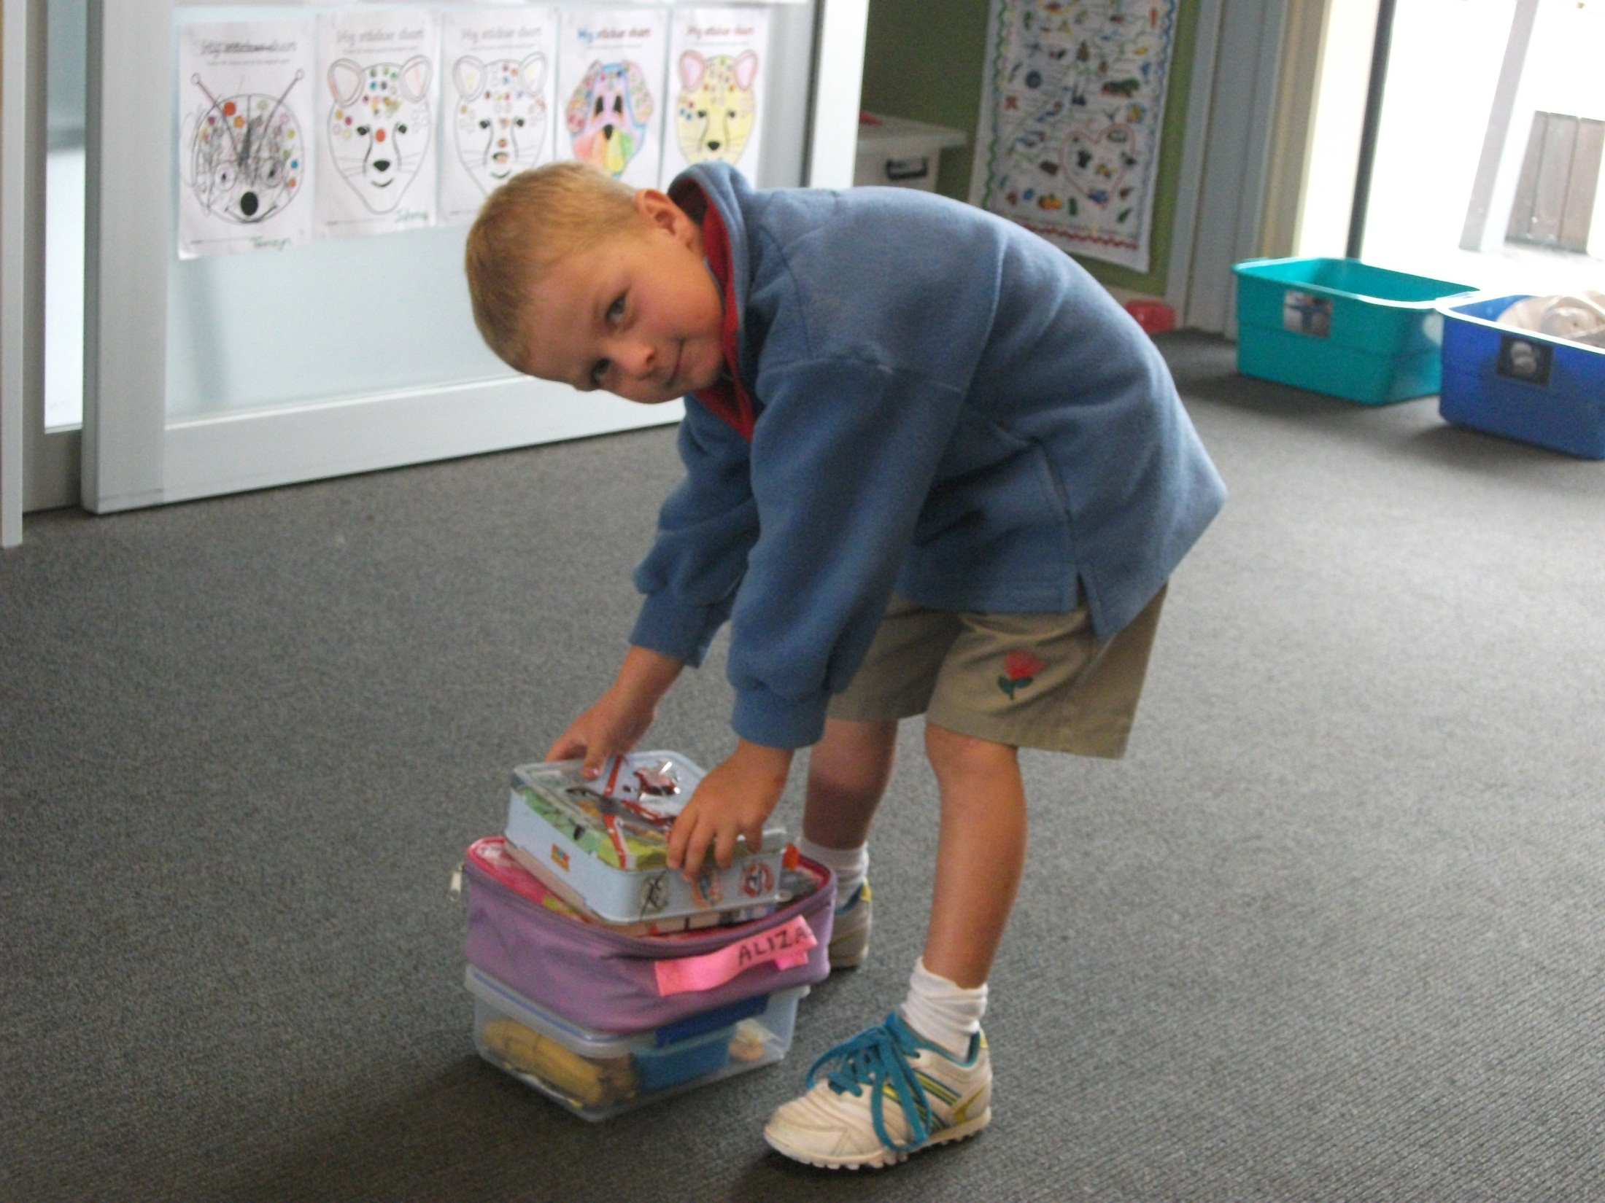
And Jahmo’s airplane lunch box.

Slide 8
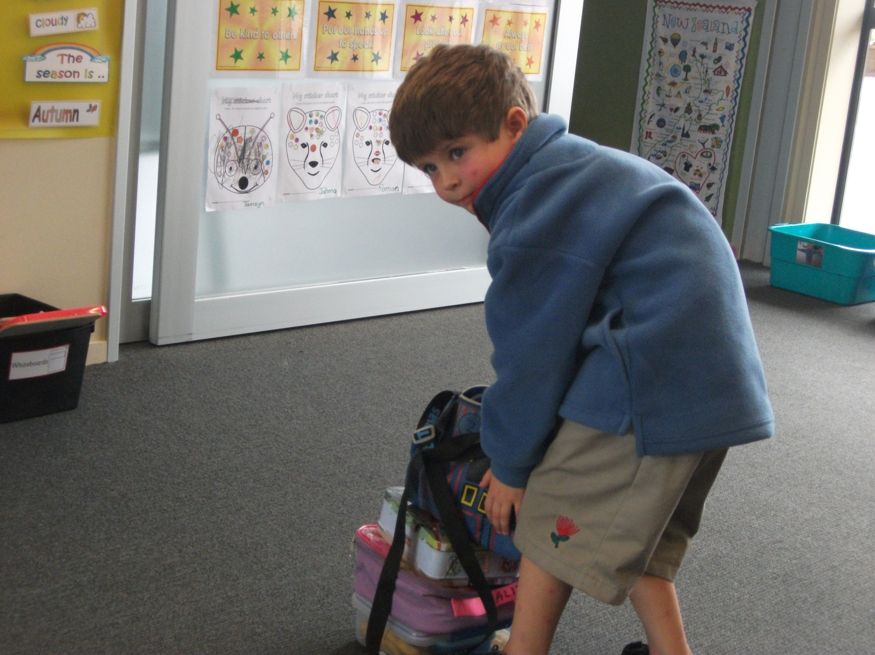
And Zack’s train lunch box.

Slide 9
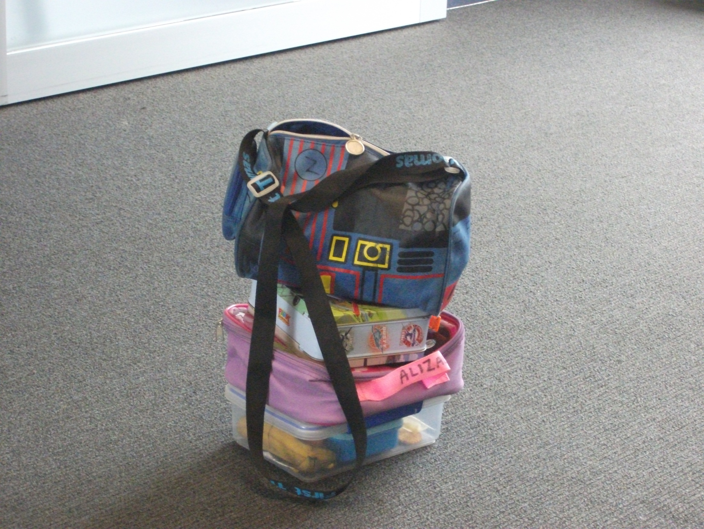
Look out!

