Slide 1
I can write
by Kauri 2

Slide 2
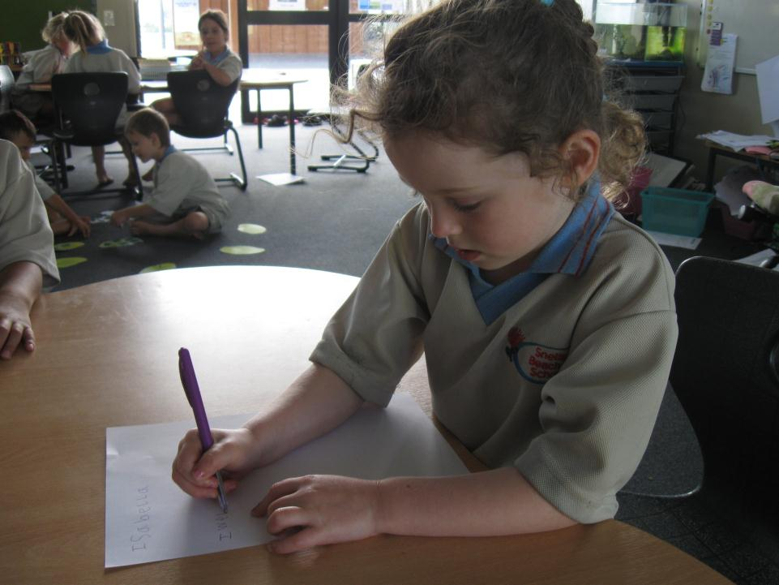
I can write on paper with a pen.

Slide 3
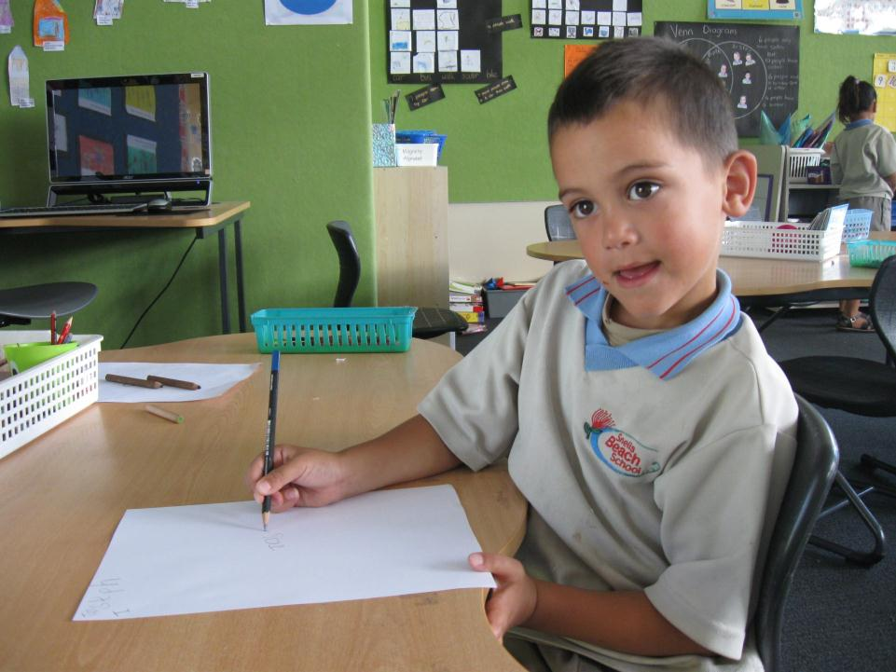
I can write on paper with a pencil.

Slide 4
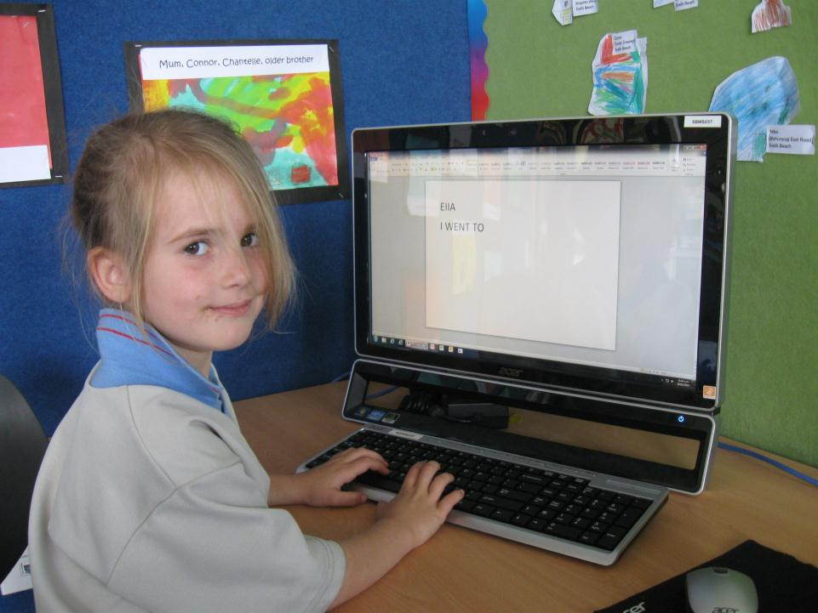
I can write on the computer.

Slide 5
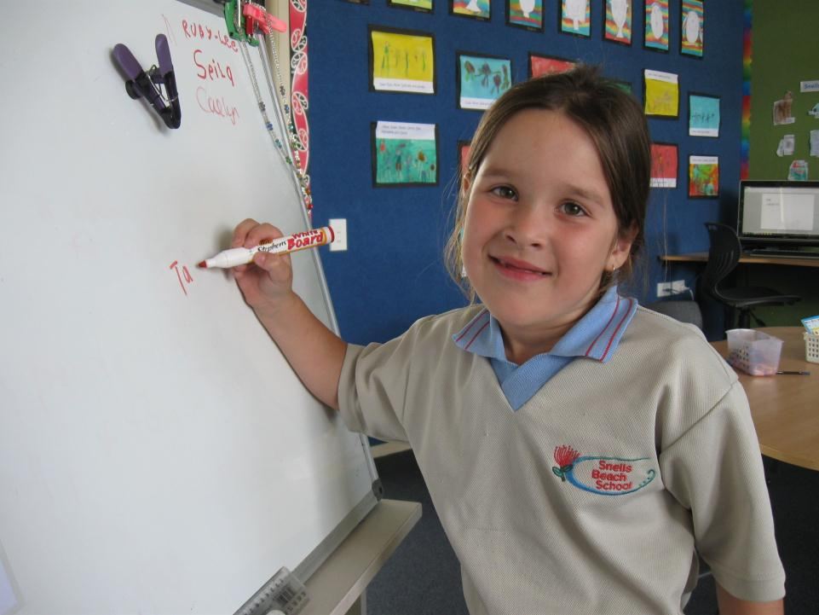
I can write on the whiteboard

Slide 6
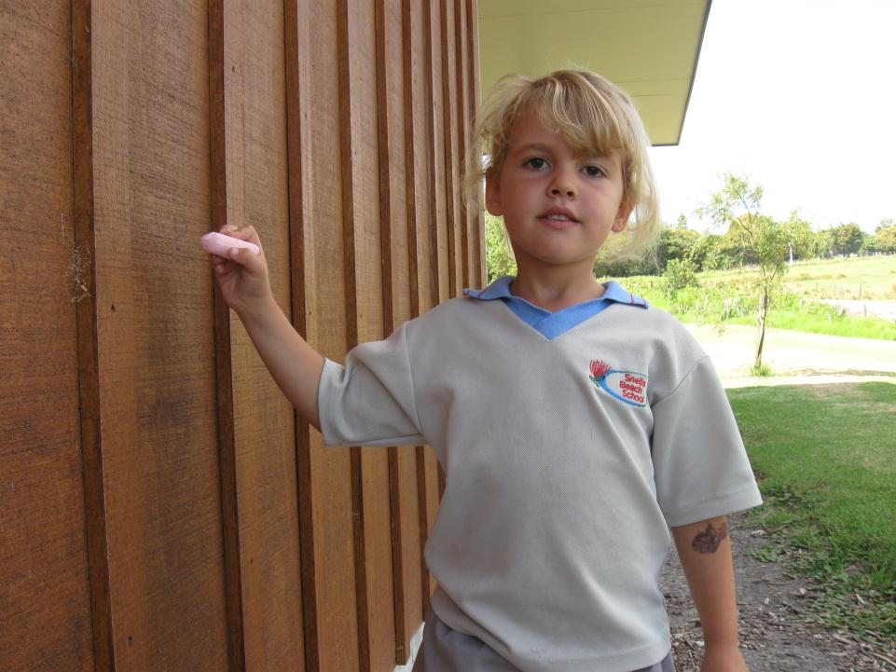
I can write on the wall with chalk

Slide 7
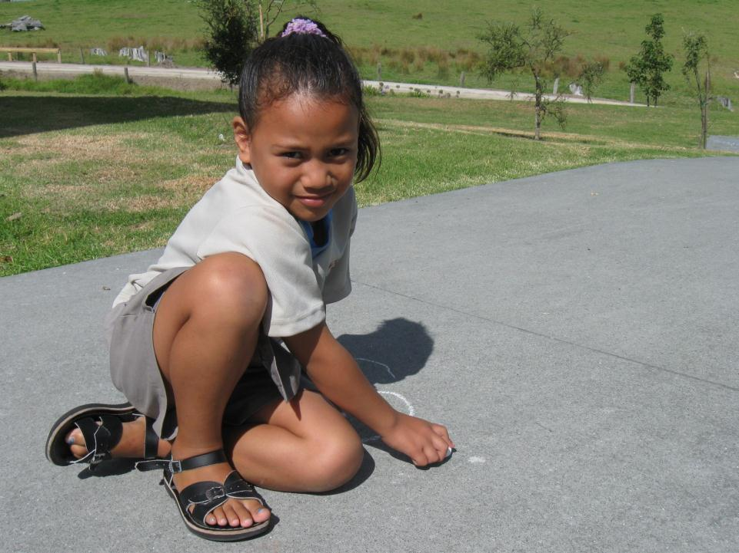
I can write on the path with chalk

Slide 8
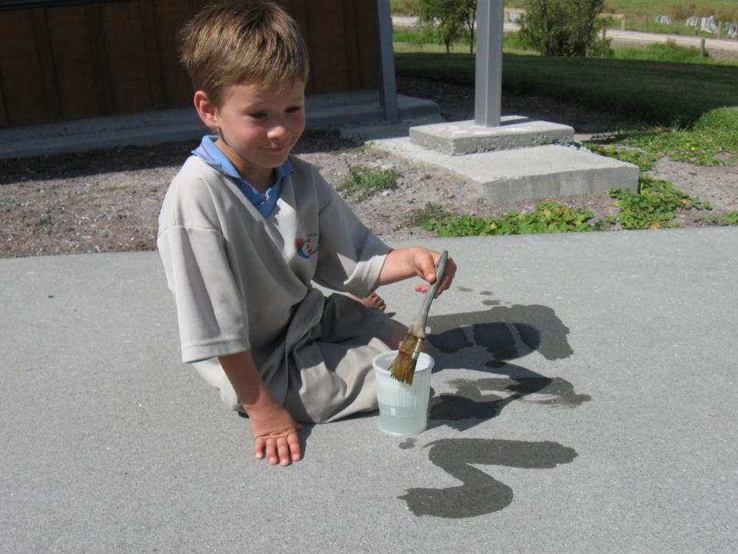
I can write on the path with water.

Slide 9
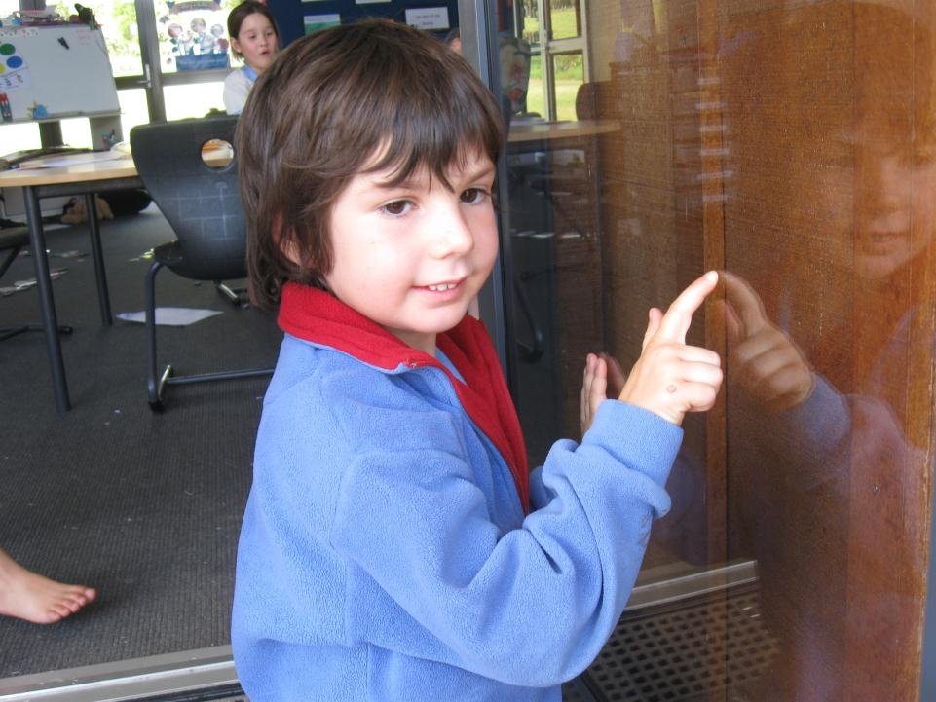
I can write on the window with my finger.

Slide 10
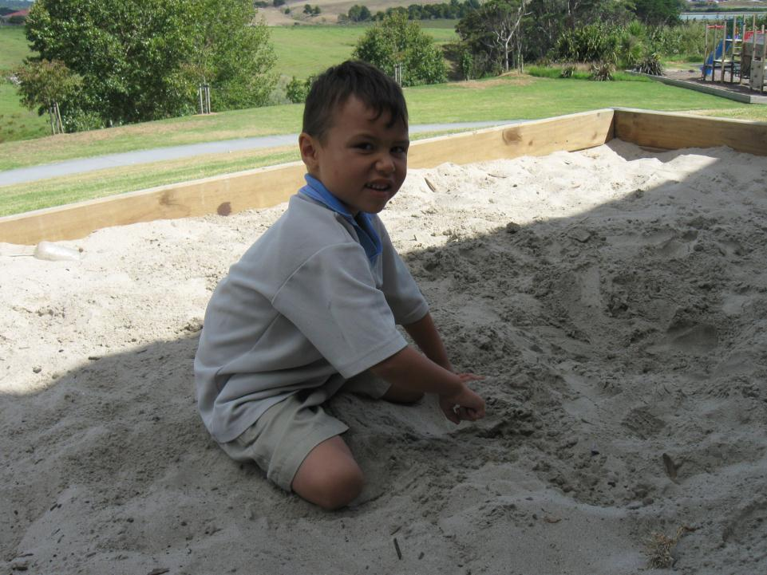
I can write in the sand with my finger

Slide 11
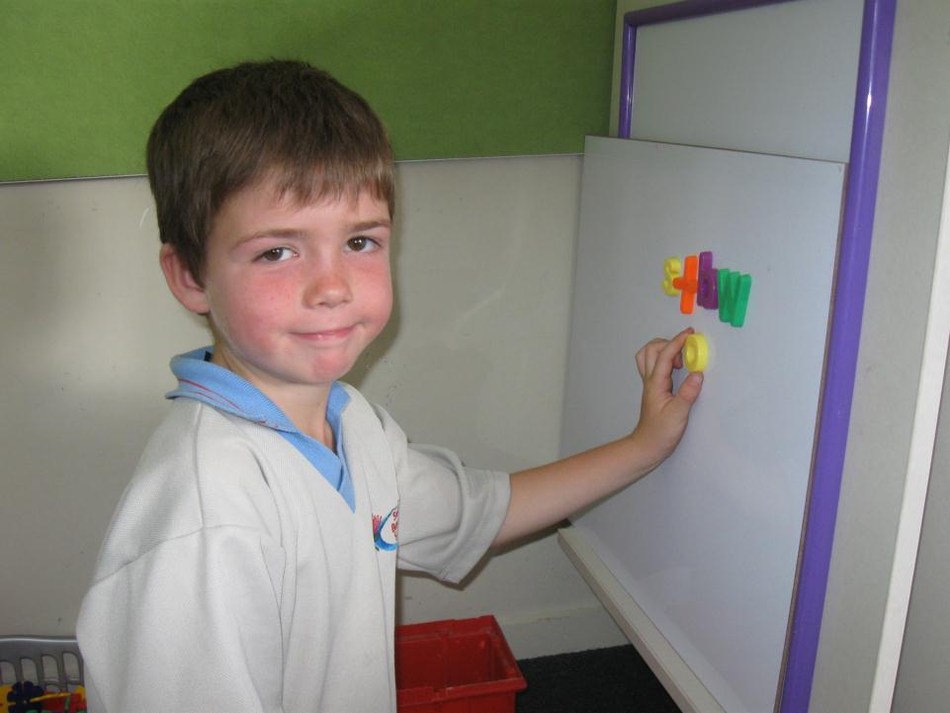
I can write on a whiteboard with magnetic letters.

Slide 12
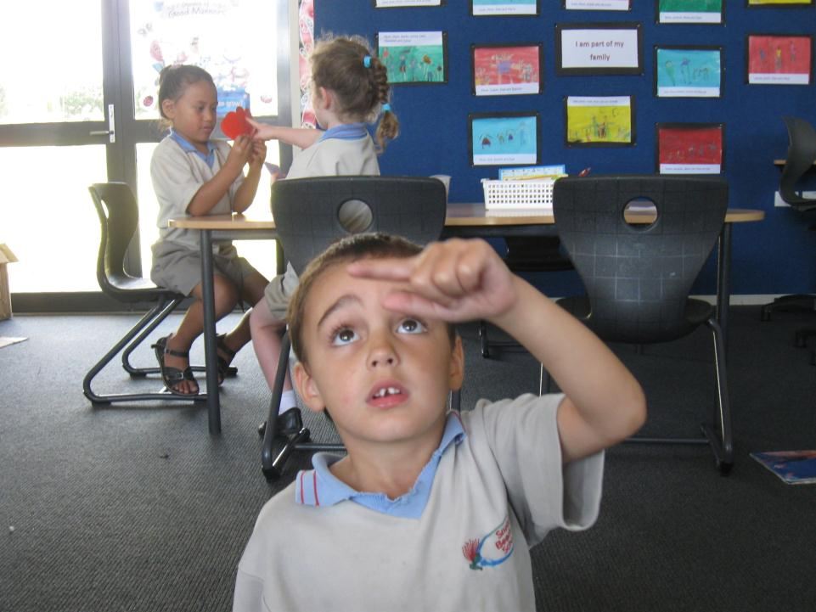
I can write in the air with my finger.

Slide 13
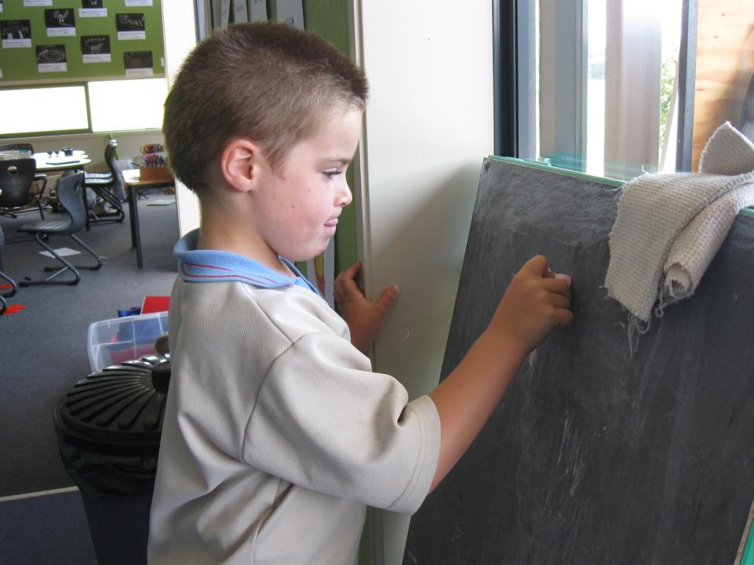
I can write on the blackboard with chalk.

Slide 14
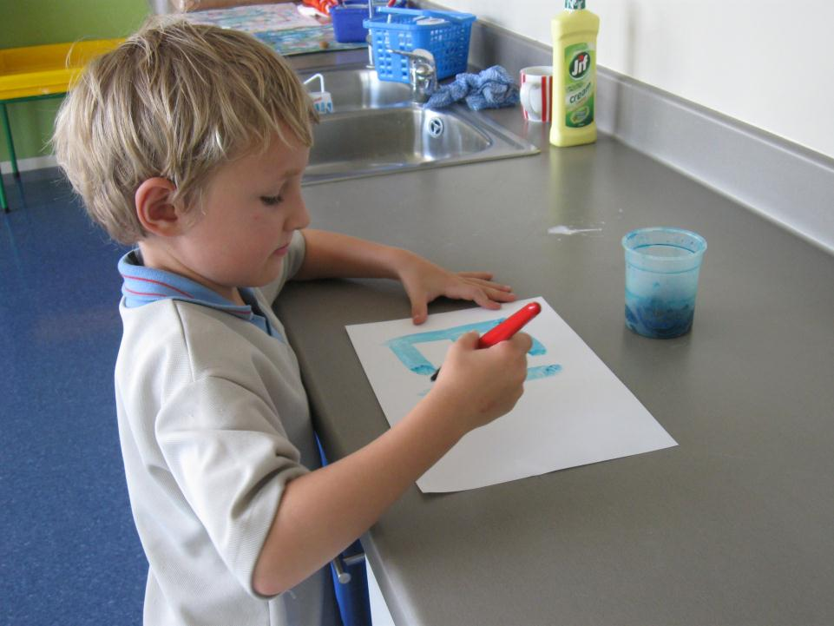
I can write on paper with dye.

Slide 15
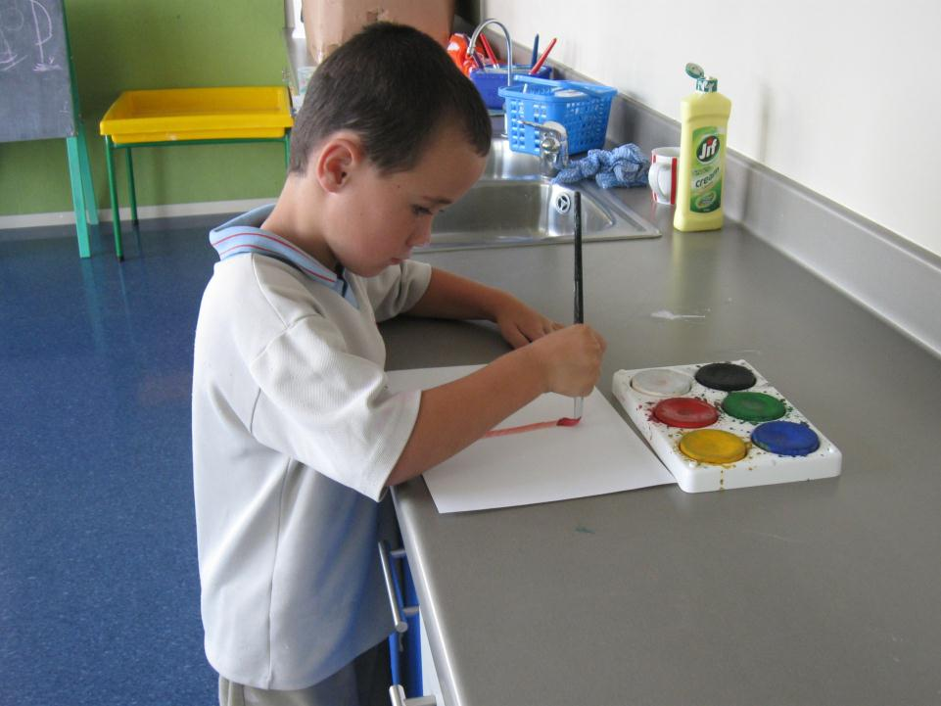
I can write on cardboard with paint

