Slide 1
I Can Read.
by Kauri 1

Slide 2
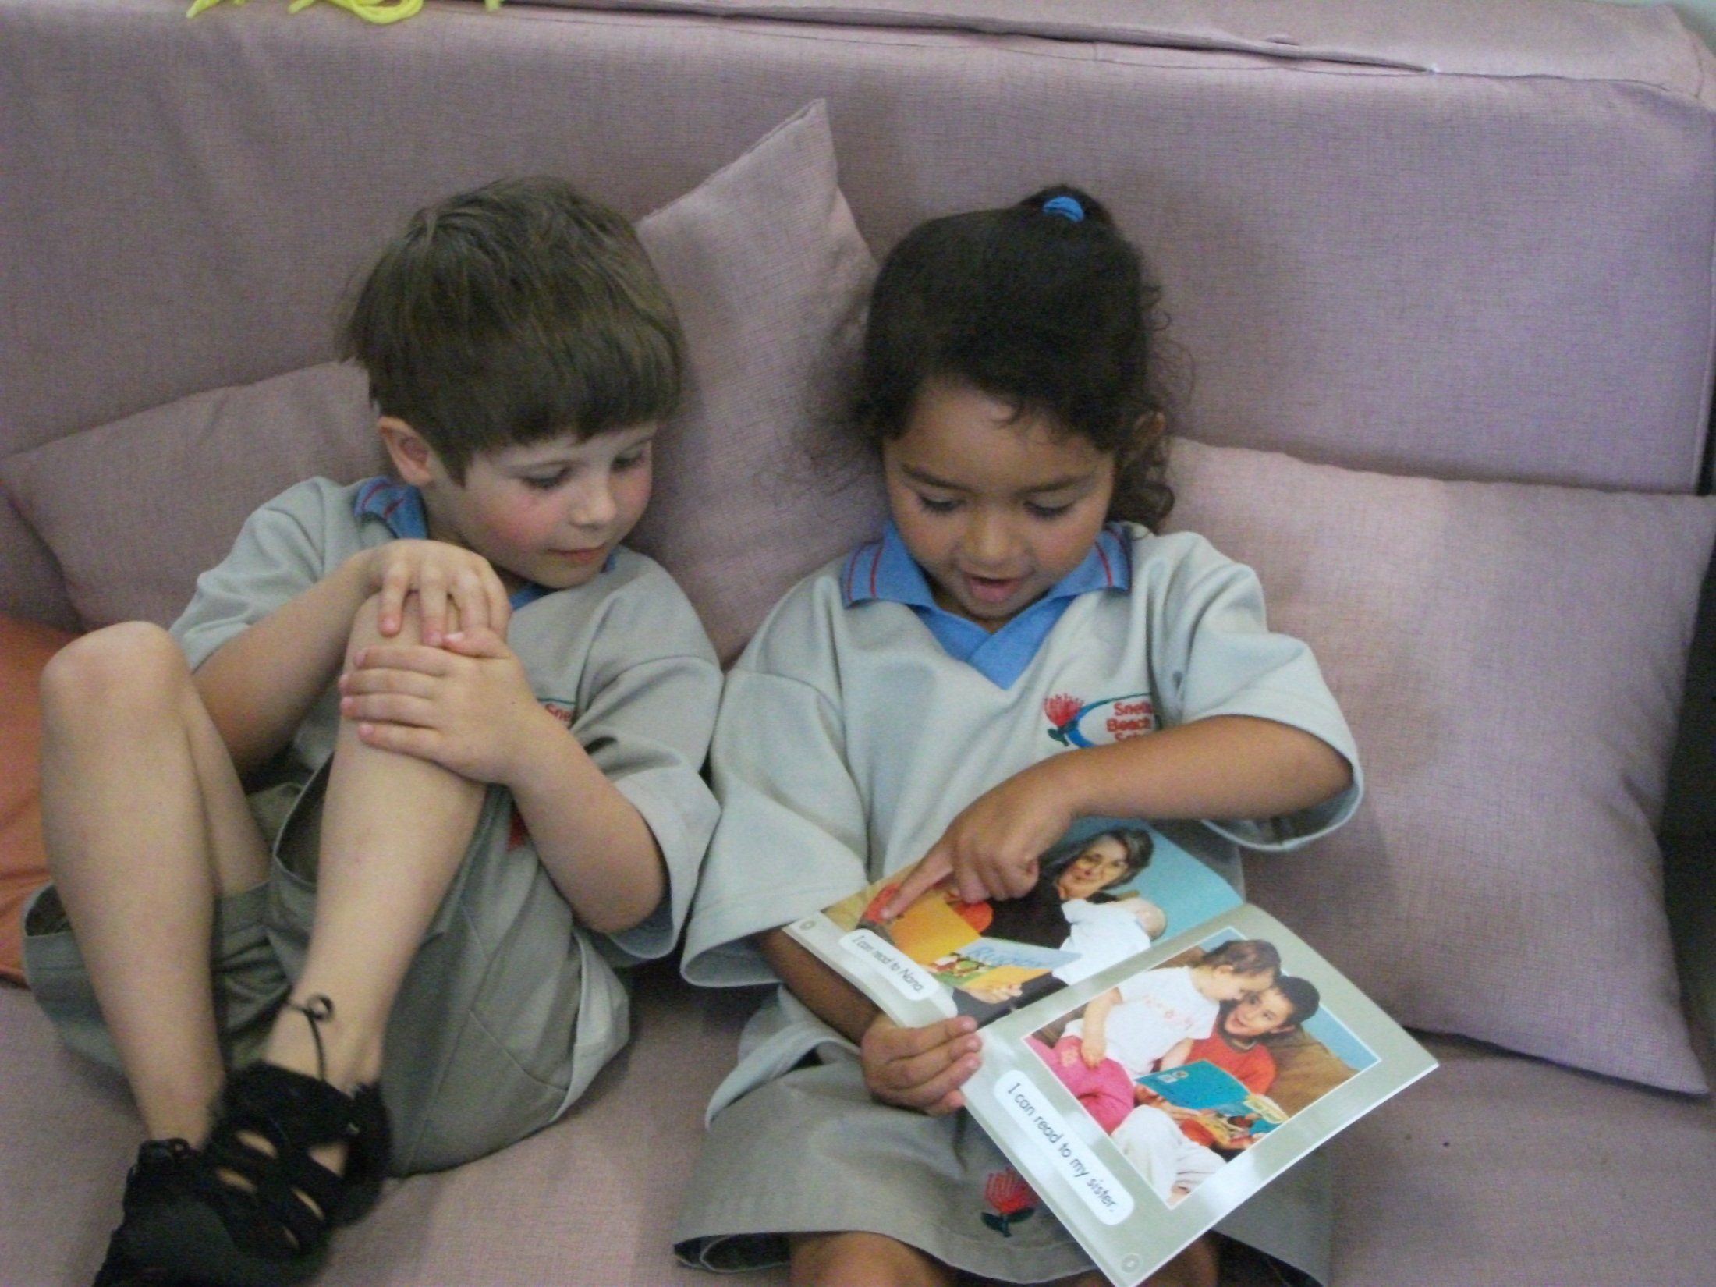
I can read to Zack.

Slide 3
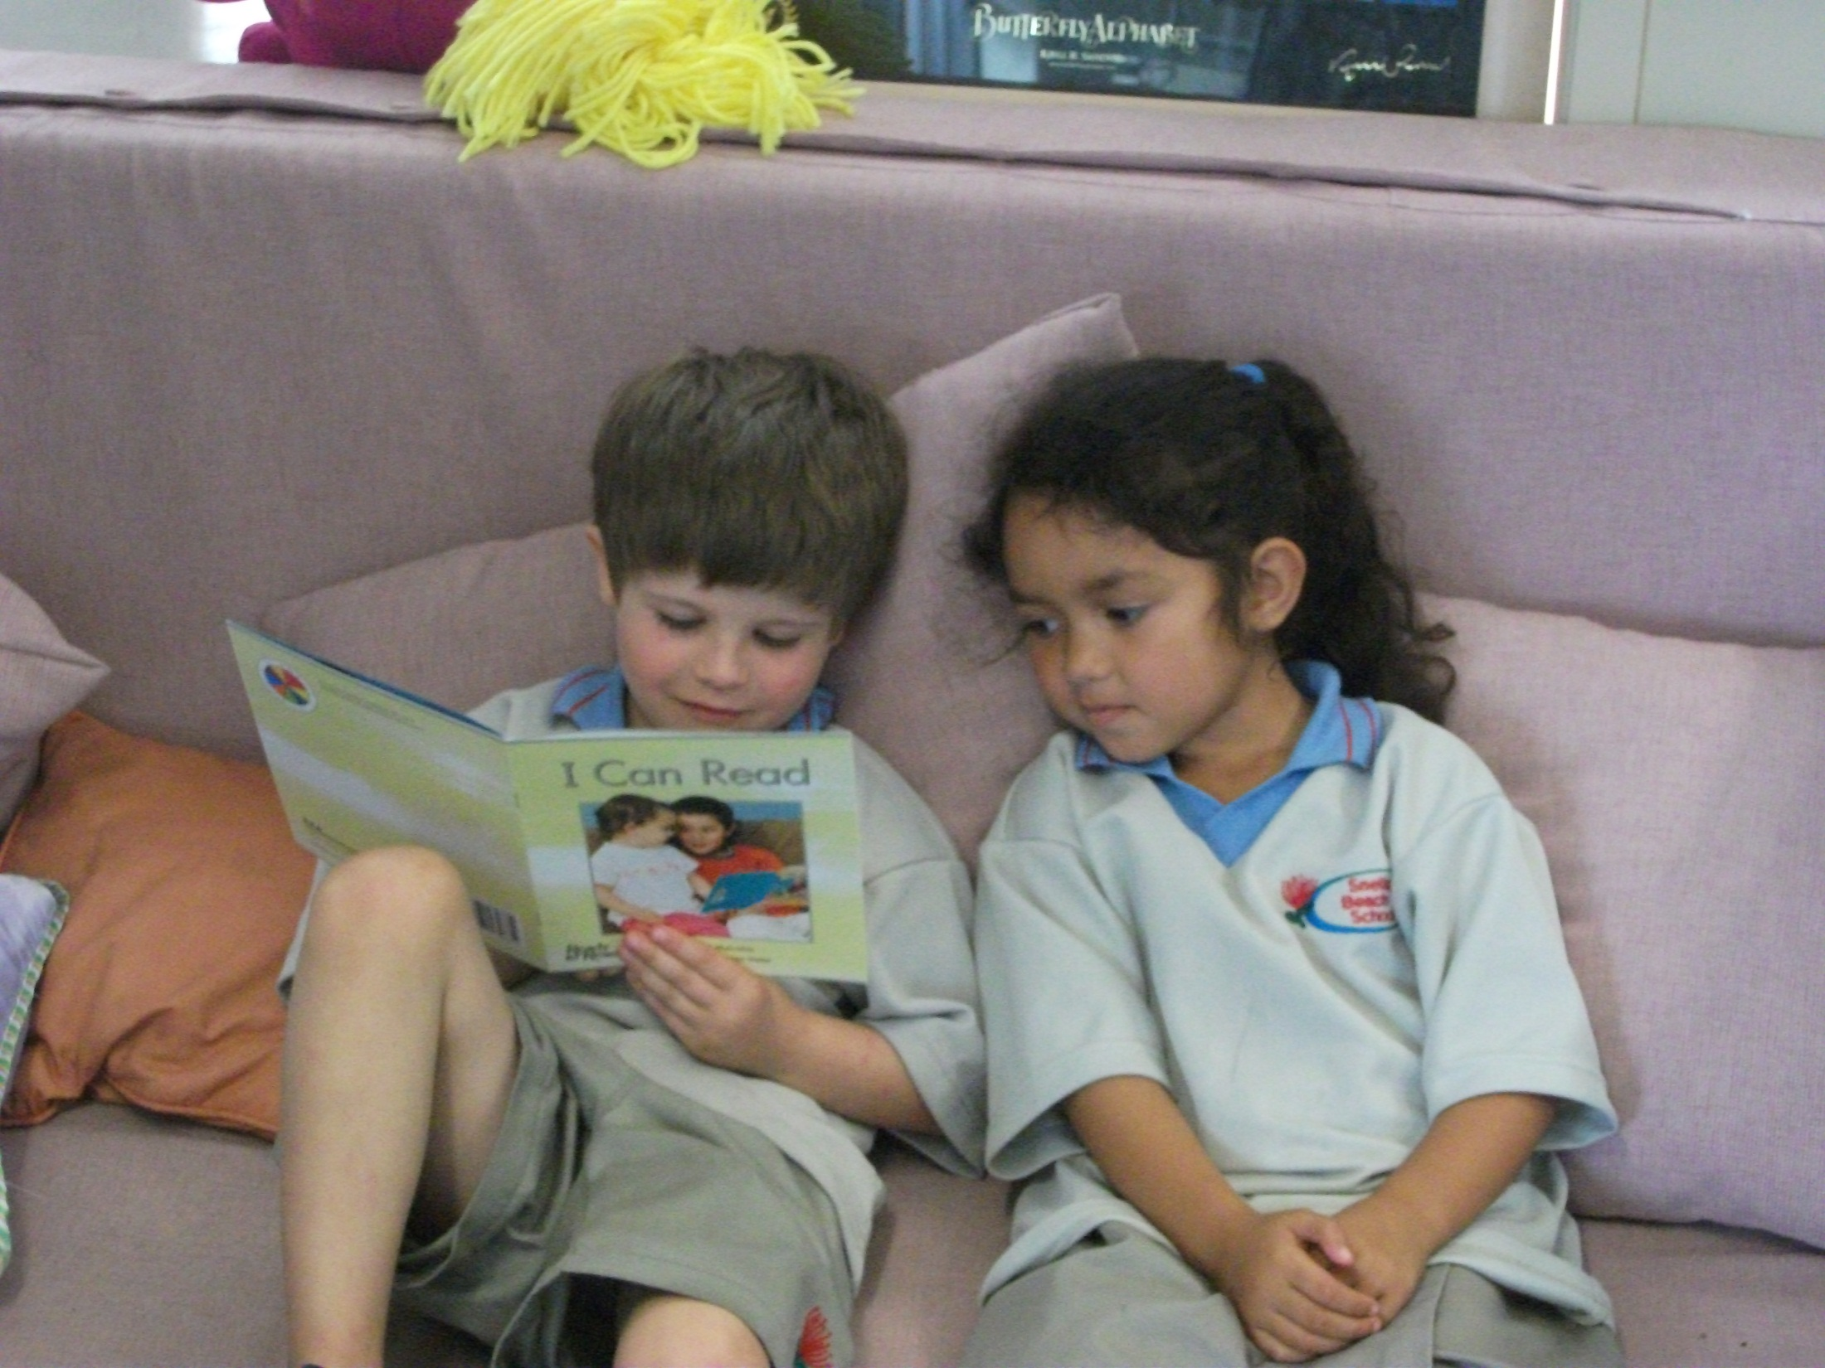
I can read to Alizae.

Slide 4
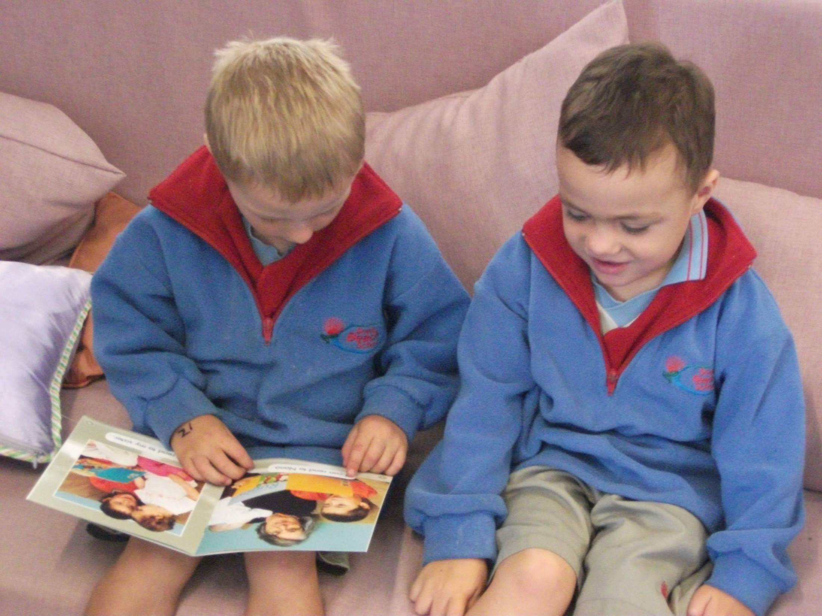
I can read to Taiatta.

Slide 5
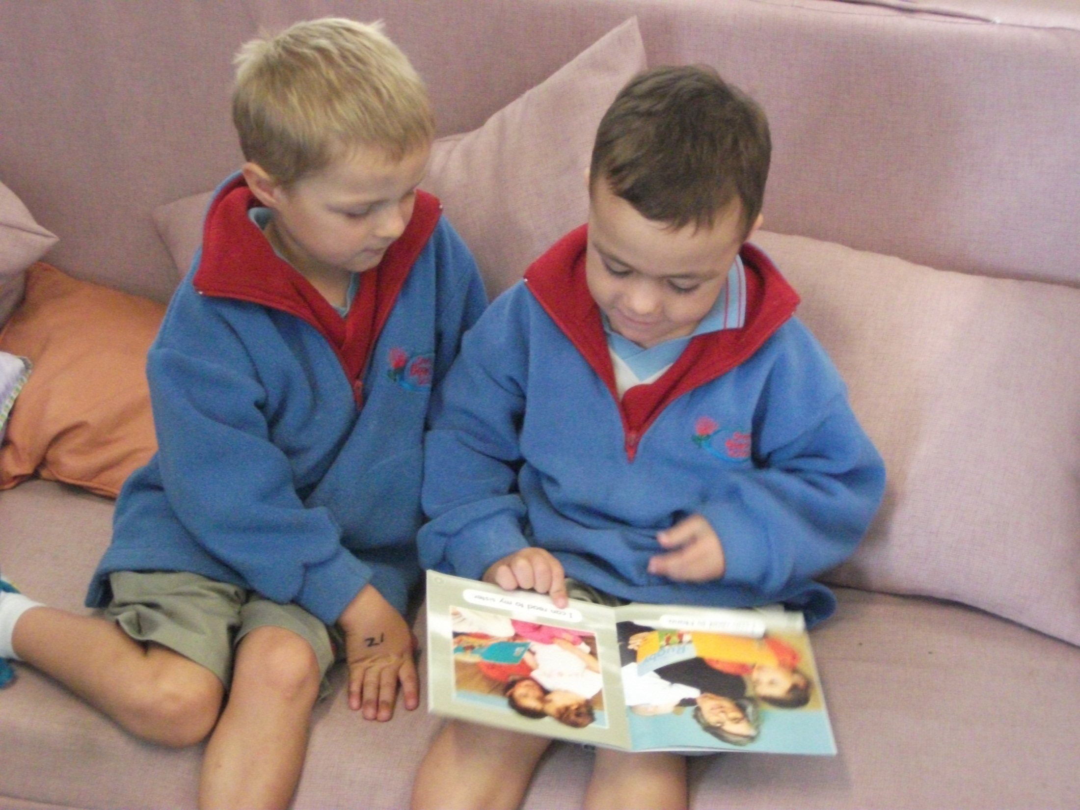
I can read to Jahmo.

Slide 6
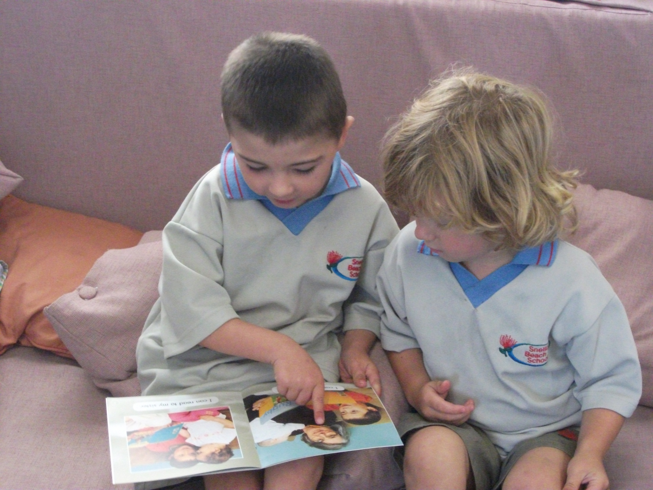
I can read to Zane.

Slide 7
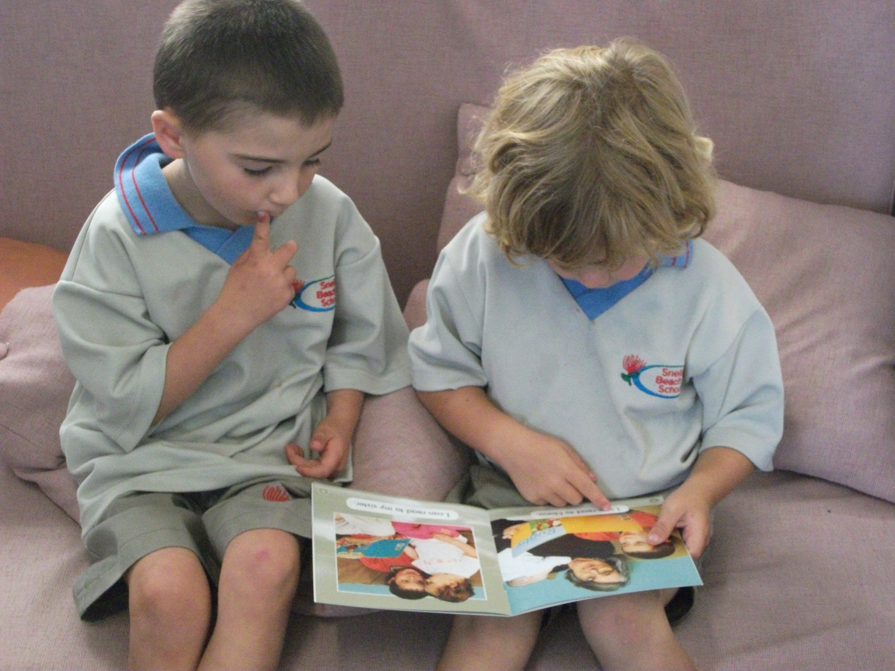
I can read to Roman.

Slide 8
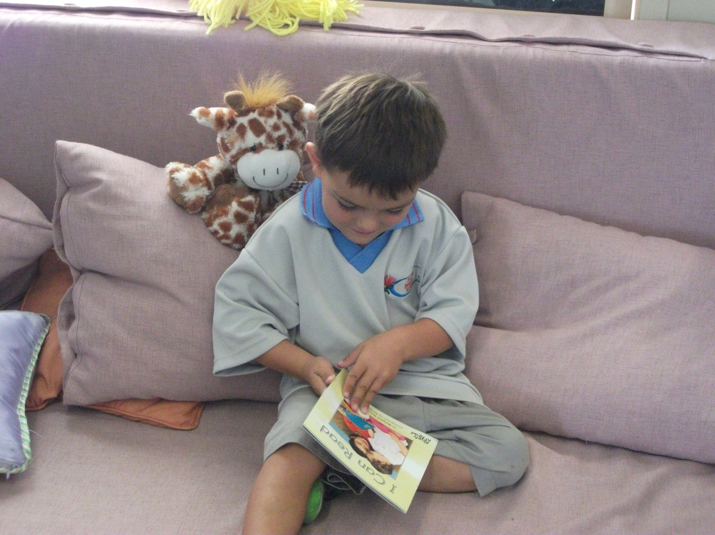
“I can read to Giraffe,” said Ollie.

