Slide 1
Guess who has Fancy Feet?
by Kauri 2

Slide 2
Can you guess whose feet?

Slide 3
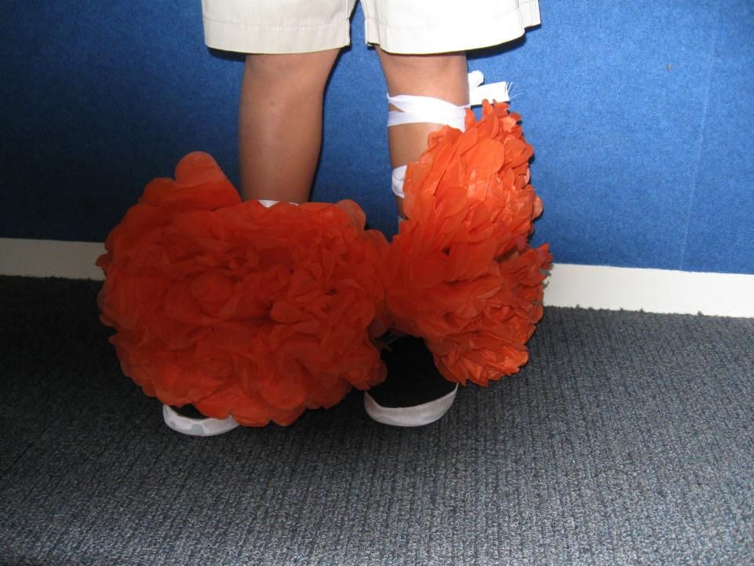
I had rocket shoes. They were orange and it was fancy feet day.
1

Slide 4
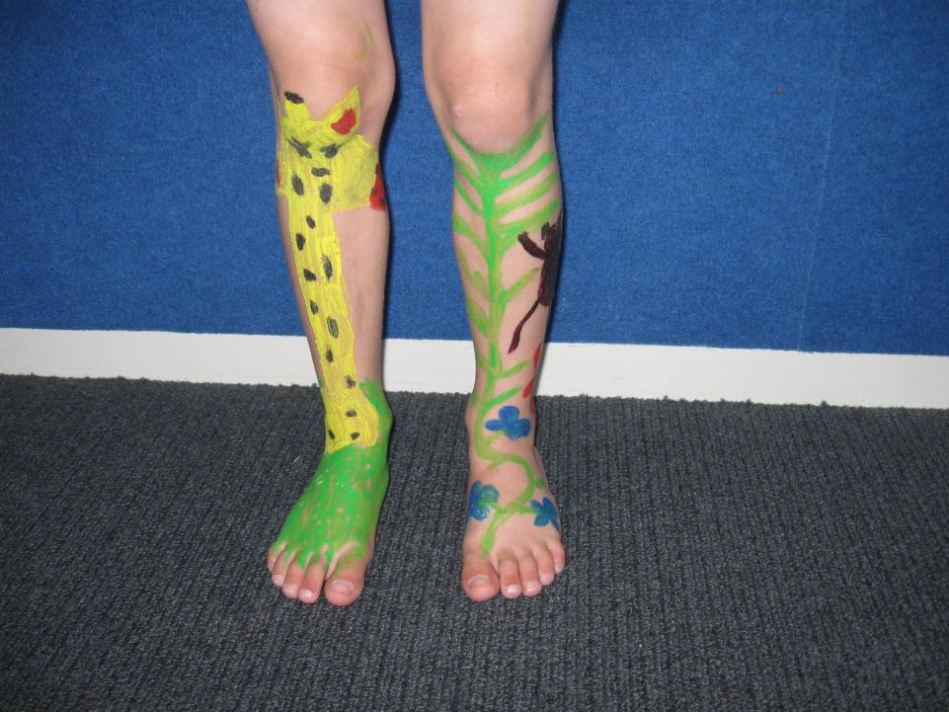
I went to the fancy feet parade. I had red giraffe feet.
2

Slide 5
I had glue on my shoes.
3

Slide 6
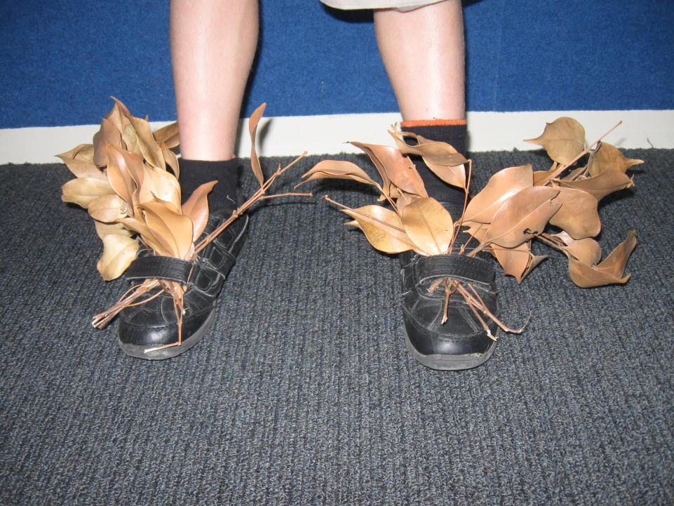
I went to the fancy feet parade. I had leaves on my feet.
4

Slide 7
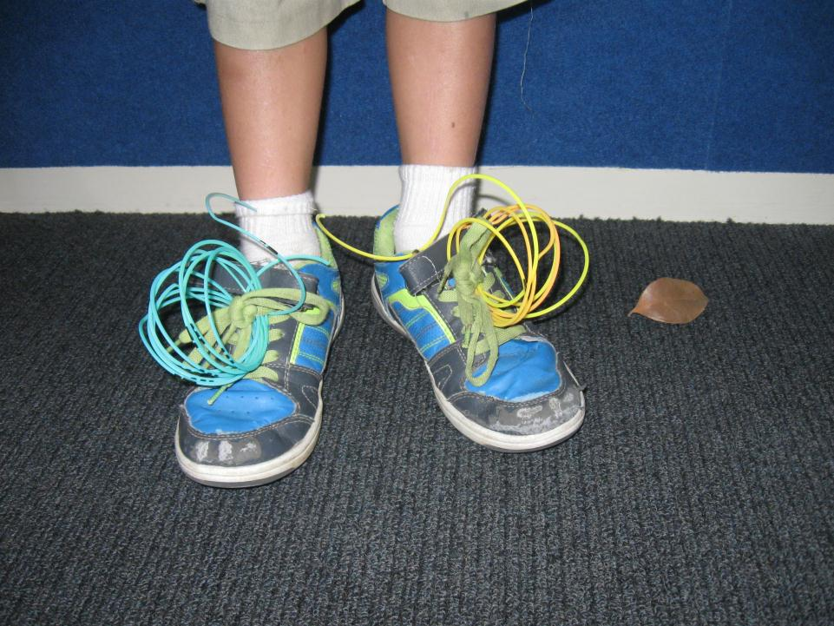
I had springs on my feet.
5

Slide 8
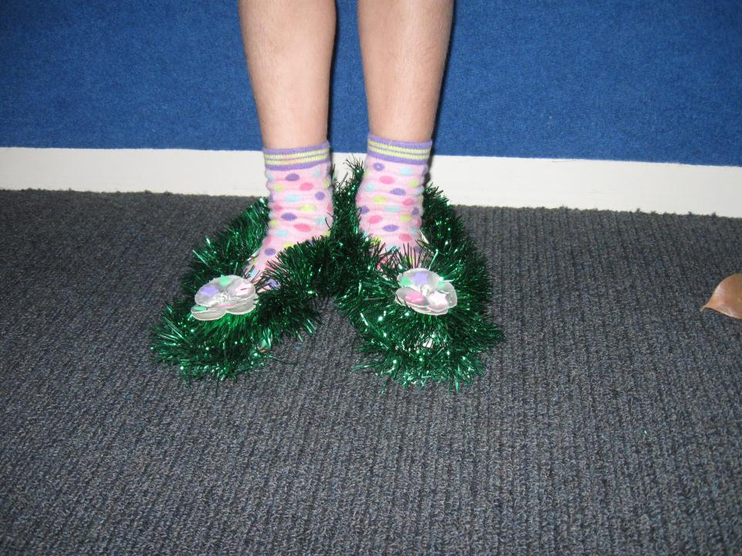
I had green tinsel on my shoes.
6

Slide 9
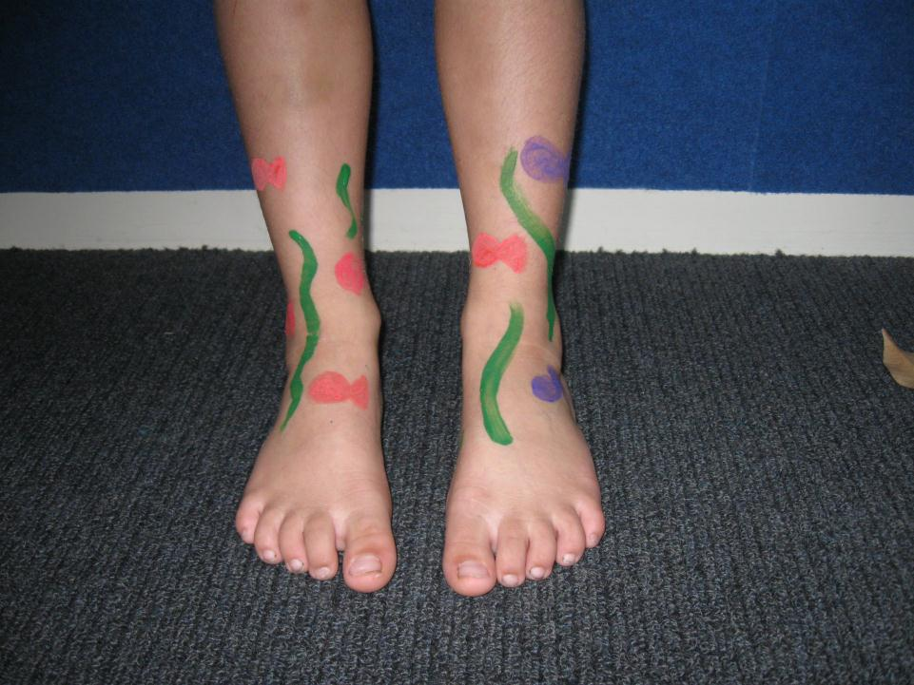
I had fish and seaweed on my feet.
7

Slide 10
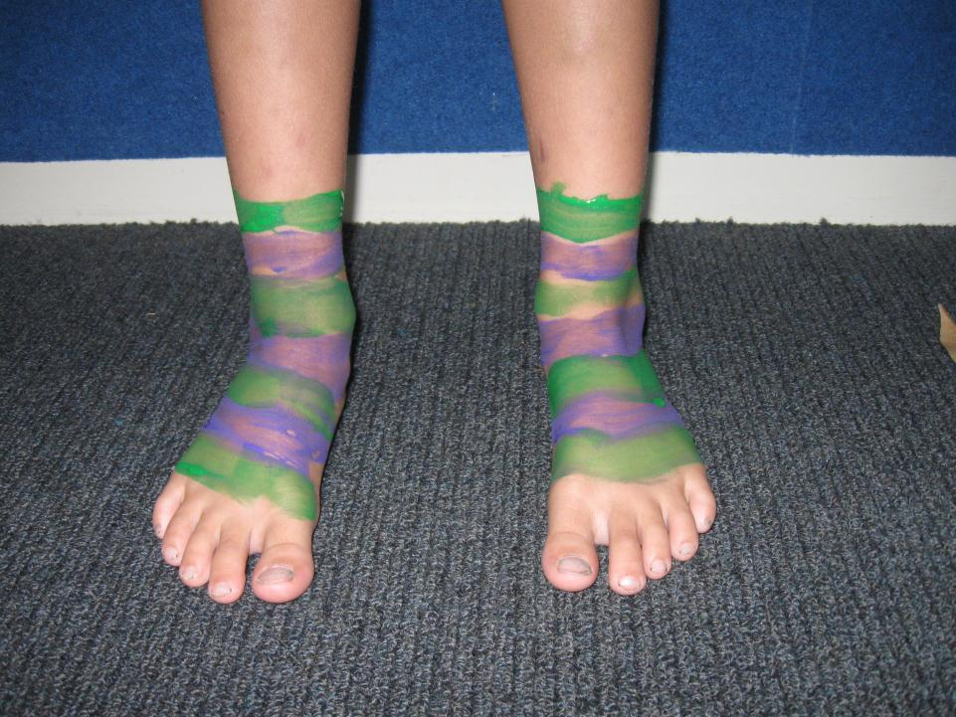
I had painted feet.
8

Slide 11
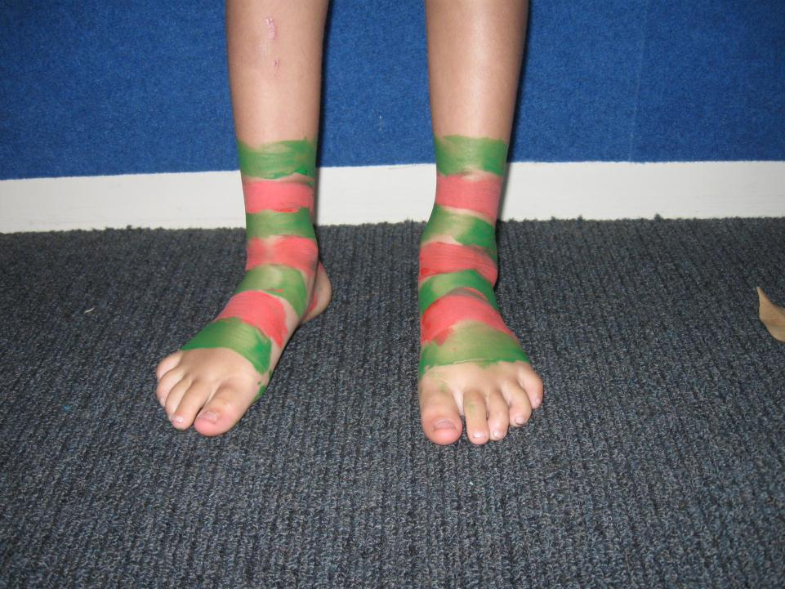
I had painted feet.
9

Slide 12
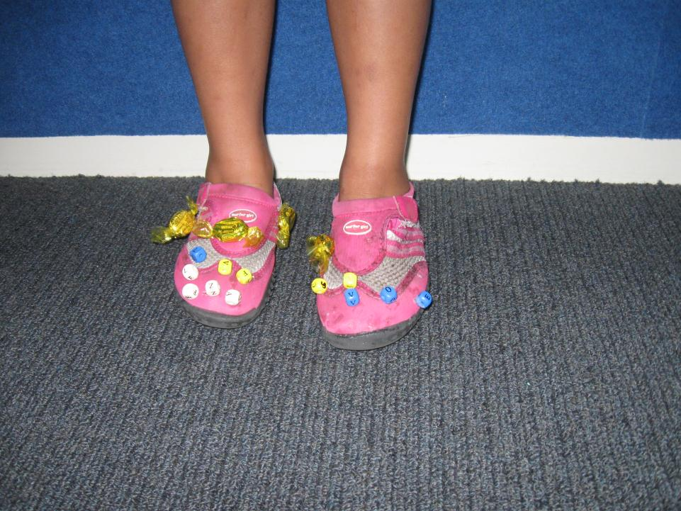
I had sparkly shoes with beads on.
10

Slide 13
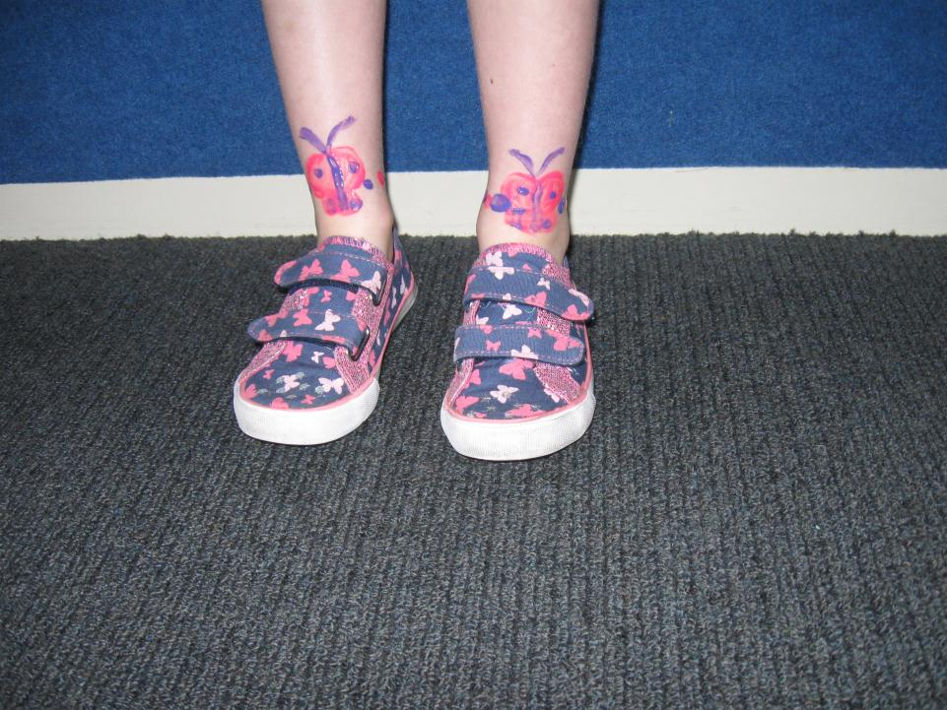
I wore my butterfly shoes and my mummy painted my feet. They had butterflies and dots.
11

Slide 14
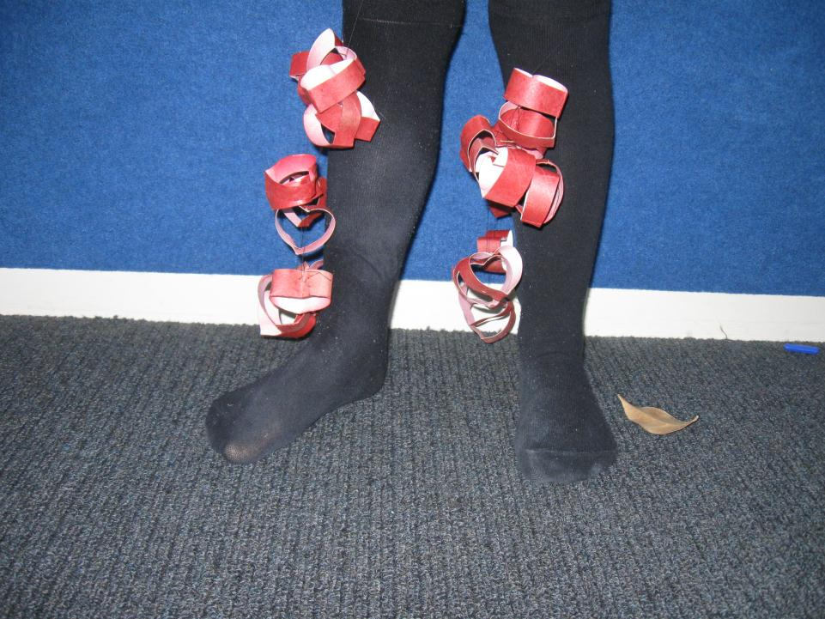
12
I had love hearts feet. I had red feet. I danced in the parade. It was a surprise.

Slide 15
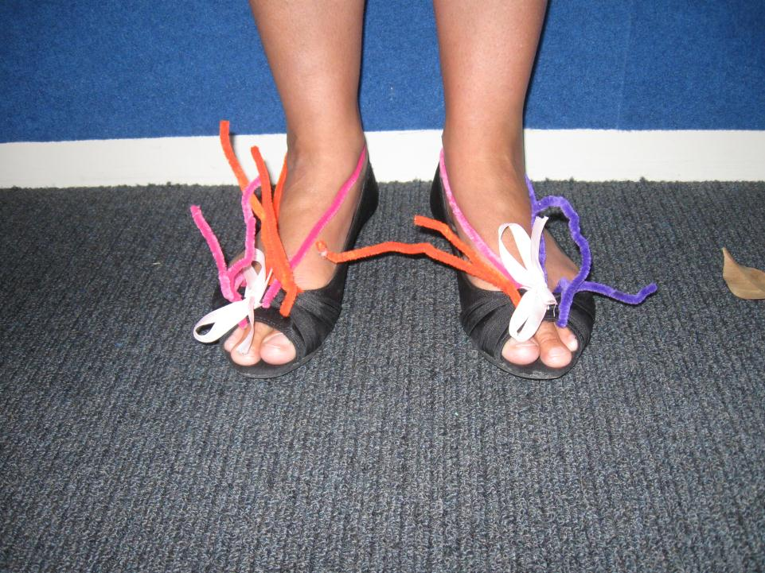
I had pipe cleaners and bows on my shoes.
13

Slide 16
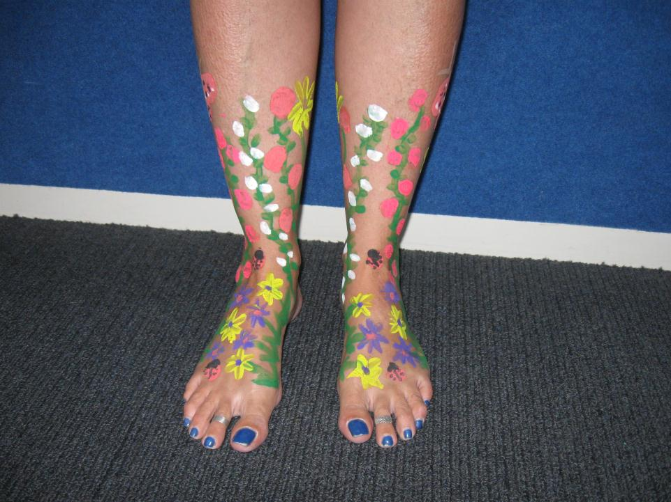
I painted my feet with plants, flowers and butterflies.
14

Slide 17
How many did you get right?
Elliot
Ephraim
Tailah
Conor
Niko
Caelyn-May
Zephia
Joseph
Cody
Seila
Bella
olivia
Lovetta
Miss Jolliffe

