Slide 1
The Tiger who came to Morning Tea.
by Kauri 1.

Slide 2
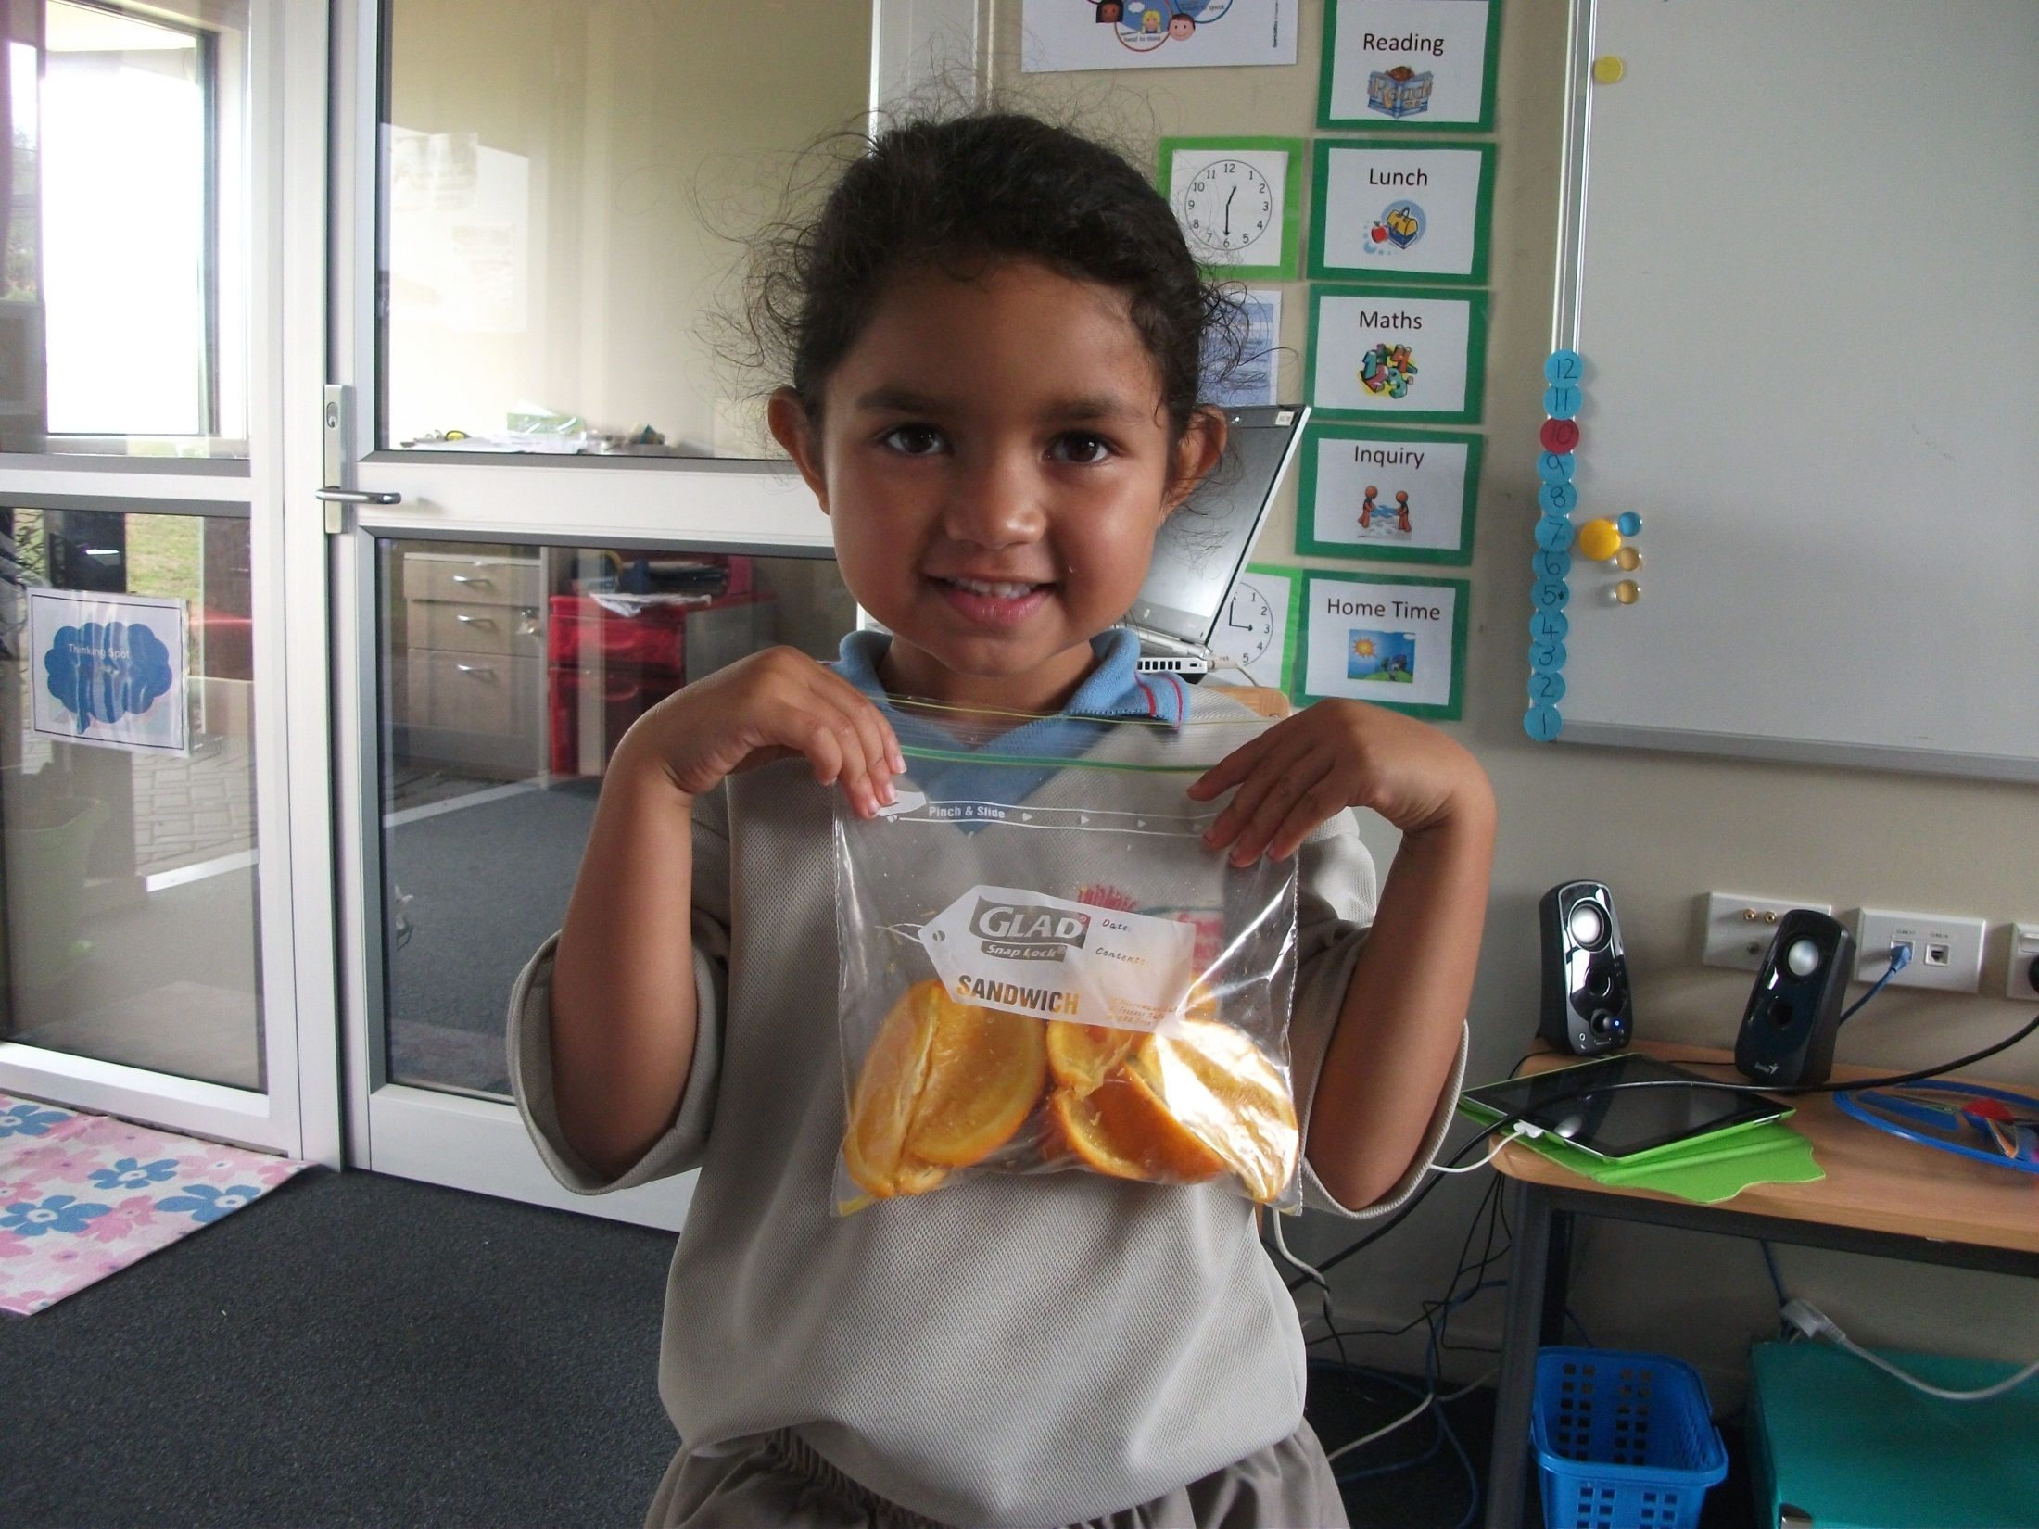
The oranges.
Gobble, gobble.

Slide 3
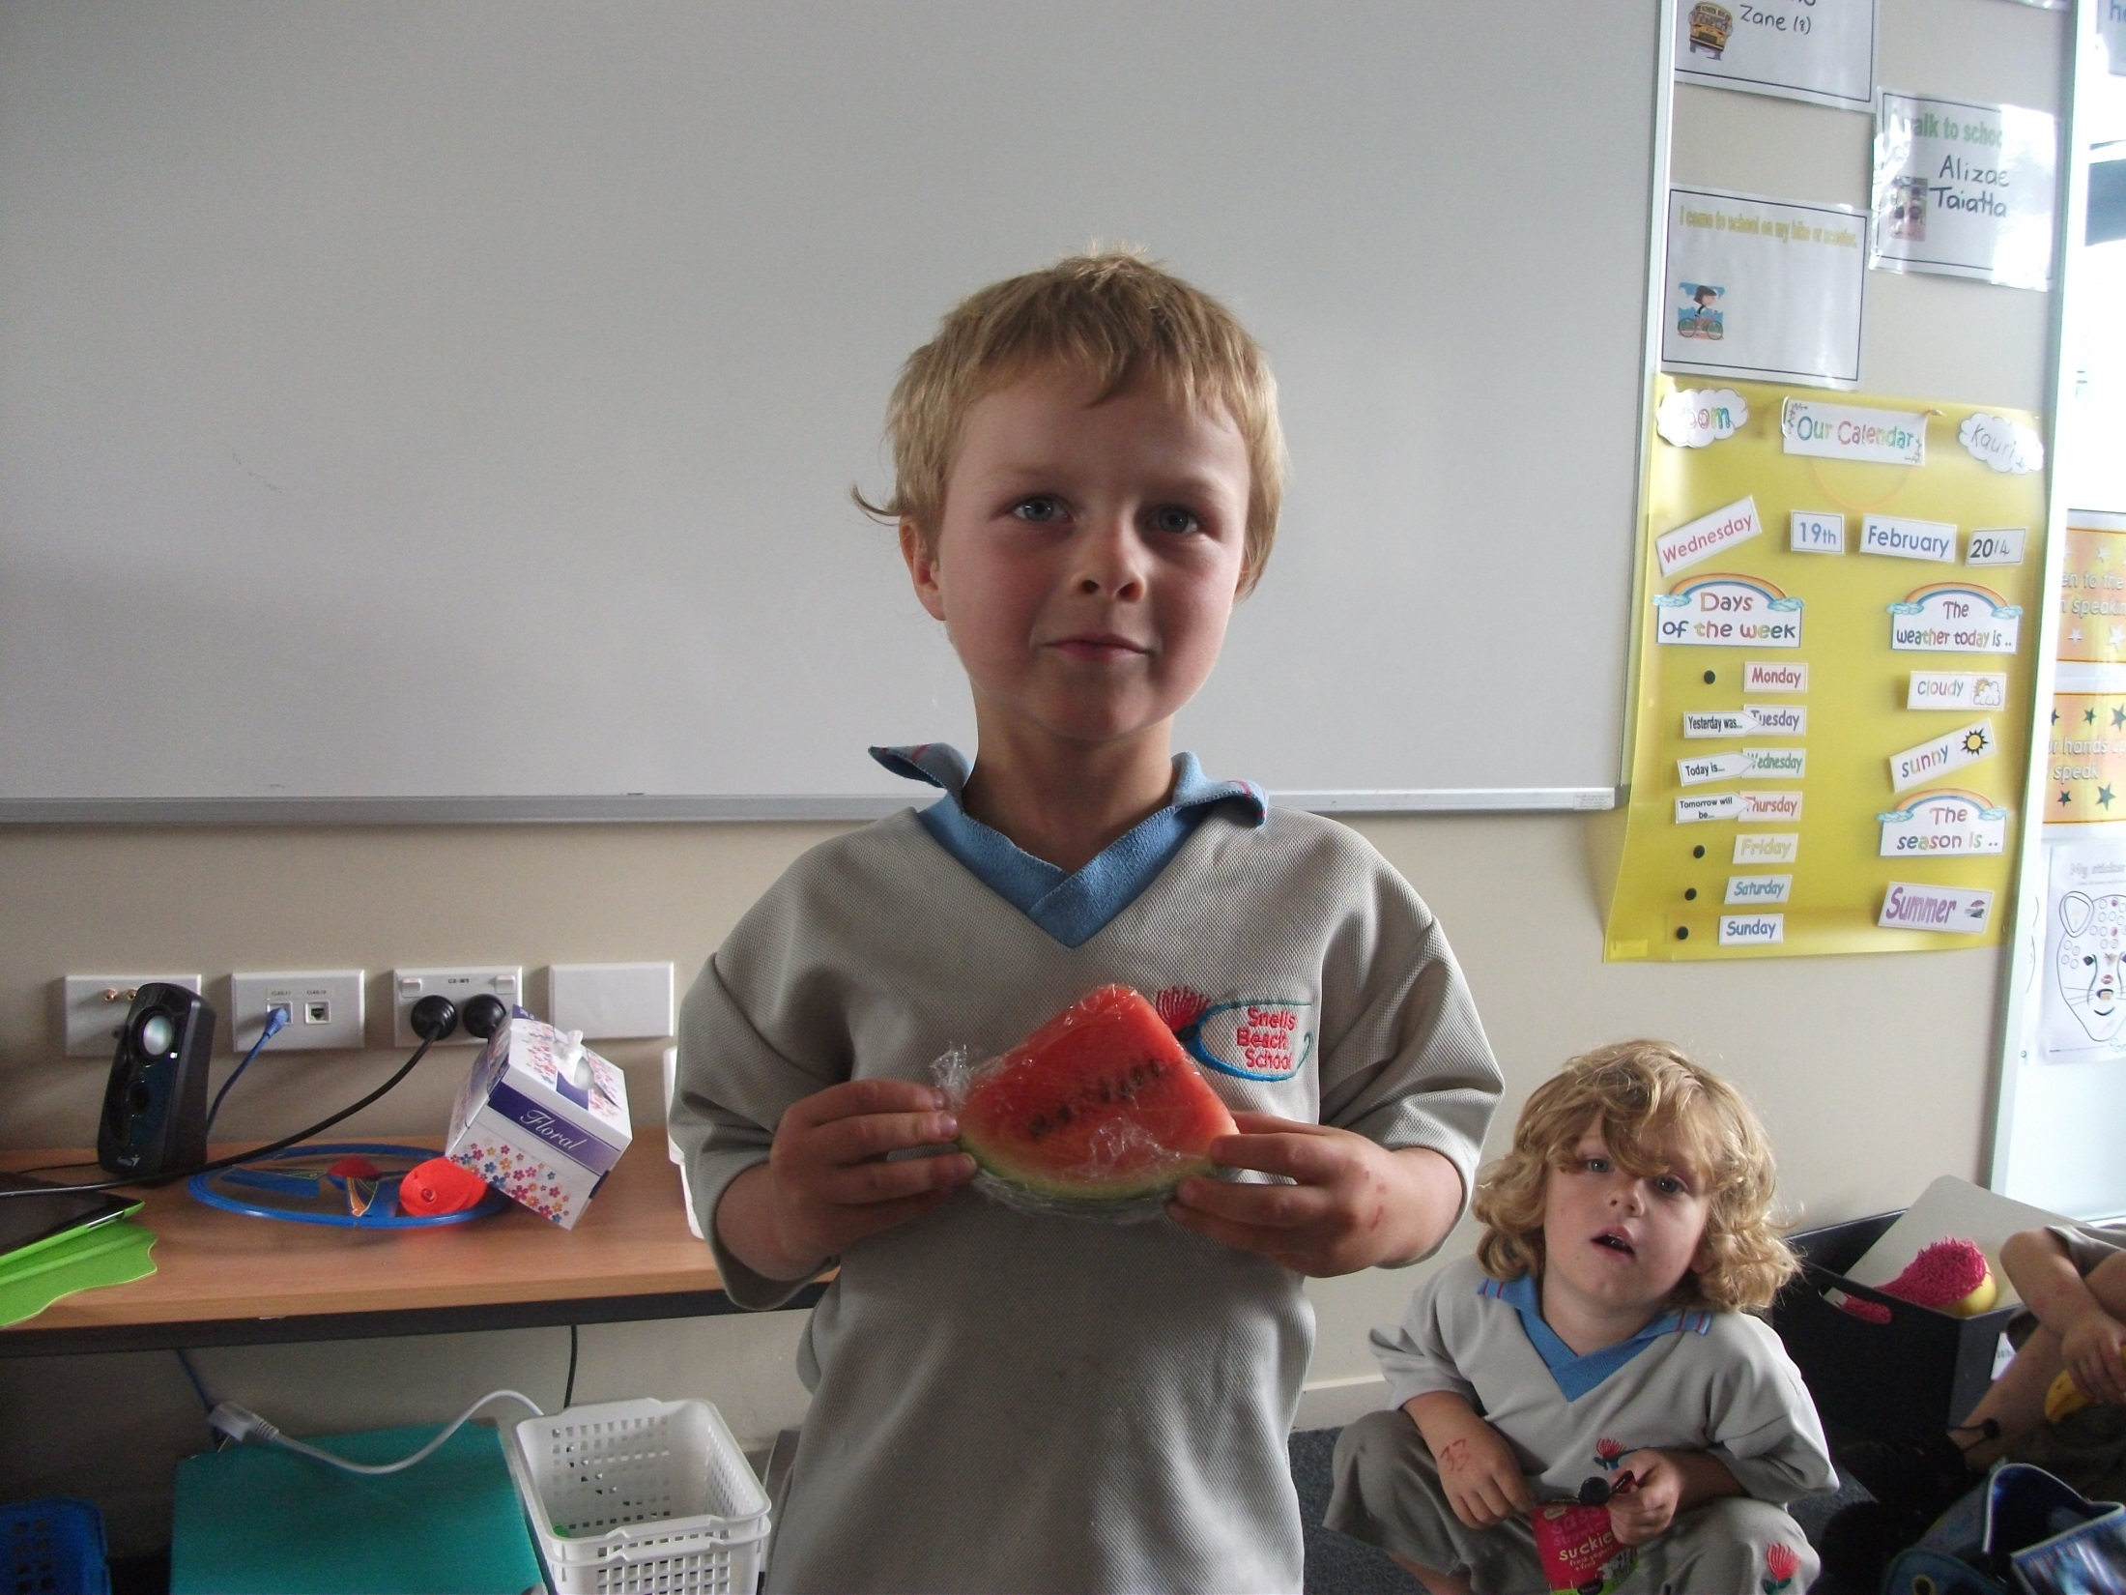
The watermelon.
Gobble, gobble.

Slide 4
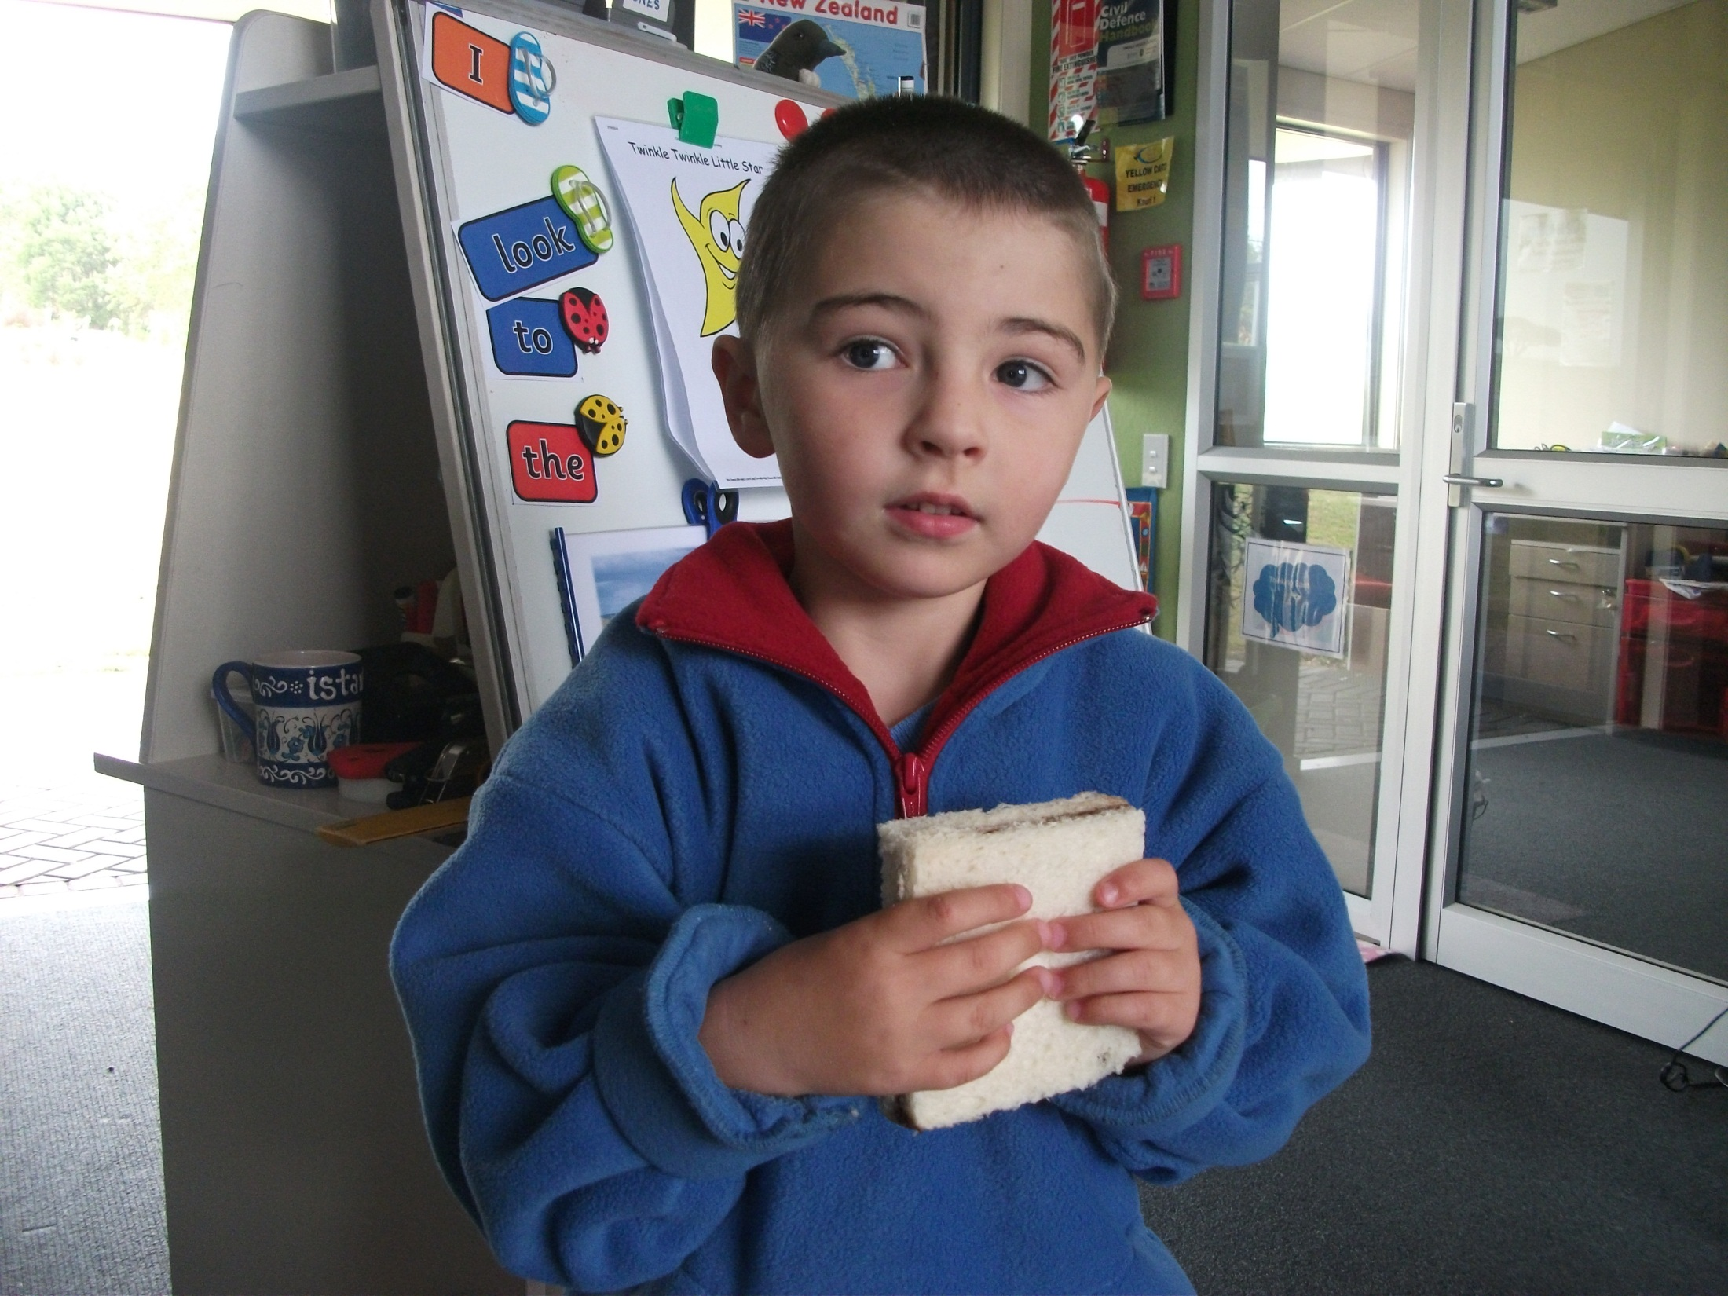
The sandwich.
Gobble, gobble.

Slide 5
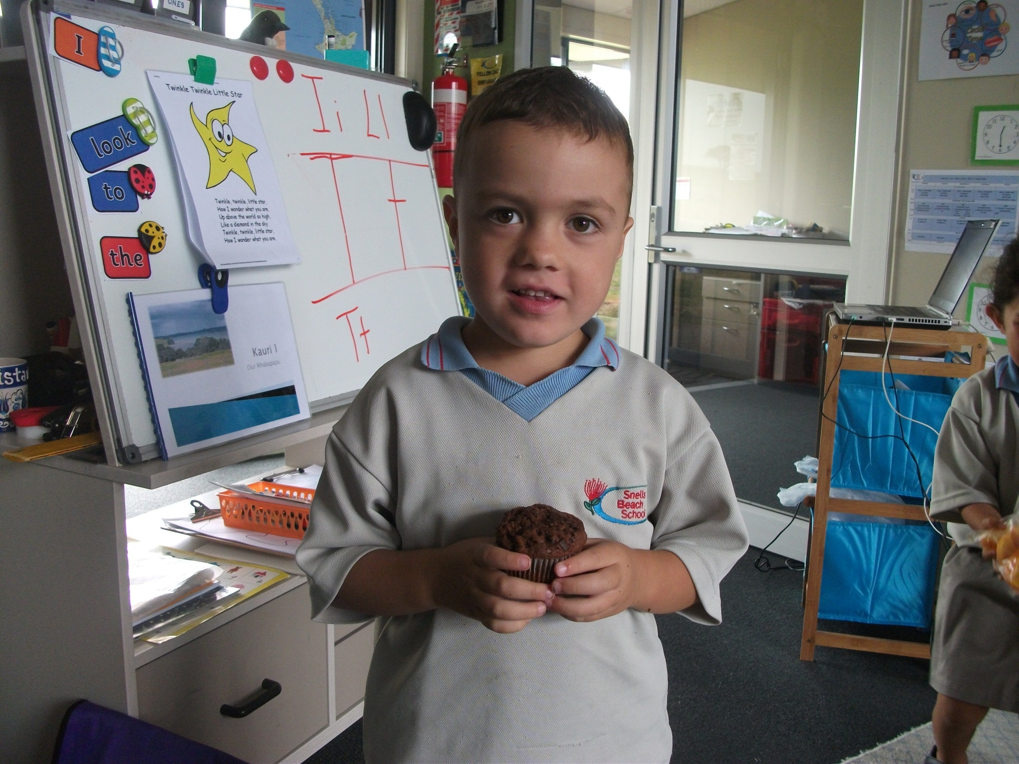
The chocolate muffin.
Gobble, gobble.

Slide 6
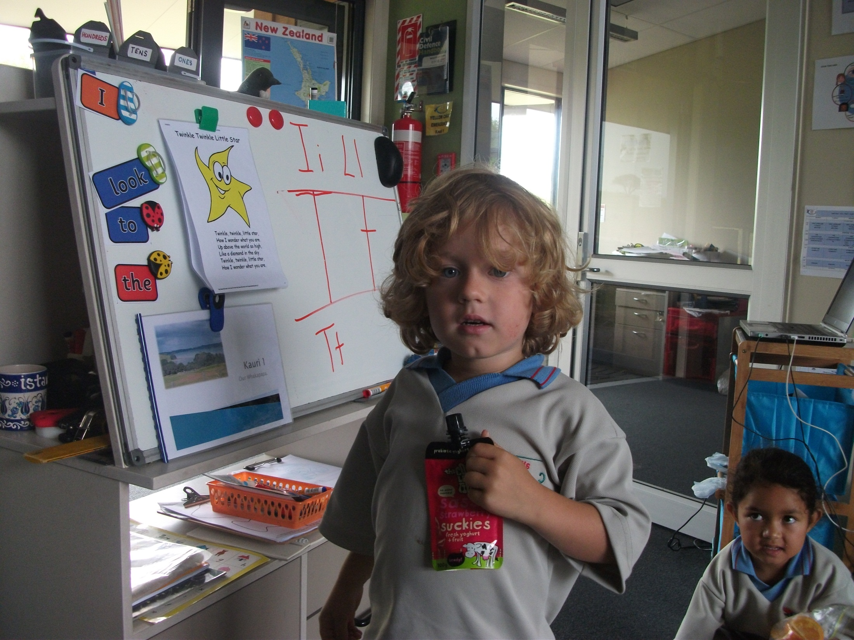
The yoghurt.
Gobble, gobble.

Slide 7
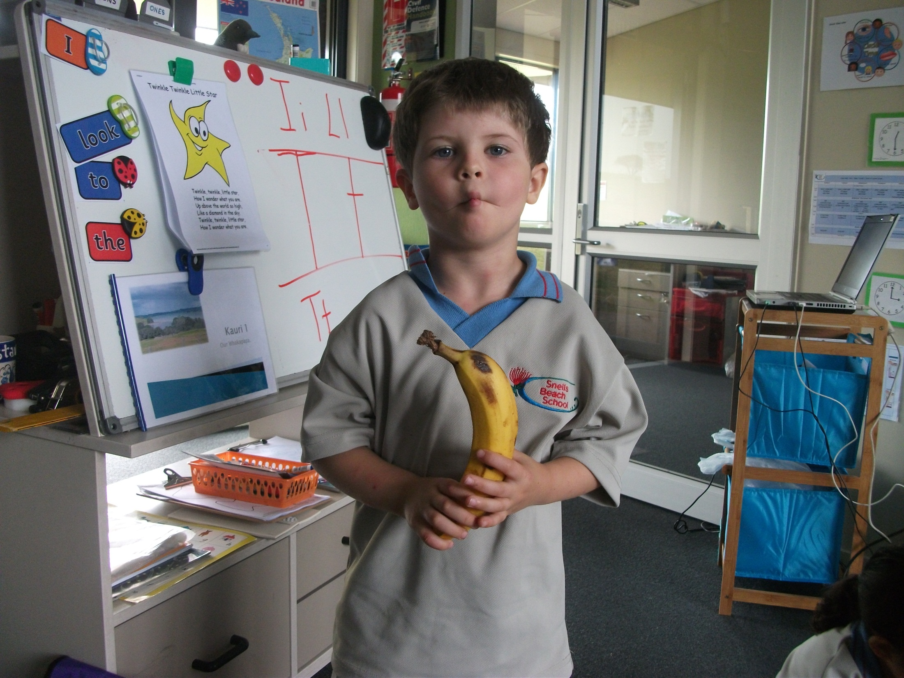
The banana.
Gobble, gobble.

Slide 8
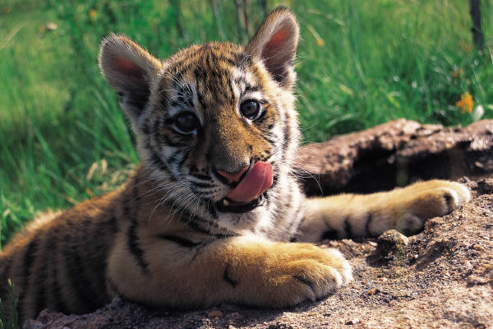
Oh! You terrible tiger.

