Slide 1
Stop, Look and Listen
by Kauri 1

Slide 2
Stop!

Slide 3
Look!

Slide 4
And listen.

Slide 5
Before you
Cross the street.

Slide 6
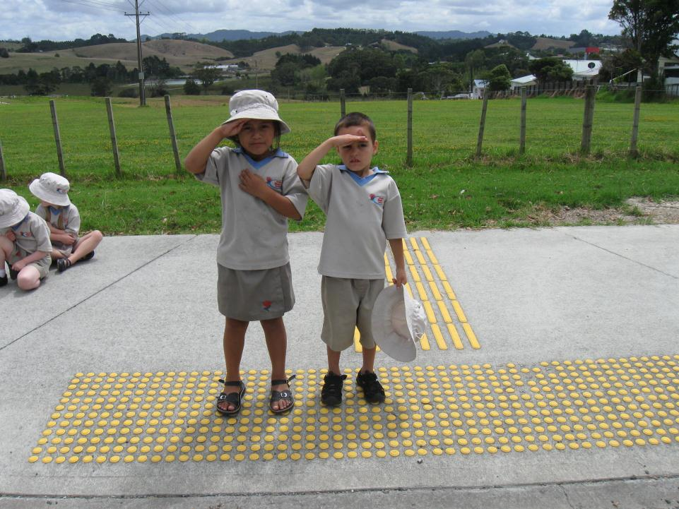
Use you eyes.

Slide 7
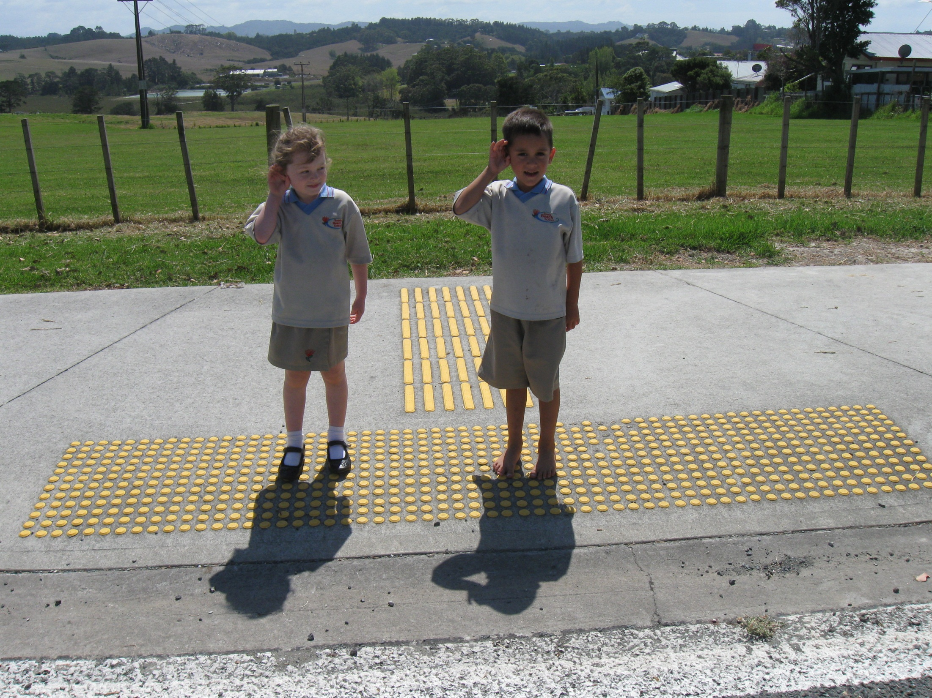
Use your ears.

Slide 8
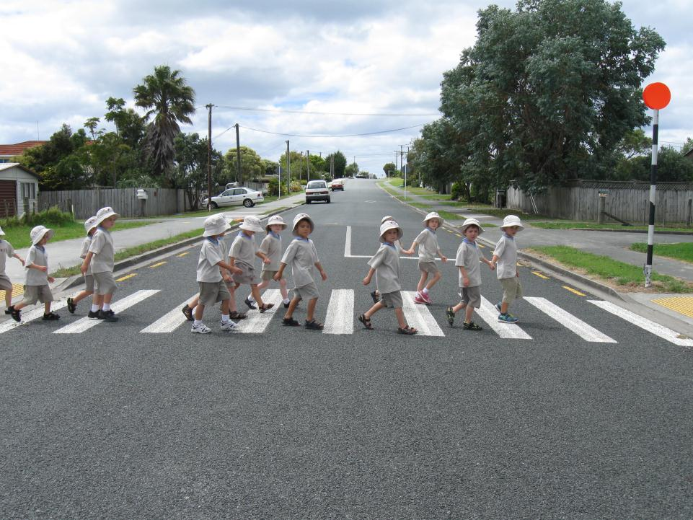
Before you cross the street!

