Slide 1
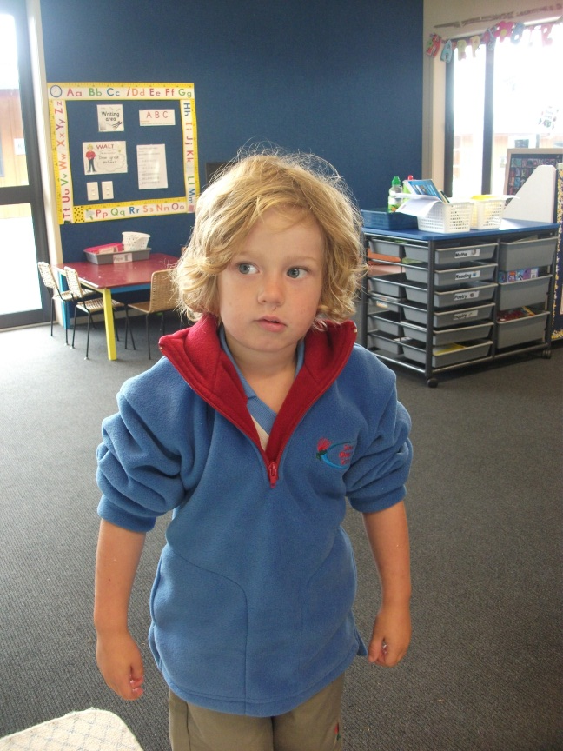
Look at Me
by Kauri 1

Slide 2
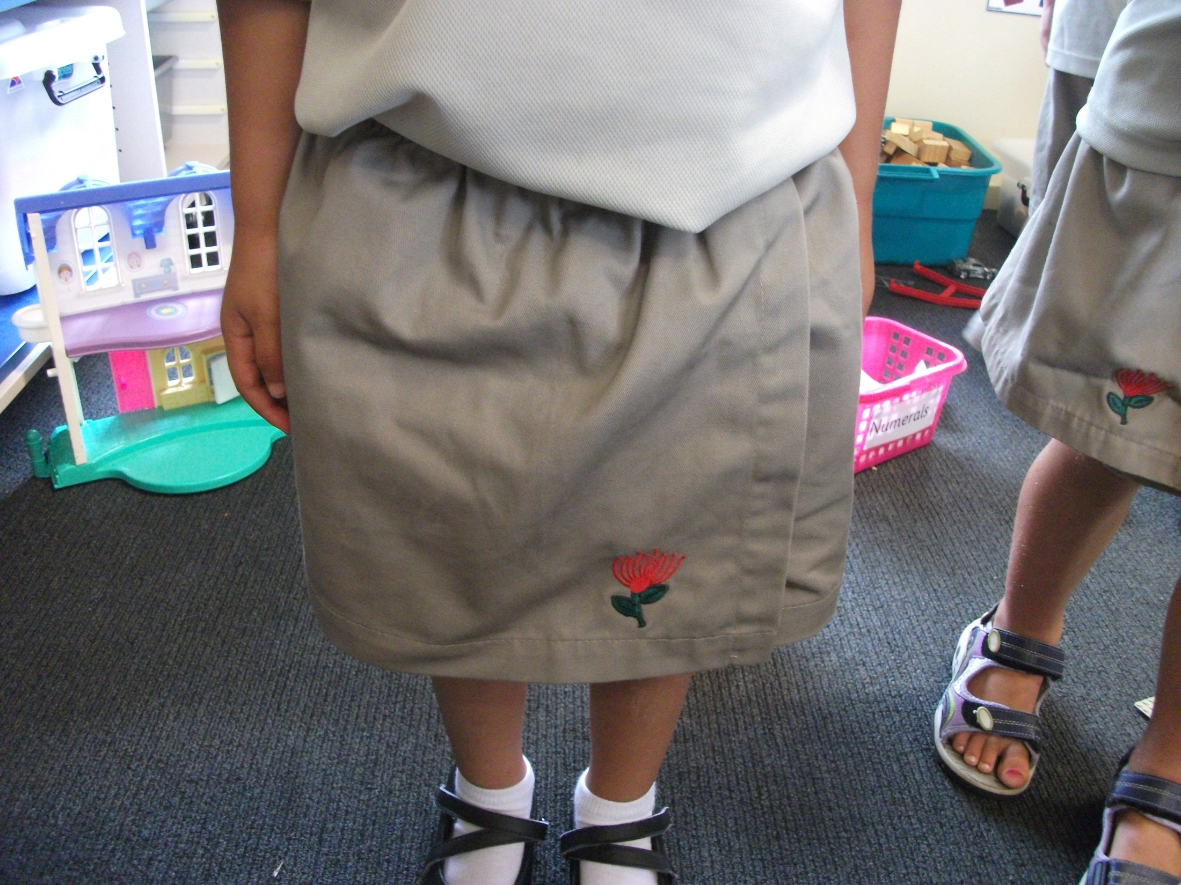
I put on my skort.

Slide 3
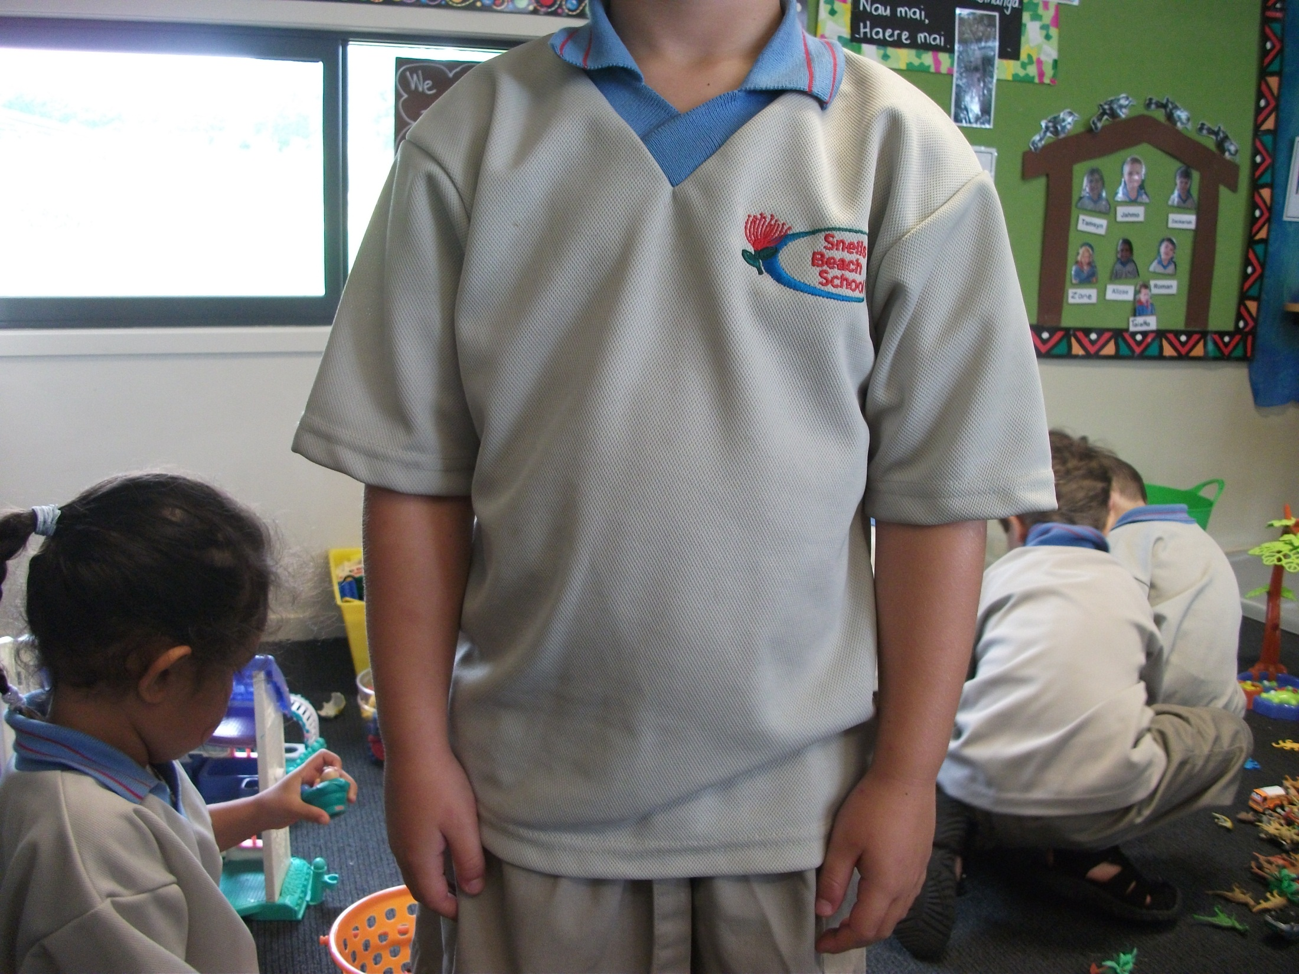
I put on my shirt.

Slide 4
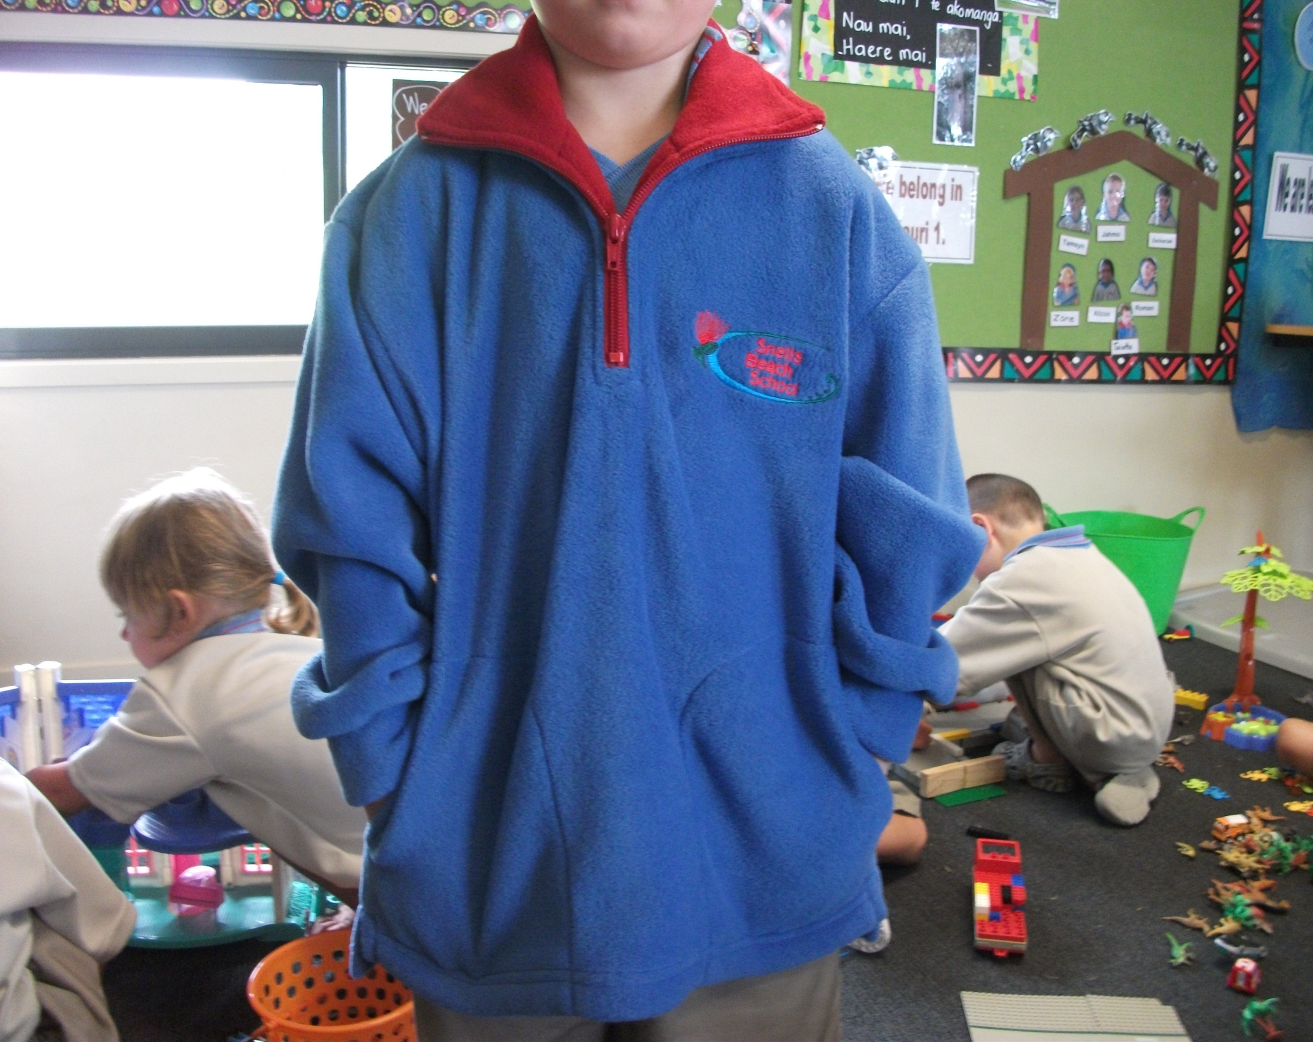
I put on my jumper.

Slide 5
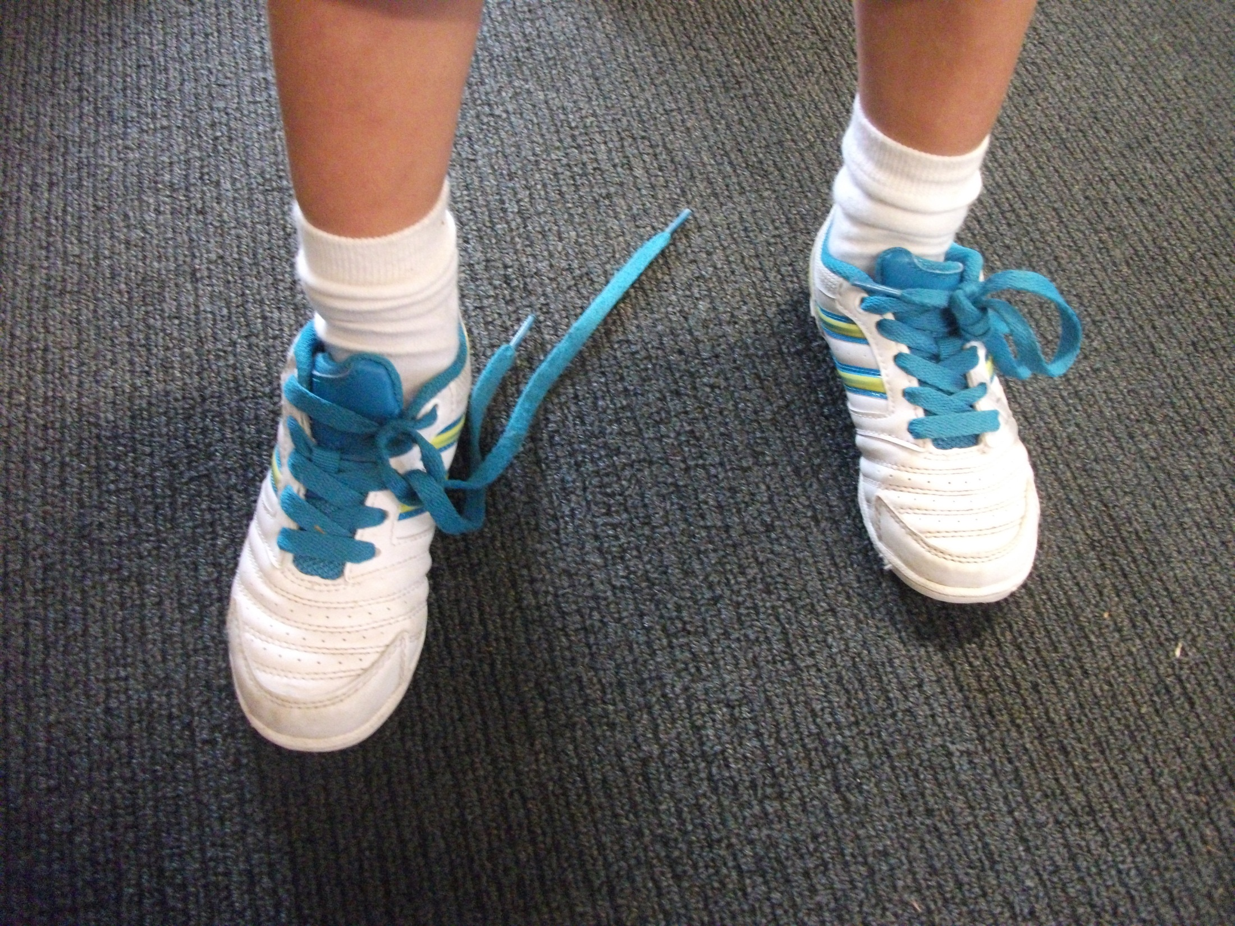
I put on my shoes.

Slide 6
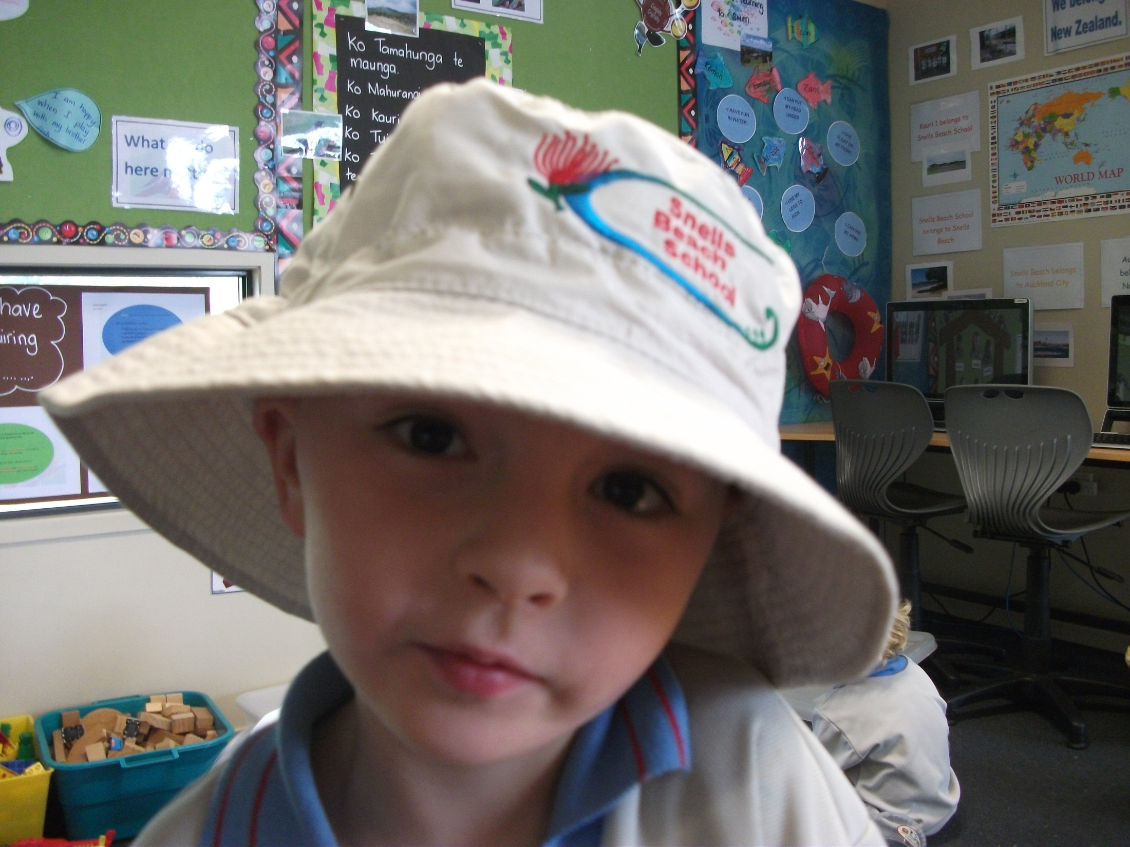
I put on my hat.

Slide 7
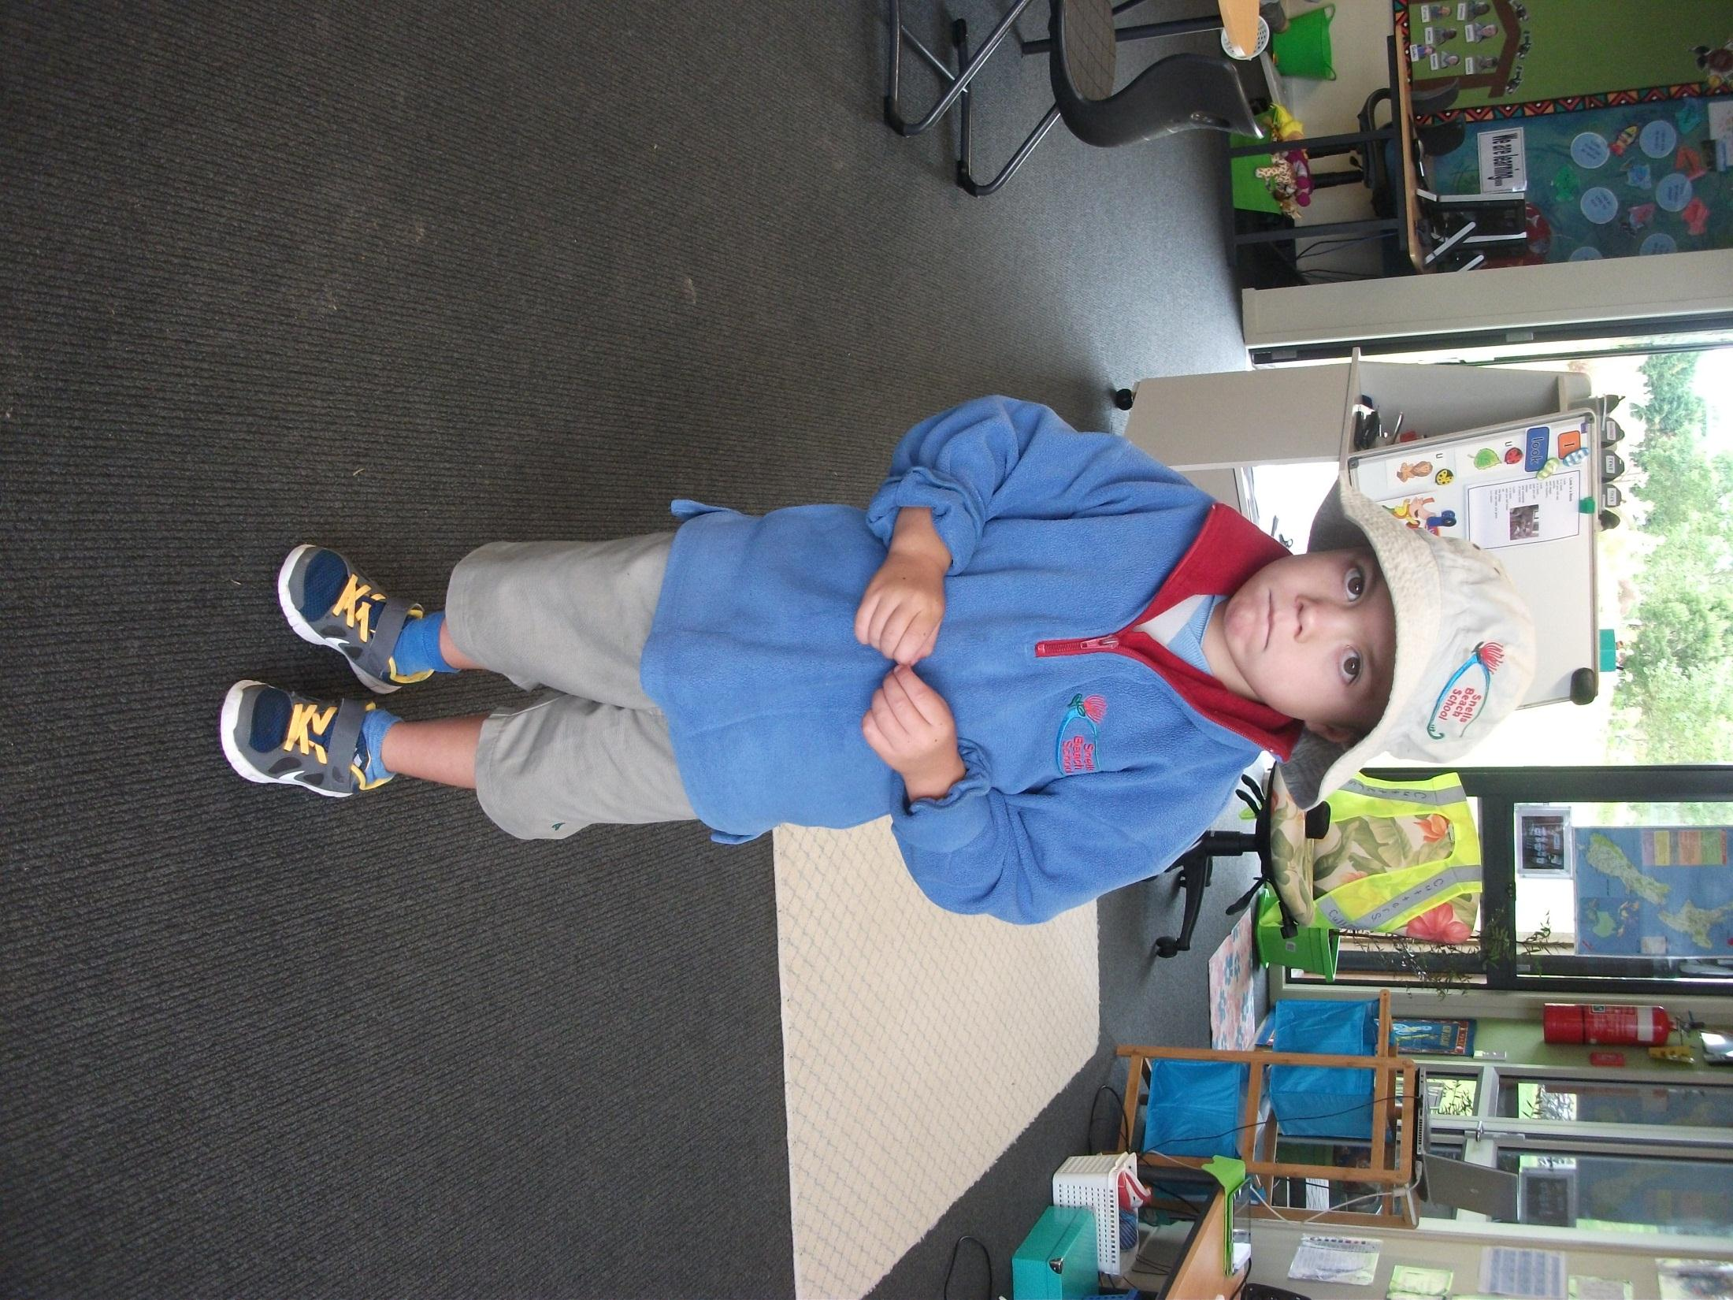
Look at me.
I am a school kid.

