Slide 1
“It’s my bread”
By Kauri 2

Slide 2
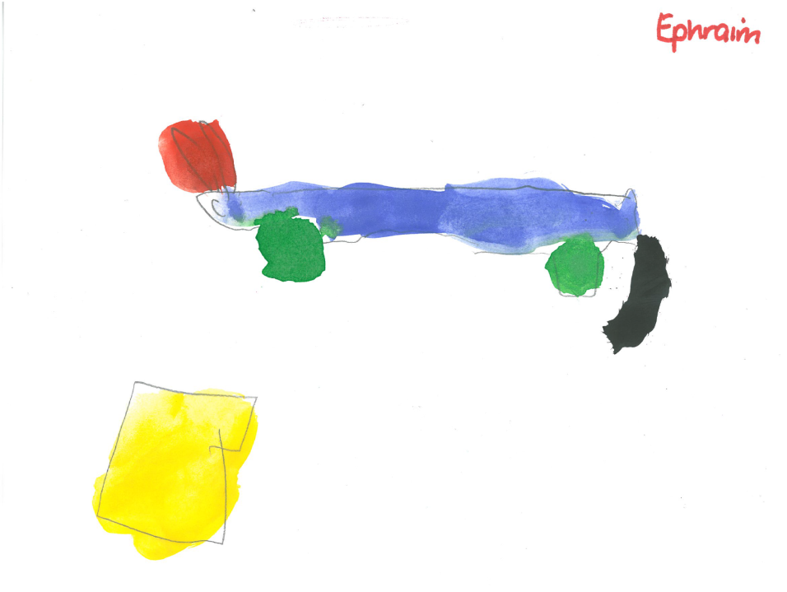
“It’s my bread,”
Said the rhino.

Slide 3
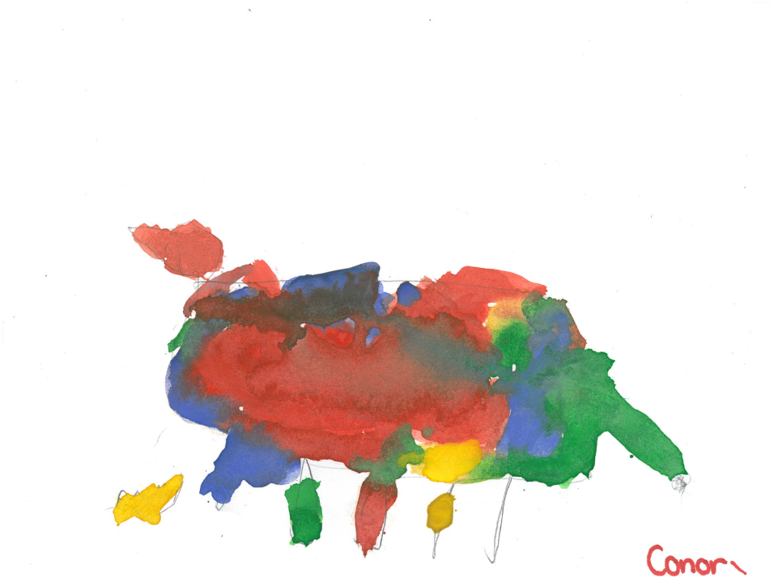
“It’s my bread,”
said the cheetah.

Slide 4
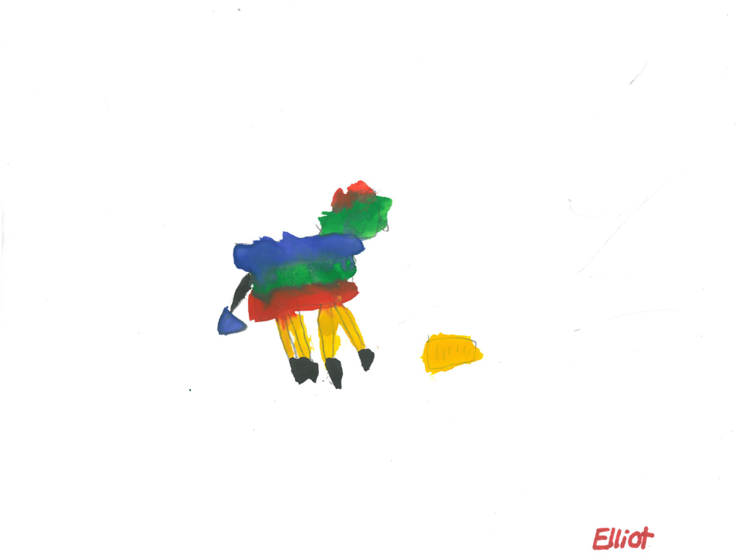
“It’s my bread,”
said the zebra.

Slide 5
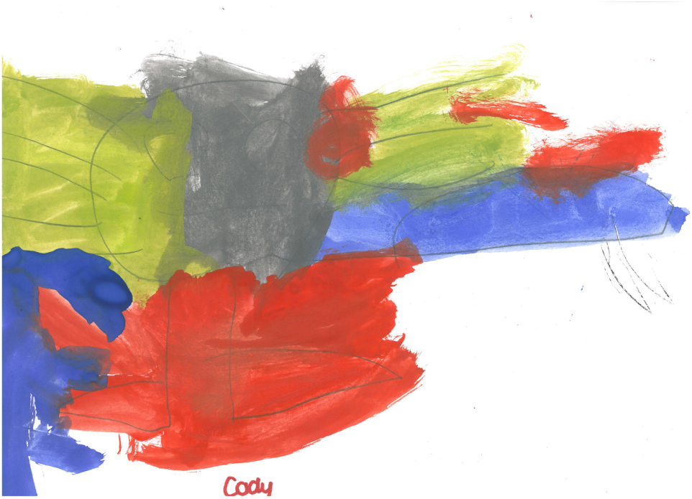
“It’s my bread,”
said the tiger.

Slide 6
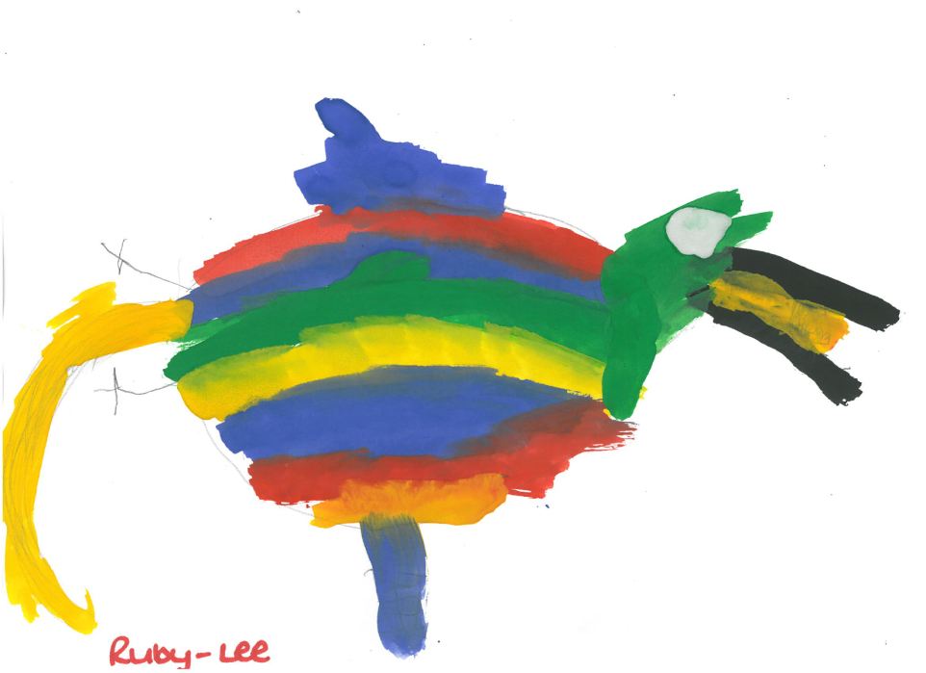
“It’s my bread,”
said the parrot.

Slide 7
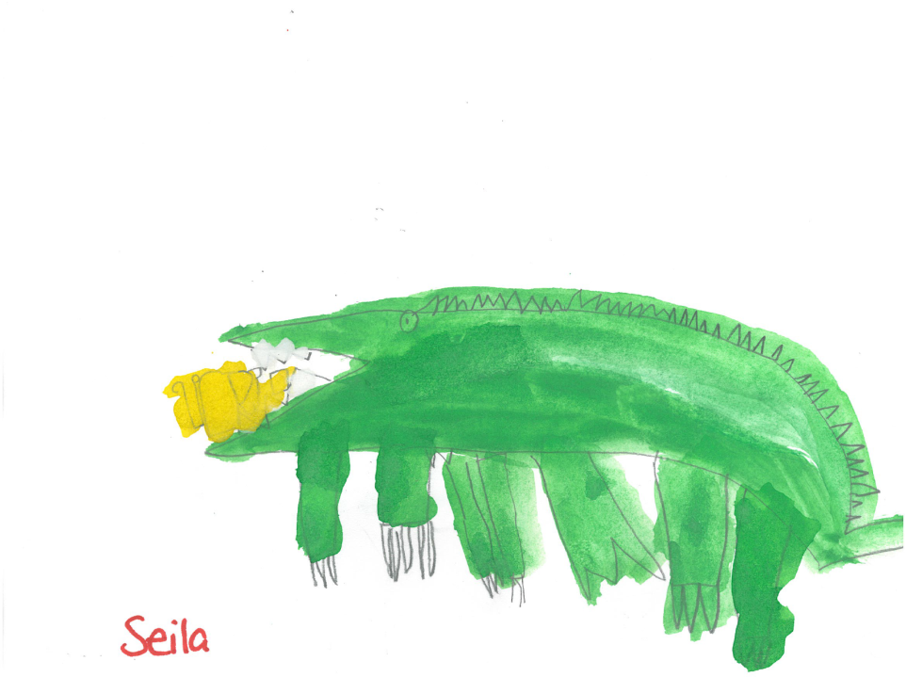
“It’s my bread,”
said the crocodile.

Slide 8
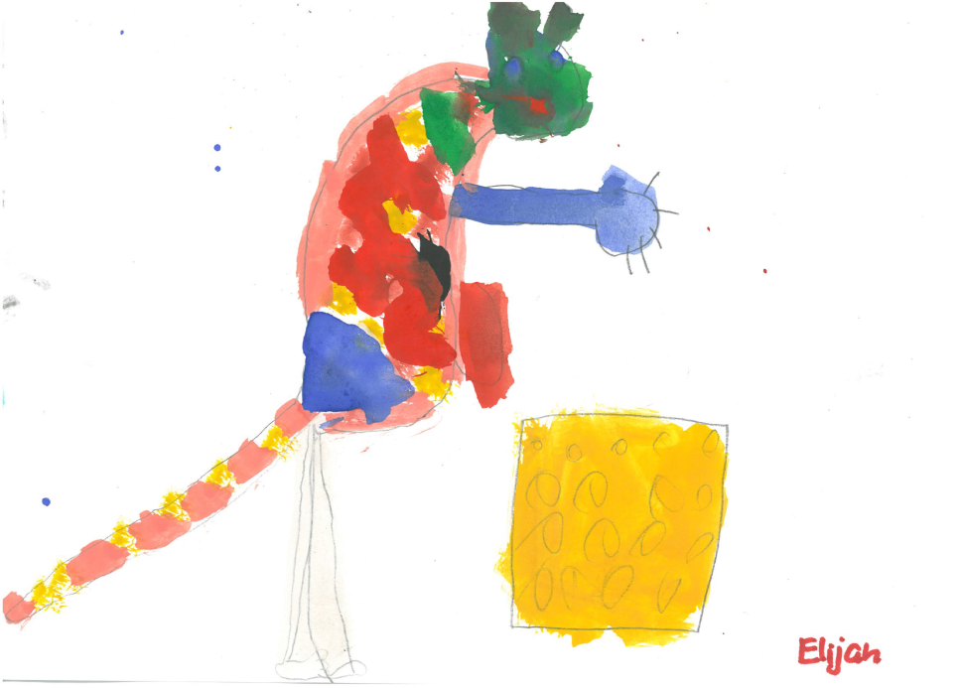
“It’s my bread,”
said the kangaroo.

Slide 9
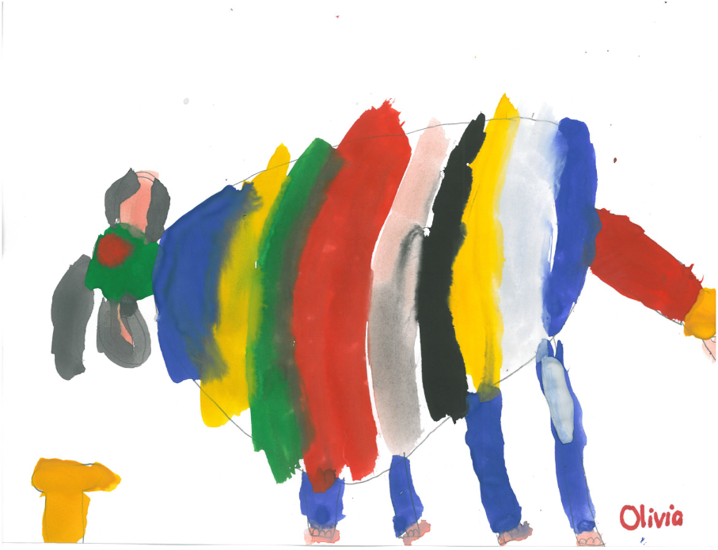
“It’s my bread,”
said the elephant.

Slide 10
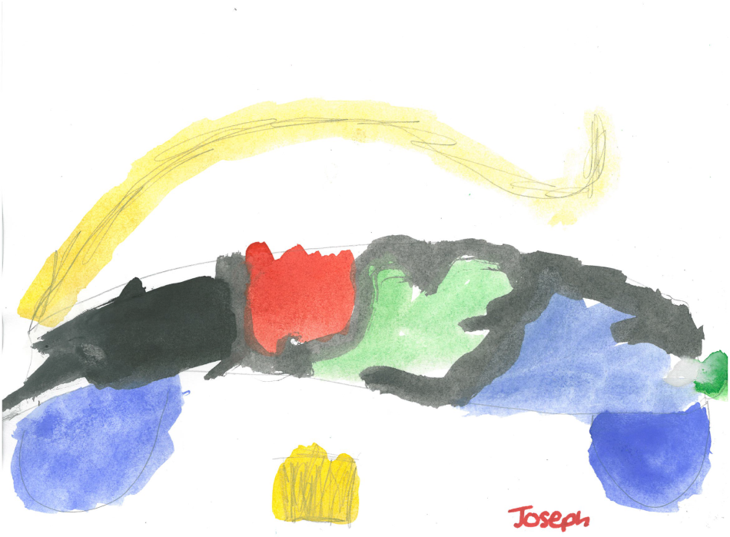
“It’s my bread,”
said the cat.

Slide 11
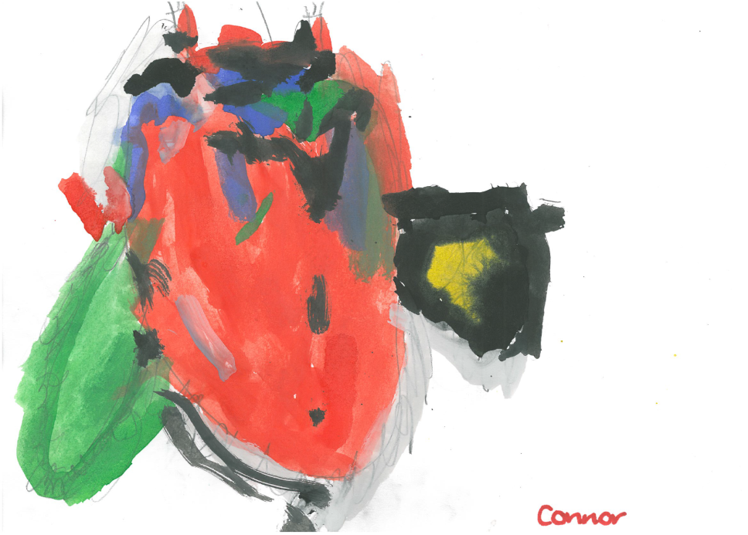
“It’s my bread,”
said the eagle.

Slide 12
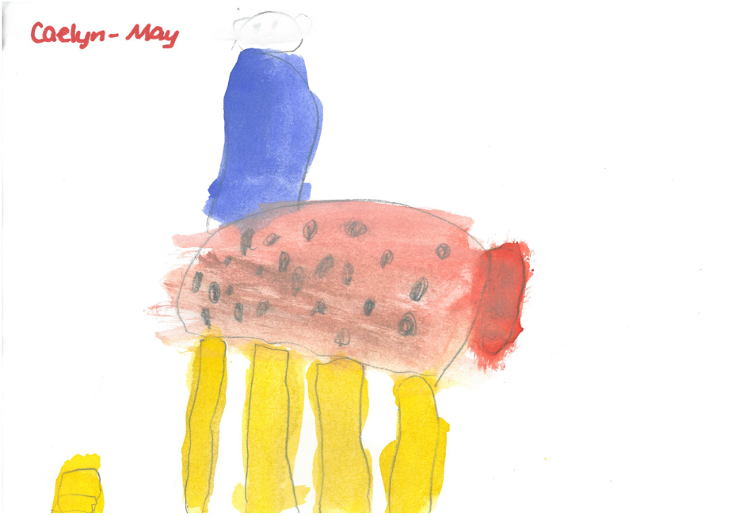
“It’s my bread,”
said the giraffe.

Slide 13
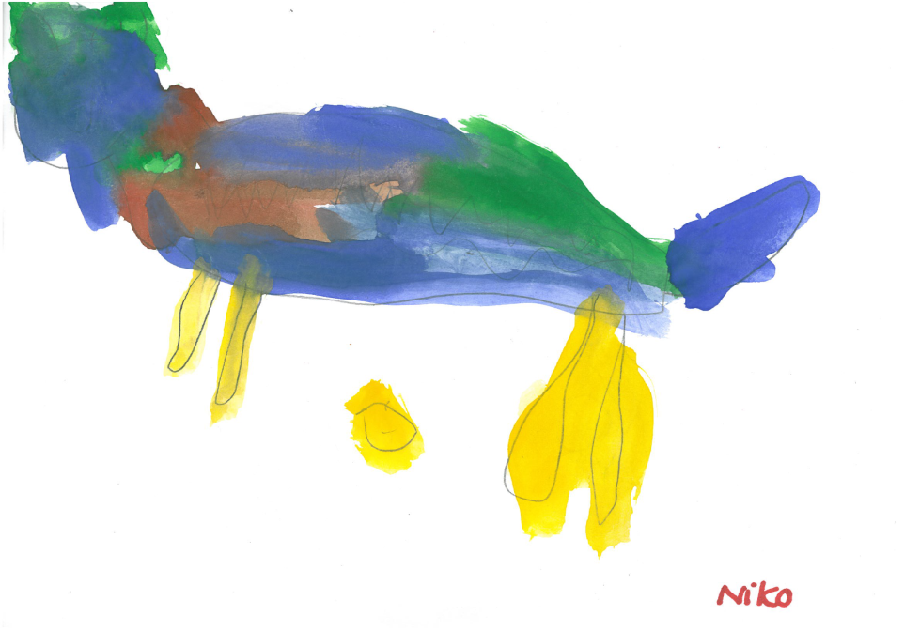
“It’s my bread,”
said the horse.

Slide 14
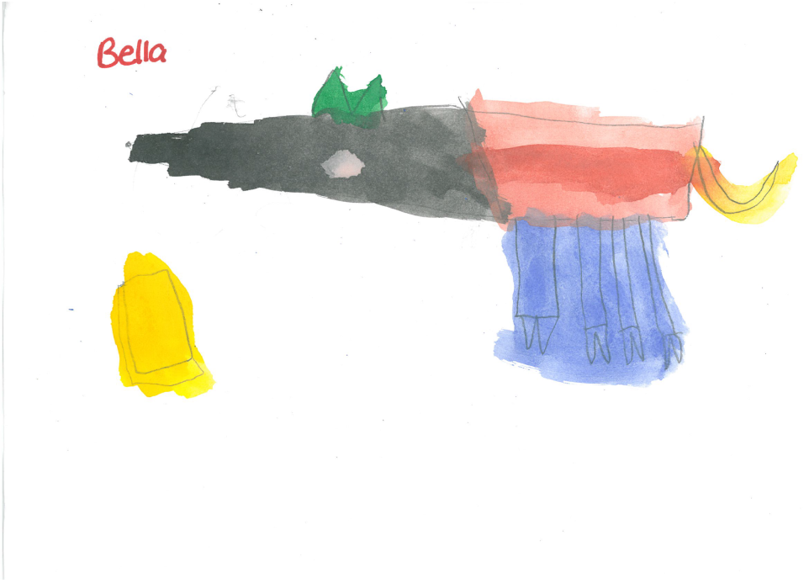
“It’s my bread,”
said the dog.

Slide 15
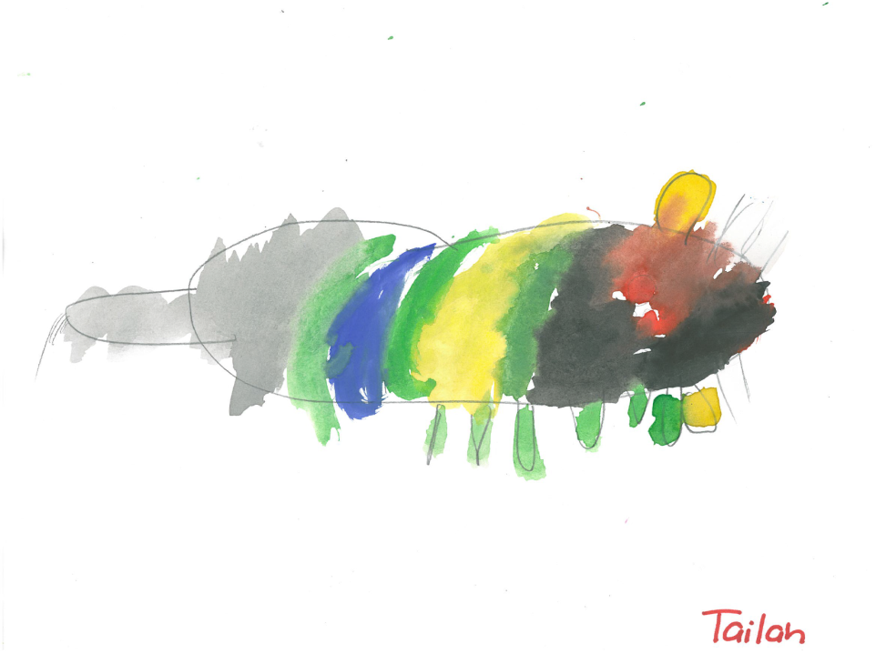
“It’s my bread,”
said the mouse.

Slide 16
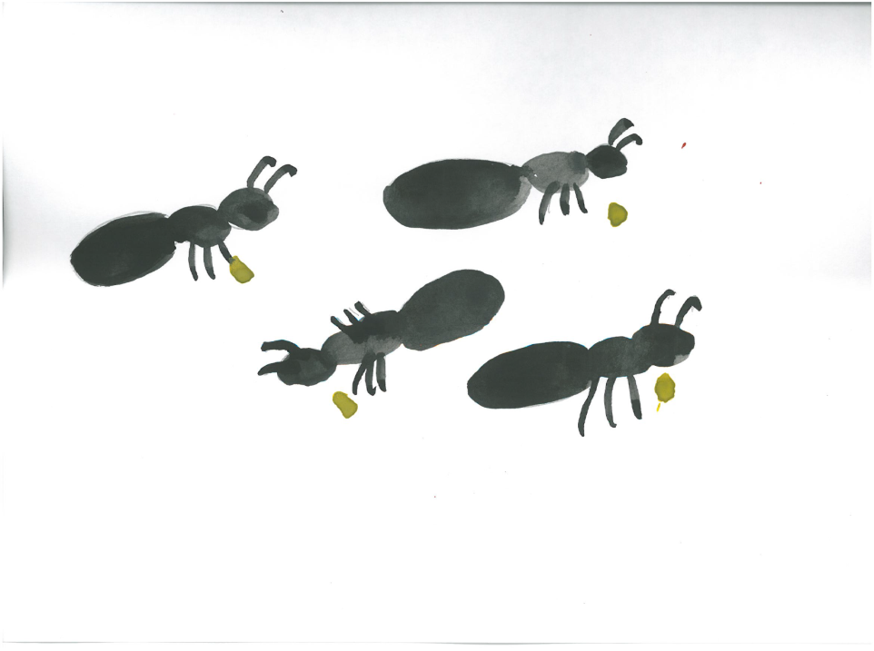
“No! It’s our bread,”
said the ants.

