Slide 1
“Smile” said Mrs Watkin.
by Kauri 1.

Slide 2
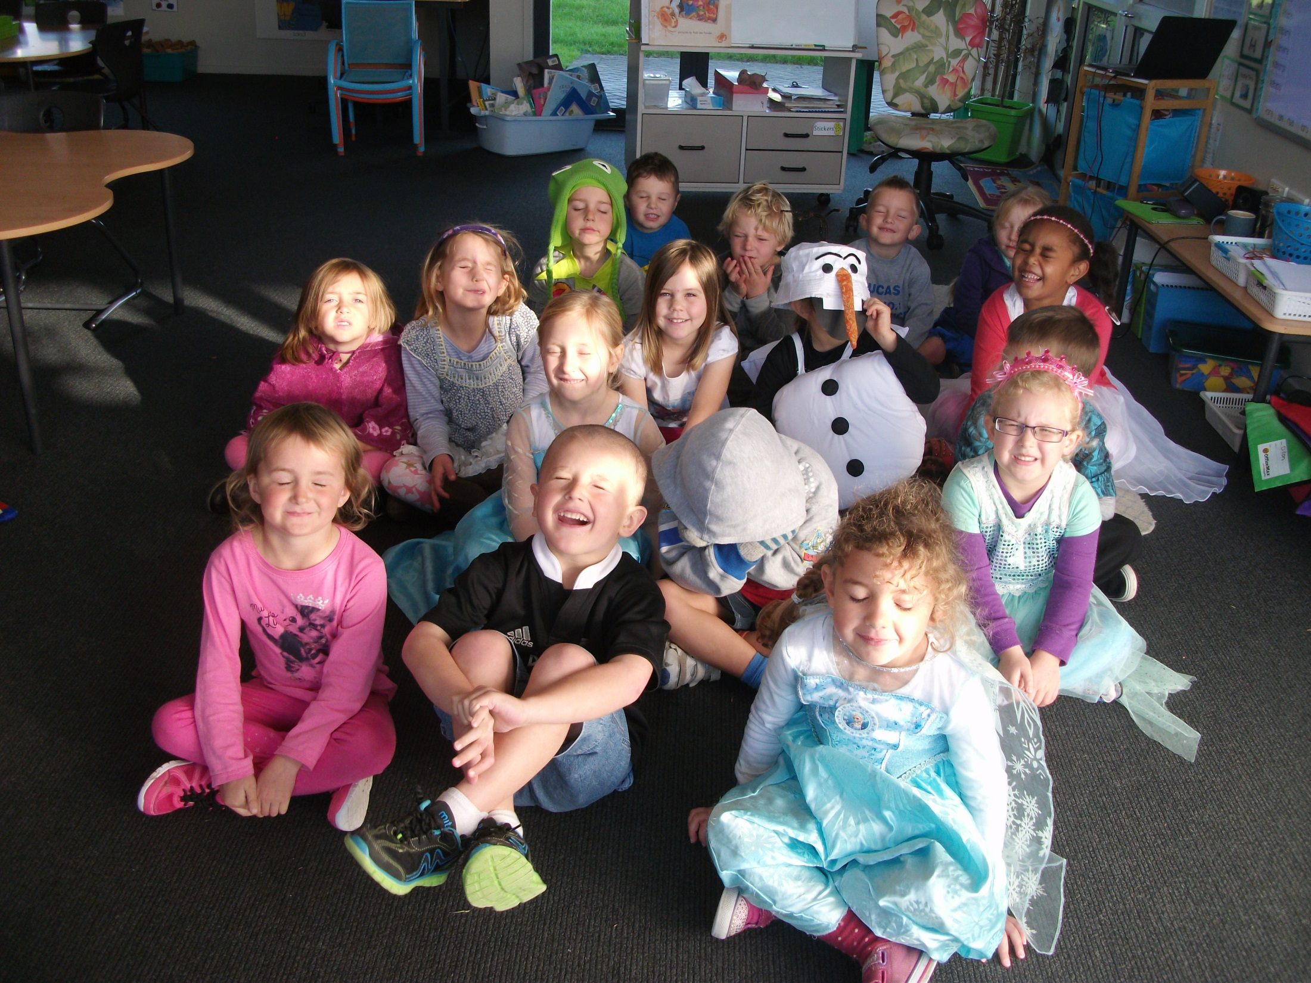
“Smile”, said Mrs Watkin.
But Kauri 1 had their eyes shut.

Slide 3
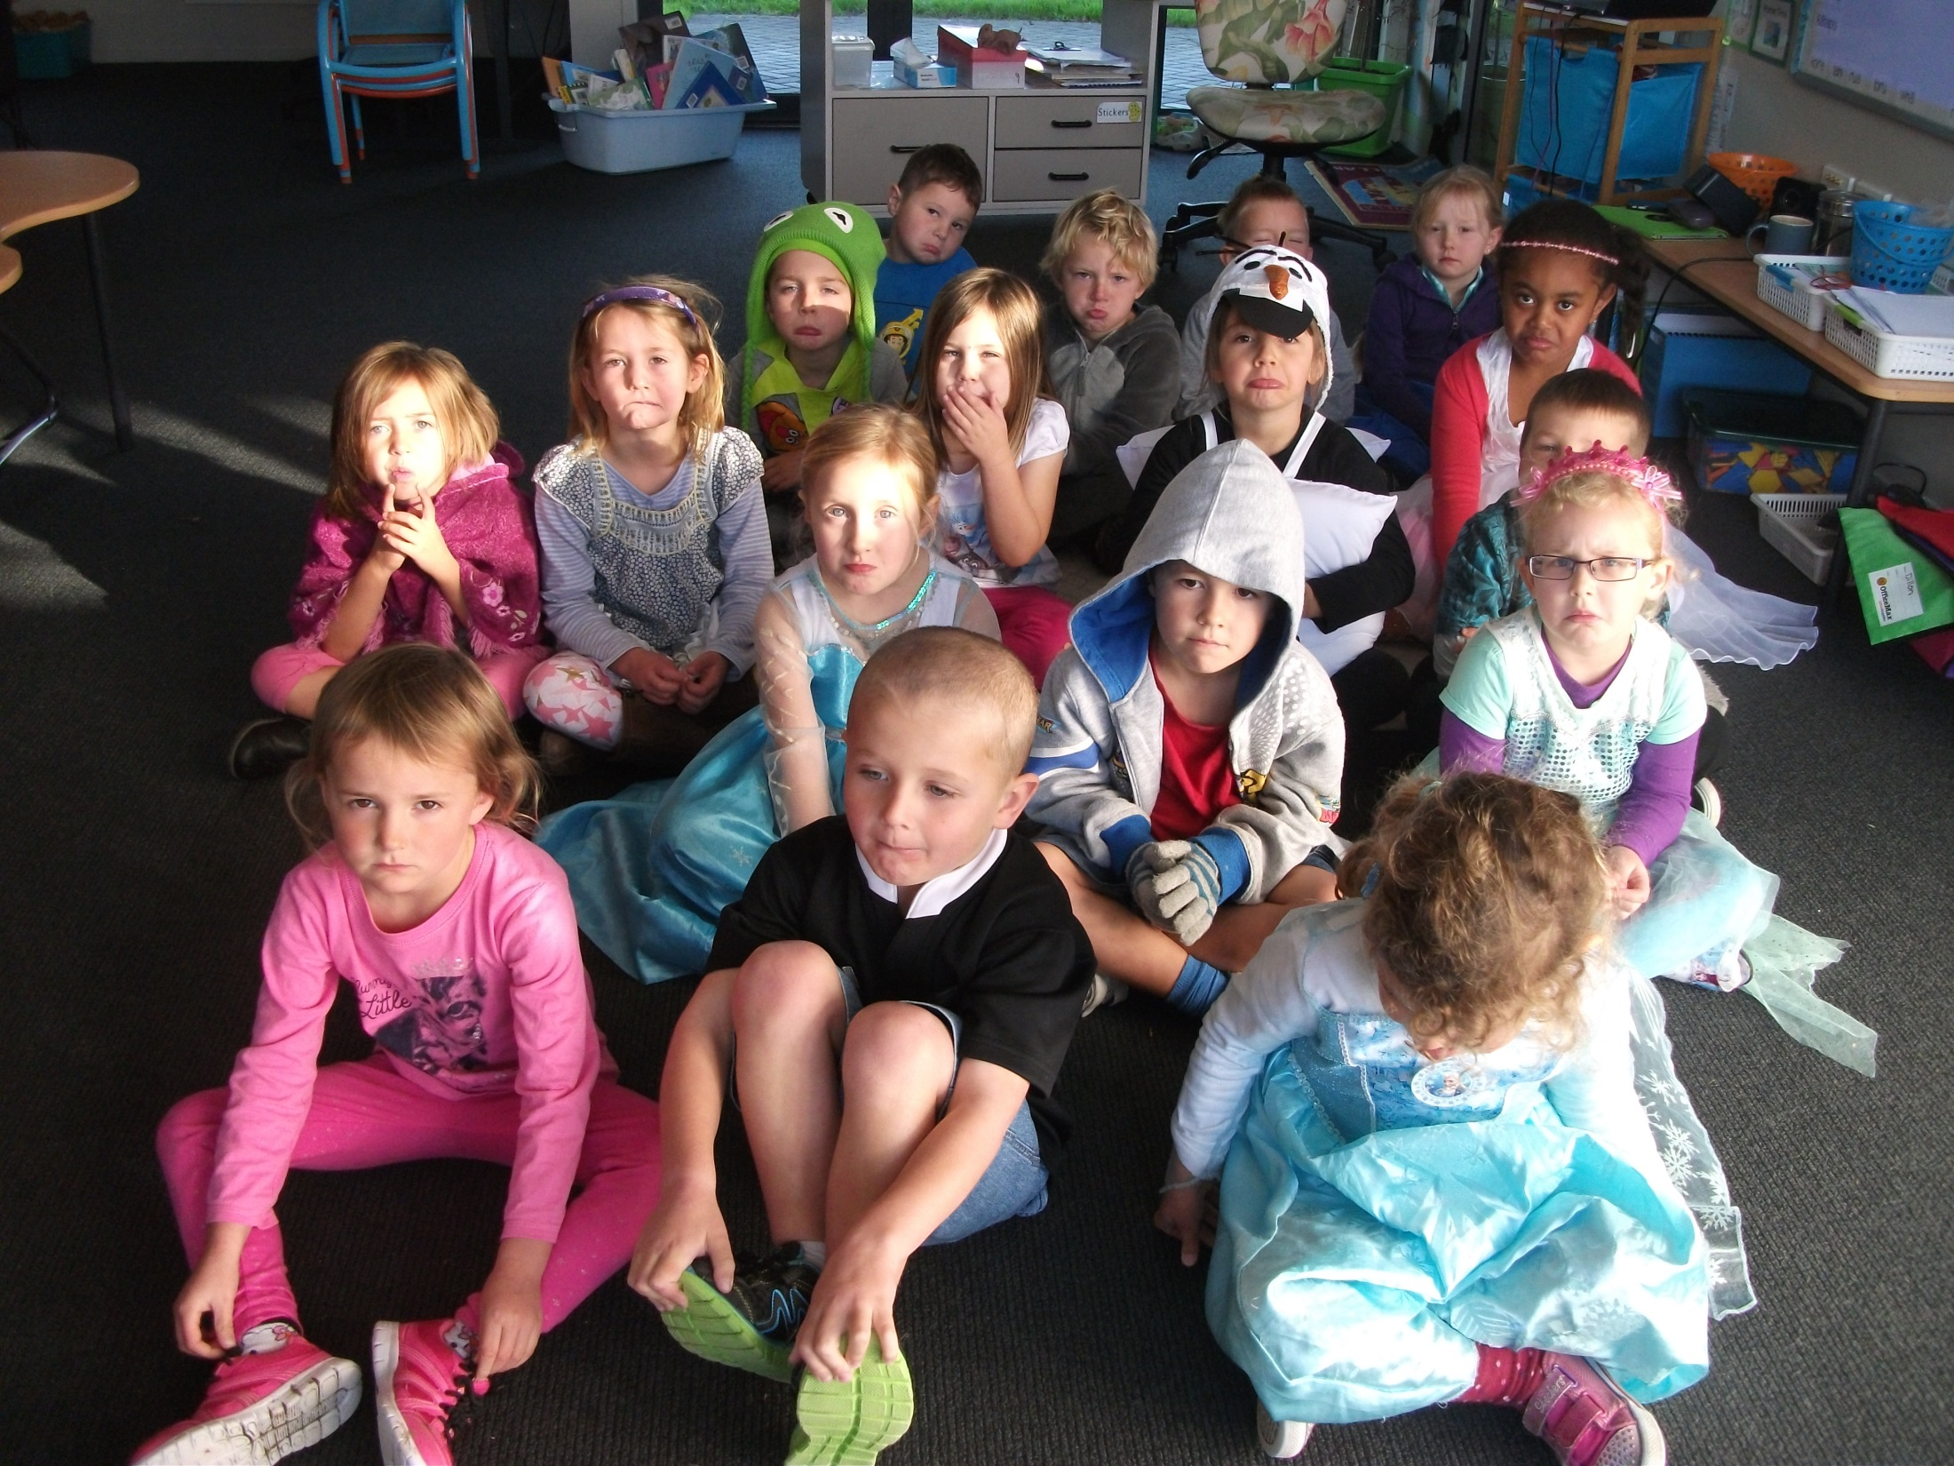
“Smile” said Mrs Watkin.
But Kauri 1 had their sad faces on.

Slide 4
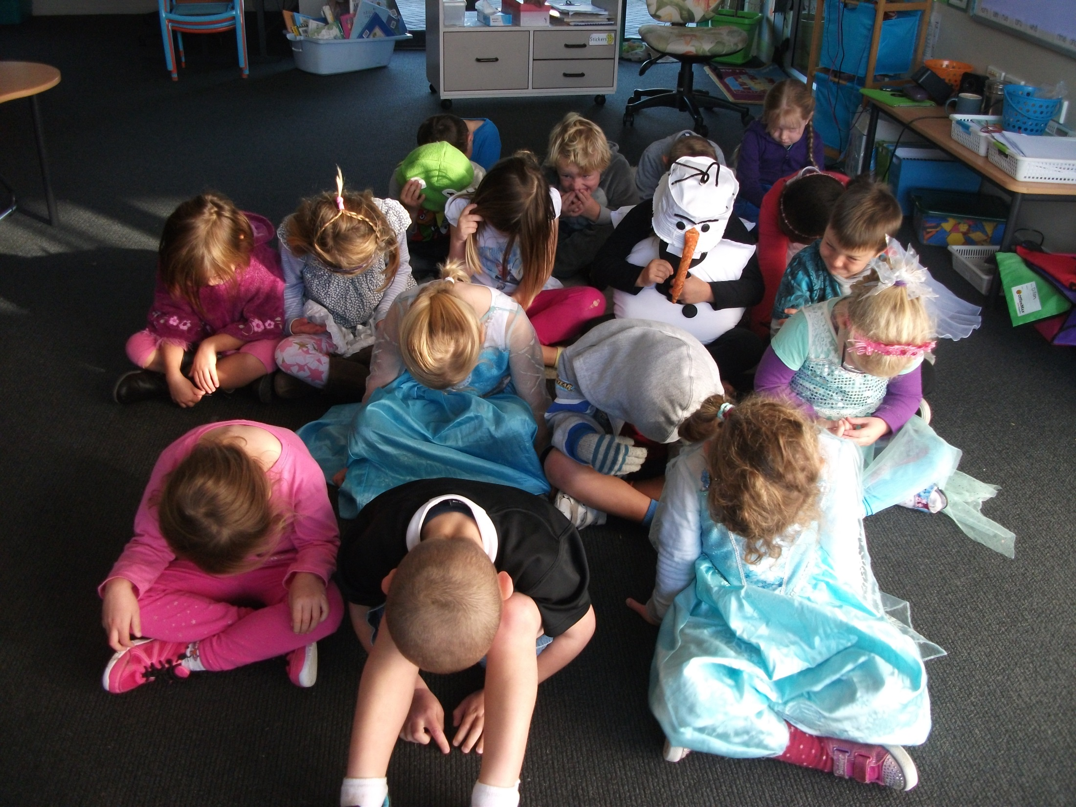
“Smile” said Mrs Watkin.
But Kauri 1 had their heads down.

Slide 5
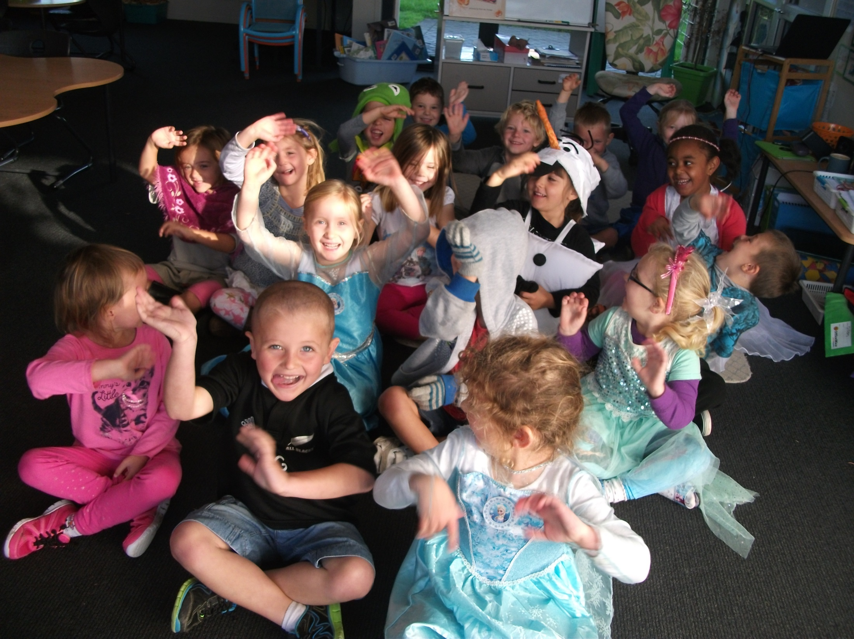
“Smile” said Mrs Watkin.
But Kauri 1 had their arms up.

Slide 6
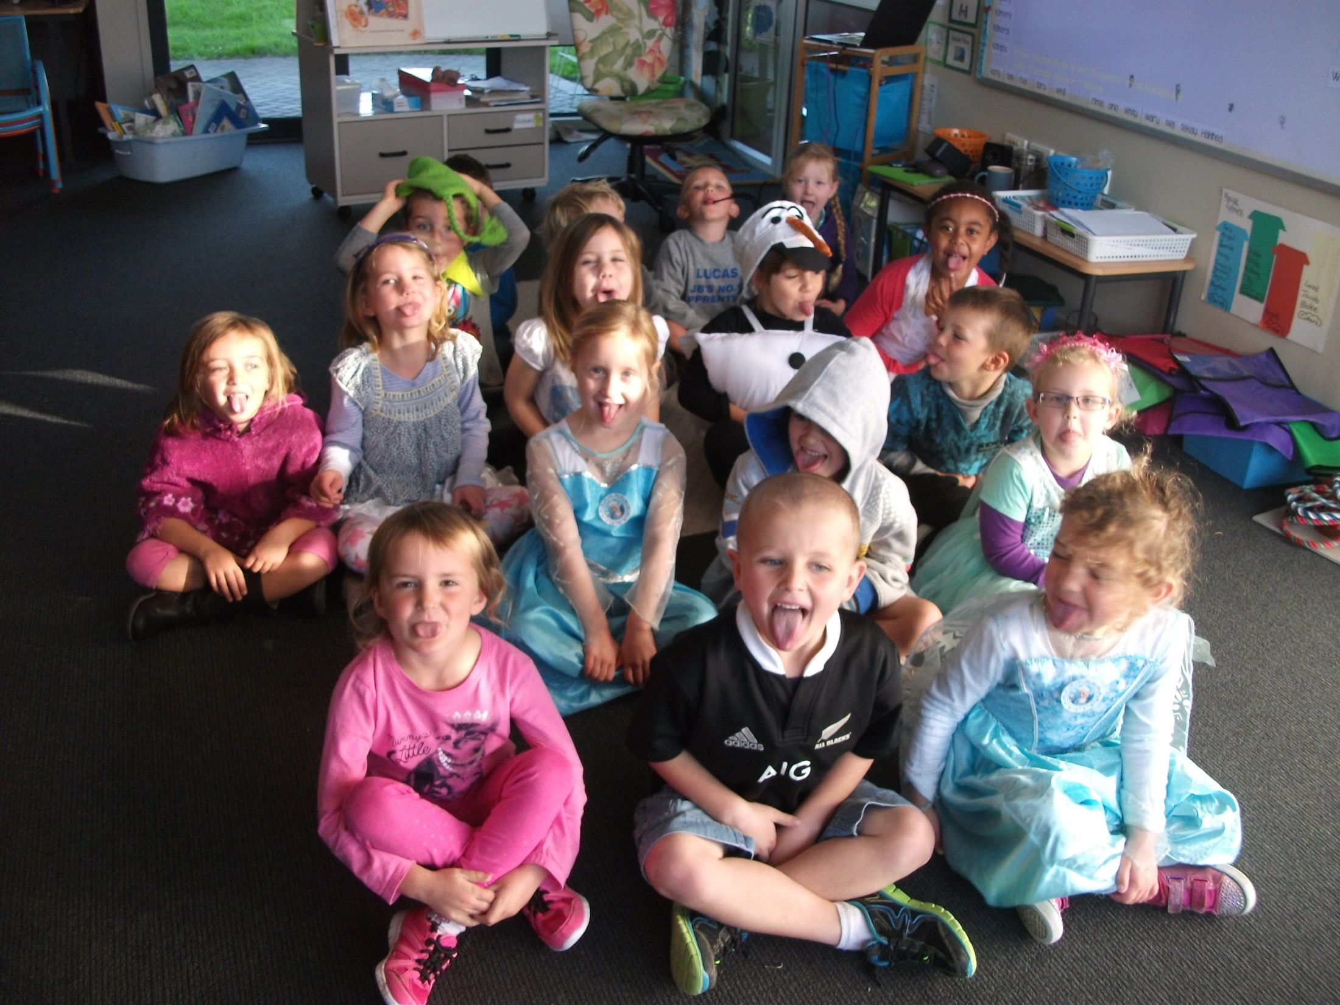
“Smile” said Mrs Watkin.
But Kauri 1 had their tongues out.

Slide 7
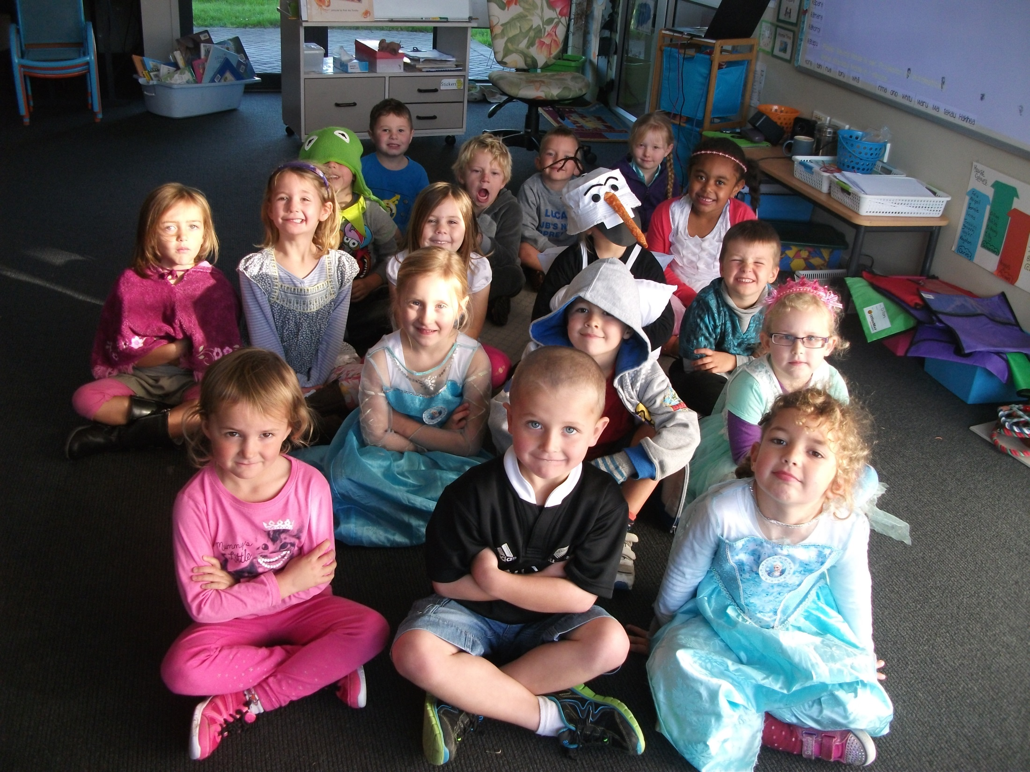
“Smile” said Mrs Watkin, and the picture was beautiful.

